Slide 1
JAMMING OUR WAY TO BETTER
UNDERSTANDINGS OF CREATIVITY IN HE
Norman Jackson
Presentation can be downloaded from
http://www.normanjackson.co.uk/mmu.html
Notes:
Aims – to develop better shared understandings about what creativity means to us in the contexts of:
our everyday life
disciplinary practices
educational practices
And use our imaginations and creativity

Slide 2
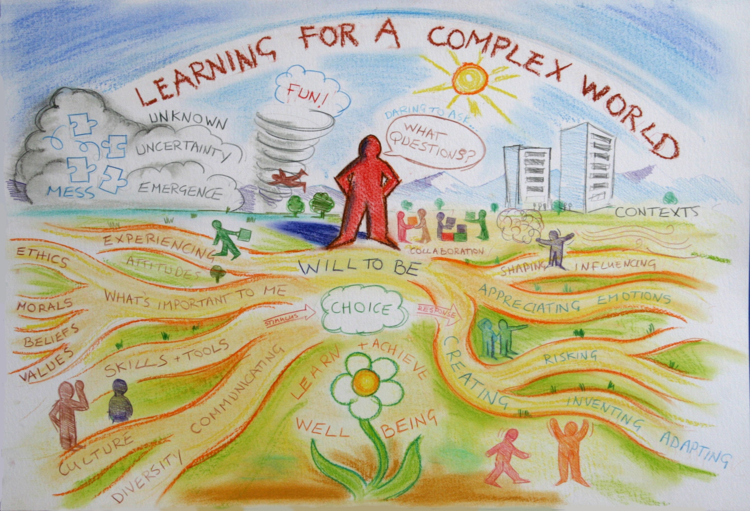
The challenge of preparing learners for long complex learning lives
me 1978
Notes:
I nearly always begin my talks here – we drew this picture on the wall of our educational centre at the University of Surrey in 2006 to remind us everyday that the focus of our work was to tackle this perpetual wicked challenge.
The creative development of people is bound up with the challenge of preparing them for long complex learning lives stretching half a century or more into the future.
Governments, trans-national agencies, business and industry are highlighting the importance of creativity to future economic and social prosperity and the very survival of the planet.
But this call for action is bound up with the wicked challenge of how we prepare people for long complex learning lives stretching 40 or 50 years ahead into a world that will be very different to the world we experience now. Indeed if futurists are right then we are in fifth of the way through the last century in which humans will exist as we know them. Scary thought.
For teachers the challenge is associated with a question like ‘ how do we prepare people for an ever more complex world?’… I don’t just mean preparing students for their first job when they leave university I mean how do we prepare them so that they can face and adapt to the many challenges they will encounter over a lifetime of working, learning and living.
From the students’ perspective the same challenge is expressed in the question ‘ How do I prepare myself for the rest of my life?’… what sorts of things do I need to learn, what sorts of skills, qualities, dispositions and values do I need to develop, and what sorts of experiences do I need to have.. Personal and professional development needs to be so much more than simply studying and learning an academic curriculum.
This picture, which we drew on the wall of our Centre at the University of Surrey, symbolically represents some of the complexity embedded in this wicked problem – which is a problem that is very difficult to define, is nested in other problems and has many perspectives on it, has no right or wrong answers, and no clear resolving actions.
My perplexing question. If creativity is so important to solving the world’s problems, and so many venerable trans national organisations, governments and business are saying its one of the top skills required for 21st century, why is higher education still paying so little attention to it?
We might begin by recognising the nature of the problem of creativity in HE?

Slide 3
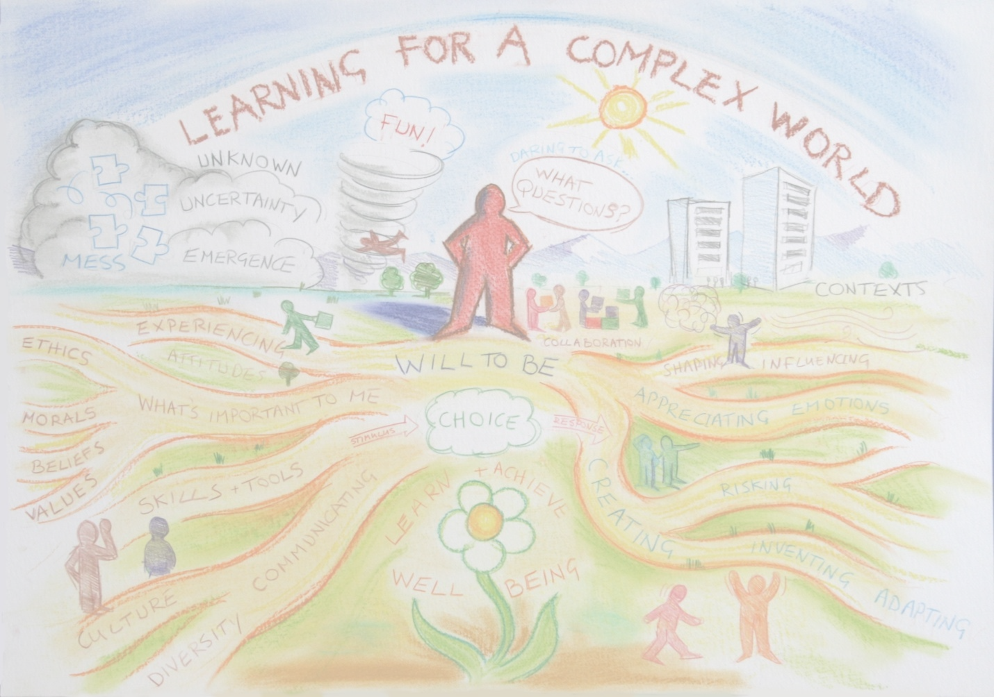
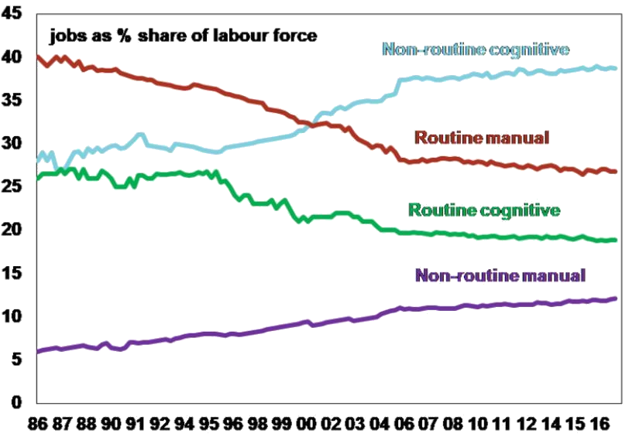
Non-routine cognitive
Notes:
People need to sustain themselves economically but the nature of work is changing – AI and robotics are sweeping away many jobs that are routine cognitive and routine manual. People who engage in HE are aspiring to work that might be termed cognitive non-routine : work that isn’t predictable that requires people to work with uncertainty and interact in an intelligent, self aware and creative ways with their environment and the problems it contains.

Slide 4
Non-routine cognitive
Non-routine cognitive work
Management
Business & Finance
Computer & Mathematical
Architecture
Engineering
Life, Physical & Social Sciences
Law
Medicine & Health/Social Care
Education
Arts, Design, Entertainment
Sports
Media
And more
Non-routine cognitive
Notes:
People need to sustain themselves economically but the nature of work is changing – AI and robotics are sweeping away many jobs that are routine cognitive and routine manual. People who engage in HE are aspiring to work that might be termed cognitive non-routine : work that isn’t predictable that requires people to work with uncertainty and interact in an intelligent, self aware and creative ways with their environment and the problems it contains.

Slide 5
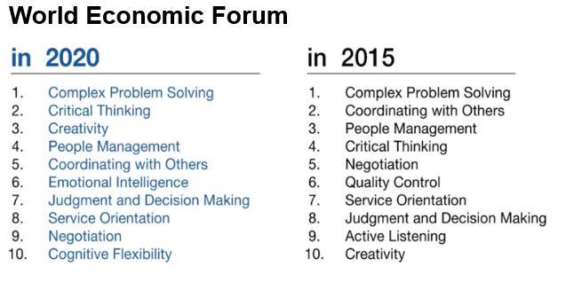
Notes:
Creativity for innovation has become a hot topic for Governments and International agencies concerned with sustaining the global economy.

Slide 6
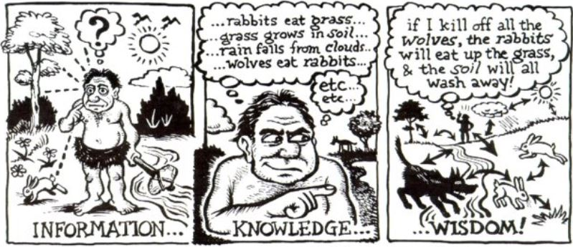
The essence of creativity is ecological thinking – taking in
information from our environment, creating new meaning
and making use of what we have learnt
PERCEPTION REASONING IMAGINATION INSIGHT

Slide 7
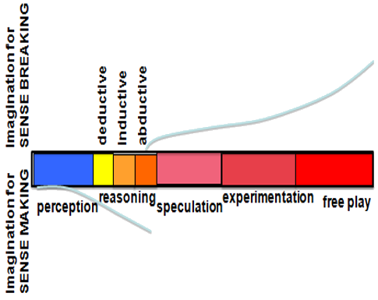
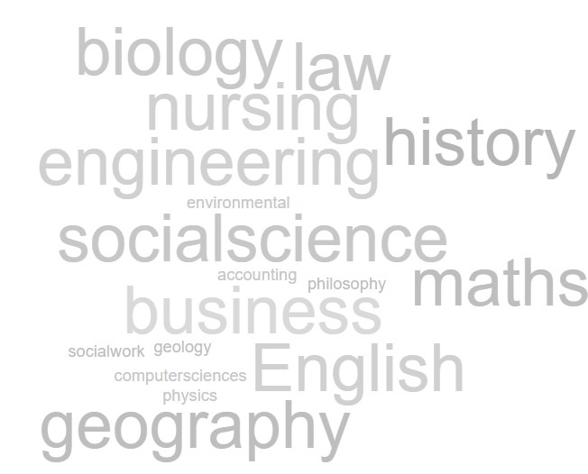
The cognitive continuum – ‘pragmatic imagination’
Pendleton-Julian and Brown (2016)

Slide 8
What is the problem with creativity in HE?
1 not seen as chronic within the academy 2 difficult to understand and explain 3 disciplinary context gives it meaning 4 rarely explicit outcome in education 5 many constraints
PROBLEM IS AN OPPORTUNITY TO DO MORE
AND A MORAL OBLIGATION TO DO MORE GIVEN THE WAY THE WORLD IS DEVELOPING

Slide 9
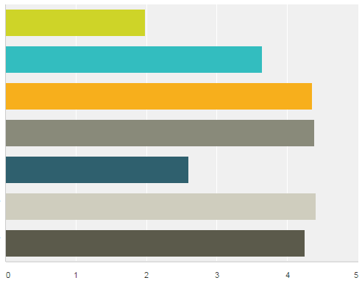
#lthechat n=40
Creativity is a rare gift that
only a few people have
Some people are naturally
more creative than others
Most people can develop their
creativity if they are given the
opportunity to do so
Developing students' creativity
should be integral to their
development while at university
Students' programmes are
designed to encourage students'
to use and develop their creativity
HE could do more to encourage &
support students' creative development
HE should do more to encourage &
support students' creative development
STRONGLY DISAGREE
STRONGLY AGREE

Slide 10
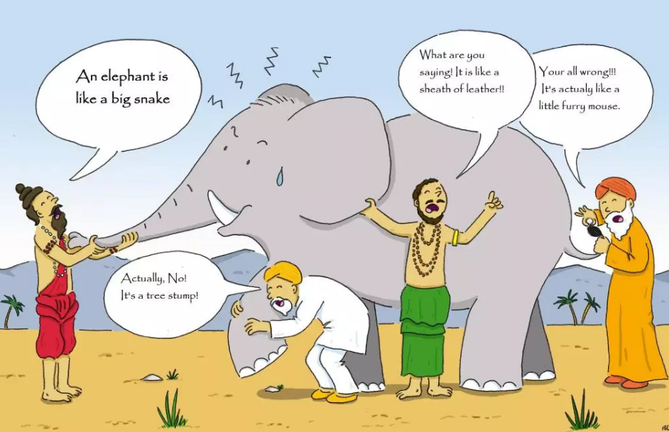
Notes:
Creativity is a confusing concept while there is broad consensus around some aspects of the concept it does mean different things to different people in different contexts.

Slide 11
Doing
New things
Solving problems
Connecting
Combining
Inventing
Making
Performing
Communicating
Ways of thinking
Using imagination
Thinking differently
Having new ideas
Having an open mind
Inquiring
Having ping moments
Attitudes
Motivated
Enthusiastic
Curious/inquisitive
Willing to try
Willing to take risks
Determined
Obsessive
Feelings
Feels personal
Satisfying
Exciting
Passion
Uncomfortable
Fulfilling
Effects
New ideas
New things
Changes what exists
Changes you
Innovation
Transforming

Slide 12
8 disciplines (Jackson & Shaw 2006)
Being imaginative – ability to think generatively & associatively
Having new ideas and being able to adapt existing ideas.
Being curious having an enquiring
disposition – the desire to find out
Being resourceful – finding and making
use of what is available
Being able to think synthetically and
relationally – connect things in novel ways,
recognise patterns
Being able to think critically to evaluate
ideas
Being able to communicate ideas to enable
people to understand and see things differently
Notes:
Where Does Creativity Reside in the Discipline?
Surveys of academic teachers in different disciplines²⁴ reveal that sites for creative thinking and action appear to be available in most aspects of disciplinary practice. Sites for creativity can be connected through the idea of disciplinary enquiry and problem solving.
Being original – is understood as creating something new and useful to the discipline. For most academics this is embodied in the processes and products of research many of whom are active contributors. The idea is also connected to invention and innovation. For example in history this could mean: new approaches to solving historical problems; new techniques to gather and analyse data; new approaches to validate evidence; new interpretations of evidence; new forms of history and new forms of communicating historical information.
Making use of imagination – is focused on the use of mental models in disciplinary thinking. It is a source of inspiration, stimulates curiosity and sustains motivation. It generates ideas for creative solutions and facilitates interpretation in situations which cannot be understood by facts or observations alone. Disciplinary problems and concerns provide an essential context for the use of imagination.
Finding and thinking about complex problems – the engine of academic creativity is intellectual curiosity – the desire to find out, understand, explain, prove or disprove something. Curiosity leads academics to find questions that are worth answering and problems that are worth solving.
Making sense of complexity, synthesising, connecting and seeing relationships – Because working with complex problems often involves working with multiple and incomplete data sets, the capacity to synthesise, make connections and see new patterns and relationships is important in sense-making (interpreting and creating new mental models) and working towards better understandings and possible solutions to difficult problems.
Communication - the communication of ideas, knowledge and deeper understandings are important dimensions of creativity in the discipline. The symbolic language and tools and vehicles for communicating are all part of the disciplinary heritage. Story telling is an important dimension of communication. Disciplinary cultures are largely based on writing using the conceptual and symbolic language and images that have been developed to communicate complex information. Story-telling and story-writing are important sites for academics’ creativity.
Resourcefulness – in the professional disciplines many roles involve solving difficult problems requiring ingenuity and resourcefulness. For example, a social worker or medic might need all their resourcefulness to access and acquire the resources to solve a client or patient’s problem.
Amabile⁶ reveals how these characteristics of disciplinary creativity might be integrated into her model of creativity (Figure 3) through the example of a bio-engineer utilising his expertise, creative thinking and motivations to find and solve problems (contexts) that motivate him. In this scenario we are dealing with the Pro-c versions of creativity recognised by Kaufman and Beghetto¹⁶
A bio-engineer's expertise includes his innate talent for imagining and thinking about complex scientific problems as well as sensing out the important problems in that domain, his factual knowledge of biochemistry and the techniques of genetic engineering, his familiarity with past and current work in the area, and the technical laboratory skill he has acquired. This component can be viewed as the set of cognitive pathways that may be followed for solving a given problem or doing a given task ^{6 p5}
Our bio-engineer's arsenal of creativity skills might include his ability to break out of a preconceived perception or expectation when observing experimental results, his tolerance for ambiguity in the process of deciding on the appropriate interpretation for puzzling data, his ability to suspend judgment as he considers different approaches, and his ability to break out of strict algorithms for attacking a problem^{6 p5}
Task motivation makes the difference between what our bio-engineer can do and what he will do. The former depends on his levels of domain-relevant skills and creativity-relevant skills. But it is his task motivation that determines the extent to which he will fully engage his domain-relevant skills and creativity-relevant skills in the service of creative performance.^{6p7}
For many people, simply having the intellectual challenge of a problem they care about is all they need to motivate themselves and increase their potential for creativity.

Slide 14
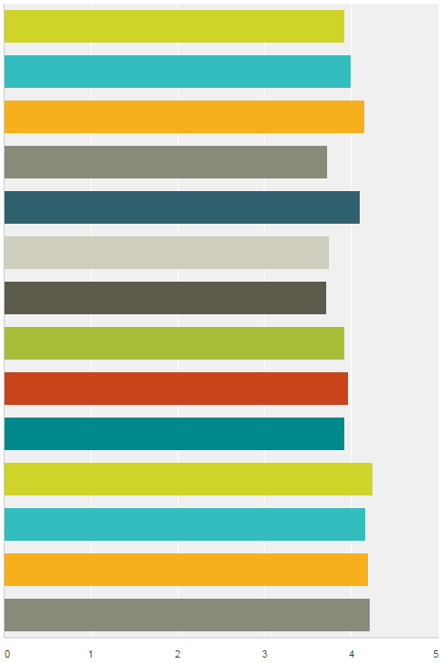
#lthechat n=40
In the context of your work what does being creative mean?
4.0 Agree
Having ideas that are new to the context
Being able to look at new concepts and put them
together in different but personally meaningful ways
INCREASING LEVEL OF AGREEMENT
Seeing situations from different perspectives
Solving problems and overcoming barriers
Going beyond what has been done before
Having ideas that are new to me
Generating something new in response
to an educational need
Adapting ideas to the context
Changing my understanding
Making new things happen
Doing things differently
Improvising when necessary
Using my imagination
Making new things
These actions begin to reveal the phenomenon of creativity
Notes:
These ideas describe the phenomenon through which an individual’s creativity is more likely to happen.

Slide 15
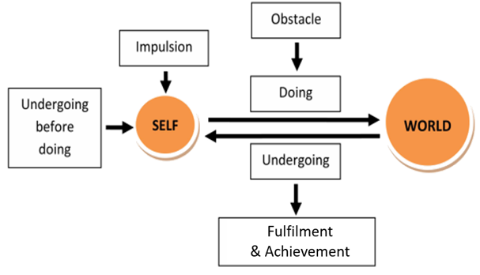
Paul Kleiman (2008) Five ways
academic’s experience creativity
John Dewey’s interactional model of creativity
PRODUCT FOCUSED
PROCESS FOCUSED
CONSTRAINT
FOCUSED
FULFILMENT FOCUSED
TRANSFORMATION FOCUSED
Glaveanu et al (2013) Creativity as action: findings from five creative domains Frontiers in Psychology 4, 176

Slide 16
3 RESOURCES
information, knowledge, people, tools, technologies
& other artefacts (anything that can be used)
4 SPACES
physical, social, virtual, intellectual, psychological, liminal
WHOLE PERSON
with their mind and body, purposes and motivations, sensing, perceiving, feeling, imagining, relating to, interacting with, interpreting & making sense of their environment & emerging situations
ENVIRONMENT
2 AFFORDANCES
possibilities that can be perceived or imagined for thinking and action
PAST
FUTURE?
5 PLACES
some things can
only be learned in a
particular place.
1 CONTEXTS
situations, circumstances, culture, ourselves familiar or unfamiliar, simple –complicated - complex or chaotic
6 RELATIONSHIPS
with people, communities, places, ideas, objects, work, hobbies, problems, anything!
7 PROCESSES/ACTIVITIES/EXPERIENCES
sg study, work, making, research, inquiry,
problem solving and much more….
Jackson, N. J. (2016) Exploring Learning Ecologies. Chalk Mountain/Lulu.
Notes:
Summary of the components of a learning ecology
Learning ecologies (Jackson 2013a:14) 'the process(es) we create in a particular context for a particular purpose that provides us with opportunities, relationships and resources for learning, development and achievement'.
This definition represents the integration and interdependence of the elements of learning and achievement which include the contexts and spaces we inhabit, including our history, relationships and resources, (the most important being knowledge and tools to aid thinking), and our will and capability to create a learning process or learning ecology for a particular purpose.
Such actions may be directed explicitly to learning or mastering something but more likely they will be primarily concerned with performing a task, resolving an issue, solving a problem, or making the most of a new opportunity.
Learning ecologies have temporal dimensions as well as spatial and contextual dimensions: they have the capability to connect different spaces and contexts existing simultaneously across a person's life-course, as well as different spaces and contexts existing in different time periods throughout their life-course.
HYPOTHESIS : ECOLOGIES FOR ACHIEVING OUR PURPOSES
ARE OUR VEHICLES FOR DISCOVERING & CREATING MEANING
Our beliefs shape what we value and what we value shape our beliefs
Our beliefs & values shape our purposes – purposes emerge from the circumstances of our life and what we value they give our life meaning
Purposes create intentions (will/desire/ambition) to act on purpose (to reinforce the meaning that is our life) eg the desire to make a positive contribution/to make a difference to create a better version of oneself and to create new value in the world we are attending
Intentions cause us to search our life/world (contexts) for affordance (perceptions of possibility for action – eg to make a difference)
Affordance enables us to formulate goals to drive specific actions and behaviours in the particular contexts and situations of our life/world
These actions and behaviours result in an ‘ecology for achieving our goals’. Our ecology is the way we interpret, relate to, connect and interact with our world of which we are a part not a separate entity. Our ecology involves relationships, activities, experiences, use of resources (knowledge/tools and other artefacts) through which we learn and develop in order to accomplish something we value and create new and deeper meanings in the process.
New meaning grows from the experiences and reflections on experience grown through our ecology when it is integrated with our previous understandings, values and beliefs. Our unfolding experiences contain things which are currently meaningful and also things that do not make sense to us. It is in striving to make sense or better sense of such things that new meaning grows in relation to all of the above. Its an ecological process.

Slide 17
Over 100 published definitions
Creativity is a phenomenon whereby something new and valuable is formed (Latin creō "to create, make").(Wikipedia).
The [something new] may be intangible (such as an idea, a scientific theory, a musical composition or a joke) or a physical object (such as an invention, a literary work or a painting)
the “standard consensual definition,” of creativity consists of “effectiveness and originality.”
[But there are] two ambiguities. Firstly, the definition leaves open the choice of the context and norms against which to measure originality and effectiveness. Secondly, it does not discuss the possible role of a subjective judge.
Thomas Colin

Slide 18
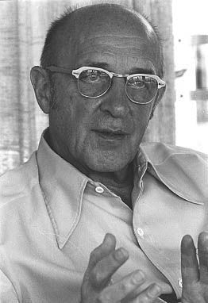
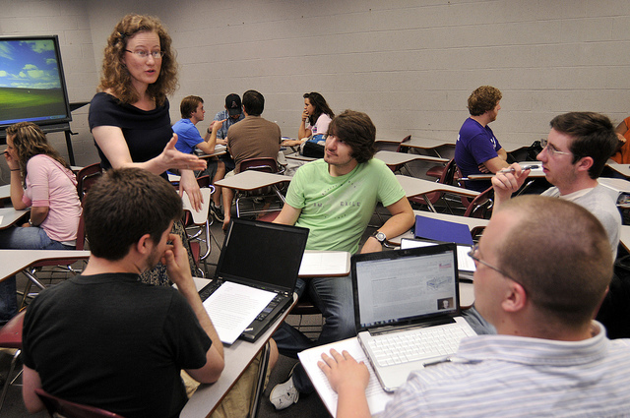
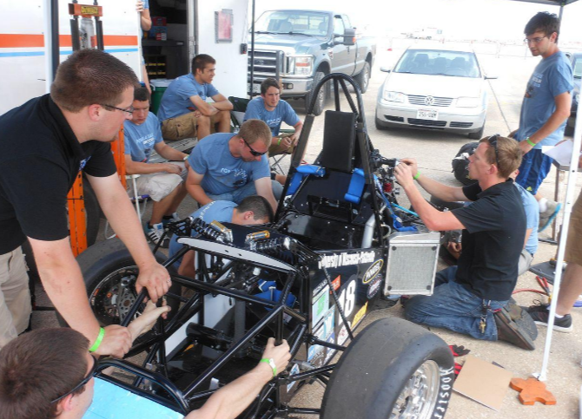
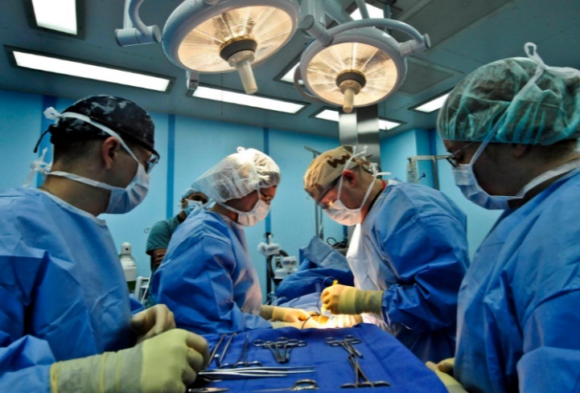
'the emergence in action of a novel relational product growing out of the uniqueness of the individual on the one hand, and the materials, events, people, or circumstances of [their] life'
Carl Rogers (1960)
product = ideas, material or virtual objects, practices, performances, relationships, processes, learning and more……
MEANINGS OF CREATIVITY ARE GENERATED IN SITU
situations provide, contexts, norms and subjective judges
Notes:
So how does creativity manifest itself as a phenomenon. Carl Rogers framed the way creativity manifests itself in these terms 'the emergence in action of a novel relational product growing out of the uniqueness of the individual on the one hand, and the materials, events, people, or circumstances of his life' ^{27:350}
The bottom line is that creativity is an ecological phenomenon. It’s about human beings having thoughts that are stimulated by their relationship and interactions with the world around them. A creative thought is the result of a person interacting cognitively, physically, emotionally, virtually with something in their world ideas, people, things, problems, situations and experiences, and a multitude of other things and this interaction triggering a novel thought. These thoughts are often the result of connecting/combining two or more things to create something that is different to the things that were connected. McWilliam and Taylor⁶ catch this beautifully in their idea that creativity is often the result of making a third ‘thing’ from two existing things or ideas, rather than making something from nothing.
So the phenomenon of creativity is a situated phenomenon in which contexts norms and judges are all located.

Slide 19
James Kaufman and Ron Beghetto
4C Model of creativity
Most investigations of creativity tend to take one of two directions: everyday creativity (also called “little-c”), which can be found in nearly all people, and eminent creativity (also called “Big-C”), which is reserved for the great. [We] propose a Four C model of creativity that expands this dichotomy. [We] add the idea of “mini-c,” creativity inherent in the learning process, and Pro-c, the developmental and effortful progression beyond little-c that represents professional-level expertise in any creative area.
Kaufman, J.C. and Beghetto, R.A. (2009) Beyond Big and Little:
The Four C Model of Creativity. Review of General Psychology 13, 1, 1-12.
Notes:
One of the challenges for creativity in higher education is to develop useful conceptual tools that help us develop better shared understandings. One tool with good potential is the 4C model of creativity proposed by Kaufman and Behgetto in 2009
Kaufman, J.C. and Beghetto, R.A. (2009) Beyond Big and Little:
The Four C Model of Creativity. Review of General Psychology 13, 1, 1-12.

Slide 20
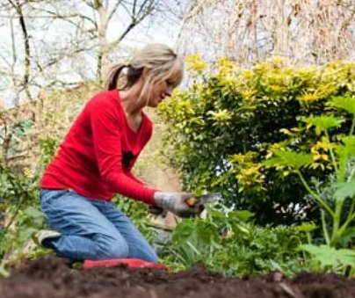
world
4C model of creativity
Kaufman & Beghetto (2009)
cross-cultural
society
Big-C
field/domain
organisation/ community/
network
mini-c creation of new meaning
Pro-c
CONTEXTS FOR CREATING & USING
family/group/team
little-c
creator/maker
Where originality, newness, novelty are recognised, evaluated & valued
NORMS FOR JUDGING & VALUING CREATIVITY
Notes:
This is our instrument.

Slide 21
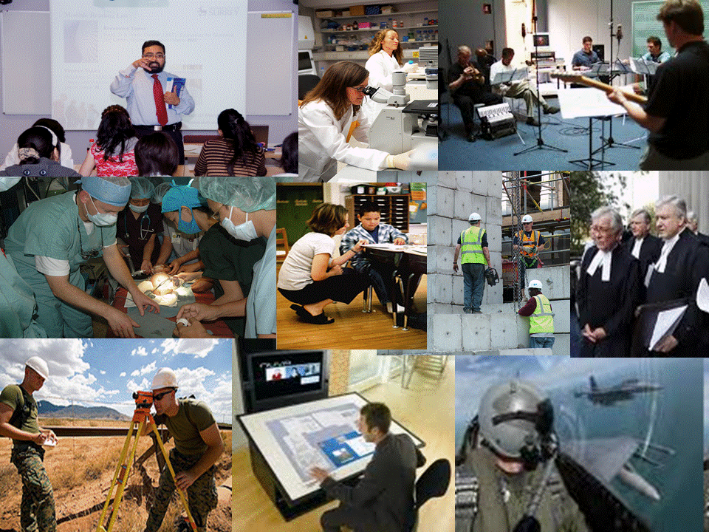
world
Pro-c ‘non-routine cognitive work’
society
FIELD/DOMAIN
TEACHER
SCIENTIST
ENGINEER
SURVEYOR
SURGEON
CONTEXTS FOR CREATING & USING
ORGANISATION
TEAM
INDIVIDUAL
INDIVIDUAL
TEAM
ORGANISATION
FIELD/
DOMAIN
NORMS FOR JUDGING & VALUING CREATIVITY
Notes:
This is our instrument.

Slide 22
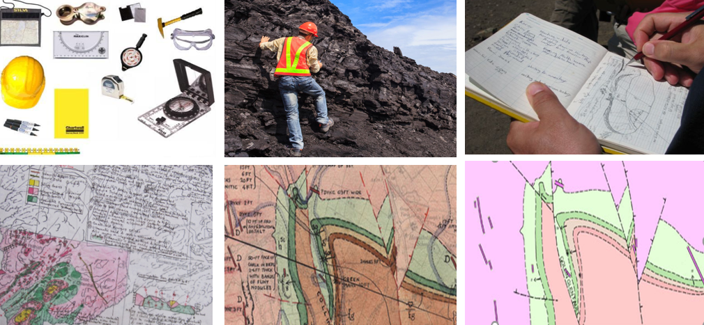
Making a geological map – transforming information into knowledge
& symbolically representing knowledge in an artefact
information
KNOWLEDGE & PRODUCT
information
TOOLS
KNOWLEDGE & PRODUCT
KNOWLEDGE & PRODUCT
KNOWLEDGE & PRODUCT

Slide 23
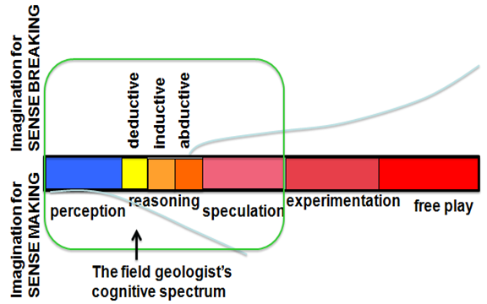
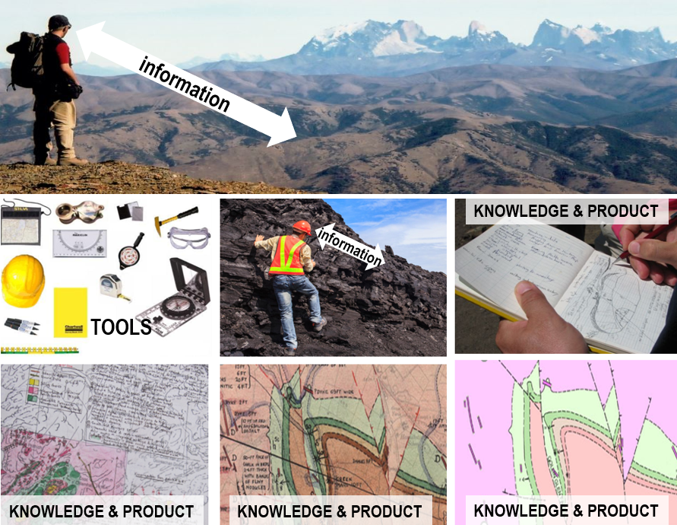
The important concept of transformation in creativity
The geologist combines and integrates his pragmatic use of imagination with specialist knowledge and problem solving skills to create a knowledge-rich artefact to share his understandings
The cognitive spectrum
Pendleton-Jullian and
Brown (2016:73)

Slide 24
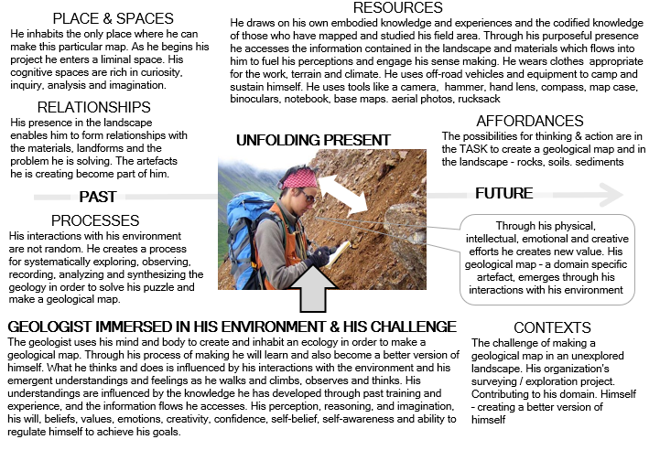
A geologist’s ecology of practice

Slide 25
world
Pro-c ‘the phenomenon of creativity’
society
FIELD/DOMAIN
GEOLOGIST
CONTEXTS FOR CREATING & USING
ECOLOGY OF PRACTICE
ORGANISATION
TEAM
INDIVIDUAL
?
INDIVIDUAL
TEAM
ORGANISATION
FIELD/
DOMAIN
SOCIETY
NORMS FOR JUDGING & VALUING CREATIVITY
Notes:
This is our instrument.

Slide 26
HOW DOES CREATIVITY WORK IN YOUR
SUBJECT/FIELD OF PRACTICE?
THINKING TIME 2mins
Each person thinks of an activity that people working in
their field do that involves them using their imagination and creativity
STORY TIME 3 mins
Each person tells a 1 minute story about something that people do in their field that involves them using their imagination and creativity explaining what it means to be creative
SYNTHESIS 3 mins
What are the educational implications for encouraging students to use their imaginations and creativity, ‘to be creative’ in your disciplines?

Slide 27
Is education an essential domain? ed-c Carly Lassig (2013)
world
5C model of creativity
recognising the educational domain
cross-cultural
society
Big-C
field/domain
organisation
HE institution
mini-c creation of new meaning
CONTEXTS FOR CREATING & USING
Who creates, values and makes use of the creation?
What are the circumstances of creation?
Pro-c
teacher
group/team
ed-c
little-c
student
creator/
maker
Where is originality, newness, novelty recognised & evaluated?
NORMS FOR JUDGING CREATIVITY
Notes:
Does education require its own meta-domain?

Slide 28
ed-c - developing creative potential for Pro-c?
DISCIPLINE
e.g. Chemistry,
Engineering,
Medicine,
Law, Art,
History,
Business
local environment, business,
social enterprise or community,
TEACHER
PEDAGOGY
eg Inquiry
Problem solving
Fieldwork
Role play
Projects
Assessment
preparing
for Pro-c
CONTEXTS FOR CREATING & USING
Environment, Circumstances, Problems, Opportunities, People
mini-c creation of new meaning
SOLUTION
ed-c
PROBLEM
STUDENT
Defines / engages with his problem and interacts with his environment to create solutions that are new to him
STUDENT
PEERS
TEACHER
Domain
Society
Where originality, newness, novelty and utility
are recognised, evaluated & assessed
NORMS FOR JUDGING CREATIVITY

Slide 29
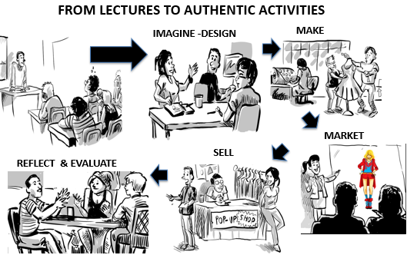
Ed-c - developing creative potential for Pro-c
DISCIPLINES
Fashion
Design
Merchandising
Marketing
Preparation for Pro-c
TEACHER
Coach
Co-worker
preparing
for Pro-c
PEDAGOGY
Inquiry
Problem solving
Design
Relevant work-related activities
Assessment
mini-c creation of new meaning
CONTEXTS FOR CREATING & USING
Environment, Circumstances, Problems, Opportunities, People
SOLUTION
ed-c
PROBLEM
STUDENTS
Define / engage with their problem and interact with their environment to create solutions that are new & novel to them taking risks
STUDENT
PEERS
TEACHER
Domain
Society
employers
Where originality, newness, novelty and utility
are recognised, evaluated & assessed
NORMS FOR JUDGING CREATIVITY
Notes:
This is our instrument.

Slide 30
Each of you - share a 1 minute story of something
you have done to encourage/enable students or
colleagues to use their creativity.
2) Using the stories or any other idea that inspires
you, invent an entirely new pedagogical practice
to encourage students to use their creativity
3) 5mins - Make a sketch of your new invention on the flip chart
paper, give it an imaginative title and photograph it.
4) 2 mins - Record on your phone a 1min narrative about the practice you have invented and send it with the photo of your poster, to lifewider1@gmail.com
POSTERS & CLIPS will be exhibited at:
http://www.normanjackson.co.uk/creativejam.html

Slide 31
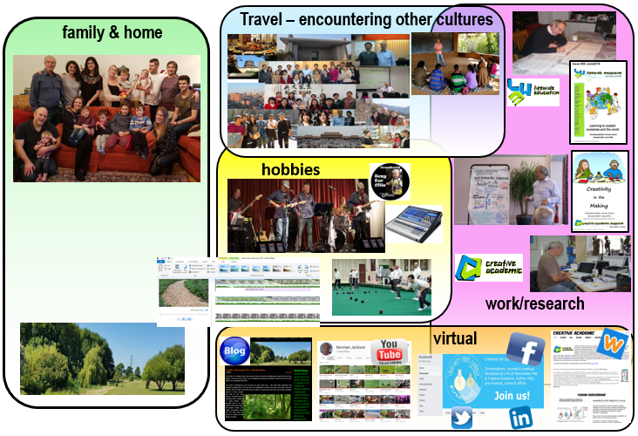
world
little-c
cross-cultural
society
field/domain
community/ network
WHO VALUES & MAKES USE OF?
family/group
creator/maker
NORMS
CONTEXTS
WHERE ORIGINALITY / NEWNESS / NOVELTY ARE RECOGNISED
Notes:
This is our instrument.

Slide 32
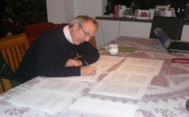
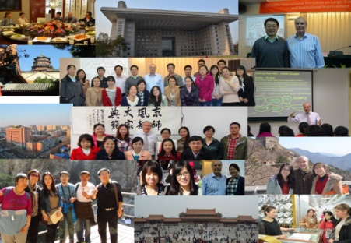
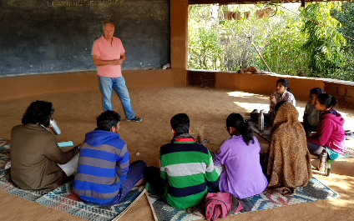
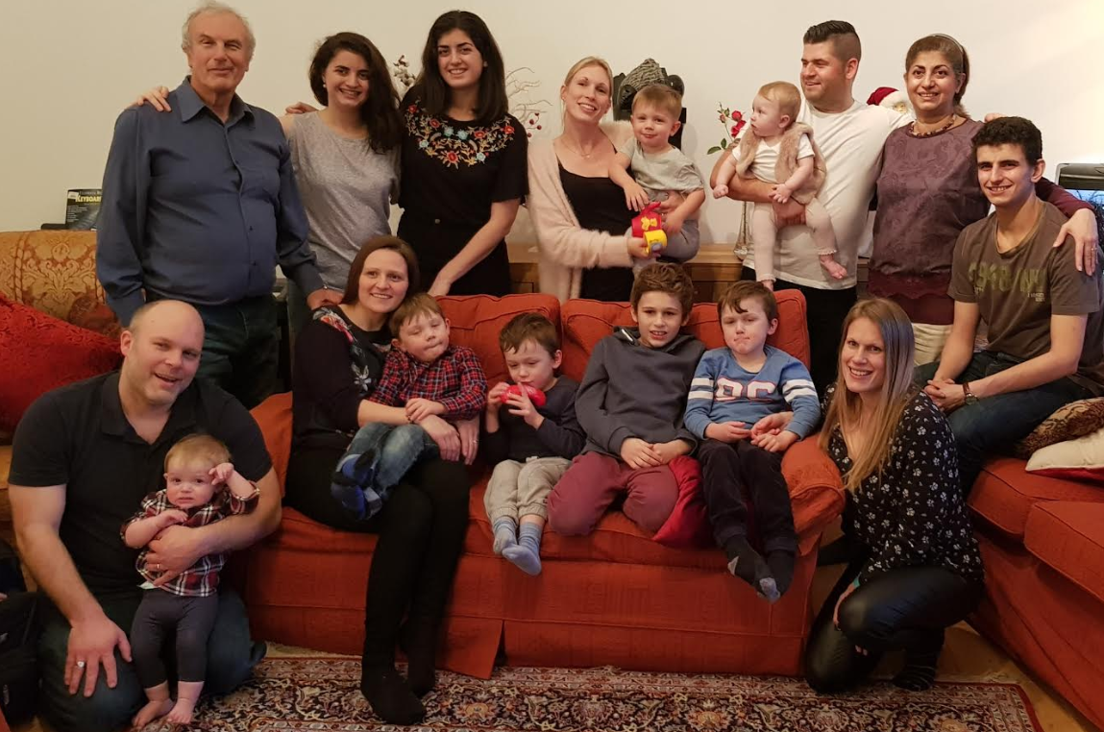
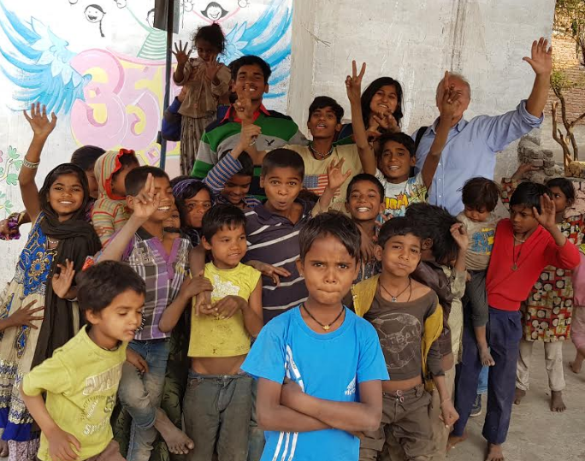
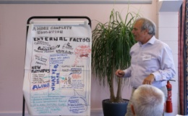
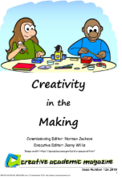
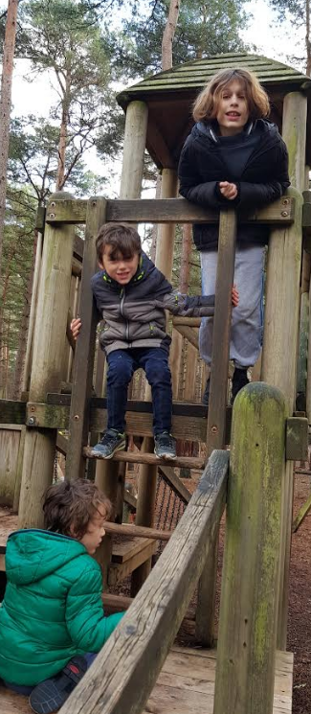
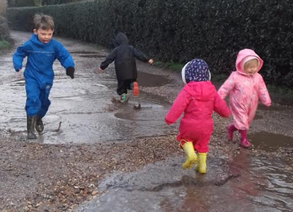
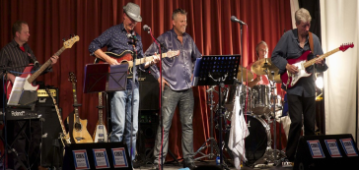
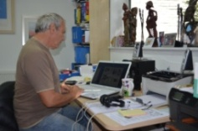
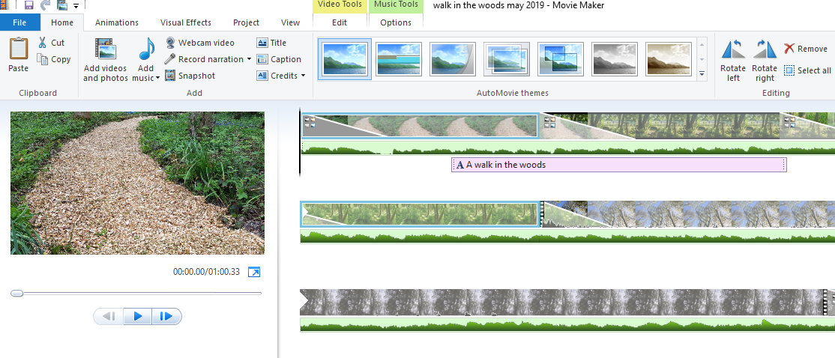
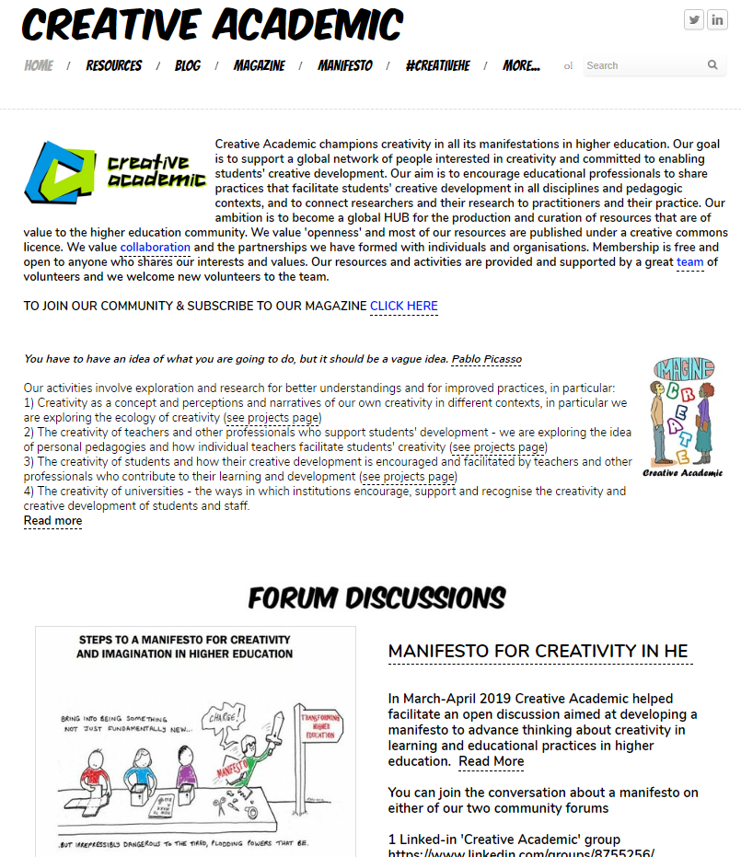
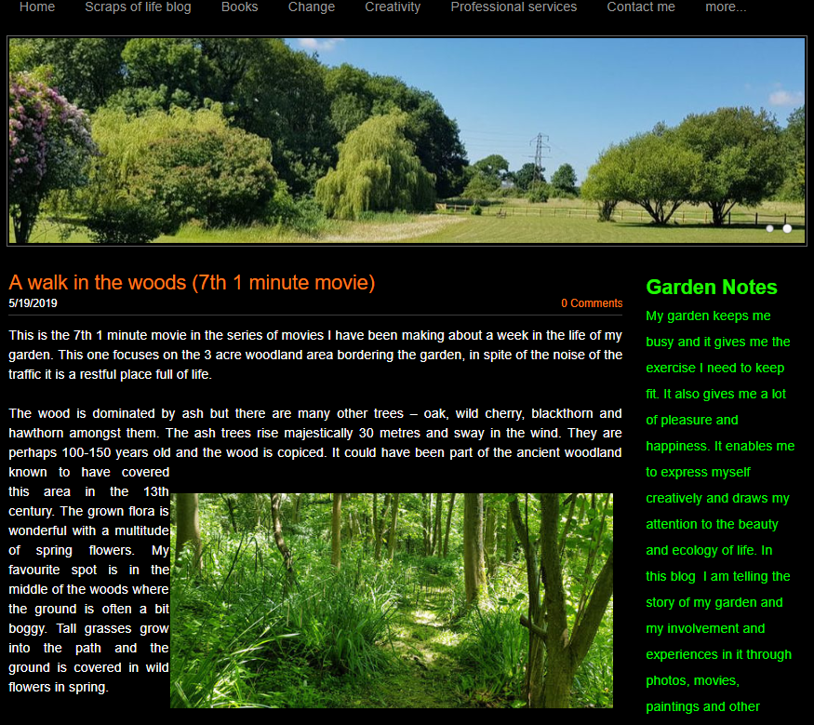
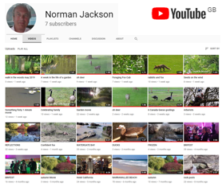
CREATING MEANING EVERY DAY: LEARNING, DEVELOPING,
CREATING & ACHIEVING ACROSS THE WHOLE OF OUR LIVES
family & home
travel – encountering other cultures
hobbies
work/research
virtual
LIFEWIDE

Slide 33
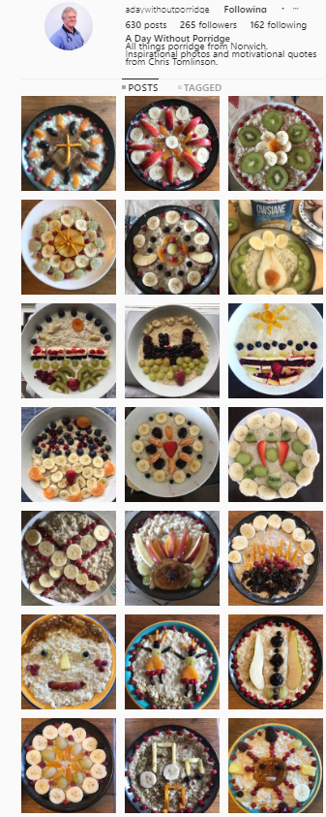
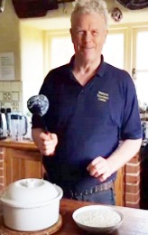
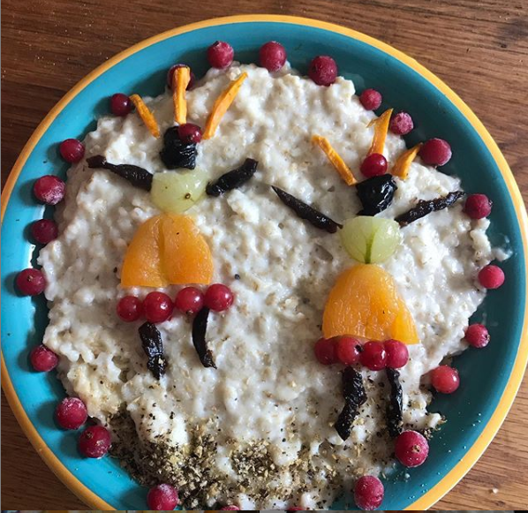
The art of making porridge with meaning
curated
artefacts
other
followers
little-c & mini-c in action
friends
& family
network
mini-c creation
of new meaning
Daily commitment to creating a
meaningful picture on his porridge
CONTEXTS FOR CREATING & USING
himself
family
265 instagram & 735 facebook followers
Where is originality, newness, novelty recognised & evaluated?
NORMS FOR JUDGING CREATIVITY

Slide 34
CREATIVITY IN EVERYDAY LIFE
2mins each
Share something that you do in your life
that enables you to be creative in your own way. How does your creativity manifest itself? What are its effects and who feels them?
2mins discussion
What is special about the contexts/situations in which you are able to be creative? Why do you feel creative in the context? Who is judging your creativity?
WHAT ARE THE IMPLICATIONS FOR ENCOURAGING AND ENABLING STUDENTS TO USE THEIR CREATIVITY IN HE?

Slide 35
EDUCATIONAL IMPLICATIONS OF RECOGNISING PERSONAL CREATIVTY IN ALL DOMAINS OF EVERYDAY LIFE
Academic
curriculum
UNIVERSITY
ECOSYSTEM
Extra-curriculum
Part-time work
and internships
Managing own life
Study
programme
/modules
Co-curriculum
Organised
learning
outside
formal
curriculum
Caring for others
Running own
business
Work-related curriculum
Placement Internship
Apprenticeship
Participating in Sport
Volunteering &
social enterprise
May include fieldwork,
projects in
real world,
study abroad, community projects
Travel
Mentoring
Creative activity
Student Representation
& Societies
Study abroad
AN MORE!!!
World of infinite possibilities for being creative
The infinite creative potential of a Lifewide Curriculum

Slide 36
A thousand tiny universities – Barbara Grant
“How can we [be] alert to the daily possibilities for transformation towards our imagined future university. I propose the idea of a thousand tiny universities as one that offers a … basis for continually proposing and enacting in the present the kind of university we cherish.” Philosophy and Theory in HE (2019)
Notes:
The final thought is that we are all able to contribute to shaping the sort of education system we believe is right for the growth of our students.

