Slide 1
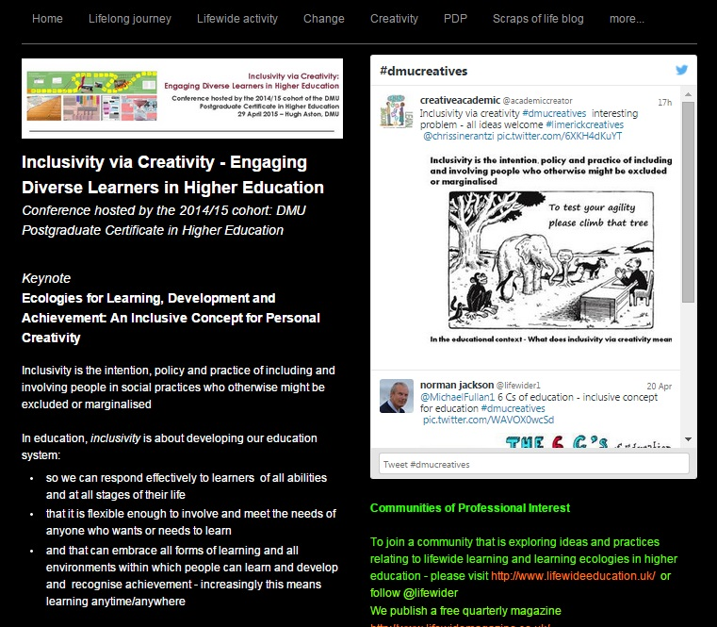
Ecologies for Learning, Development & Achievement
An inclusive concept for personal creativity
Norman Jackson
Slides & Links - http://www.normanjackson.co.uk/dmucreatives.html
Please post comments,
questions & suggestions
Twitter #dmucreatives

Slide 2
Inclusivity is the intention, policy and practice of
including people in social practices who otherwise
might be excluded or marginalised
In education, inclusivity is about developing our
education system so it:
* can respond effectively to anyone who wants or needs to
learn and has the ability at all stages of their life
* is flexible enough to involve and meet the needs
of anyone who wants or needs to learn
* can embrace all forms of learning and all environments
within which people learn and develop and have
their achievements recognised
Notes:
Inclusivity is the intention, policy and practice to include people in social practices who might be excluded or marginalised on grounds of gender, race, age, class, sexuality, class, disabilty or any other characteristic..
Inclusive Education is all about developing intention, policy, practice and the supporting infrastructures and cultures to achieve this. For example in
1 Developing educational cultures, policies and practices so that they can respond effectively to an increasingly diverse range of learners
2 Developing the education system so that it is flexible enough to involve and meet the needs of anyone who wants to learn
3 Developing the education system so that it can embrace all forms of learning and all environments within which a diverse range of learners can learn and develop and be able to recognise diverse forms of learning and achievements
In my talk I'm going to focus primarily on the third of these possibilities and engage with five themes:
1 The inclusive challenge facing all universities & teachers
2 Lifewide learning - the most inclusive concept of learning, development and achievement
3 Lifewide Curriculum / Lifewide Education – approaches used in formal education that can embrace the most inclusive concept of learning, development and achievement
4 Inclusive concepts of personal creativity - concepts that can include everyone in their everyday life
5 Ecologies for learning, development & achievement within which inclusive concepts of learning and achievement, including creative achievements, can be embedded and realised

Slide 3
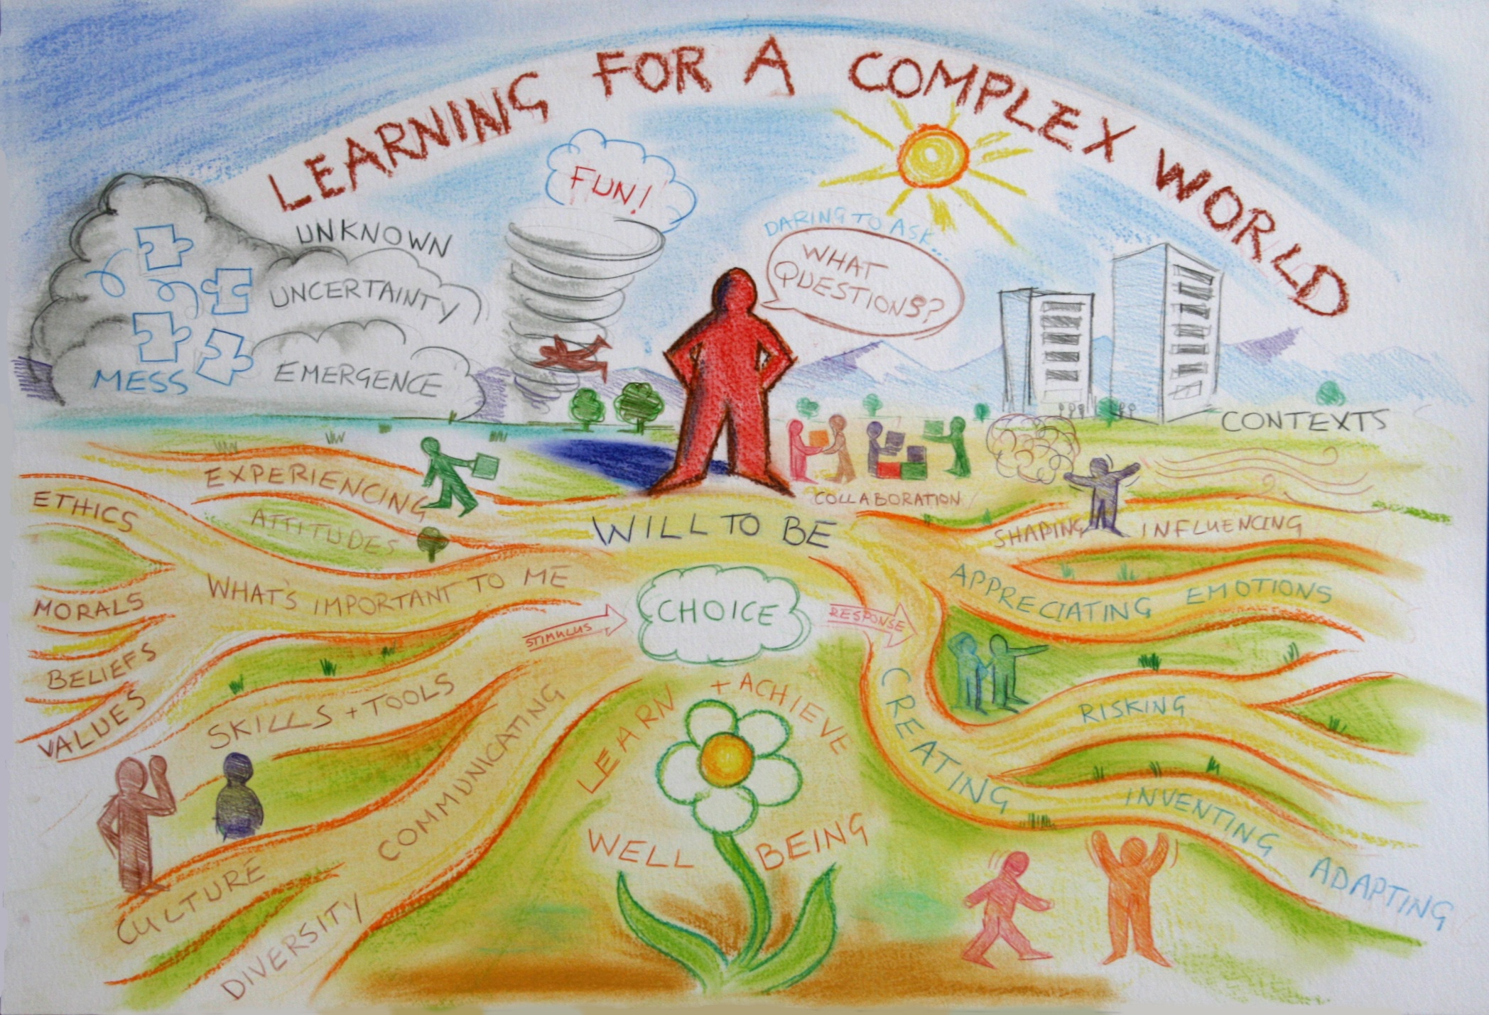
The inclusive challenge of preparing people for their future
me 1978
What is the Problem with Creativity in HE
1 not chronic 2 difficult to understand and explain 3 disciplinary context gives it meaning 4 rarely an explicit outcome 5 many constraints
AN OPPORTUNITY TO DO MORE
Notes:
The question of inclusivity in education and the question of creativity are bound up with the
fundamental challenge that everyone working in higher education faces.
For teachers it is associated with a question like ‘ how do we prepare people with diverse educational, cultural and social backgrounds, for an ever more complex and diverse world?’… I don’t just mean preparing students for their first job when they leave university I mean how do we prepare them so that they can face and adapt to the many challenges they will encounter over a lifetime of working, learning and living.
From the students’ perspective the same challenge is expressed in the question ‘ How do I prepare myself for the rest of my life?’… what sorts of things do I need to learn, what sorts of skills, qualities, dispositions and values do I need to develop, and what sorts of experiences do I need to have.. Personal and professional development needs to be so much more than simply studying and learning an academic curriculum.
This picture, which we drew on the wall of our Centre at the University of Surrey, symbolically represents some of the complexity embedded in this wicked problem – which is a problem that is very difficult to define, is nested in other problems and has many perspectives on it, has no right or wrong answers, and no clear resolving actions.
These are all ingredients for a challenge and an opportunity that is guaranteed to stimulate creativity. Ultimately, this set of challenges is the DRIVER for much of the creative effort in higher education.
It can be argued that creativity itself is an issue of inclusivity in that it is often and neglected and marginalised when it comes to the design of higher education programmes and student experiences. Jackon and Shaw demonstrated this in an analysis of subject benchmark statements.

Slide 4
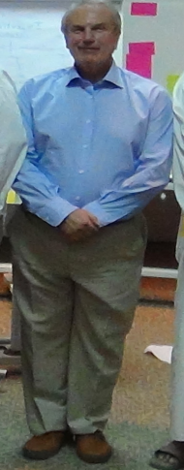
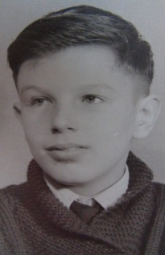
Life is a Creative Project
R
E
D
U
N
D
A
N
T
2003-05
HEA
2011-15
2000-03
LTSN
2005-11
Uni Surrey
CETL
Lifewide Education &Creative Academic
1998-2003
Uni Surrey
1997-2000
QAA
U
N
E
M
P
L
O
Y
E
D
R
E
DUNDAN
T
I
N
D
U
C
T
I
O
N
1995-97
HEQC
1990-93
HMI
U
N
E
M
P
L
O
Y
E
D
1993-95
Uni Plymouth
1985-90
Senior Lecturer
Kingston Poly
1980-85
Economic
Geologist DGMR
Saudi Arabia
1971
summer work in Cornish
tin mine
1962
Sat milk
round
1968
Sat job
supermarket
1973-74
FT geology
technician
1977-80
Ass. Professor
King Abdul Aziz
Uni Saudi Arabia
school & PT work
university & PT work
1963-67
daily
newspaper
round
1969-70 summer work restaurant work
Christmas post
bar work
1972
6 months
working
in tin mine
Start of PhD
1974-76
University Teaching
Assistant
Notes:
From a personal perspective – I have benefited greatly from the opportunity I had to go to university. I was born into a working class family one of six children whose parents had no aspirations for me to carry on at school beyond 16. But because of the grant system I was eventually able to go to university to study geology which provided me with the platform for my subsequent career.
This is a map of my educational and working life and I can use it to illustrate several things that are relevant to what I want to say..
You have no idea where life will take you.. I was 17 before I had any idea about what I wanted to do in my life. But that took me only so far – the detail is worked out as you travel through life.
Life is full of disruptions and change caused by all sorts of reasons – for me it has been a process of continuous change/development as I have moved from one role to another and even professional domains.. Looking back I can appreciate it as a creative project in which I was responsible for bringing ideas, stuff & roles into existence..

Slide 5
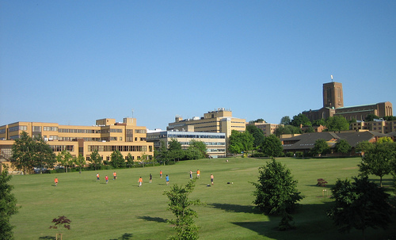
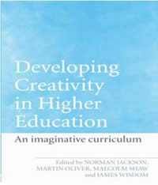
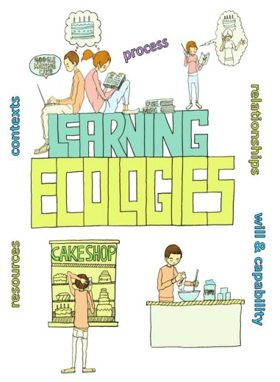
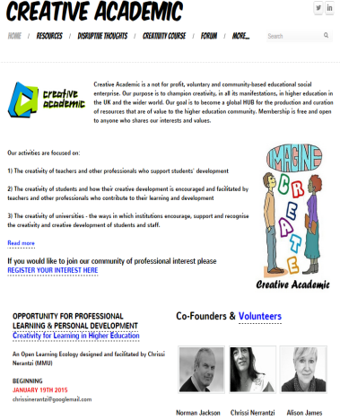
My interest in creativity, lifewide learning & learning ecologies
Lifewide Education
University of Surrey
Policy/Regulation Research Development & Innovation
Study of ‘how a
university changed’
Personal Development
Planning Community
Imaginative Curriculum
Network
SCEPTrE CETL
Lifewide Education
Community
Creative Academic
Community
1999-2000
2000-05
2006-11
2011- present
Notes:
The insight I have gained through thinking about the idea of inclusivity is that much of my educational development work has been about trying to include aspects of education that I thought were being excluded and marginalised.
1) My interest in creativity in higher education began about 15 years ago when I was working at QAA developing policy on programme specifications and became convinced that the outcomes model of learning was neglecting important developmental outcomes – like creativity. Also developed the policy for PDP which convinced me of the educational value of combining and integrating planning, action and reflection.
2) Moved to LTSN/HEA 2000 established a network of people interested in creativity – out of that I began to appreciate that people were creative in all aspects of their lives and if we were to support students creative development we needed to adopt a lifewide perspective – the work we did was published in a book - Developing Creativity in Higher Education and the work influenced my subsequent thinking
3) Moved to Surrey in 2005 led a Centre for Excellence in Teaching and Learning which focused on informal learning as a way of supporting students’ professional development began to develop and apply the idea of lifewide learning… also used the opportunity to explore further how and where students were being creative in different parts of their lives and the idea of personal creativity being used across the domains of our life is important to my understanding of what it means to be creative.
4) 2011 I left Surrey and set up my own social enterprise to promote the idea and support people and institutions wanting to develop their own practices in lifewide education. Over last 12 months I have been developing the idea of learning ecologies which I believe are important vehicles for personal creativity which I will include in this story. I also maintained my interest in creativity in higher education and in Jan 2015 with two others I set up ‘creative academic’ to provide support for people who were interested in students’ creative development
Two additional studies –
1) Study of how educational innovation emerged through a strategic change programme--
2) Current work on trying to understand the relationship between ‘Creativity in development’ – one project I have worked with educational developers to try to understand the role of creativity in their developmental processes.

Slide 6
Three things you associate
with being creative

Slide 7
Academics’ Views Many Surveys
Ways of thinking
Having new ideas – original to self
Inspiring – energising ideas
Having an open mind
Thinking that is different to the norm
Having ping moments
what does being
creative mean to you?
Doing things
Doing new things
Problem solving
Connecting things
Communicating telling stories,
selling ideas, persuading others
Making new things
Performing
Attitudes
Curiosity
Willing to engage/explore
Enthusiasm
Being proactive
Willing to take risks
Determination
Obsession
Feelings
Its about expressing yourself
It feels personal to begin with but
latter it might be something different
Feels exciting
Can be very uncomfortable
Feels great …. ping moments
Effects
Causes change
New ideas
New things
Innovation
Adaptation
Changes you
Notes:
Many surveys of people working in higher education reveal that these are the sorts of things that people associate with being creative. Seem to be recognised across different cultures.
Creativity in higher education. Where do we begin?
One place to begin is to have conversations with teachers about their creativity. If you ask any group of higher education teachers in the UK, ‘what does being creative mean to you?’ the following ideas emerge: originality and individuality being imaginative, generating new ideas, thinking outside the boxes we normally inhabit, looking beyond the obvious, seeing the world in different ways making new things doing things no one has done before doing things that have been done before but differently experimenting and taking risks
At this level there is consensus as to what being creative means. In fact it is likely that if you ask this question of higher education teachers anywhere in the world you will get a broadly similar set of responses because these basic concepts of creativity transgress cultural domains. These conceptions provide a starting point for contextualising conversations about creativity in teaching and learning practices or in any other form of professional or work practice.

Slide 8
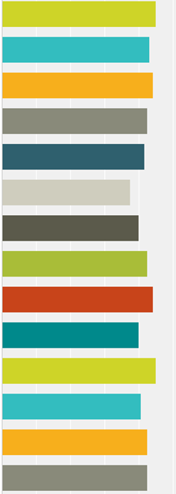
What does being creative mean? (n=12)
4.0
5
4
3
2
1
0
4.5
4.5
3.8
Seeing situations from different perspectives
Having ideas that are new to the context
Being able to look at new concepts and put them
together in different but personally meaningful ways
Going beyond what has been done before
Generating something new in response
to an educational need
Having ideas that are new to me
Solving problems and overcoming barriers
Adapting ideas to the context
Making new things happen
Changing my understanding
Improvising when necessary
Doing things differently
Using my imagination
Making new things
0 = strongly disagree 5.0 strongly agree

Slide 9
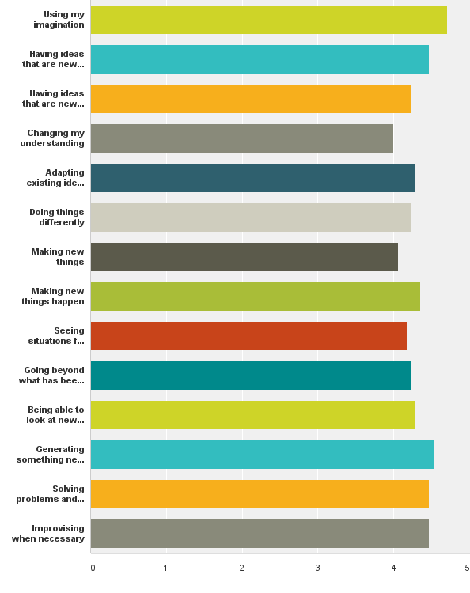
What does being creative mean? (n=28 course tutors)
5
4
3
2
1
0
4.7
4.5
4.5
4.5
4.5
4.0
Having ideas that are new to the context
Having ideas that are new to me
Going beyond what has been done before
Seeing situations from different perspectives
Solving problems and overcoming barriers
Being able to look at new concepts and put them
together in different but personally meaningful ways
Adapting ideas to the context
Generating something new in response
to an educational need
Changing my understanding
Making new things happen
Using my imagination
Doing things differently
Improvising when necessary
Making new things
0 = strongly disagree 5.0 strongly agree

Slide 10
Creativity is about bringing ideas, objects, processes,
performances and practices into existence
Creativity is the production of novel and useful ideas in any domain Teressa Amabile 1996
Creativity is any human act that gives rise to something new is.... a creative act regardless of whether what was created is a physical object or some mental or emotional construct that lives within the person who created it and is known only to him
Lev Vygotsky 1930
Creativity is the act of turning new and imaginative ideas into reality. It involves two processes: thinking then producing.
Linda Naiman 2014
Notes:
Some definitions

Slide 11
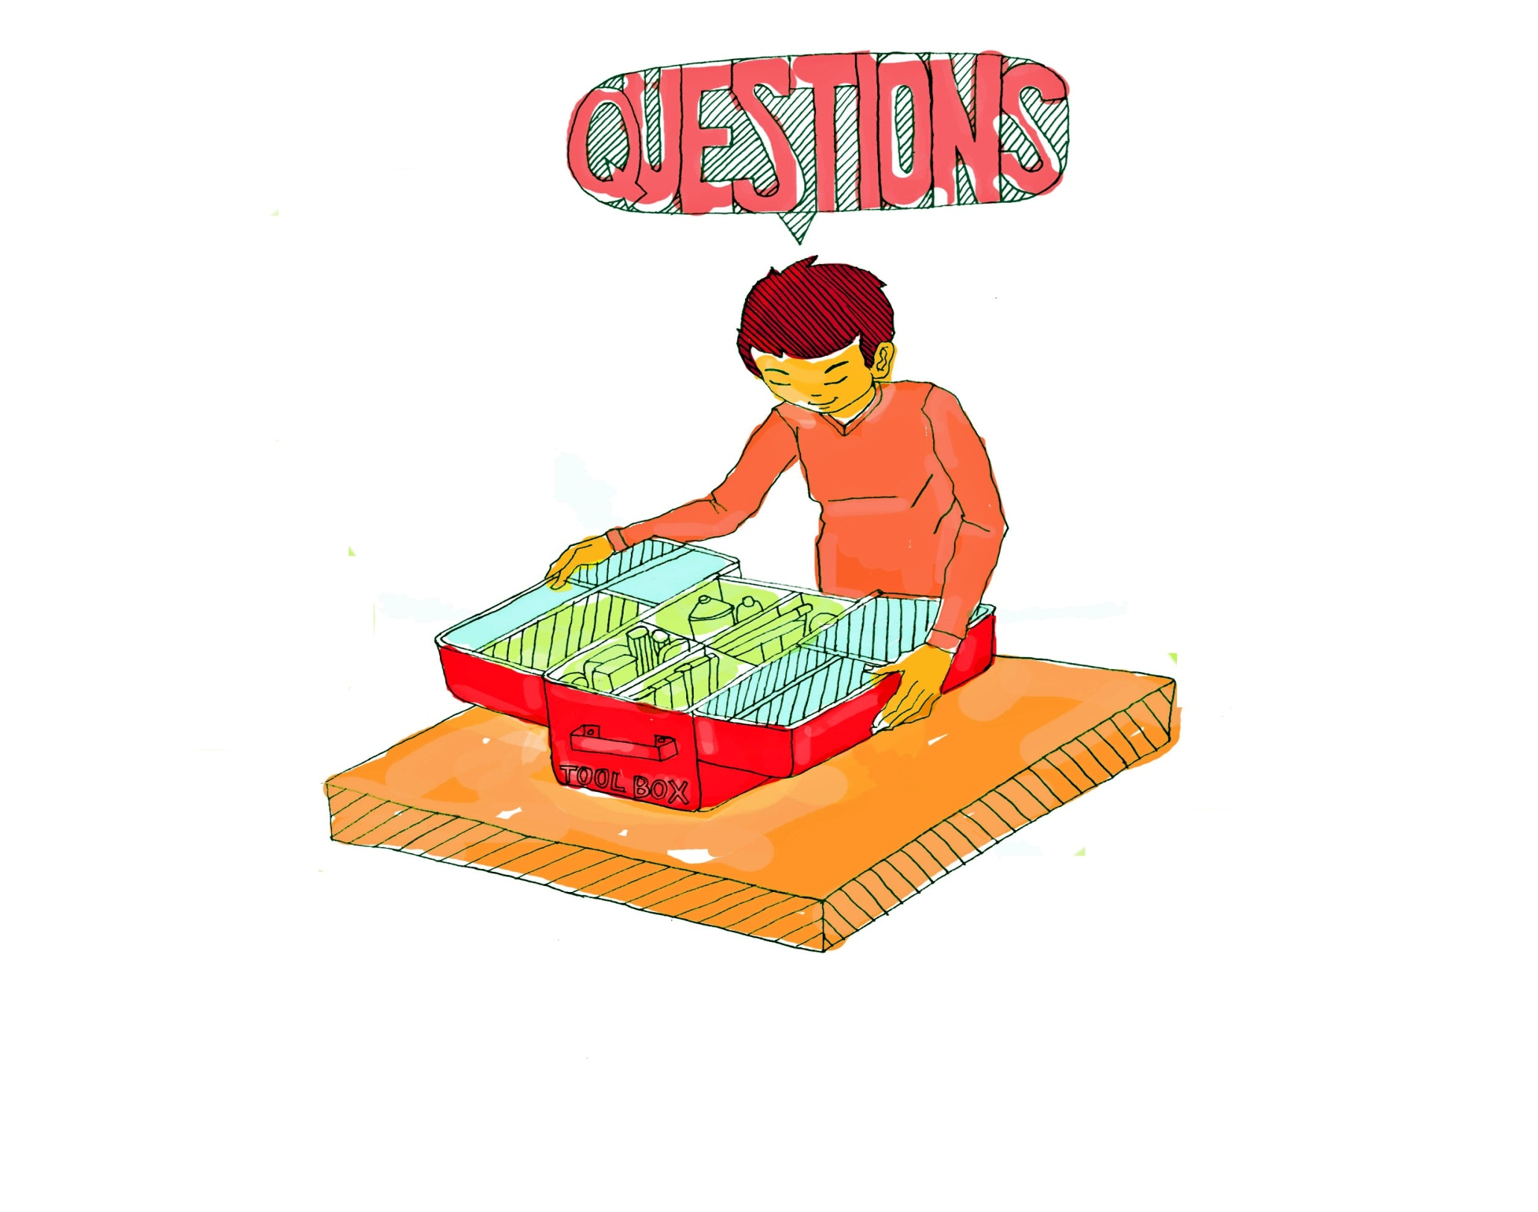
m
Creativity Conceptual Tools
2 Developmental
perspective
3 Personal
characteristics
1 Forms &
social/cultural significance
4 Integrative
thinking
7 Ecology
5 Cultural & Social
6 Context
Notes:
Out of the many possible perspectives we could choose to examine I want to offer 7 perspectives that are useful when we consider inclusive forms of creativity in the context of learning, development and achievement in higher education. These perspectives provide us with a set of tools to help share understandings about creativity.

Slide 12
1 Forms & significance - inclusive view of creativity
Four-C model of creativity Kaufman and Berghetto (2009)
mini-c
little-c
pro-c
Big-C
Transformative
learning,
personally meaningful interpretations of experiences, actions and insights
eminent
creativity of
exceptional
people
creative acts of experts/experienced
people & teams within an organisation, community
or domain
Context for new ideas &
their implementation
everyday creative
thoughts and actions in every aspect of our lives
impact on
culture, society,
the world
impact on an organisation, field, system of practice,
or market
changes in our understandings
impact on
individuals and their
zone of influence
individuals’
Socio/cultural significance and impact
Notes:
Scale and influence of individual's creativity
Some people believe that they are just not creative: a belief that stems from comparing themselves with people they perceive as being highly creative (ie 'compared to her I am not creative'). Individuals' creative development will be hindered unless they believe that they have potential to be creative in their ways and circumstances. One approach is use the 'scale and significance' diagram to explain the nature, scope and influence of individuals' creativity (slide)
Kaufman and Beghetto suggest that human creativity can be categorised into 'Big-C' creativity that brings about significant change in a domain; 'Pro-c' creativity associated with the creative acts of experts or people who have mastered a field, including but not only people involved in professional activity; 'little-c' creativity - the everyday creative acts of individuals who are not particularly expert in a situation and 'mini-c' the novel and personally meaningful interpretation of experiences, actions and events made by individuals. Central to the definition of mini-c creativity is the dynamic, interpretative process of constructing personal knowledge and understanding within a particular socio-cultural context.
Both mini-c and little-c forms of creativity are relevant to higher education learning and curriculum designs, teaching and learning strategies could usefully encourage and facilitate these. One might speculate that participation in these forms of creativity are pre-requisite for Pro-c and Big-C creativity in later life: if we want creative professionals then we should be encouraging our students to be creative. It is however important to note that 'everyday creativity can extend from mini-c to little-c through Pro-c. It is only Big-C that remains eminent creativity (ibid:6) beyond the reach of most of us. From an educational perspective it might be reasoned that by encouraging and empowering students to use, develop and make claims for mini-c and little-c forms of creativity, we are better preparing them not only for using these forms of creativity in later life but for engaging in more expert-based forms of creativity that emerges through sustained engagement with a particular domain or field of activity.
Armed with these tools to aid thinking about personal creativity we will now consider three different dimensions of the developing students' creativity puzzle - the pedagogic challenge, the disciplinary context and the wider context of students' everyday lives.
Kaufman, J.C., and Beghetto, R.A. (2009) Beyond Big and Little: The Four C Model of Creativity. Review of General Psychology 13, 1, 1-12.

Slide 13
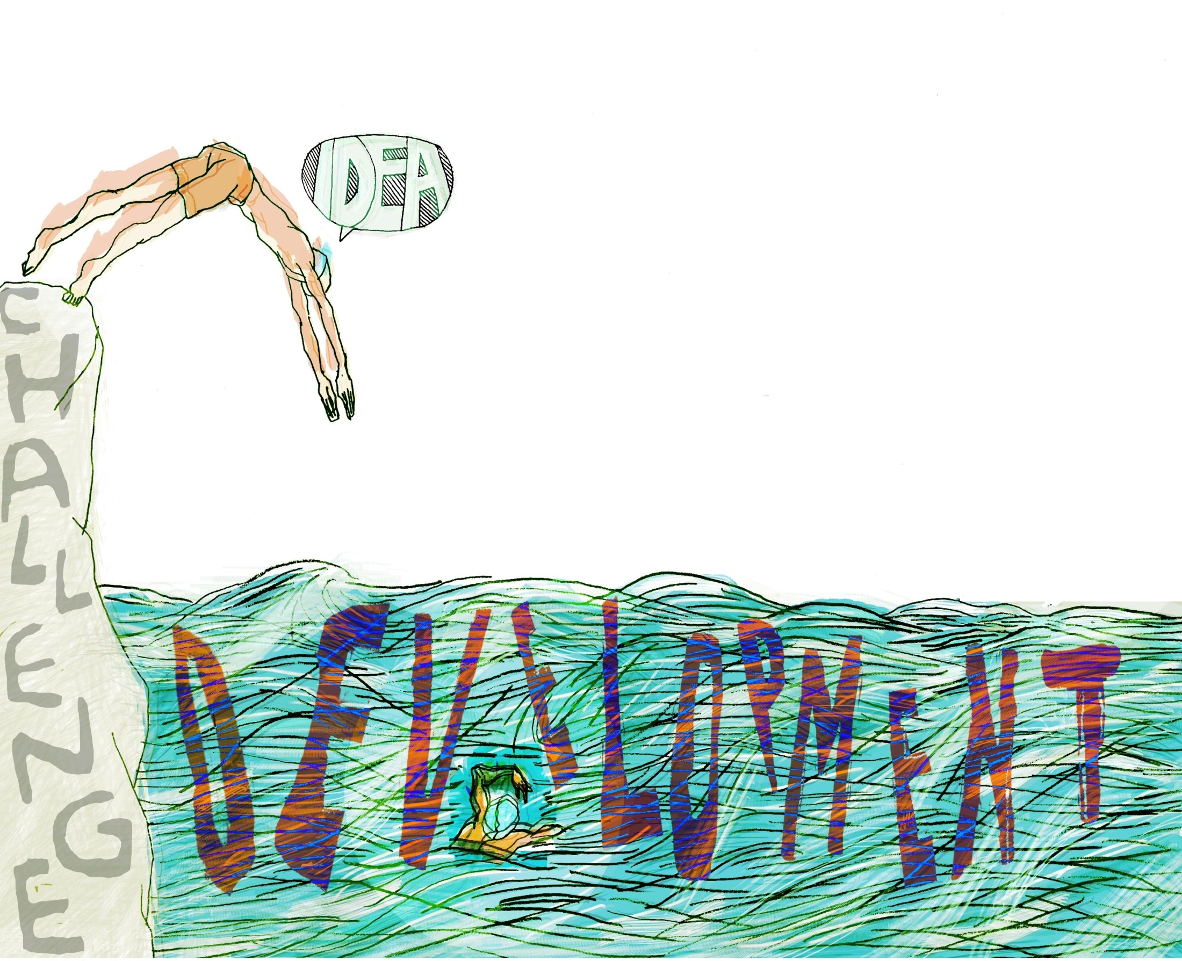
2 Developmental perspective
C
Development is the process by which we convert novel ideas into something more tangible
R
E
A
T
T
Y
I
V
I
INCREMENTAL
Doing the right things
Doing things right
Doing things better
NON-INCREMENTAL / INNOVATION
Doing new things that someone else is doing
Appropriating what someone else is doing
Doing things that no one else is doing
Trying to do things that can’t be done
Notes:
Development is intentional movement towards something different that has potential to be better than what currently exists or to add value to what exists
Development is the process by which we convert novel ideas into something more tangible.
Development is a vehicle for creativity – we might have a good idea at the start of the process but through development we are likely to have/need many more.

Slide 14
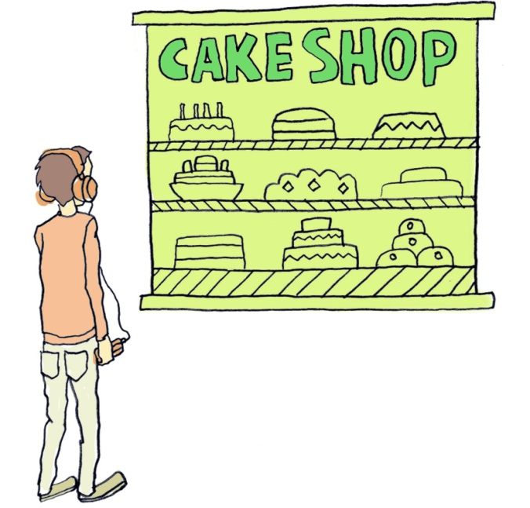
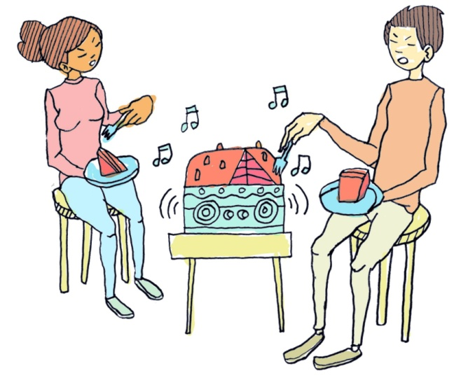
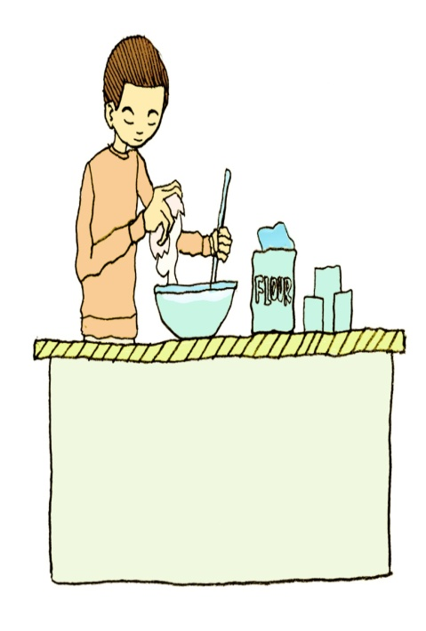
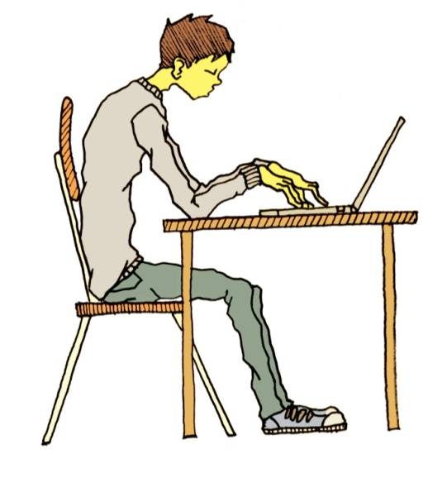
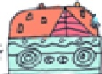
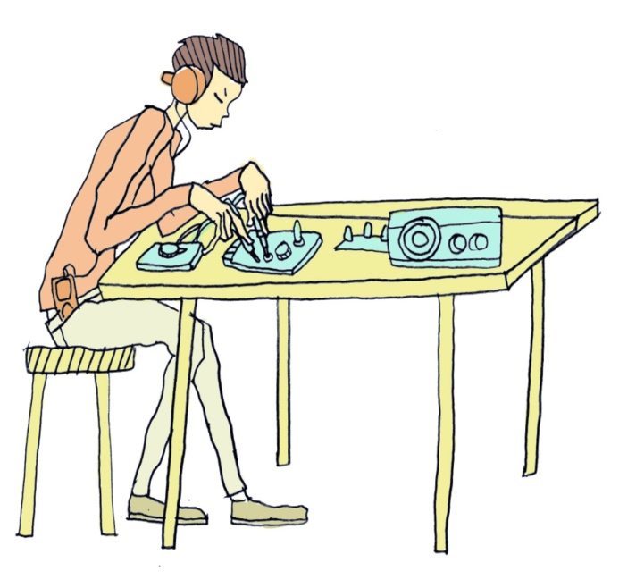
Integrating creativity, development
& innovation in the same narrative
INNOVATION
A cake that plays your favourite tunes as you eat it
?
?
?
CREATIVE
ACHIEVEMENT
?
IMAGINE DESIGN, EXPLORE, MAKE, EXPERIMENT, PRODUCE
D E V E L O P
Notes:
A creativity narrative that integrates novel ideas, with the process of bringing the idea into existence.
A young man who enjoys listening to music and eating cakes is standing in front of a bakers shop looking at the cakes while listening to his favourite singer on his ipod. He has the novel idea of a cake that plays music when you eat it. The idea is new to him and although other people may have thought about it before no musical cake has ever been brought into existence. This part of the story illustrates the initial creative thought.
The young man is highly motivated by his idea and is convinced that he could make such a cake. So he sets about developing his idea. He explores the possible ways in which he might create the music mindful of the costs and the potential health risks of integrating electrical devices into a cake. He hits on the idea of a small chip in the base of the cake that is not eaten which sends a pre-recorded message or tune to a mobile phone which plays the recording.
He starts designing and making his musical cake. It requires much experimentation and involves many setbacks. He enlists the help of the local bakery and a small electronics company who are both willing to help build a prototype which can then be pitched to potential investors. The whole developmental process involves continuously solving problems and seeing opportunities in which the young man’s creative and analytical thinking comes into play. Every new idea or possible solution is evaluated and judged in the search for possible right answers. Creativity flourishes is a developmental process where individuals and groups are inspired to bring something new into existence.
While the initial idea might be truly original the hard work of creativity is to turn an idea that inspires into something real and concrete – whether it be a process, product, virtual object or performance. This normally requires a process through which ideas are questioned, problems are solved and obstacles are overcome. This development process provides scope for further creativity and if the result creates something tangible that is of value to the individual or others then it might be deemed an innovation if it is significantly different to anything that has existed before.

Slide 15
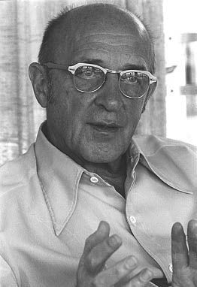
A definition of creativity
consistent with the narrative
Personal creativity is
'the emergence in action of a novel relational product growing out of the uniqueness of the individual on the one hand, and the materials, events, people, or circumstances of his life'
Carl Rogers (1960)
product = ideas, material or virtual objects,
practices, performances and processes
PRODUCT RESULTS FROM PROCESS!
Notes:
The assumption underlying my work on creativity is we are all creative and we all have potential to be creative.
But many people do not believe they are creative and they need reassurance that they are creative. They need conceptions of creativity that they can readily relate to in their own lives.
If we accept his conception then we are all creative and all more or less continuously creating. It is a fundamentally human characteristic.
Rogers provides a useful definition of personal creativity that we can all relate to and which can explain our creative acts.

Slide 16
3 Personal characteristics
Componential model of creativity
Teresa Amabile (1983, 1996)
Expertise
Thinking
creativity
emerges
Character
Motivation
Notes:
There are many models of human creativity including for example the multiple models of Greene (2006). For the purpose of trying to make sense of creativity in the context of educational development Amabile's model (Amabile 1983) is as useful as any. The model has three components all of which are necessary for creativity in any domain namely, domain relevant expertise, the ability to think creatively about domain relevant problems and opportunities, and the will to engage with a domain relevant problem or opportunity and persist until the job is done.
Expertise in a domain
The expertise of educational professionals includes their talent for imagining and thinking about the problems, challenges and opportunities for improving students' learning, for helping them to learn certain things in certain ways and for enabling them to demonstrate their learning and development. Their knowledge includes domain specific knowledge of subject disciplines and pedagogic knowledge and knowing relating to teaching and learning. Both teachers and educational developers also have knowledge of how their university works and the people who make it work. Educational developers will also have the process knowledge required for working across and upwards through the structures and personalities of their university - knowledge of how to bring about change in context.
Expertise is the foundation for all creative work. This component includes memory for factual knowledge, technical proficiency, and special talents in the target work domain .....This component can be viewed as the set of cognitive pathways that may be followed for solving a given problem or doing a given task. As Newell and Simon (1972) poetically describe it, this component can be considered the problem solver's "network of possible wanderings" (p. 82) (Amabile 1996:5)
Creative ways of thinking
Creative thinking provides the source of creative ideas. According to Amabile (1996) this type of thinking includes a cognitive style favourable to taking new perspectives on problems, an application of techniques (or "heuristics") for the exploration of new cognitive pathways, and a working style conducive to persistent, energetic pursuit of one's work. Creative thinking skill depends to some extent on personality characteristics related to independence, self-discipline, orientation toward risk-taking, tolerance for ambiguity, perseverance in the face of frustration, and a relative unconcern for social approval (Amabile 1996: 5)
A teacher's application of creative thinking might involve challenging assumptions about the relevance of what they are teaching to the world outside higher education. By changing their perspective they might change their whole approach to what and how they are teaching. The educational developer may be called upon to assist their colleague in the development process adding their expertise and creative thoughts to the mix. Alternatively, they might be pursuing a developmental agenda provided by their university. Their immersion in a challenge, like 'how do we encourage more higher education teachers to utilise enquiry-rich approaches to learning?' provides the context and stimulation for their imagination and creative ideas. Typically, they are likely to draw on knowledge and expertise from their own affordance networks (Barab and Roth 2006) and from these, the seeds of entirely new institutional practices and communities may be born.
Intrinsic motivation to engage with and accomplish a task
While the two skill components determine what an individual is capable of doing in a domain, without the will to approach a task in a particular way, creativity will not emerge. It is the task motivation component that determines what that person actually will do (Amabile 1996:7).
Motivation can be either intrinsically driven by deep interest or passion and involvement in the work, by curiosity and enjoyment, by dissatisfaction with what currently exists, by a sense of challenge or a strong conviction or belief. It can also be nurtured by beliefs in a different future stimulated by a sense of purpose ie the important life projects we pursue (Miller and Brickman 2004:14). Extrinsic motivation to achieve more concrete goals is driven by rewards, threats or performance measures that are outside the control of the individual such as managerial praise, meeting someone's deadline or gaining a bonus or promotion as a result of the work.
A person can have no motivation for doing a task, a primarily intrinsic motivation, or a primarily extrinsic motivation; obviously, intrinsic and extrinsic motivation for the same task may coexist. However, one is likely to be primary. A number of studies have shown that a primarily intrinsic motivation will be more conducive to creativity than a primarily extrinsic motivation (Amabile 1996:7).
Task motivation makes the difference between what a teacher or educational developer are capable of doing and what they will actually do. All too often development work requires people to do more than might be reasonably be expected of them particularly in the academic environment - you do your teaching, administration and research and then you do your development work. To go the extra mile required of developer innovators requires the deep beliefs and convictions that are associated with intrinsic value-driven motives. Such values are most likely to be held in the long term goals (individual's life projects or purposes) discussed under the theme of self-regulation (p17-18).
Amabile's componential theory suggests that creativity is most likely to occur when people take on willingly a developmental challenge and their expertise and thinking skills align to their values and beliefs and their deepest interests and passions.
Studies of innovators also reveal that they have certain personal character traits that enables them to engage with challenges in the way they do. For example they are committed, ambitious, driven, energetic, enthusiastic, integrity, honest, open, confident, self-belief, positive and optimistic, willing to take on risks and to engage with challenge

Slide 17
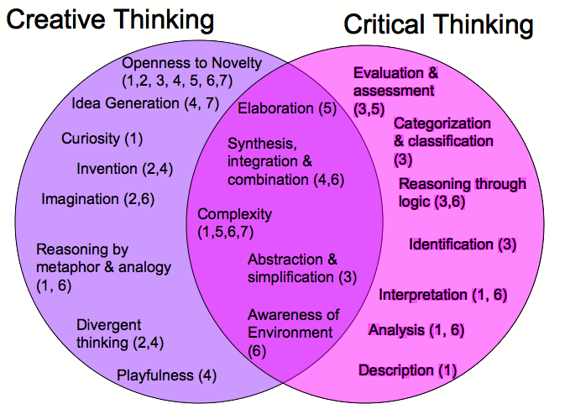
4 Integrative thinking
PROBLEM SOLVING SEQUENCE 1 Assess situation 2 Visioning 3 Formulate challenges
4 Explore ideas/possible solutions 5 Formulate solutions 6 Gain acceptance
7 Formulate a plan
Puccio, Murdock, and Mance (2005)

Slide 18
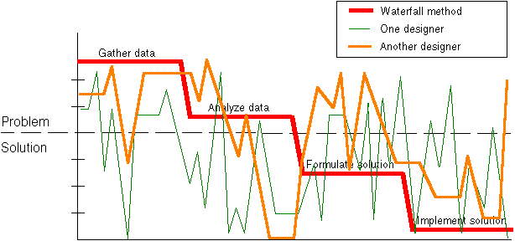
What does creativity look like?
How experts solve complex problems
Pro-c creativity in action
Click on image for the paper (pdf): "Wicked Problems and Social Complexity"
Context
IMAGINING
IMPLEMENTING
Rittel, Horst and Melvin Webber (1973) ‘Dilemmas in a General Theory of Planning’
Notes:
Here is an example of creative thinking and action which integrates the different perspectives that have been illustrated.
Opportunity Driven Problem Solving described by Jeff Conklin
A study in the 1980’s at the Microelectronics and Computer Technology Corporation (MCC) looked into how people solve problems. The study focused on design, but the results apply to virtually any other kind of problem solving or decision-making activity –
the kinds projects are fraught with.
A number of designers participated in an experiment in which the exercise was to design an elevator control system for an office building. All of the participants in the study were experienced and expert integrated- circuit designers, but they had never worked on eleva- tor systems before. Indeed, their only experience with elevator systems came from riding in elevators. Each participant was asked to think out loud while they worked on the problem. The sessions were videotaped and analyzed in great detail.
The analysis showed, not surprisingly, that these designers worked simultaneously on understanding the problem and formulating a solution. They exhibited two ways of trying to understand the problem:
• efforts to understand the requirements for the system (from a one page problem statement they were given at the beginning of the session); and
• mental simulations (e.g. “Let’s see, I’m on the second floor and the elevator is on the third floor and I push the ’Up’ button. That’s going to create this situation....”).
On the solution side, their activities were classified into high, medium, and low levels of design, with high-level design being general ideas, and low being details at the implementation level. These levels are analogous to an architect’s sketch, working drawings, and a detailed blueprint and materials list for a house.
Traditional thinking, cognitive studies, and the pre- vailing design methods all predicted that the best way to work on a problem like this was to follow an orderly and linear ‘top down’ process, working from the problem to the solution. This logic is familiar to all of us. You begin by understanding the problem. This often includes gathering and analyzing ‘require- ments’ from customers or users. Once you have the
problem specified and the requirements analyzed, you are ready to formulate a solution, and eventually to implement that solution. This is illustrated by the ‘waterfall’ line in the slide.
This is the pattern of thinking that everyone attempts to follow when they are faced with a problem, and it is widely understood that the more complex the problem is, the more important it is to follow this orderly flow. If you work in a large organization, you will recognize this linear pattern as being enshrined in policy manuals, textbooks, internal standards for project management, and even the most advanced tools and methods being used and taught in the organization. In the software industry it is known as the ‘waterfall model,’ because it suggests the image of a waterfall as the project ‘flows’ down the steps towards completion.
However, the subjects in the elevator experiment did not follow a waterfall. They would start by trying to understand the problem, but they would immediately jump into formulating potential solutions. Then they would jump back up to refining their understanding of the problem. Rather than being orderly and linear, the line plotting the course of their thinking looks more like a seismograph for a major earthquake, as
illustrated in Figure 2. We will refer to this jagged-line pattern as opportunity-driven, because in each moment the designers are seeking the best opportunity for progress toward a solution.
These designers are not being irrational. They are not poorly trained or inexperienced. Their thought process was something like: “Let’s see, idle elevators should return to the first floor, but then, you only need one elevator on the first floor, so the others could move to an even distribution among the floors. But the elevators need to be vacuumed regularly. I suppose we could add a switch that brought idle elevators down to the first floor. But then what happens in an emergency?” In other words, what is driving the flow of thought is some marvelous internal drive to make the most headway possible, regard- less of where the headway happens, by making opportunity-driven leaps in the focus of attention. It is precisely because these expert designers are being creative and because they are learning rapidly that the trace of their thinking pattern is full of unpredictable leaps.
In particular, the experiment showed that, faced with a novel and complex problem, human beings do not simply start by gathering and analyzing data about the problem. Cognition does not naturally form a pure and abstract understanding of ‘the problem.’ The subjects in the elevator experiment jumped immedi- ately into thinking about what kind of processors to use in the elevator controller, and how to connect them, and how to deal with unexpected situations, such as if one processor failed. These are detailed solution elements.
These experienced designers illustrated that problem understanding can only come from creating possible solutions and considering how they might work. Indeed, the problem often can best be described in terms of solution elements. A requirement in the problem statement calling for ‘high reliability’ was quickly translated into the idea of using a network of distributed processors – a high-level solution that drove the rest of the design process.
The slide illustrates another striking observation: problem understanding continues to evolve until the very end of the experiment. Even late in the experi- ments the designer subjects returned to problem understanding, the upper part of the graph. Our experience in observing individuals and groups working on design and planning problems is that, indeed, their understanding of the problem continues to evolve -- forever! Even well into the implementation of the design or plan, the understanding of the problem, the ‘real issue,’ is changing and growing.
The natural pattern of problem solving behavior may appear chaotic on the surface, but it is the chaos of an earthquake or the breaking of an ocean wave – it reflects a deeper order in the cognitive process. The non-linear pattern of activity that expert designers go through gives us fresh insight into what is happening when we are working on a complex and novel prob- lem. It reveals that the feeling that we are ‘wandering all over’ is not a mark of stupidity or lack of training. This non-linear process is not a defect, but rather the mark of an intelligent and creative learning process.
In fact, this non-linear pattern does not come as a surprise to most people. Anyone who has ever worked on a complex project has the intuition that this jagged line process is what is really going on. But the experi- ment is significant because it gives us a real picture of the process that people follow when they really think about novel problems, and it is not the orderly and linear process we have been taught is proper!
From another perspective, the jagged line of opportunity-driven problem solving is a picture of learning (AND CREATIVITY). The more novel the problem, the more the problem solving process involves learning about the problem domain. In this sense the waterfall is a picture of already knowing – you already know about the problem and its domain, you know about the right process and tools to solve it, and you know what a solution will look like. As much as we might wish it were otherwise, most projects in the knowledge economy operate much more in the realm of learning than already knowing. You still have experts, but it’s no longer possible for them to guide the project down
the linear waterfall process. In the current business environment, problem solving and learning are tightly intertwined, and the flow of this learning process is opportunity-driven.
Wicked Problems and Social Complexity Chapter 1 of Dialogue Mapping: Building Shared Understanding of Wicked Problems, by Jeff Conklin, Ph.D., Wiley, October 2005. For more information see the CogNexus Institute website at http://www.cognexus.org. © 2001-2008 CogNexus Institute. Rev. Oct 2008.

Slide 19
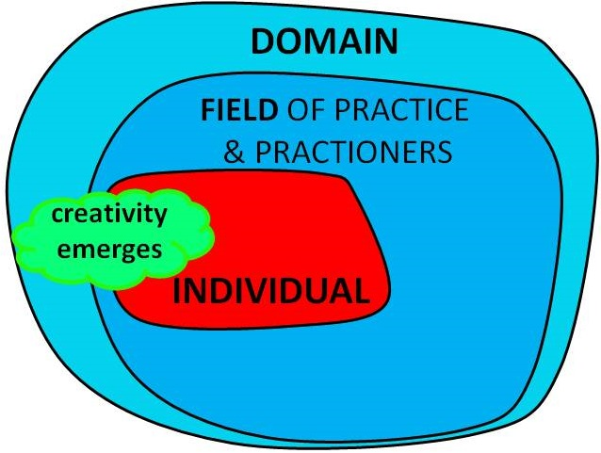
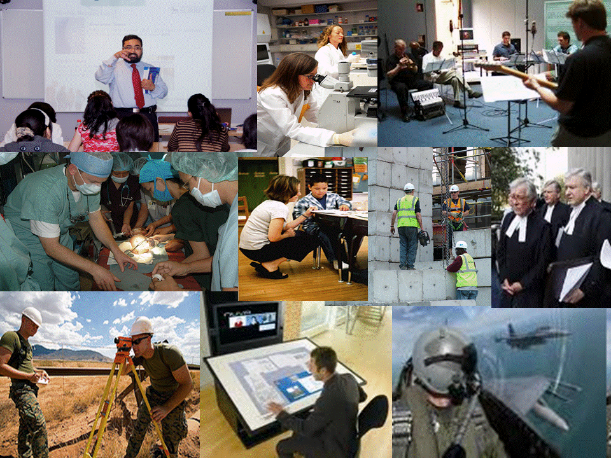
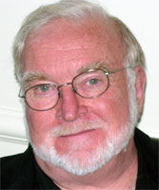
5 Cultural & Social
Creativity is a process that can be observed only at the intersection where individuals, domains and fields interact
This environment has two salient aspects: a cultural or symbolic aspect called the domain, and a social aspect called the field. Csikszentmihayli (1999)
Notes:
Drawing Inspiration From the Discipline
Creativity is a social and cultural phenomenon and we need to understand how it is understood in the different cultural domains (disciplines) and the field (teachers and others who practice in the discipline). creativity results from the interaction of a system composed of three elements: a culture that contains symbolic rules, a person who brings novelty into the symbolic domain, and a field of experts who recognise and validate innovation. All three are necessary for a creative idea, product or discovery to take place^{p6}
One way in which universities could encourage students to develop their understandings of what being creative means is to help them appreciate what creativity means in disciplinary practices and in the achievements of disciplinary practitioners. What does it mean to be a creative engineer, doctor, historian, teacher or any other practitioner in a discipline? Surveys show that faculty share similar perceptions of what being creative means in their discipline and sites for creative thinking that relate to these characteristics appear to be available in most aspects of disciplinary practice. Growing understanding and making explicit what creativity means in the academy is the first step in engaging the academy with this challenge.
Csikszentmihalyi M (1997) Creativity: Flow and the Psychology of Discovery and Invention. New York Harper Adams

Slide 20
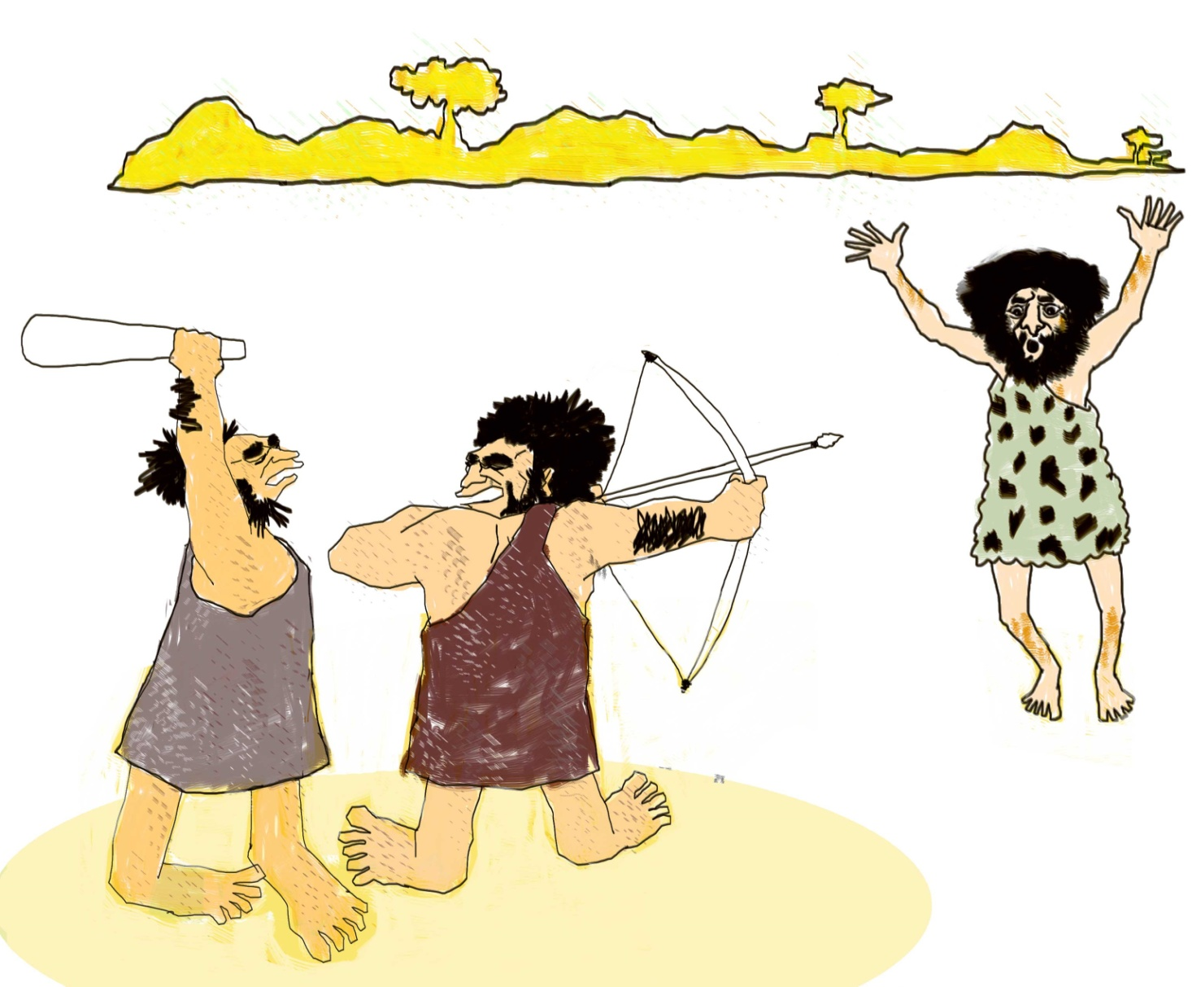
Disciplinary Tribes & Territories (Becher 1989)
Since we invented language it has become so
much easier to identify intruders on our territory

Slide 21
What being creative means in eight disciplines
Based on surveys within each community (Jackson & Shaw 2006)
Being imaginative – ability to think generatively & associatively
Being original / inventive - new ideas which add value
Being able to adapt/improvise (re-creation)
Being curious having an enquiring disposition – the desire to find out
Being resourceful – finding and making use of what is available
Being able to think synthetically and relationally -connect
in novel ways, work with incomplete data, recognise patterns
Being able to think critically to evaluate ideas
Being able to communicate in ways that help people
comprehend and if necessary, see things differently
Notes:
Where Does Creativity Reside in the Discipline?
Surveys of academic teachers in different disciplines²⁴ reveal that sites for creative thinking and action appear to be available in most aspects of disciplinary practice. Sites for creativity can be connected through the idea of disciplinary enquiry and problem solving.
Being original – is understood as creating something new and useful to the discipline. For most academics this is embodied in the processes and products of research many of whom are active contributors. The idea is also connected to invention and innovation. For example in history this could mean: new approaches to solving historical problems; new techniques to gather and analyse data; new approaches to validate evidence; new interpretations of evidence; new forms of history and new forms of communicating historical information.
Making use of imagination – is focused on the use of mental models in disciplinary thinking. It is a source of inspiration, stimulates curiosity and sustains motivation. It generates ideas for creative solutions and facilitates interpretation in situations which cannot be understood by facts or observations alone. Disciplinary problems and concerns provide an essential context for the use of imagination.
Finding and thinking about complex problems – the engine of academic creativity is intellectual curiosity – the desire to find out, understand, explain, prove or disprove something. Curiosity leads academics to find questions that are worth answering and problems that are worth solving.
Making sense of complexity, synthesising, connecting and seeing relationships – Because working with complex problems often involves working with multiple and incomplete data sets, the capacity to synthesise, make connections and see new patterns and relationships is important in sense-making (interpreting and creating new mental models) and working towards better understandings and possible solutions to difficult problems.
Communication - the communication of ideas, knowledge and deeper understandings are important dimensions of creativity in the discipline. The symbolic language and tools and vehicles for communicating are all part of the disciplinary heritage. Story telling is an important dimension of communication. Disciplinary cultures are largely based on writing using the conceptual and symbolic language and images that have been developed to communicate complex information. Story-telling and story-writing are important sites for academics’ creativity.
Resourcefulness – in the professional disciplines many roles involve solving difficult problems requiring ingenuity and resourcefulness. For example, a social worker or medic might need all their resourcefulness to access and acquire the resources to solve a client or patient’s problem.
Amabile⁶ reveals how these characteristics of disciplinary creativity might be integrated into her model of creativity (Figure 3) through the example of a bio-engineer utilising his expertise, creative thinking and motivations to find and solve problems (contexts) that motivate him. In this scenario we are dealing with the Pro-c versions of creativity recognised by Kaufman and Beghetto¹⁶
A bio-engineer's expertise includes his innate talent for imagining and thinking about complex scientific problems as well as sensing out the important problems in that domain, his factual knowledge of biochemistry and the techniques of genetic engineering, his familiarity with past and current work in the area, and the technical laboratory skill he has acquired. This component can be viewed as the set of cognitive pathways that may be followed for solving a given problem or doing a given task ^{6 p5}
Our bio-engineer's arsenal of creativity skills might include his ability to break out of a preconceived perception or expectation when observing experimental results, his tolerance for ambiguity in the process of deciding on the appropriate interpretation for puzzling data, his ability to suspend judgment as he considers different approaches, and his ability to break out of strict algorithms for attacking a problem^{6 p5}
Task motivation makes the difference between what our bio-engineer can do and what he will do. The former depends on his levels of domain-relevant skills and creativity-relevant skills. But it is his task motivation that determines the extent to which he will fully engage his domain-relevant skills and creativity-relevant skills in the service of creative performance.^{6p7}
For many people, simply having the intellectual challenge of a problem they care about is all they need to motivate themselves and increase their potential for creativity.

Slide 22
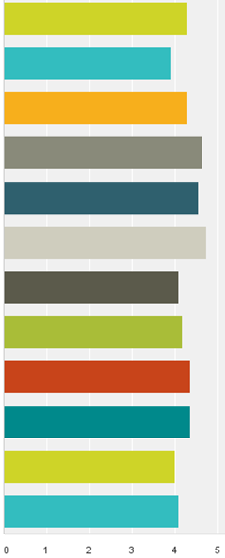
Beliefs about creativity n=12
creative skills/ attitudes identified in disciplinary surveys
use imagination – generate ideas / see possibilities
4.3
4.6
3.9
3.9
originality – making/doing things no one has done before
4.4
adaptive - being inventive with other people’s ideas
4.3
combine, connect, synthesise – recognise patterns
4.6
4.6
cope with complexity – information, relationships, situations
4.7
4.6
think critically/analytically to evaluate ideas & make good decisions
4.8
4.7
resourceful – making the most out of available resources
4.1
4.6
represent and communicate ideas in ways that engage/persuade
4.2
4.8
enquiring disposition - willing to question, explore, experiment
4.8
4.4
4.4
open to new experiences
4.8
0 = strongly
disagree
5.0 strongly
agree
willing to take risks – tackle unfamiliar problems / contexts
4.0
4.8
persistence - willing to keep trying even if not successful
4.1
4.7
0 1 2 3 4 5
0 1 2 3 4 5
Notes:
I have conducted many surveys in universities and they all show the same pattern – regardless of discipline academics support the idea that there is a core set of skills/capabilities and attitudes that are relevant to creativity. This is a survey of 28 course tutors in one university.

Slide 23
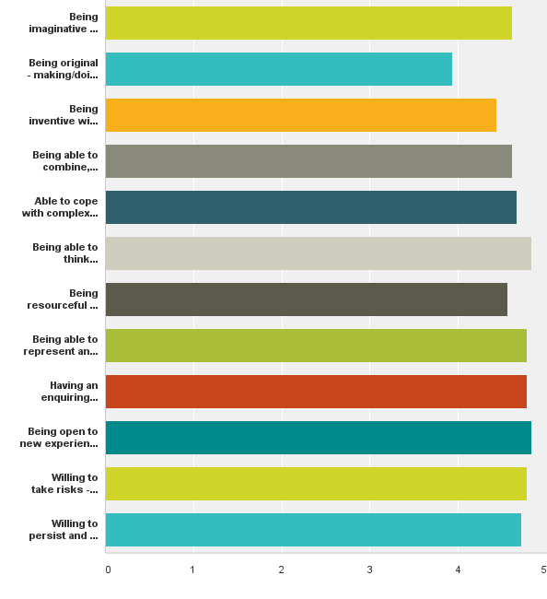
Beliefs about creativity n=28 Course Tutors
creative skills/ attitudes identified in disciplinary surveys
use imagination – generate ideas / see possibilities
4.6
originality – making/doing things no one has done before
3.9
adaptive - being inventive with other people’s ideas
4.4
combine, connect, synthesise – recognise patterns
4.6
cope with complexity – information, relationships, situations
4.7
think critically/analytically to evaluate ideas & make good decisions
4.8
resourceful – making the most out of available resources
4.6
represent and communicate ideas in ways that engage/persuade
4.8
enquiring disposition - willing to question, explore, experiment
4.8
open to new experiences
4.8
0 = strongly
disagree
5.0 strongly
agree
willing to take risks – tackle unfamiliar problems / contexts
4.8
persistence - willing to keep trying even if not successful
4.7
0 1 2 3 4 5
Notes:
I have conducted many surveys in universities and they all show the same pattern – regardless of discipline academics support the idea that there is a core set of skills/capabilities and attitudes that are relevant to creativity. This is a survey of 28 course tutors in one university.

Slide 24
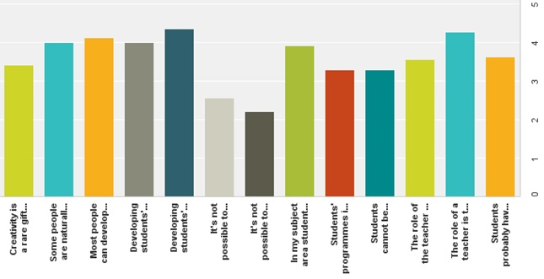
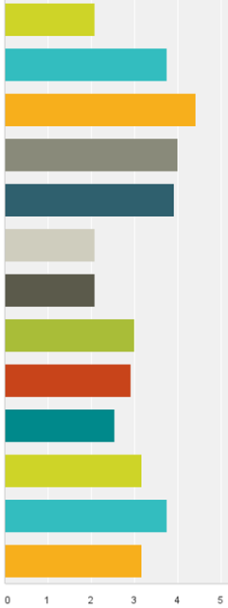
Beliefs about creativity n=12
Creativity is a rare gift
2.1
3.4
Some people are naturally
more creative than others
3.8
4.0
Most people can develop their creativity
if given the opportunity to do so
4.1
4.4
Developing students’ creativity
is a significant challenge
4.0
4.0
Developing students’ creativity should be an integral
part of their development while at university
3.9
4.4
Its not possible to teach students to be creative
2.1
2.6
Its not possible to assess students’ creativity
2.2
2.1
In my subject area students have lots of opportunity to be creative
3.0
3.9
Programmes are designed to
encourage creativity
2.9
3.3
Students cannot be creative before have
mastered a lot of knowledge and skill
3.3
2.6
The role of the teacher is to explain what creativity means then assess students against criteria that relate to these meanings
3.6
3.2
0 = strongly
disagree
5.0 strongly
agree
The role of the teacher is to help students understand their own creativity and help them make claims with the evidence they believe is appropriate
4.3
3.8
3.6
Students have more opportunity to use and develop their creativity in their lives outside their academic programme
3.2
0 1 2 3 4 5

Slide 25
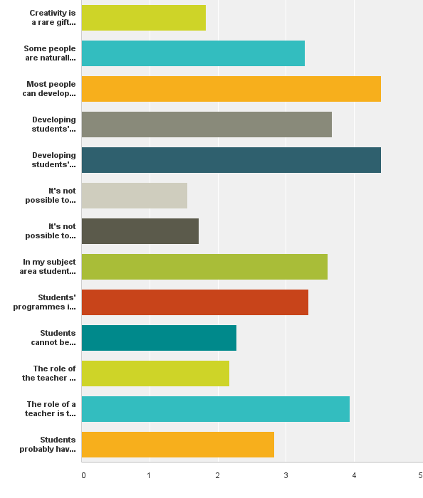
Beliefs about creativity (n=28 course tutors)
Creativity is a rare gift
1.8
Some people are naturally more creative than others
4.4
Most people can develop their creativity if given the opportunity to do so
Developing students’ creativity is a significant challenge
Developing students’ creativity should be an integral part of their development while at university
4.4
Its not possible to teach
students to be creative
1.6
Its not possible to assess
students’ creativity
1.7
In my subject area students have lots of opportunity to be creative
Programmes are designed to encourage creativity
Students cannot be creative before have
mastered a lot of knowledge and skill
0 = strongly
disagree
5.0 strongly
agree
The role of the teacher is to explain what creativity means
then assess them against criteria that relate to these meanings
The role of the teacher is to help students understand their own creativity
and help them make claims with the evidence they believe is appropriate
3.9
Students have more opportunity to use and develop their
creativity in their lives outside their academic programme
0 1 2 3 4 5

Slide 26
6 Context
unfamiliar problems & opportunities
THE DOMAIN OF
DEVELOPMENT & INNOVATION
Contexts & situations that challenge us
to learn & apply our learning, develop
new capability & resilience,
and use our
creativity
familiar
context
unfamiliar
context
KNOWN DOMAIN
OF ROUTINES &
INCREMENTAL
IMPROVEMENT
familiar problems & opportunities
Stevenson (1998)
Notes:
The importance of context
Situations can be categorised according to whether the context is familiar or unfamiliar and whether the problem (challenge or opportunity) is familiar or unfamiliar. John Stevenson (1998) developed a simple 2x2 matrix to explain how we utilise our capability (including our creativity) within this conceptual framework.
Much of our life is spent in familiar situations where we don’t have to pay too much attention to what we are doing and we can reproduce our responses without really thinking deeply about our actions. Stephenson considered this space to be one in which we practised dependent capability and he related this to traditional teaching approaches adopted in higher education. We can, if we choose, adopt and perform the routines we have learnt in these situations with little or no need to invent.
Our personal creativity in this domain is not focused on mastering new contexts and difficult problems, rather we can choose to use our creativity to transform the ordinary into something which has extraordinary meaning for ourselves. Indeed our capacity to see, value and utilise the ordinary in new or unusual ways is a feature of our creativity in all domains of this conceptual territory.
Moving to the other domains we can appreciate that if we are confronted with a problem, challenge or opportunity, or we enter a context that is unfamiliar we have to develop new contextual understandings and / or invent and try out new practices and ways of behaving. Through this process we are creating new understandings and new ways of performing or producing. These are the situations in which we develop (invent) new knowledge and capability.

Slide 27
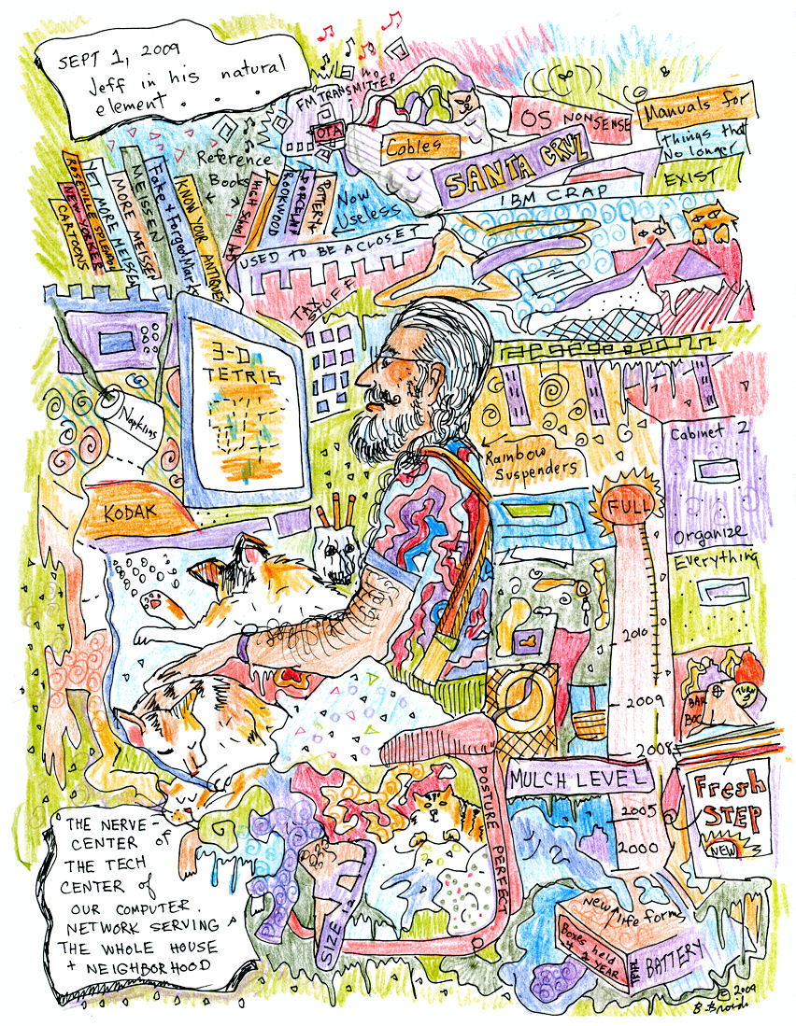
6 Context – finding your element
ELEMENT
Personal creativity flourishes when an individual finds their 'element': the particular contexts and challenges in which they can fully utilise their aptitudes, abilities, talent and enthusiasm for doing something, because they care deeply about what they are doing and are motivated to perform in a committed and inspired way to achieve things they value.
MEDIUM
For an artist his medium is his painting, drawing, sculpture or other artform,
It includes his materials and tools. For a writer his medium for self-expression is the words he writes and it includes his tools – paper/pen, wordprocessor.
‘Jeff in his element’
Notes:
The context in which people work, study, play and socialise includes the medium through which they are able to express themselves through what they do and how they do it. The medium is an agency or means of doing and accomplishing something. In the context of personal creativity it is the means or mode of creative expression.
If you’re doing something creative, you have to be working in a medium. My experience is that the most creative people love the medium that they work in. Musicians love the sounds they make. Writers love words. Mathematicians love the abstractions that numbers make possible. Engineers and architects love building things (Robinson 2007).
For an artist the medium includes his artistic expression (drawing, painting, sculpture, performance, film or other artform) and it includes the materials and tools he uses to create his art.
For a writer his medium for self-expression is the words he writes be with a pen and paper (old technology) or a computer / wordprocesseor or perhaps a blog on a website (new technologies) which are the means to writing.
For a performer like a footballer, his medium is the football field and the game of football which enables him to interpret and interact with the ebb and flow of the game to utilise his talents and skills to play football.
Finding the medium or media for creative self-expression is an important and continuous search across and through all the spaces and opportunities in our life if we want to find joy and live a fulfilled and meaningful life.

Slide 28
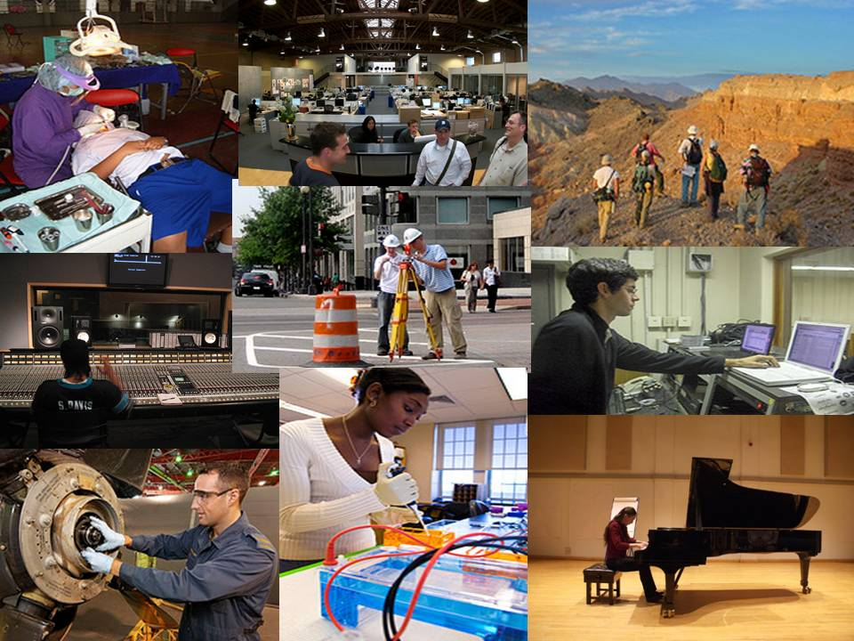
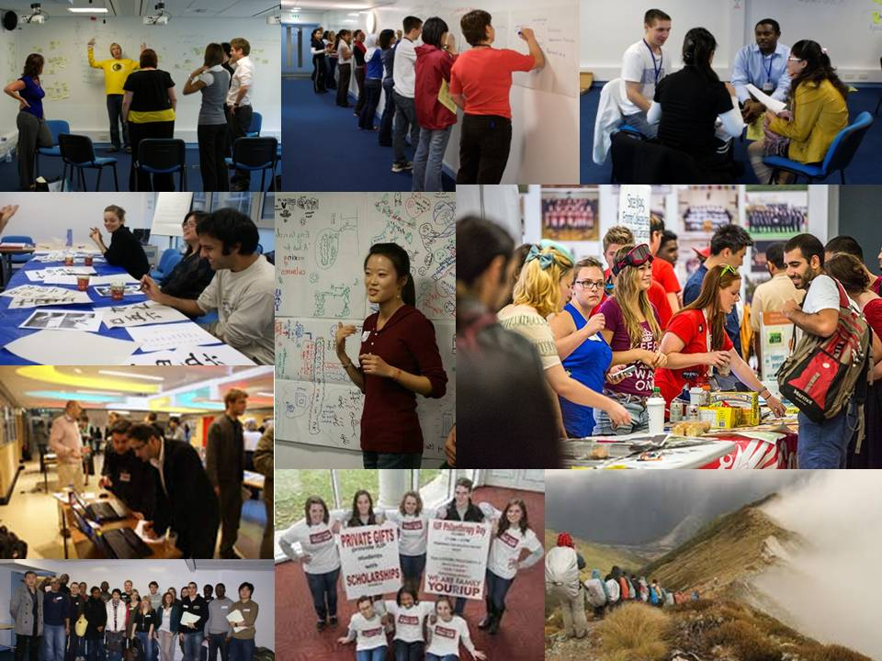
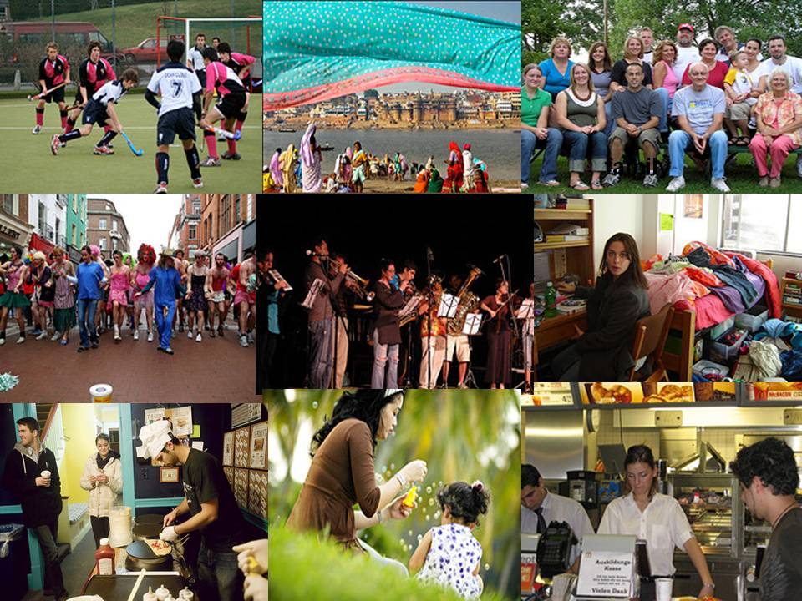
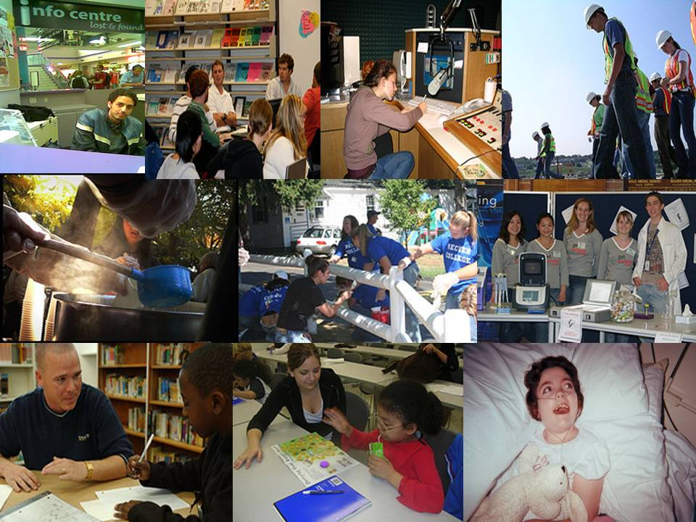
Notes:
So the trick is to enable learners to find and create experiences that enable learners to finds their 'element': the particular contexts and challenges in which they can fully utilise their aptitudes, abilities, talent and enthusiasm for doing something, because they care deeply about what they are doing and are motivated to perform in a committed and inspired way to achieve things they value.

Slide 29
Student Beliefs n=309 :
Where do you feel you are at your most creative?
never
creative
in my room
dancing
when Im relaxed
In the Tourism society
after studies
at home
in my writing,
a place that there are going to be people who will encourage
an inspiring place (seaside)
organising an event
lying in bed trying to get to sleep
playing sport-
in the shower or on the toilet
while travelling
socializing with friends
water polo team
work
romance
group meetings, brain storming and exchanging ideas with others
projects and technical things
in performance
designing research
trying to fix/make/improve something
when I do things I like & enjoy doing
trying to entertain my 1 year old
In my photography
generating new ideas for Entrep. society
doing manual work DIY/anything technical
fashion designing
writing music
painting and writing essays
in my personal life
when it comes to debate
when I interact with others
organising new, exciting events.
when I am working in teams
thinking of new business opportunities
horse riding
cooking something
when I teach
Dj'ing
when I am given a leadership role
when I’m in my home country
teaching a Salsa lesson
as a musician
when I am passionate about something
oral presentations
living abroad because I have to adapt
on the tube/train by yourself,
when I am in a quite place
through my internship
when I make or decorate something
I am not a creative person
I am sometimes creative
I am often
creative
always
creative
Notes:
This idea is born out by student surveys

Slide 30
6 Lifewide Contexts
FUTURE
o
t
h
e
r
CPD
Lifelong learning:
All learning activity
undertaken throughout
life with the aim of
improving knowledge,
skills and competencies
within a personal, civic,
social and/or employment-
related perspective
(Commission of European
Communities 2001)
formal
education
family /
home
interests/
hobbies
work
PRESENT
Lifewide learning: All learning and personal development that emerges through activities in the multiple contexts and situations we inhabit contemporaneously at any point in our life, with the aim of fulfilling roles and achieving specific goals, and continuously developing knowledge, understanding, skills, capabilities, dispositions and values within personal, civic, social and/or employment-related contexts.
PAST
Notes:
There are two dimensions to our learning and development enterprise. Lifelong – continuous journey from cradle to grave and lifewide.
Lifewide learning adds important detail to the broad pattern of human development by recognising that most people, no matter what their age or circumstances, simultaneously inhabit a number of different spaces .
It does this by recognising that most people, no matter what their age or circumstances, simultaneously inhabit a number of different spaces - like work or education, being a member of a family, being involved clubs or societies, travelling and taking holidays and looking after their own wellbeing mentally, physically and spiritually. So the timeframes of lifelong learning and the multiple spaces of lifewide learning will characteristically intermingle and who we are and who we are becoming are the consequences of this intermingling.
We live out our lives in these different spaces and most people have the freedom to choose which spaces we want to occupy and how we want to occupy them. In these spaces we make decisions about what to be involved in, we meet and interact with different people, have different sorts of relationships, adopt different roles and identities, and think, behave and communicate in different ways. In these different spaces we encounter different sorts of challenges and problems, seize, create or miss opportunities, and aspire to live and achieve our ambitions. It is in these spaces that we create the meaning that is our life.
Different spaces, different temporal rhythms, managing our lives
The learning experiences that an individual undergoes simultaneously will themselves be associated not only with different timeframes but with forms and spaces of learning that have different rhythms. For example in the space of 24 hours we might inhabit spaces relating to work, the classroom or self-study, we might inhabit a family environment or our own home, we might go shopping, socialise with friends, travel on public transport or by car, play some sport and do any number of things in different sorts of spaces, not to mention the virtual spaces we access through our smart phones, computers or other devices.
Each of these activities has its own rhythm; fast and slow time jostle and compete and we have to manage our time and determine priorities as the various responsibilities are heeded. So lifewide learning helps us develop capability to manage ourselves and our lives. Banks et al in a report for the NSF Funded Life Centre Learning In and Out of School (2007) tell us that lifewide learning includes
'experience in management of ourselves and others, of time and space, and of unexpected circumstances, turns of events, and crises. This learning brings skill and attitudinal frames for adaptation. Here we figure out how to adapt, to transport knowledge and skills gained in one situation to another, and to transform direct experience into strategies and tactics for future use.'
So it is through our lifewide activity and experiences that we learn to manage our busy lives, cope with the unexpected, adapt to situations as they emerge and transfer our understandings and capabilities between different contexts, and use this self-knowledge in planning for the future.
So the timeframes of lifelong learning and the multiple spaces of lifewide learning will intermingle and who we are and who we are becoming are the consequences of this intermingling.

Slide 31
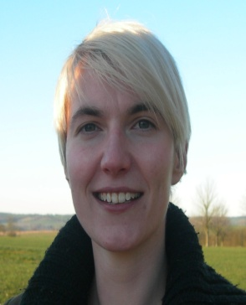
P E R S O N A L
https://www.youtube.com/watch?v=ThZSbKXlVow
N
O
W
family /
home
interests/
hobbies
formal
education
work
o
t
h
e
r
LIFEWIDE LEARNING
LIFEWIDE LEARNING
Formal
Intended
Need
Directed
Planned
De-contextualised
Informal
Unanticipated
Interest
Self-directed
Emergent
Contextualised
A
L
L
&
S I G N I F I C A N T
Notes:
The important characteristic of lifewide learning is that it embraces a comprehensive understanding of learning, development , knowledge and knowing and achievement. Lifewide learning includes all types of learning – learning that is developed in formal educational environments which is directed or self managed.. Intentional or unintended. Interest or needs driven and learning which emerges during the course of activity. But all this only has meaning when you personalise it so here is an example of personalised learning, development and achievement
5min VIDEO WHEN YOU WATCH THE VIDEO TRY TO IDENTIFY THIS STUDENT’S OUTLETS FOR CREATIVE SELF EXPRESSION
What does lifewide learning mean to this psychology student called Sarah who summarises six years of her life between leaving school and starting a doctoral programme?

Slide 32
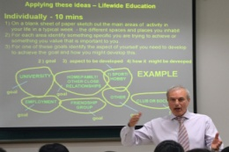
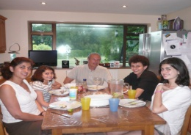
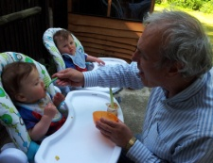
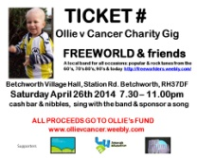
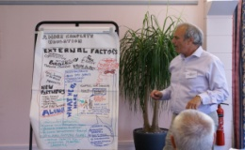
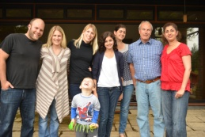
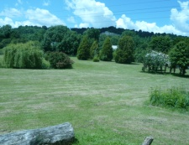
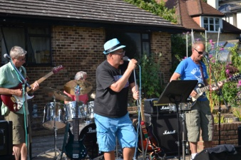
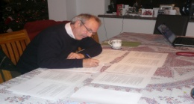
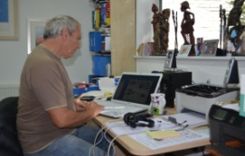
6 Lifewide contexts for personal creativity
work
travel
o
t
h
e
r
family & home
virtual
hobbies
5 min ACTIVITY LIFEWIDE SPACES FOR CREATIVITY
Create a map of the different parts of your life – label the parts in ways that make sense to you
In which parts of your life do you feel you are able to be creative and WHY??
What medium(s)/tools facilitate creative self-expression?
Notes:
Because we are the integration of all of our experiences past and present, I believe that the concept of lifewide is the most comprehensive and inclusive framework within which we can understand learning and therefore personal development.
A lifewide map of the places and spaces we inhabit also helps us reveal the affordances for creative self-expression across our life.

Slide 33
My affordances for creativity
work
travel
o
t
h
e
r
family & home
virtual
hobbies
High affordance
1) WORK (interest/complexity/ambition/freedom/play)
2) BAND (freedom/collaboration/play)
Which medium(s) facilitate creative self-expression?
words/pictures/processes 2) music
What tools help you express yourself creatively?
1) laptop/word/paint/photoshop/ Web 2.0 & Social Media
2) drum kit
Notes:
Because we are the integration of all of our experiences past and present, I believe that the concept of lifewide is the most comprehensive and inclusive framework within which we can understand learning and therefore personal development.
Our planning and aspirations for personal and professional development and our reflections on how we have developed lie in the lifelong dimension but our actual personal and professional development lies in our day to day, thinking, activities and experiences -

Slide 34
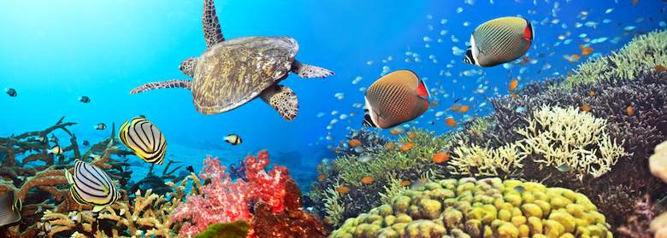
7 Ecology
Ecologies- a complex set of relationships among the living resources, habitats, and residents of an area for the
purpose of living
Learning ecology (Jackson 2013:14)
the complex set of relationships we create in a particular context for a particular purpose that provide us with opportunities and resources for learning, development and achievement
Notes:
Within the ecosocial systems we inhabit everyday we create our own ecologies for learning, development and achievement
An individual's learning ecology comprises their processes and contexts, relationships, networks, interactions tools, technologies and activities that provides them with opportunities and resources for learning, development and achievement. Organised educational settings provide ecologies for learning into which learners fit themselves but outside formal education settings self-created learning ecologies are essential to the way we learn and develop in work, family and other social settings. The ability to create our own processes for learning and development is perhaps the most important capability we need for sustaining ourselves in a complex, ever changing and often disruptive world and for maintaining our sense of wellbeing.

Slide 35
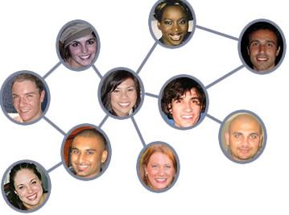
7 Ecology
PAST
CONTEXTS
RELATIONSHIPS
CONNECTIONS
RESOURCES
LEARNING ECOLOGY
created for a
PURPOSE
creativity
emerges
FUTURE
PROCESSES
CAPABILITY, KNOWLEDGE, CONFIDENCE & METACOGNITION
Notes:
An Ecological Perspective on Creativity
We tend to think of creativity in the context of a specific thing - a sudden insight that helps solve a problem. But at an entirely different scale we might speculate that individuals' creativity is paramount to their creation of entire ecologies for learning and achieving. This is a particularly useful concept for students to grasp as it helps them make sense of the way in which they structure and orchestrate their learning lives. It's also important for teachers to realise that students have rich learning lives beyond their study programme.
An individual's learning ecology comprises their processes and set of contexts, relationships and interactions that provides them with opportunities and resources for learning, development and achievement . Organised educational settings create their own ecologies for learning into which learners have to fit themselves but outside these settings self-created learning ecologies are an essential component of the way we learn and develop in work, family and other social settings. They are the means by which we connect and integrate our experiences from the past to the present and the means by which we create meaning from the whole of our life. Because they are an act of unfolding creation they are an important focus for our personal creativity.
Components of a learning ecology
Learning ecologies (Jackson 2013a:14) 'the process(es) we create in a particular context for a particular purpose that provides us with opportunities, relationships and resources for learning, development and achievement'.
This definition represents the integration and interdependence of the elements of learning and achievement which include the contexts and spaces we inhabit, including our history, relationships and resources, (the most important being knowledge and tools to aid thinking), and our will and capability to create a learning process or learning ecology for a particular purpose.
Such actions may be directed explicitly to learning or mastering something but more likely they will be primarily concerned with performing a task, resolving an issue, solving a problem, or making the most of a new opportunity.
Learning ecologies have temporal dimensions as well as spatial and contextual dimensions: they have the capability to connect different spaces and contexts existing simultaneously across a person's life-course, as well as different spaces and contexts existing in different time periods throughout their life-course.
Jackson, N. J. (2013a) The Concept of Learning Ecologies, in N. J. Jackson and G.B. Cooper (eds) Lifewide Learning, Education and Personal Development E-book Chapter A5 available on-line at http://www.lifewideebook.co.uk/conceptual.html
Jackson, N. J. (2013b) Learning Ecology Narratives, in N. J. Jackson and G. B. Cooper (eds) Lifewide Learning, Education and Personal Development E-book Chapter C4 available on line at: http://www.lifewideebook.co.uk/research.html
Jackson, N.J. (2014) Lifewide Learning and Education in Universities & Colleges: Concepts and Conceptual Aids in N Jackson and J Willis (eds) Lifewide Learning and Education in Universities and Colleges Chapter 1 available at: http://www.learninglives.co.uk/e-book.html

Slide 36
Ecology of Personal Creativity
RELATIONSHIPS & CONNECTIONS
Field of Practice/Personal Learning Networks /Collaborations
PROCESS
PAST
PERSON
CONTEXT
Purpose
Problems,
Challenges &
Opportunities
CULTURE
Domain
Organisation
Society
Expertise
Capability
Thinking
Skills
Character
Motivation
Connections - PLN
CREATIVITY
RESOURCES
'the emergence in action of a novel relational product growing out of the uniqueness of the individual on the one hand, and the materials, events, people, or circumstances of his life' Carl Rogers (1960)
Notes:
We can integrate these different perspectives on creativity into a model of how creativity works in the work environment.
This is a model of self-directed learning.
Individuals with all their expertise, capabilities and unique ways of thinking about their world are motivated to engage with a challenge or opportunity that might be familiar or unfamiliar to them. Assuming they have the capability to tackle the issue they use their imaginations to consider possibilities and eventually through deliberation and imagination, ideas are brought into existence which they refine and put into action by creating a process to achieve their goals that is appropriate for their contexts. They draw on resources and relationships that are available and create new resources and relationships to achieve their purpose. Through their relationships they form alliances and collaborations with people who share their interests and goals. The culture of the environment may or may not be supportive but even if the enterprise is hindered the forces that drive it may enable those who participate to overcome obstacles and difficulties they encounter. The whole enterprise might be framed within the idea of an ecology for learning, creativity, development and achievement.

Slide 37
Teacher created ecology for learning & creativity
RELATIONSHIPS
Learners / Teacher / others
RELATIONSHIPS (networks)
Learners / Teacher / others / things
LEARNER
LEARNERS
Motivations
Knowledges/Capabilities
Thinkings
Characters
PROCESS/ACTIVITY
Motivation
Thinking
TEACHER
RESOURCES
& TOOLS
TEACHER
Motivation
Knowledge/expertise
Thinking
Character
Capability
Motivation
Character
Capability
Thinking
RESOURCES
& TOOLS
PAST
Character
CULTURE
Respect,
Recognition,
Encouragement,
Emotional support,
Affiliation
CULTURE
Respect,
Recognition,
Encouragement,
Emotional support,
Affiliation
PROCESS
SPACES
& PLACES
CREATIVITY
PEDAGOGIC CONTEXT
Problems, Challenges &
Opportunities
PEDAGOGIC CONTEXT
Purpose, Problems, Challenges,
Opportunities & Control
Notes:
Teachers also create ecologies for the purpose of learning. They are the designers and implementers of the set of conditions to encourage certain forms of learning and achievement. Effectively they are controlling or directing the learning ecologies of learners.

Slide 38
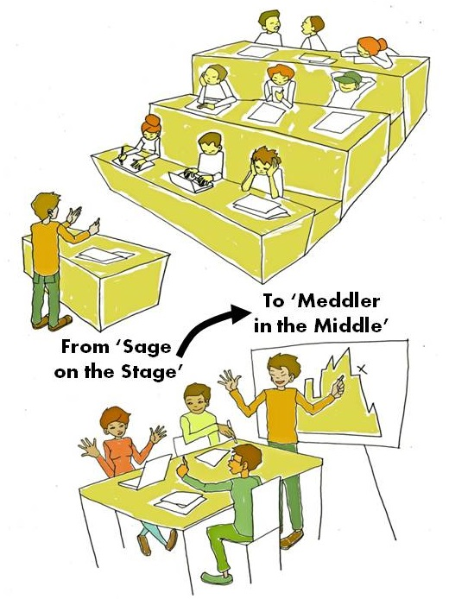
Pedagogic influence on learning ecology
McWilliam (2009)
three pedagogic stances
1 'sage on the stage'
(knowledge transmitter)
2 'guide on the side' (facilitator)
3 'meddler-in-the-middle' (an
involved co-learner/co-producer
in the learning process).
My addition
4 advocate & supporter of self-directed learning
Notes:
An appropriate pedagogic stance
Critical to students' creative development is the teachers' pedagogic stance which McWilliam (2009) categorises into one of three types - 'sage on the stage' (knowledge transmitter), 'guide on the side' (facilitator), and 'meddler-in-the-middle' (an involved co-learner/co-producer in the learning process). In her view the promotion of students' creativity is best served by teacher as 'meddler' (ibid: 290):
Meddlers have clear intentions about what they do, and they are energetically up and doing it. “Command-and-control” is not the ethos that drives their actions, nor is their teaching by any means laissez-faire. They provide support and direction through structure- rich activity in which they themselves are highly involved. They do not take over the work of thinking and doing....
A teacher who “meddles-in-the-middle” is active and engaged. They have high expectations and provide a high level of support, in the knowledge that neither of these dispositions by themselves will make for better learning outcomes. Meddlers anticipate that they have a responsibility to induct their students into communities of creative practice... Meddlers create opportunities for hands-on, minds-on and, where appropriate, plugged-in learning collaborations. They challenge more long-term notions of “good” teaching in a number of ways. Specifically, their pedagogy involves:
less time spent on transmission and more time spent on working through problems in a way that puts everyone in the thick of the action;
less time spent on risk minimization and more time spent on experimentation, risk- taking and co-learning;
less emphasis on teaching as forensic classroom auditing and more time spent on designing, editing and assembling knowledge;
less time spent on testing memorization and more time spent on designing alternative forms of authentic assessment;
less time spent on psychological counseling and more time spent on collaborative criticality and authentic evaluation.
The pedagogic task for teachers who intend to develop students' creativity is threefold. Firstly, it is one of developing learners' understandings of their own creativity by facilitating metacognitive development through self-observation, recording of experience, and reflection and self-inquiry. Understanding one's own creativity is through the development of a narrative that describes the process and the points at which creative thoughts and acts emerge. The development of insights is aided by the sharing of perspectives and understandings within the group of learners including the teacher.
Secondly, it is about enriching their understandings with knowledge about creativity and its role in human endeavour and achievement. This knowledge is likely to include: 1) the conceptual tools that will enable learners to appreciate and make sense of their own creativity, 2) their own personal knowledge and understandings of creativity derived from trying to achieve something they value and 3) the personal knowledges of creativity shared by peers and teachers with whom they are connected in collaborative learning projects.
Thirdly, from a teaching and learning perspective, it is about providing novel and challenging opportunities and situations for the learner to use and develop their creativity. Affordances for student creativity within the academic curriculum are greatly enhanced if teachers adopt pedagogic stances that are facilitative, enabling and empowering, open and responsive to possibilities, collaborative and mutually co-creative and which value learners' own learning processes as well as the outcomes from such processes. Pedagogies that encourage active (rather than passive) learning, and which encourage creative responses include social learning in contexts such as problem-based, enquiry-led, work- based, context-based, making, enterprise-led, game-play and role-play.
There is a fourth pedagogic position which is where the educator tries to relinquish control and encourage and support (through mentoring/coaching) students’ self-directed learning. This is perhaps easiest to achieve in project based work or in contexts and situations that extend outside the academic curriculum. Potentially, this approach provides the greatest affordances for creativity and creative development since motivations are likely to be intrinsic and decisions and judgements about what to do and how to do it are being made by the learner themselves.

Slide 39
Pedagogic Task – relating to creative development
1 To enrich learners’ understandings about creativity and its role in human endeavour and achievement
2 To develop learners' understandings of their own creativity by facilitating metacognitive development through self-observation, recording of experience, and reflection and self-inquiry.
3 To provide novel and challenging opportunities, activities and situations for the learner to use and develop their creativity
Or to create educational designs that enable learners to find or create their own challenges, opportunities and situations in which they can use and develop their own creativity
4 To create the means to assess & recognise learners’ creativity
Notes:
Above and beyond the pedagogic task of developing learners’ subject knowledge and skills.
The pedagogic task for teachers who intend to develop students' involves doing four things.
Firstly, it is about enriching their understandings with knowledge about creativity and its role in human endeavour and achievement. This knowledge is likely to include: 1) the conceptual tools provided in Guide 2 which will enable learners to appreciate and make sense of their own creativity, 2) their own personal knowledge and understandings of creativity derived from trying to achieve something they value and 3) the personal knowledges of creativity shared by peers and teachers with whom they are connected in collaborative learning projects.
Secondly, it is one of developing learners' understandings of their own creativity by facilitating metacognitive development through self-observation, recording of experience, and reflection and self-inquiry. Understanding one's own creativity is through the development of a narrative that describes the process and the points at which creative thoughts and acts emerge. The development of insights is aided by the sharing of perspectives and understandings within the group of learners including the teacher.
Thirdly, from a teaching and learning perspective, it is about providing novel and challenging opportunities and situations for the learner to use and develop their creativity.
Fourthly – its about creating the means to assess and recognise learners’ creativity
Affordances for student creativity within the academic curriculum are greatly enhanced if teachers adopt pedagogic stances that are facilitative, enabling and empowering, open and responsive to possibilities, collaborative and mutually co-creative and which value learners' own learning processes as well as the outcomes from such processes. Pedagogies that encourage active (rather than passive) learning, and which encourage creative responses include social learning in contexts such as problem-based, enquiry-led, work- based, context-based, making, enterprise-led, game-play and role-play.

Slide 40
CURRICULUM /PEDAGOGIC REVIEW & DESIGN TOOL
Situations that encourage self-regulation & favour emergence of creativity
OPPORTUNITY FOR LEARNERS TO
experience contexts that are unfamiliar
experience novel tasks and challenges
experience real word situations
create their own ecologies for learning & achieving
use their imaginations to design, invent, adapt and/or develop something
make something or make something happen
take risks without being penalised for not fully succeeding
reflect and grow personal understandings about their own creativity
gain recognition for personal creativity
PEDAGOGIC APPROACHES THAT
foster intrinsic motivation
immerse the learner in challenging, solution-finding situations and tasks
involve inquiry-rich approaches to learning and problem working
are rich in peer2peer interaction and collaboration
involve teacher as co-creator ‘meddler or facilitator’ not just a transmitter
require and provide space for reflection to enable learners’ to understand their own creativity
utilise portfolios or other strategies for recording, curating and communicating learning, creativity and achievement

Slide 41
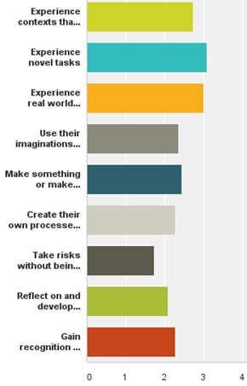
Teaching & Learning Strategies
that encourage creativity
To what extent is the curriculum
in your discipline providing opportunity for learners to?
To what extent do you use
pedagogic approaches that?
1= not at all 2 = Occasionally 3= Often 4 = Extensively

Slide 42
Active learning practices that encourage students’ creativity

Slide 43
IMPORTANT FEATURES
OF CREATIVITY
Using imagination
Being original - new ideas /
perspectives/things /solutions * Being curious / inquiring /
find solutions * Being resourceful * Being able to combine,
connect, synthesise etc * Being able to think critically,
analyse, evaluate * Being able to think reflectively
/ empathically
*Being able to represent ideas
and communicate meaning to
others & form / tell stories
create a process for learning
Notes:
Evidence suggests that involving undergraduate students in Inquiry-Based Learning and research-type activities promotes the development of research ‘mindedness’, enhances learner motivation and engagement, develops graduate attributes and complex achievements, supports progression and retention, and prepares students for an uncertain and complex future (e.g. Brew 2006, Healey & Jenkins 2009; Levy et al. 2011). There is also evidence that this approach creates an environment conducive to collaborative learning, empowering students to engage in learner-led, peer-supported learning activities and to become co-creators of their own learning experience.Inquiry is the basis for all research and scholarship in the disciplines but it is also the key learning process in all knowledge development processes and is what sustains the ecology of the university (Boyer 1999).
Inquiry-Based Learning is an umbrella term to describe a range of active learning approaches that are driven by a process of enquiry. Khan and O'Rourke (2004) outline the main characteristics of IBL:
Engagement – with a complex problem or scenario – that is sufficiently open-ended to allow a variety of responses or solutions.
Students direct the lines of enquiry and the methods employed.
Figure 9 Representation of IBL process (Levy et al 2011)
The enquiry requires students to draw on existing knowledge and identify what else they need to know Tasks stimulate curiosity in the students, encouraging them to actively explore and discover new evidence to support the formulation of solutions.
Responsibility falls to the student for analysing and presenting that evidence in appropriate ways and in support of their own response to the problem.
IBL can be developed in any academic discipline. For example, in sciences it is fundamental to conducting
experiments, in technology for the testing and evaluation of materials and the building of prototypes, in natural sciences it is the basis of field investigations, in medicine PBL can form the basis of the whole curriculum, and IBL is the basis for individual and collaborative research in all disciplines. It can be used for whole programmes/modules or as discrete activities built into lectures, seminars, laboratory work, fieldwork or co-curricular activities. IBL may be undertaken as an individual project but it more typically a collaborative project in which learners work in small groups.
The EBL process can be represented as a cycle (shown in slide) involving: developing questions, making observations, negotiating and agreeing tasks, undertaking research to find out what information is available, recording and collating information, developing methods for surveys or experiments, developing instruments for data collection, collecting, analyzing, and interpreting data, developing tools and frameworks for analysis, discussing possible explanations and solutions, negotiating and agreeing the content of reports and making presentations that have to be defended, and then reflecting on the process of doing and learning.
Banchi and Bell (2008) identify four levels of inquiry through which learner autonomy and self-management increases (Table 2). Open inquiry activities are only successful if students are motivated by intrinsic interests and if they are equipped with the skills to conduct their own research study

Slide 44
Combining inquiry-rich learning, design, making & selling
Using the experience as a resource for learning
FROM THIS TO
A CREATIVE LEARNING ECOLOGY
DESIGN
MANUFACTURE
MARKET
REFLECT ON – what would
we do differently next time?
SELL

Slide 45
Lifewide Learning &
Educational Practice
Learner – takes an inclusive
& self-directed view of their
own learning and development
University – takes an inclusive
view of students’ learning
& development and provides a
framework and support for
self-directed learning &
achievements

Slide 46
University of Surrey 2006-2011
13,500 students - 9000 ugrad + 4500 pgrad
Multicultural campus 27% international + culturally diverse UK students
Research intensive + strong commitment to professional education
Four Faculties: Management and Law, Health and Medical Sciences
Arts and Human Sciences, Engineering and Physical Sciences

Slide 47
Lifewide Curriculum (Jackson 2011)
HONOURS
DEGREE
CO & EXTRA-CURRICULAR AWARDS
commitment to own personal and professional development
Extra-curriculum
Academic
curriculum
Mentoring
Caring for others
Work-related
curriculum
Work placement
related to area of study or integration
theory & practice
eg health and social care programmes
Work including PT jobs and internships
Sport
Co-curriculum
learning spaces
outside formal
curriculum
Travel
Study abroad
Running own
business
Volunteering
& social enterprise
Creative
enterprise
Student Representation & Societies
Notes:
Lifewide Curriculum Paradigm
One of the objectives of helping learners prepare themselves for a lifetime of living and working with complexity is to be able to enact successfully, knowing-acting-being, in lots of different contexts and situations. Consequently, there is an argument for expanding the scope of the higher education learning enterprise to embrace all of a learner's contexts and situations while they are studying at university (Jackson 2011).
Many universities in the UK are beginning to adopt the idea and practice of lifewide learning, personal development and education. Explicitly or implicitly they are adopting the concept of a lifewide curriculum (Jackson 2011, 2014) to embrace an educational design that seeks to empower and enable a learner to incorporate and integrate their learning from any aspect of their life into their higher education experience.
The concrete expression of a lifewide curriculum as depicted in Figure 3 contains three or four different curricular domains:
1. academic curriculum, which may by design integrate real-world work or community-based experiences;
2 work-related curriculum which is linked to a programme but does not receive academic credit
3. co-curriculum: experiences provided by the university that may or may not be credit-bearing and for which learners may or may not receive formal recognition;
4 extra-curriculum: experiences that are determined by the learners themselves and constitute all the spaces that they inhabit outside the other domains.
The distinction between co- and extra-curricular has been deliberately blurred in some universities as experiences that would be considered to be extra-curricular in Figure 2 have been incorporated into the co-curriculum. Each of these curricular domains have their own affordances for students' creative development.

Slide 48
Recognition of Lifewide Learning, Development & Achievements
Notes:
Surrey Lifewide Learning Award – a scheme to encourage, recognise and value lifewide learning and achievements
Jackson et al (2011) describe a scheme at the University of Surrey which embraced the ideas and ideals outlined above. The Award Framework comprised an overarching award and a family of certificates underpinned by a lifewide learning capability and values statement which embodied capabilities, dispositions and values that are considered necessary to deal with and create situations in any context. Within them explicit reference is made to Being creative and enterprising: you need to be creative, enterprising and resourceful to invent new solutions, adapt to changing circumstances in novel ways and create new opportunities for yourself.
The Award did not gain academic credit and it was not attached to any level of the UK HE Qualification Framework. Participation was voluntary and it required a learner to recognise the intrinsic value and benefit of engaging in this type of learning experience. The Award was made to a student who was able to demonstrate learning and personal development through their co-curricular and extra-curricular experiences, in line with the requirements for the award. A minimum involvement of 150 hours of experience-based and reflective learning was required. Students decide what experiences to include in their portfolio but they have to demonstrate new learning and personal development against the award’s capability and values statement (Appendix 1). Guidance is provided through a dedicated website http://www.surreylifewideaward.net/ which also contains examples of students' lifewide learning and development.
To demonstrate their personal development students created:
a Life Map to show the areas in their life where they were learning/developing
a personal development plan to show how they were attempting to develop the core capabilities for the award
a 2000 word reflective account drawing out the ways in which they developed paying attention to the award capability statement (Appendix 1)
a portfolio documenting or illustrating the experiences they drew on for their personal development.
Judgements as to whether a learner deserved the Award were based on:
their commitment to their own personal development through self-directed and unplanned activities over a period of time while they are studying at the University
their self-awareness - their ability to recognise that they are learning and developing in different ways through their lifewide experiences.
their ability to explain and communicate their self-awareness of learning, personal development using the tools and frameworks provided and their overall perception of how they have
changed as a result of participation and self-evaluation.
their honouring of the self-directed learning process and completion of requirements.

Slide 49
I want to become a doctor
Level 1 biosciences student University of Surrey
What learning ecology do I need
to create to become a doctor?
BSc Biosciences
CHALLENGE FOR HIGHER EDUCATION
How can we support and recognise the learning, development
and achievement involved in becoming a doctor?
Notes:
ASSUMPTIONS
1 If we assume that an individual’s deep intrinsic motivation comes from actualising themselves becoming the person they want to become – then it is likely that their creativity will be associated with their process of becoming.
2 If we assume that these deep motivations will create the will to do everything that is necessary to develop in ways that will enable the person to become who they want to become and we can be certain that they will create their own ecology for learning and development.
3 If HE is serious about encouraging and helping learners to achieve their potential and recognising learning and development that goes well beyond the academic curriculum then
the challenge for HE becomes in one of supporting and recognising the learners lifewide learning, development and achievement

Slide 50
EXAMPLE LEARNING ECOLOGY
Level 1 international student (2009)
Friends: As an international student, it is difficult to be away from my home and family. Friends, therefore, become a new kind of family…
BSc Study Programme : I am studying biosciences but I want to study medicine at postgrad level. I study about 20h per week learn through lectures, lab practicals, books/papers, discussions with friends
Looking after myself
Domestic chores
Shopping
Entertainment
music, cinema, meeting friends
University Tutoring
and Mentoring
I work at a Combined Learning Centre for students with learning disabilities and/or behavioural problems. I worked one-on-one with three different students, one of whom had Aspergers Syndrome
Sport – uni netball team
Playing as a part of a team allows me to develop my inter-personal and communication skills, and always gives me a feeling of satisfaction. It lends a sense of unity and strength- when we put on our match uniforms, we know that we are no longer individuals, but part of something that is bigger than ourselves.
Volunteer - St John’s Ambulance service
I joined St Johns’ Ambulance, to learn first aid and general safety measures. I think this is an essential part of not just University life but life in general. Taking part in that course allowed me to feel more secure in my ability to deal with emergencies. As I hope to study Medicine as a Postgraduate degree, I found the course interesting and engaging.
Organising and leading a group of volunteers to work during the summer vacation in Uganda
Notes:
Here is an example of how the award enabled one student to demonstrate her lifewide development.
This is an example of a student’s life map in her first year in 2009. Her ultimate ambition was to become a doctor although at this stage she was studying for a biosciences degree. To achieve her ambition not only will she have to perform very well in her degree, she will have to show commitment to the values that are expected to underlie medical practice and develop a wide range of capabilities, qualities and dispositions that are not necessarily developed in an academic environment. What she is doing to develop herself in ways that are consistent with becoming a doctor for the pathway she is taking is her learning ecology.
Being a doctor requires so much more than technical knowledge – skills, qualities, values and dispositions that have to be developed in ways other than a programme of study. Her personal ecology involves participating in many different activities and social groups. In engaging in this process she is beginning to represent her personal ecology for becoming a doctor.

Slide 51
Personal Development Plan
1 Personal goals
areas of significant challenge/opportunity
2 WHAT aspects of yourself do you want to develop?
3 WHY is this important?
4 HOW do you intend to develop & demonstrate it?
5 WHAT capabilities, qualities, values dispositions will be developed?
Use award capabilities and values statement as prompt
PDP should make provision for unplanned learning
Notes:
Personal Development Plan For the award she extracted her personal goals from each of the areas of her life and identified the aspects of herself that she wanted to develop, why this was important to her and how she would try to develop it. This was her personal development plan. We will focus on one aspect of her PDP which was to organise a group of volunteers to spend part of their summer vacation helping run a school and medical centre in Uganda. The aspects of herself she wanted to develop were related to her leadership and organisational skills and to gain some experience of working in a medical centre.

Slide 52
unfamiliar problems
familiar
context
unfamiliar
context
familiar problems
Notes:
Using Stevenson's contexts and problems map we can see that she was pushing herself and taking the group of volunteers out of their comfort zones into cultural contexts they had never experienced before to deal with totally unfamiliar problems. There was no supervision by teachers and this is a good example where the university would deem it unethical to put students into such a risky situation without adequate support or supervision. But the students were choosing to do this themselves.
In the space of about a year – four students raised nearly £1000 for Mukano Medical Centre primarily to provide mosquito nets, they collected 200 books and sent them to the school library. They spent time with children in a Ugandan village and got involved in teaching and sex education and saved the life of one young girl by securing her aids treatment and a home with a family member. After returning they set up a new student association to continue raising money to help send students to Uganda to continue the work they had started.
You can watch a short video recording her story at http://www.youtube.com/watch?v=gECPBQ3J_PU and appreciate some of the complexity in the experience she helped create which provided her with opportunity to be creative.

Slide 53
Creating and representing meaning
SHOE BOX!
BLOG
SCRAPBOOK
E-PORTFOLIO
VIDEO DIARY
DIGITAL STORY
VIDEO FILM
SLIDE SHOW
https://www.youtube.com/watch?v=gECPBQ3J_PU
Notes:
Lifewide Learning & Development Portfolios
The portfolio is the physical or virtual medium for students to record and represent their learning and development. Its role is intended to encourage learners to develop the habit of thinking about and recording their experiences, drawing out deeper meanings and understandings in the process. They are not intended to be showcases of best work but honest appraisals of life experiences and their own performance in the experience and learning from the experience. They are their accumulated narratives of learning.
Although the requirements for the award specify that a portfolio be produced containing various documentary artefacts (life space map, personal development plan, evidence of ongoing reflection, final written reflective account and updated CV), the presentation of this portfolio is entirely the choice of the individual. This freedom to choose reinforces the self-managed ethos that underpins the award and allows for creative self-expression.
Adopting this reasoning, participants in the Lifewide Learning Award were able to choose the format and style of portfolio but they were required to demonstrate an ongoing and regular engagement with it. The emphasis is on commitment to a process of critical reflection rather than purely listing or describing activities.
The portfolios submitted for the award pilot in 2010-11 were rich and diverse.Some students used blogs and e-portfolios, enabling them to blend or connect technologies and resources such as digital images, audio and video.
In contrast some students opted with enthusiasm to produce a physical portfolio in the form of a scrapbook rich in images and mementos of the events that they had experienced as well as the textual descriptions and reflective evaluations.
We discovered that having a conversation with students and inviting them to talk about their portfolios was an excellent way of bringing out the detail in the narrative learning. Simply because questions could be asked to gain deeper insights into why something was significant and
Narrative themes
A number of recurrent themes can be recognised in the experiences that students describe in their lifewide learning portfolios and integrating accounts, namely:
employability and career related experiences
personal, emotional or spiritual wellbeing / overcoming or coping with challenging situations
travel and being immersed in new cultures or countries
involvement in societies or clubs either as an organiser or participant
personal interests and hobbies
volunteering, caring for others and mentoring
being creative and enterprising including running their own business
When portfolios and integrating accounts are audited for their content, generalised patterns of responses can be identified namely 1) career, employability and development for being an effective professional 2) personal growth and self-actualisation 3) combination of these orientations.
Participants were expected to show, in their personal accounts, how their learning and development relates to the Capability and Values Statement. This was achieved by relating aspects of their account to specific items in the statement - an audit process.

Slide 54
My Learning Ecology – an inclusive view of learning, developing and achieving in higher education
‘becoming the archaeologist I want to be’
organising
a student archaeology conference
Final
year
project
participating
in numerous excavations
volunteer
Young Archaeologists Club
THREE YEARS LEARNING ARCHAEOLOGY &
BEING/BECOMING AN ARCHAELOGIST
attending archaeology conferences
MY COURSE
Homeless Heritage
excavation
& exhibition
The Posthole editorial team
MY GOAL
to learn archaeology
past knowledge, experience
interests and orientations
Notes:
But what does a learning ecology in higher education actually look like? The slide illustrates the ecology developed by Michael an archaeology student who graduated from the University of York in 2013. The learning ecology map shows all the things he did while he was studying for his degree that enabled him to become the archaeologist he wanted to be.
He says ‘My degree course formed the backbone to my learning about archaeology. It provided me with contacts with people who were also interested in my subject and enabled me to develop a mind-set that encouraged me to engage with [the subject] ....But some of the best opportunities for me to learn how to be an archaeologist lay outside my degree course (Jackson 2013b:5).
These archaeology-related activities that were additional to his course, included: joining the editorial team of the student archaeology magazine, participating in numerous archaeological digs organised by research students, academic staff or other organisations, joining the Homeless Heritage project organised by a post-graduate student, helping to organise an exhibition, participating in several conferences and, at the end of his course, leading and organising a national conference for archaeology students. At weekends he also volunteered at the Young Archaeologists Club working with school children. These experiences were highly influential in his overall development as an archaeologist.
Being an archaeologist involves 'digging' to expose artefacts through which we can interpret the past. Unfortunately, my course only provided a four week introductory fieldwork course so I joined a number of 'digs', six in total run by two different PhD students, a member of the academic staff, a commercial company, and an external public organisation. Overall I probably spent over three months on excavations which gave me valuable insights into how to organise and conduct a dig, how to conduct various types of surveys, how to prepare, identify and display artefacts and beyond this how to work as a member of a team. The commercial digs I undertook introduced me to the world of commercial archaeology and the different approaches and mindsets that are used in the commercial world. (Jackson 2013b:7).
And some of his extra-curricular experiences profoundly affected him as a person.
One of these projects had a particular significance for me. Homeless Heritage.....is dedicated to working with homeless communities in order to understand and value the spaces used by such communities using archaeological methods. But it is more than archaeologists just applying archaeological techniques to the study of spaces that a particular group of people use: it involves working with homeless people in order to understand the relevance of what is found. In this way I was able to form friendships with people I would never have come into contact with in my student life. I began to appreciate the problems of homeless people and to see the world through their eyes. The experience enabled me to understand the value of contemporary archaeology, but I also began to see a new relevance of what I was doing, through it I became interested in the ways archaeology can be used to engage communities. (Jackson 2013b:8)
He also used his opportunity at university to complete the extra-curricular York Award but this was a means of gaining recognition rather than the award itself providing encouragement and support for him while he was engaged in them.
This developmental narrative provides a useful demonstration of how the idea of learning ecologies can be applied to undergraduate higher education. It shows that the process of learning, being and becoming is not simply confined to the structure, content and assessment of a pre-determined course. Rather we see how his intrinsic motivations, his desire to become a good archaeologist, form the central purpose around which he creates his personal learning ecology. An unfolding and sustained process that embraces not only his course but also contains within it all the other opportunities for learning that he has accessed or created for himself. We can see that this process involved a multitude of processes, each with their own purpose connected by his overarching goal, a multitude of relationships involving people associated with the course and the university, and some people who are in the wider world, and a multitude of contexts within which learning, development and achievement are accomplished.
We see his learning ecology being used not just to learn about archaeology, or even to be an archaeologist but to become a certain type of archaeologist and beyond this we see Michael discovering that what he really enjoys doing is working with people. The narrative reveals how he discovered the particular aspects of being an archaeologist that he enjoyed and valued, and in that process how he found a possible way of continuing the ways of being that he valued through employment after university.

Slide 55
My Learning Ecology
becoming the archaeologist I want to be
Interest-driven learning and development
When my
creativity
flourished
organising
a student archaeology conference
Final
year
project
participating
in numerous excavations
volunteer
Young Archaeologists Club
THREE YEARS LEARNING ARCHAEOLOGY &
BEING/BECOMING AN ARCHAELOGIST
attending archaeology conferences
MY COURSE
Homeless Heritage
excavation
& exhibition
The Posthole editorial team
MY GOAL
to learn archaeology
past knowledge, experience
interests and orientations
Notes:
I response to the question – where do you feel you had the greatest opportunity to be creative? He identified three experiences that stood out.
All were characterised by self-determined / self-directed learning one within the curriculum two outside. Each of these comprised its own learning ecology within which he had the freedom to express himself creatively.
This sort of pattern has been replicated in many other conversations with students.
My proposition is that by being inclusive in the way we view the affordances for students’ creativity, we can embrace more systematically the idea of inclusivity via creativity.

Slide 56
Example of incorporating lifewide learning in the curriculum
Students as Teachers Inclusivity Project University of Plymouth
4th year undergraduates at Peninsula School of Medicine spend 6 months undertaking a Special Study Unit (SSU) called Doctors as Teachers.
Students taught at two secondary and two primary schools, with a high proportion of pupils from disadvantaged backgrounds
They produced and delivered educational health promotion outreach activities to help raise aspirations of primary, secondary school pupils, teachers, parents and carers
Notes:
4th year undergraduates at Peninsula School of Medicine spend 6 months undertaking a Special Study Unit (SSU) called Doctors as Teachers. The aim is to enable students to develop aspects of professionalism and the skills of a competent teacher to prepare for a role educating the public and training future doctors. Most of the projects in this unit involve preparation of learning tools related to medical knowledge/clinical skills which are delivered to peers. The longitudinal nature of this SSU allows time for each student to create, develop, deliver and evaluate their resource.
This particular project combined pedagogy with widening participation (WP) and social engagement. It developed the professional education of the medical students but also promoted the importance of individuals having an equal chance and education as a strong determinant in life opportunities and a major contributing factor to patterns of poverty and inequality. The school children received health and science education in an aspiration building context.
Two secondary and two primary schools, with a high proportion of pupils from disadvantaged background, were identified through established partnerships
The medical profession is consistently dominated by those from the highest socio-economic backgrounds with only 7% coming from the lower three socio-economic classes (HESA Student Record 2002/03 and 2010/11, 2012).
An independent review on social mobility and child poverty conducted by Alan Milburn in May 2012 highlighted the need for fair access to the medical profession and the positive implications that a diverse medical sector workforce would have on the health of the nation. The British Medical Association made clear in 2009 that “doctors should be as representative as possible of the society they serve in order to provide the best possible care to the UK population”.
The Medical Schools Council has recently set up an executive working group to make rapid progress in supporting aspiration amongst the lower socio-economic groups and increasing the number of successful applicants from such groups on to medical degree programmes.
Accrued disadvantage aside, the choice to go to university and even more to study medicine for pupils from a working class background is counter cultural and the decision process will be greatly influenced by teachers, guardians and peers^{1 & 2}.
Outreach activities have been shown to not only raise aspirations but to raise educational achievement ³.
The challenges here were to adapt the SSU to incorporate WP and promote health and well-being to school children and to trigger a change in attitudes of staff and current students at PUPSM.
The objective of this SSU for the medical students was to produce a short series (approximately 4) of educational, health promotional and inspirational outreach activities to build on the aspirations of primary and secondary school pupils, their teachers, parents and carers.
In essence the majority of the activities set out to convey messages of health promotion, education, aspiration to achieve at school and raising awareness in the children, their families and teachers about healthy lifestyle and the realistic prospect of a career in medicine.
The medical students should develop their professionalism skills and attitudes, particularly when interacting with young/adolescent children and their teachers and guardians. This experience will be invaluable for future practice when they will encounter people of different ages, class and professions. They should also gain the knowledge and skills required of a competent teacher, such as lesson/activity planning, inspirational and effective delivery and become familiar with the basic
principles of learning and teaching and the obligation to educate the public. They should also improve their group work skills and identify their own learning needs and those of this age range. Students also have the opportunity to evaluate and reflect on the resource and their experiences. In addition it was hoped that all involved gained an understanding of the importance of widening participation for society as a whole.
This case study illustrates the merging of pedagogy and WP and could be categorised as: enabling diverse approaches to learning student engagement with the community celebrating diversity
WP addresses under-representation of certain social/cultural groups in HE. In medicine staff from disadvantaged backgrounds are severely under-represented. As part of our strategy to widen participation in medicine we have developed 5 themes. Two of these involved engaging with children in primary schools and secondary schools in areas of deprivation. As part of this strategy, a compact partnership was developed with Plymouth City Council.
Teaching and learning resources were developed by the students with advice and support from academic and school staff.The activity for children, aged 5 to 7, was based on the Teddy Bear Hospital, and a ‘roundabout’ of activities related to health education and current topics covered in the curriculum. For the secondary school pupils, activities were centred on airways and asthma, linked to their current science topics. These were delivered in stations at the Clinical Skills Laboratory. For both age groups the introductory and closing sessions aimed to motivate the children to consider the real possibility of a career as a doctor.
The major change from previous Doctors as Teachers projects was the inclusion of outreach to young people, along with their families and teachers. In addition the projects required the student to collaborate with other medical students as well as teachers and families of the school children, increasing their range of interaction to different ages and SES.
The main problems included the level at which to pitch the resources and their delivery and the scheduling of the activities, which were not always convenient for the majority of parent/carers to attend.
1. Sacker, A., Schoon, I., and Bartley M. Social inequality in educational achievement and psychosocial adjustment throughout childhood: magnitude and mechanisms. Social Science and Medicine. 2002;55(5):863–80.
2. Reay, D., David, M., And Ball S. Making a Difference?: Institutional Habituses and Higher Education Choice. Sociological Research Online. 2001;5(4).
3. Miller J, Smith C. Raising aspirations and widening participation: an evaluation of Aimhigher in Herefordshire and Worcestershire. Research in Post-Compulsory Education. 2011;16(2):231–48
Learning Gateway Roland Levinsky Building
Inclusivity Development Learnig Support and Wellbeing
T. 01752 587676 E. lsw@plymouth.ac.uk

Slide 57
My ecology for learning within which my creativity is embedded
PAST LEARNING ECOLOGIES
creativity/learning ecologies
CHALLENGE/PURPOSE
ENGAGING
MY PLN
via twitter
ENGAGING DMU COMMUNITY
ADAPTING
EXISTING
RESOURCES
CREATING & UTILISING NEW
KNOWLEDGE RESOURCES
CURATING & SHARING
KNOWLEDGE RESOURCES
On-line Survey, Links
Presentation & Videos
CONFERENCE TALK & DISCUSSION
POSSIBLE CONTRIBUTIONS
VIA SOCIAL MEDIA & POST
CONF CONVERSATIONS
FUTURE : NEW INTENTIONS
FOR LEARNING
Notes:
Outside formal education we continually build learning ecologies to accomplish tasks in everyday life that require us to learn. For example, here is a representation of my learning ecology to develop myself and my resources for your conference.
1) I drew on past learning ecologies and the resources I had developed through them including my learning about learning ecologies – learning ecology
2) I developed and posted the online survey based on previous surveys
3) I prepared a web page to enable my resources to be curated and shared with you
4) I shared my ideas through my presentation which included feedback on the results of the survey
5) I encouraged you to post your ideas and questions to #dmucreatives
While the ideas are not new to me the challenge has been in developing and presenting them for the particular context of your conference – it has made me think about what I know differently and also caused me to realise what I don’t know and that I should try to learn more. On this occasion my process has been mainly one of adaptation and recontextualisation but I feel it has become the starting point for a new trajectory of learning and a new ecology for learning.

Slide 58
Creative Academic Community
Lifewide Education Community
http://www.creativeacademic.uk/
http://lifewideeducation.uk

