Slide 1
Evolving Ecosystems for Encouraging, Supporting and
Recognising the Lifewide Formation of Students' in
the English Higher Education System
Norman Jackson
The theme of our conference this year is “Frameworks to encourage,
support and recognise the lifewide formation of students.” From my side,
I would appreciate your consideration of a keynote address on a topic
along the lines of “The step from encouraging to officially recognizing the
lifewide formation of students: challenges and solutions.”
email Chris Picone 3 August 2016
Presentation & article can be downloaded from
http://www.normanjackson.co.uk/icolace4.h
Notes:
In my first talk, I described the idea of learning ecologies. In this talk I want to locate this idea concept within the idea of educational ecosystems.
Being invited to give a talk at a conference is a great catalyst for making you think – sometimes about thing and in ways that you have not done before.
This invitation by Chris Picone got me thinking about the journey we are on in UK HE towards the goal that Chris alluded to in his email. I suppose it's all a matter of perception in that there might be simple solutions to this challenge but the more I thought about it the more I saw it as part of a complex web of developments in the continually unfolding story of how a society shapes its educational institutions and systems in order to prepare learners for their unknown and unknowable future. A future in which harnessing the affordances in the lifewide dimension of their life in order to achieve and sustain themselves and their society will be the major lifelong challenge for most people.
Its an enormous challenge to change an educational ecosystem whether it’s a school, college, university or whole education system so that it values and is supportive of students’ lifewide learning.
In my talk I want to try to do things.
1) provide a conceptual framework for viewing higher education as an ecosystem - more accurately a constellation of evolving ecosocial systems that interact and change over time. There are currently about 160 higher education institutional ecosystems in the UK higher education ecosystem and each one is evolving along its own unique trajectory along with numerous 'other organisational agents' that contribute to and influence the ecosystem as a whole.
2) to provide some examples of how the UK higher education ecosystem has evolved and is evolving to encourage, support and recognise what we term 'lifewide learning and development'

Slide 2
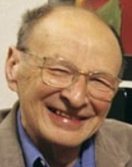
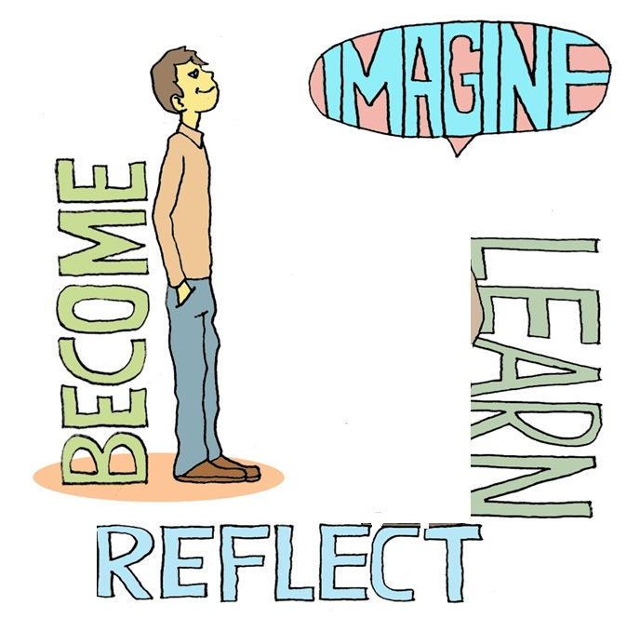
Concept of Educational Ecosystems [Bronfenbrenner]
Macro system
social/ political/economic influences SOCIETY / GOVERNMENT / ECONOMY
Exo system
INSTITUTION : leadership, culture, infrastructure, frameworks, policies,
tools, resources for learning and the support/regulation of practices
agencies of the state
Meso system
sites for interaction/learning created by teachers
and others who support student development
Micro system
Competitors & other institutions
other institutions and their practices and the
wider community of HE practitioners
programme of study / modules
co-curricular opportunities
professional & statutory bodies
other independent agents in the HE system
employers
personal ecologies for learning
inside and outside the institution
ecologies for learning created by others
secondary education
Notes:
Conceptual framework for viewing Higher Education as a complex ecosystem
Urie Bronfenbrenner, a developmental psychologist, introduced his ecological paradigm for interpreting human development, 'in order to understand human development, one must consider the entire ecological system in which growth occurs' (Bronfenbrenner 1994:1643).
Bronfenbrenner's work culminated in his theory of ecological systems (Bronfenbrenner 1999). His conceptual framework highlights the nested nature of ecosocial systems. A personal interpretation of his model, in the context of UK higher education, is provided in Figure1.
Slide My interpretation and representation of Bronfenbrenner's model of the nested structure of ecosocial systems. The ecosystem comprises PEOPLE interacting with other PEOPLE in their unique institutional environments each with their own cultures, policies, structures and infrastructures, to engage in social practices (teaching, mentoring, coaching and other means of supporting students' learning and development). Each level of the ecosystem interacts with the level above and below. It must also be appreciated that the UK higher education ecosystem is open to influences from the global ecosystem of higher education ecosystems.
A) The microsystem embraces all the situations and circumstances of an individual's life. This is the level at which we encounter situations, make decisions and plan what to do and how to do it and the level at which we act and use our capability (everything we know and can do) to deal with a situation. This is the level at which we reflect on our experiences and the effects of our actions. This is the level at which we create our own ecologies for learning, developing and achieving (the focus of my second conference contribution).
B) The mesosystem encompasses the interactions of people with particular physical and social settings like school, college, university and work. It involves students' relationships and interactions with their teachers and others who support their learning. In the context of a university course or programme its the level at which students fit into ecologies for learning and achieving that their teachers are creating. It's the level at which guidance and tools are provided to help learners fulfil the requirements for their programme. Appropriately organised activity in the mesosystem enables people to learn more and learn more effectively in their own microsystem.
C) The exosystem is the ecological level at which an institutional culture, policies and practices impacts the affordances for students' learning and development, at the mesosystem level of the course or wider learning experience. For example an educational institution might adopt a lifewide concept of learning and personal development and develop the frameworks to enable learners to gain recognition for achievements in the different parts of their life, not just their academic course. They might also develop tools like e-portfolios to encourage and enable learners to record their experiences and develop policies that encourage educational practices that value reflection.
Ellis and Goodyear (2010) develop a compelling narrative for viewing the university as a large complex ecosystem involving all the relationships and interactions of all the inhabitants - students, teachers, researchers, support and administrative staff, managers and leaders, and their connections with employers and society more generally, and the resources, physical spaces and virtual environments, processes and practices that are played out day to day. A university ecosystem includes its culture which Seel suggests 'is the emergent result of the continuing negotiations about values, meanings and proprieties between the members of that organisation and with its environment - in other words culture is the result of all the daily conversations and negotiations between the members of an organisation about the way we do things [or perhaps would like to do things!] here'. Written and unwritten rules, procedures and policies that govern and control behaviour within which social (educational) practices are constructed.
D) The macrosystem is the wider society in which the educational institutions and enterprises of the exo- and meso-system are located. It includes the socio-economic, cultural and political contexts within which all activities are undertaken and includes government policies and strategies for promoting and supporting a citizens right to learn. In the case of the UK our macrosystem also includes the political and economic influences of the EU which is very active in the formulation of strategies for education and training, lifelong learning and open learning.
The ecosystems model highlights the connectivity and interdependence of the different parts of a higher education system and the society within which it is located. While the ecosystems can be mapped at any point, these points lie on a trajectory of change. Bronfenbrenner introduced the idea of chronosystem to represent all the changes in an individuals microsystem but the idea applies to change at any of the four ecosystem levels.
Bronfenbrenner, U. (1979). A future perspective. In The ecology of human development: Experiments by nature and design (pp. 3-13). Cambridge, MA: HarvardUniversity Press.Bronfenbrenner, U. (1994). Ecological models of human development. In International Encyclopedia of Education (2nd ed., Vol. 3, pp. 1643-1647). Oxford: Elsevier.

Slide 3
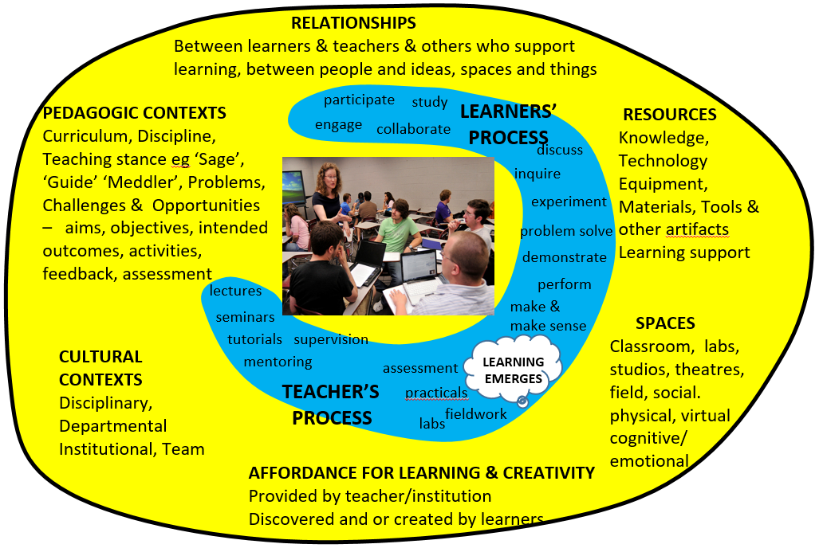
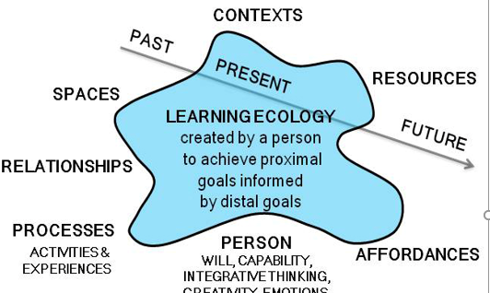
Locating learning ecologies within the institutional ecosystem
Macro system
Exo system
INSTITUTION: leadership, culture, infrastructure, frameworks, policies, tools, resources for learning and the support/regulation of practices
Meso system
sites for interaction,
learning development
employers,
community,
other experiences
outside the university
Micro system
ecologies for learning
created by teachers
& institution
programme of study / modules
support for
learning
outside
institution
ecologies for learning
created by learner
Notes:
Learners’ own ecologies for learning can be located in the microsystem either within the institutional ecosystem (if teachers design the rights affordances) and outside the institutional ecosystem, for example when learners involve themselves in work or community settings.
Ecologies for learning created by teachers and others who support student development are located in the meso system but connect with the exosystem and microsystem.
Slide My interpretation and representation of Bronfenbrenner's model of the nested structure of ecosocial systems. The ecosystem comprises PEOPLE interacting with other PEOPLE in their unique institutional environments each with their own cultures, policies, structures and infrastructures, to engage in social practices (teaching, mentoring, coaching and other means of supporting students' learning and development). Each level of the ecosystem interacts with the level above and below. It must also be appreciated that the UK higher education ecosystem is open to influences from the global ecosystem of higher education ecosystems.
A) The microsystem embraces all the situations and circumstances of an individual's life. This is the level at which we encounter situations, make decisions and plan what to do and how to do it and the level at which we act and use our capability (everything we know and can do) to deal with a situation. This is the level at which we reflect on our experiences and the effects of our actions. This is the level at which we create our own ecologies for learning, developing and achieving (the focus of my second conference contribution).
B) The mesosystem encompasses the interactions of people with particular physical and social settings like school, college, university and work. It involves students' relationships and interactions with their teachers and others who support their learning. In the context of a university course or programme its the level at which students fit into ecologies for learning and achieving that their teachers are creating. It's the level at which guidance and tools are provided to help learners fulfil the requirements for their programme. Appropriately organised activity in the mesosystem enables people to learn more and learn more effectively in their own microsystem.
C) The exosystem is the ecological level at which an institutional culture, policies and practices impacts the affordances for students' learning and development, at the mesosystem level of the course or wider learning experience. For example an educational institution might adopt a lifewide concept of learning and personal development and develop the frameworks to enable learners to gain recognition for achievements in the different parts of their life, not just their academic course. They might also develop tools like e-portfolios to encourage and enable learners to record their experiences and develop policies that encourage educational practices that value reflection.
Ellis and Goodyear (2010) develop a compelling narrative for viewing the university as a large complex ecosystem involving all the relationships and interactions of all the inhabitants - students, teachers, researchers, support and administrative staff, managers and leaders, and their connections with employers and society more generally, and the resources, physical spaces and virtual environments, processes and practices that are played out day to day. A university ecosystem includes its culture which Seel suggests 'is the emergent result of the continuing negotiations about values, meanings and proprieties between the members of that organisation and with its environment - in other words culture is the result of all the daily conversations and negotiations between the members of an organisation about the way we do things [or perhaps would like to do things!] here'. Written and unwritten rules, procedures and policies that govern and control behaviour within which social (educational) practices are constructed.
D) The macrosystem is the wider society in which the educational institutions and enterprises of the exo- and meso-system are located. It includes the socio-economic, cultural and political contexts within which all activities are undertaken and includes government policies and strategies for promoting and supporting a citizens right to learn. In the case of the UK our macrosystem also includes the political and economic influences of the EU which is very active in the formulation of strategies for education and training, lifelong learning and open learning.
The ecosystems model highlights the connectivity and interdependence of the different parts of a higher education system and the society within which it is located. While the ecosystems can be mapped at any point, these points lie on a trajectory of change. Bronfenbrenner introduced the idea of chronosystem to represent all the changes in an individuals microsystem but the idea applies to change at any of the four ecosystem levels.
Bronfenbrenner, U. (1979). A future perspective. In The ecology of human development: Experiments by nature and design (pp. 3-13). Cambridge, MA: HarvardUniversity Press.Bronfenbrenner, U. (1994). Ecological models of human development. In International Encyclopedia of Education (2nd ed., Vol. 3, pp. 1643-1647). Oxford: Elsevier.

Slide 4
Changing an Educational Ecosystem
Macro system
Exo system
INSTITUTION: leadership, culture, infrastructure, frameworks, policies, tools, resources for learning and the support/control of social practices
Meso system
sites for interaction/learning created by teachers
and others who support student development
To change an
institutional
ecosystem
you have to
influence the
exo system
Micro system
programme of study / modules
co-curricular opportunities
personal ecologies for learning
including extra-curricular opportunities
ecologies for learning created by others
Notes:
Individual teachers, especially in UK higher education, have sufficient autonomy to influence the ecologies of learners so that considerations of lifewide learning and development can be addressed – if they want to.. BUT without support at the institutional level you will not get the large scale interventions to systemically support lifewide learning.
Yesterday we heard examples of the favourable conditions in Singapore (and Hong Kong) where top down there is encouragement and support for lifewide learning.. But we also heard about examples where this was not the case. In many educational ecosystems the conditions at the top are not favourable for the support and recognition of lifewide learning, particularly where there is tight control on the content of the curriculum and teachers have relatively little professional autonomy to decide what and how to teach.
If you want to create conditions that are favourable to supporting students lifewide development across the whole institutional ecosystem you have to influence the exo system level of the ecosystem because this is the level where power resides to change policy, allocate resources & develop QA that supports rather than inhibits

Slide 5
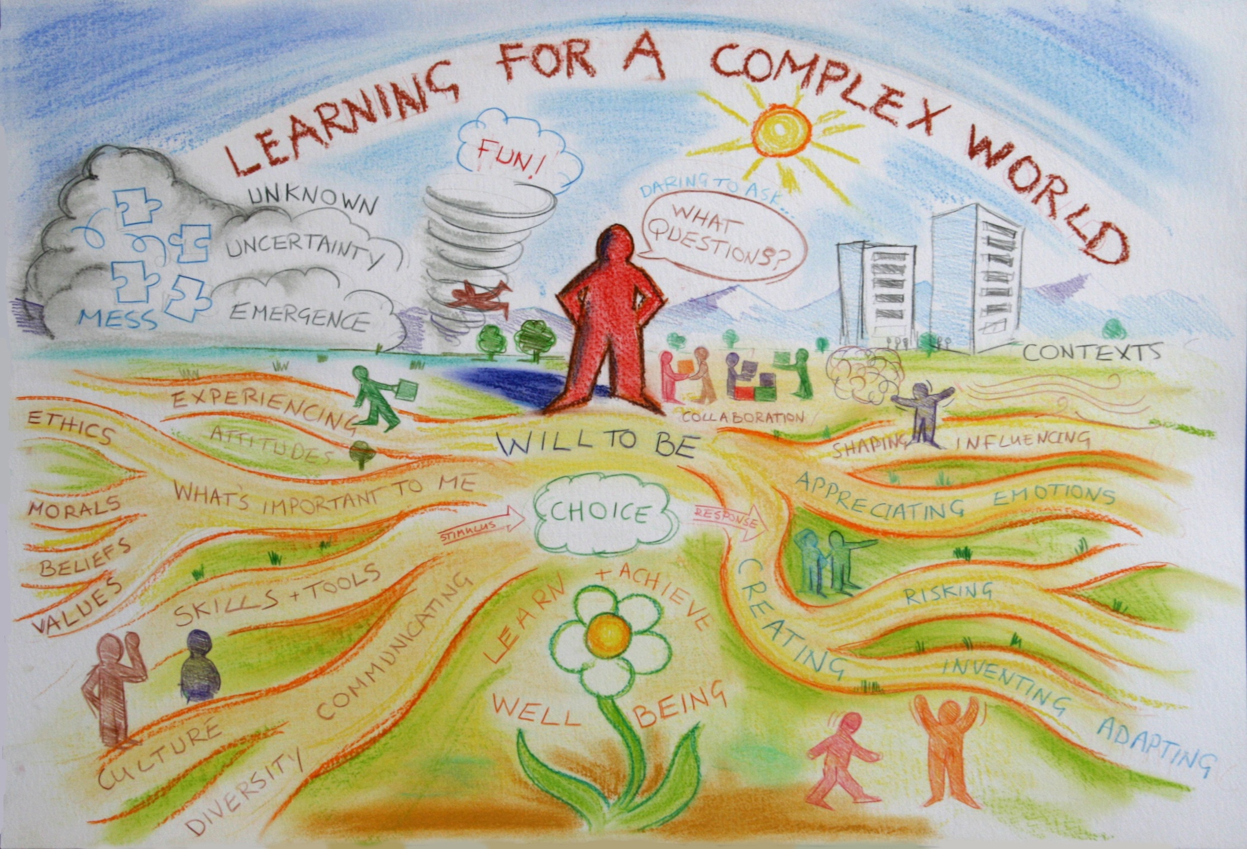
me 1978
D
I
T
Notes:
The ecosystem continually develops in order to try to solve the supreme challenge I elaborated in my first talk. How do we prepare learners/ how do they prepare themselves for a lifetime of grappling with the complexities and disruptions of their future world. How do we equip them to survive and prosper so that our society as a whole can prosper?
Our ecosystem for encouraging supporting and recognising students lifewide development has not been created with this objective in mind rather its an ecosystem that has evolved to meet this wicked problem and support and recognition of lifewide learning is an incidental bi-product of numerous policies and interventions

Slide 6
Map of the English HE Ecosystem ‘support for lifewide learning’
Macro system
Government policies & interventions
Effective, private-funded, state regulated high participation system, serving economy & fit for 21st century
EU Drivers
Lifelong Learning, Future of Learning /
Open Education/ Diploma Supplement /
GLOBAL
COMPETITION
Exo system - institutions
E
M
P
L
O
Y
E
R
S
Employability & Teaching & Learning Strategies
HE Institution Co/Extra-curricular Awards schemes
Personal development planning policies/practices
Higher Education Achievement Report (HEAR)
New technologies / social media
Dedicated professional support
Important Agents/Brokers
Higher
Education
Academy
Quality
Assurance
Agency
Meso system – practitioners & social practice
Ecologies for learning, developing & achieving
created by teachers and others who
support development of students
practitioners & practices in other HEIs
UK & world wide
http://www.hear.ac.uk/
Centre for Recording Achievement
Micro system – individual practice
practitioner networks
AGCAS
Association for careers advisors
Students’ ecologies for learning, developing
& achieving across the whole of their life
Lifewide Education
SCHOOLS, ACADEMIES & COLLEGES
SOCIETY

Slide 7
My own career involvement in the ecosystem ‘for lifewide learning’
Macro system
Government policies & interventions
Effective, privately-funded, state regulated high participation system, serving economy & fit for 21st century
EU Drivers
Lifelong Learning, Future of Learning /
Open Education/ Diploma Supplement /
GLOBAL
COMPETITION
Exo system - institutional frameworks, policies, tools & infrastructure
E
M
P
L
O
Y
E
R
S
Employability, Teaching & Learning & WP Strategies
HE Institution Co/Extra-curricular Awards schemes
Personal development planning policies/practices
Higher Education Achievement Report (HEAR)
New technologies / social media
Dedicated professional support
System Agents/Brokers
Higher
Education
Academy
Quality
Assurance
Agency
Meso system – social practice
practitioners & practices in other HEIs
UK & world wide
Ecologies for learning, developing & achieving
created by teachers and others who support development of HE students
http://www.hear.ac.uk/
Centre for Recording Achievement
supportive agent/broker
Micro system – individual practice
Individuals’ ecologies for learning, developing
& achieving across all parts of their life
Lifewide Education
independent
supportive agent/broker
SCHOOLS, ACADEMIES & COLLEGES
SOCIETY

Slide 8
Evolving Ecosystem for Lifewide Learning
LWE
other
agents
AGCAS
CRA
CRA
CRA
HE Achievement Record
Universities
& Colleges
Co/Extra-curricular Awards
E-portfolios
Progress Files – Transcripts & PDP
HEQC
Graduate
Standards
Project
QAA
Progress Files policy
LTSN/HEA
HE agencies &
representative
bodies
BURGESS
REVIEWS
employability
UUK/GuildHE
HEFCE
HEFCE
NCIHE
Government
its agents &
interventions
E H E
EU Bologna Process – all graduates to have Diploma Supplement by 2005
2003 Government White Paper 'The Future of Higher Education' invited higher education to consider the provision of information about student achievement and the honours degree classification
from 15-45% participation
from state to privately funded
1990
2000
2010
2020
Notes:
Evolving ecosystems for encouraging, supporting and recognising students' lifewide learning, development and achievement
A higher education ecosystem doesn't just come into existence; it is a continually unfolding and emergent process of formation shaped by powerful political and managerial forces and mediated by the passions, interests, creativity and pragmatic responses of individual practitioners, institutions and other agents within the ecosystem. Another feature of an ecosocial system is that things often happen in parallel. New structures, policies and practices are being created and implemented simultaneously in different parts of the system and not sequentially across the whole system. New policies and practices are grown in particular contexts and developed for particular purposes so perceptions about anything are influenced by the local perspectives that people have mediated by any large scale developments that are taking place. Ecosystem development is a messy business and while the narrative outlined below might seem well ordered it is a simplistic linear representation of the emergence of different policies and practices over nearly three decades. Figure 3 shows some of the more important interventions and educational developments over the last 25 years through which UK HE has developed an ecosystem for encouraging, supporting and recognising students' lifewide learning, development and achievement. This is far from complete but it serves to illustrate how key changes in a higher education ecosystem emerge and evolve over time
SLIDE Some of the more important interventions and educational developments over the last 25 years through which the HE system in England has developed an ecosystem for encouraging, supporting and recognising students' lifewide learning, development and achievement.
Abbreviations: EHE -Enterprise in Higher Education Initiative, UUK - Universities UK and GuildHE (these are the current universities and colleges representative bodies, formerly these two bodies were called CVCP - Committee Vice Chancellors and Principals and SCOP Standing Conference of Principals). National Committee of Inquiry into Higher Education Chaired by Lord Dearing, HEFCE - Higher Education Funding Council England, HEQC - Higher Education Quality Council QAA - Quality Assurance Agency LTSN - Learning and Teaching Support Network HEA - Higher Education Academy CRA - Centre for Recording Achievement AGCAS - Association of Graduate Careers Advisors. LWE - Lifewide Education, PDP - Personal Development Planning
New elements and order in the ecosocial system emerges on the scale of years and decades. This pattern is brought about through the continuous interactions and adaptations of ideas, policies, practices and technological advancements through a combination of bottom-up inventions and practitioner movements grown at the level of the micro- and meso-systems, top down interventions from the macrosystem including policies and inquiries emanating from Government and its agents (eg Funding Councils) and independent university representative bodies, and responses to these bottom-up, top down and middle out developments by institutions, agencies and independent agents in the exosystem. The net effect is a system in continuous change and over time the trend is to increase the complexity in the ecosystem as new components are added, piloted and implemented, and then efficiencies and other improvements are sought to connect the components and sometimes integrate them in new systems and processes.
Progress towards an HE ecosystem that encourages, supports and recognises that students' develop through their lifewide experiences is not the result of pursuing this goal. Rather, it is a consequence of pursing a raft of political goals for example - changing the emphasis in the pattern of purposes of a higher education system, increasing the levels of participation in higher education, a stronger emphasis on student employability and enterprise , making the outcomes of a higher education experience more explicit, and providing better information to graduates and employers about the outcomes of a higher education. Perhaps it's also a consequence of encouraging learners to take more responsibility for their own learning and managing their own development. However the net effect of introducing policies to accomplish these goals has been to create an environment which also encourages, supports and recognises that students' develop through their lifewide experiences.

Slide 9
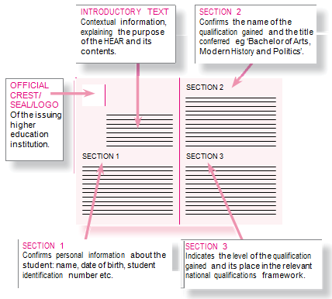
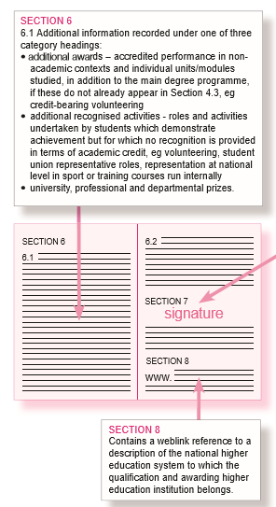
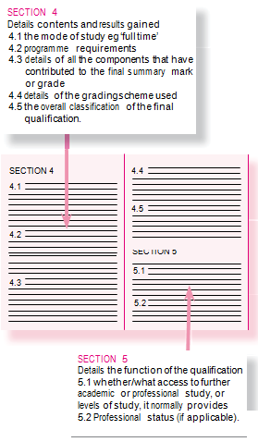
Higher Education Achievement Report: A universal record of achievement which
makes provision for learning gained through activity outside the academic curriculum
Notes:
The HEAR is currently being implemented about half UK universities have implemented or are in the process of implementing.
Comprehensive 6 page document detailing all sorts of things – following requirements of the EU Diploma Supplement except section 6 which details
It’s an important step in the formal recognition of students’ more holistic development while at university - the question is will it be used and valued by employers..
More details at http://www.hear.ac.uk/about

Slide 10
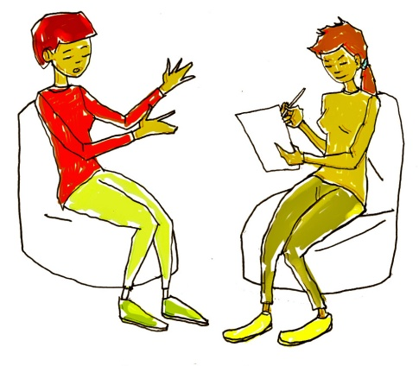
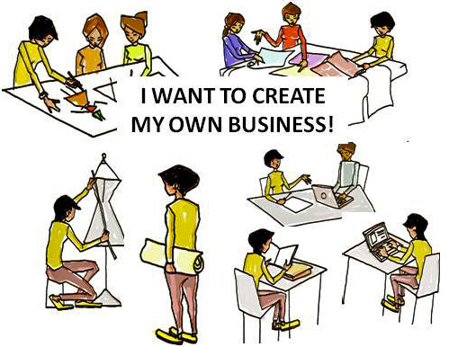
SUMMARY Requirements for a University ecosystem that values,
supports & recognise students’ lifewide development
EMPLOYERS
Institutional Ecosystem culture frameworks, policies, infrastructure
Culture/leadership: all forms of learning and development valued here!
Policies & Strategies eg 1) Employability 2) Teaching & Learning 3)PDP 4) E-learning
Quality Assurance eg validation of awards, external scrutiny, award boards
Frameworks/Awards/Badges: eg HE Institution Co/Extra-curricular Awards schemes
Infrastructure/tools: eg e-portfolios / web 2.0 social media
Responsibility & capacity : eg Careers Department, Students’ Union or other with dedicated professional support eg tutoring, mentoring, coaching, interviewing, validating
Achievement records: Transcripts or Higher Education Achievement Report (HEAR) that
recognize lifewide learning & are USED & VALUED BY EMPLOYERS
GRADUATES
External support
to enable employers
access information
Meso system – social practice
Micro system
Ecologies for learning, developing & achieving
created by teachers and others who support development
of HE students eg
tutoring, mentoring, coaching, interviewing, validating
Individuals’ ecologies for learning, developing
& achieving across all parts
of their life

Slide 11
Approaches used to support lifewide learning in UK HE
involvement in own UNSTRUCTURED experiences + reflections on personal learning that is claimed and assessed
4 Retrospective claim
for learning through
structured form
Recognition through
Certificate or Award
5 Creation of portfolio
and synthesis claim
through personal account
Recognition through
Certificate, Badges or Award
1 Module in
academic programme
Recognition through
academic credit & Hons Degree
2 Module in
co-curriculum
Recognition through
academic credit & Certificate/Award
3 Module in Work-based programme & Accreditation
of Experiential Learning
Recognition through general credit & Hons Degree
involvement in STRUCTURED curriculum experiences taught + reflections on experiences – taught learning is assessed

Slide 12
Approaches to recognising and valuing extra curricular learning
Betts and Jackson (2011) n=50 schemes
1 Holistic Focus
Underpinned by conceptions of whole person development & self-actualisation
HYBRIDS
2 Employability Skills Focus
Underpinned by career development and preparation for future employment
3 Leadership Focus
Encouragement and opportunity to use & develop leadership qualities
Notes:
A UK wide phenomenon
In 2010/11 we undertook a survey across UK HE to find how many other institutions were involved in recognising extra curricular learning and personal development. We discovered over fifty universities either had a scheme or were developing a scheme this is now closer to 70 universities.
Although there is much variation in the way universities are recognising learning and development gained outside the programme there seem to me three main foci.
Holistic – whole person
Employability – major political driver
Leadership-
Our research has tried to identify the key conceptual features that underlie different schemes. While there is much variation and conceptual mixing, our sense is that schemes differentiate at the conceptual level according to whether:
the approach emphasises whole-person education and personal/career development or attention is focused primarily on transferable and employability skills
the environments for learning are predominantly controlled/taught or are predominantly experiential
assessment is primarily through reflective, self-evidencing and reporting or through a tutor-assessed/competency-based assessment
the experiences that make up the award are predominantly extra-curricular (not designed by the institution and not linked to a programme) or co-curricular (institution-designed, linked to or outside a student’s programme)
leadership skills are seen as either implicit or explicit within the scheme
forms of recognition - credit, certificates or badges are awarded
Most schemes contain a mix of these conceptual continua but some schemes tend to one or other sides of the conceptual diagram.

Slide 13
Approach 1 - Information about opportunities
LeedsforLife website shows students opportunities available and the rest is up to them!
Notes:
Vivien Jones, Christopher Warrington & David Gardner (2014) LeedsforLife: Preparation for Lifewide Learning in the Research-Intensive Context CHAPTER B5
http://www.learninglives.co.uk/e-book.html
See also video presentation by David Gardner on same website
http://www.learninglives.co.uk/

Slide 14
Approach 2 Module within the programme
ie part of a students’ degree programme
HONOURS
DEGREE
Make Your Experience Count - students use past learning experiences as a basis for 30 HE credits
Open to anyone, irrespective of educational background. Any type of ‘learning experience’ – formal or informal.
Online module with a dedicated website containing specially authored study materials and supported with a personal tutor
Credit awarded for the description, analysis, reflection and presentation of the processes and outcomes of past learning experiences
Academic
curriculum
Level 1
Module
Notes:
Neil Murray (2014) Make your Experience Count CHAPTER B8
http://www.learninglives.co.uk/e-book.html
MYEC is designed to get students to understand that learning is lifewide and lifelong, occurs in informal as well as formal settings and that reflecting on and acquiring knowledge about how they learn and the impact of what they learn is just as valuable for their future development as the specific, subject-related skills, knowledge and understanding derived from a particular learning episode

Slide 15
Approach 3 - taught & assessed co-curriculum
30 credits of undergraduate level study: framed by its own ‘programme specification’
HONOURS
DEGREE
Academic
curriculum
Buddying, mentoring and peer support;
Career skills and employability;
Community and volunteering;
Cultural awareness, language
learning and study abroad;
Employer-led; Enterprise,
events and project management;
Sustainability; Sports; Internships,
placements and work experience.
+ Co-curriculum
Extra-curriculum
ug Elective
Reflective logs, learning diaries, blogs, SWOT analysis, skills audits and formal assessments used to assess student learning
Notes:
Sarah Speight (2014) The Nottingham Advantage Award Chapter B1
http://www.learninglives.co.uk/e-book.html
Video of talk http://www.learninglives.co.uk/

Slide 16
Approach 4 - Accreditation of Experiential Learning
general credits for experiential learning in work-based learning programmes – could be extended to other forms of lifewide experience
HONOURS
DEGREE
Claims can be from any area of experience
where learning can be articulated and
evidenced through a reflective account
Claims require evidence, cross referencing to
generic level descriptors of the University’s
Qualification Framework, formative review and
formal assessment
Academic
curriculum
Extra-curriculum
WORK
Reflective logs, learning diaries, blogs, SWOT analysis, skills audits used to assess student learning in areas like project management, managing events, community music
Notes:
Carol Costly (2014) Accreditation of Prior Experiential Learning – recognition through general credit
Middlesex University Chapter B9
http://www.learninglives.co.uk/e-book.html
Video of talk
http://www.learninglives.co.uk/

Slide 17
Approach 5 student claims learning from experiences
Retrospective process of reflection on what has been
experienced & learned during University experience
& how this connects to/our enriches course experience
Three ‘stages’ or ‘levels’
1) First year: 2) GOLD at end of final year
3) LEADERSHIP from 2017
1 Students apply using a form in their final year and
attend a short interview
Form encourages description of experiences and reflection
Of learning & development gained in the areas of
Academic development upto 20pts
Work Experience upto 20-60pts
Personal interests upto 20 pts
Elective courses upto 50 pts
Certificate of Achievement + recognition on HEAR
HONOURS
DEGREE
Academic
curriculum
Co-curriculum
Extra-curriculum
Total at least 100pts
Prizes: York Award of the Year; York Award Volunteer
York Award Entrepreneur; Arts Prize; Societies Prize
Global Citizen
Notes:
YORK AWARD FORM INVITES APPLICANTS TO
Using no more than 150 words in each section, provide one example of, and evaluate your approach to, the way you have:
a) tailored your approach or message to a particular audience
b) demonstrated leadership skills
c) used your listening skills to good effect
d) sought to address a personal weakness
Experiences, while you have been at York, have equipped you with the skills and knowledge to:
a) take responsibility for a task or decisions
b) respond to a set-back
c) compete in an international job market
d) solve problems creatively
The evidence is tested in a short 10-15min interview

Slide 18
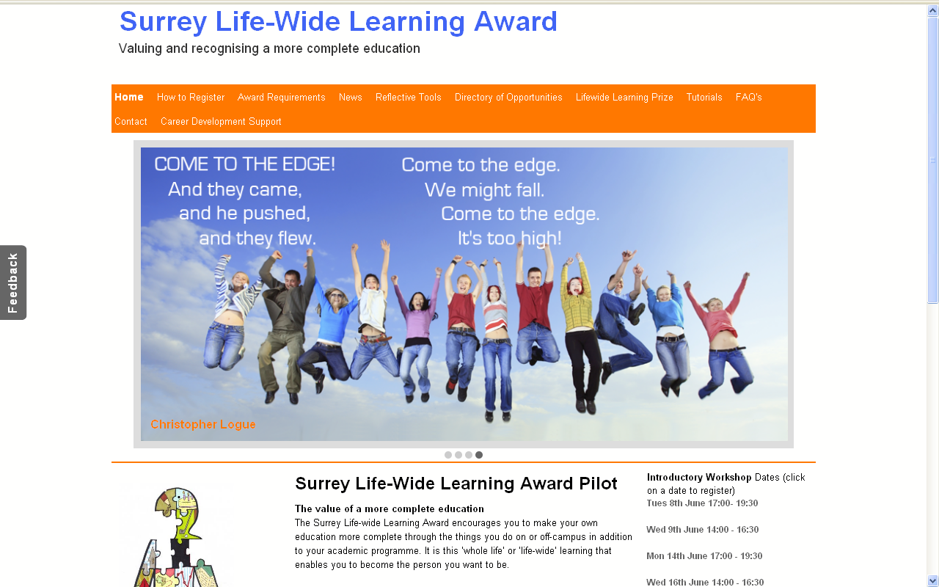
Approach 6 – Lifewide Learning & Development
Students identify aspects of themselves they would like to develop and relate these to opportunities they have in the whole of their life
They participate in any activity co- or extra- curriculum activity that enable them to develop in these ways e.g. part-time work, volunteering, peer-assisted learning, sport, student representation, travel..
They are encouraged to identify and evidence learning against a lifewide learning capabilities & values statement
They document & evidence experiences and learning through writing, audio, video - any medium
They reflect on and provide evidence through a structured account & discuss their experiences and learning with mentor
Gain Certificate of Achievement
HONOURS
DEGREE
Academic
curriculum
Co-curriculum
Extra-curriculum
Notes:
Jackson N., Betts C. and Willis J Surrey Lifewide Learning Award: a learning partnership to support lifewide learning
in N J Jackson (ed) Learning for a Complex World: a lifewide concept of learning, education and personal development Authorhouse
http://www.learninglives.co.uk/e-book.html

Slide 19
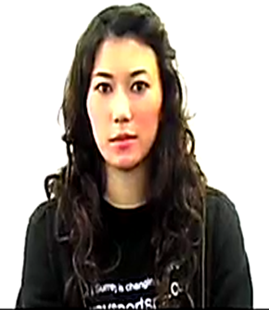
EXAMPLE LIFEWIDE LEARNING & LEARNING ECOLOGY
Naomi -Level 1 international student (2009)
Friends: As an international student, it is difficult to be away from my home and family. Friends, therefore, become a new kind of family…
BSc Study Programme : I am studying biosciences but I want to study medicine at postgrad level. I study about 20h per week learn through lectures, lab practicals, books/papers, discussions with friends
Looking after myself
Domestic chores
Shopping
Budgeting
Entertainment
music, cinema, meeting friends
University Tutoring
and Mentoring
I work at a Combined Learning Centre for students with learning disabilities and/or behavioural problems. I work one-on-one with three different students, one of whom has Aspergers Syndrome
Sport – university netball team
Playing as a part of a team allows me to develop my inter-personal and communication skills, and always gives me a feeling of satisfaction. It lends a sense of unity and strength- when we put on our match uniforms, we know that we are no longer individuals, but part of something that is bigger than ourselves.
Volunteer - St John’s Ambulance service
I joined St Johns’ Ambulance, to learn first aid and general safety measures. I think this is an essential part of not just University life but life in general. Taking part in that course allowed me to feel more secure in my ability to deal with emergencies. As I hope to study Medicine as a Postgraduate degree, I found the course interesting and engaging.
What else can I do to challenge and develop myself?
Notes:
Here is an example of how the award enabled one student to demonstrate her lifewide development.
This is an example of a student’s life map in her first year in 2009. Her ultimate ambition was to become a doctor although at this stage she was studying for a biosciences degree. To achieve her ambition not only will she have to perform very well in her degree, she will have to show commitment to the values that are expected to underlie medical practice and develop a wide range of capabilities, qualities and dispositions that are not necessarily developed in an academic environment. What she is doing to develop herself in ways that are consistent with becoming a doctor for the pathway she is taking is her learning ecology.
Being a doctor requires so much more than technical knowledge – skills, qualities, values and dispositions that have to be developed in ways other than a programme of study. Her personal ecology involves participating in many different activities and social groups. In engaging in this process she is beginning to represent her personal ecology for becoming a doctor.

Slide 20
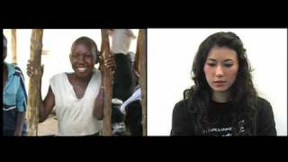
http://www.normanjackson.co.uk/icolace4.html
I want to develop my leadership skills by organising and leading a small group of volunteers to work during the summer vacation in Uganda
Personal Development Activities Plan
1 Personal goals
areas of significant challenge/opportunity
2 WHAT aspects of yourself do you want to develop?
3 WHY is this important to you?
PURPOSE
4 HOW do you intend to develop & demonstrate your development?
5 WHAT capabilities, qualities, values dispositions are you trying to develop?
Use award capabilities and values statement as prompt
PDPs should recognise that significant learning will be unplanned and emergent
Notes:
Personal Development Plan For the award she extracted her personal goals from each of the areas of her life and identified the aspects of herself that she wanted to develop, why this was important to her and how she would try to develop it. This was her personal development plan. We will focus on one aspect of her PDP which was to lead and organise a group of volunteers to spend part of their summer vacation helping run a school and medical centre in Uganda. The aspects of herself she wanted to develop were related to her leadership and organisational skills and to gain some experience of working in a medical centre. The students made a film to document and reflect on their learning. ( you can watch the film on this link http://www.normanjackson.co.uk/icolace4.html
The leader also explains what they did after they returned to the UK which reflected the way they had been transformed.

Slide 21
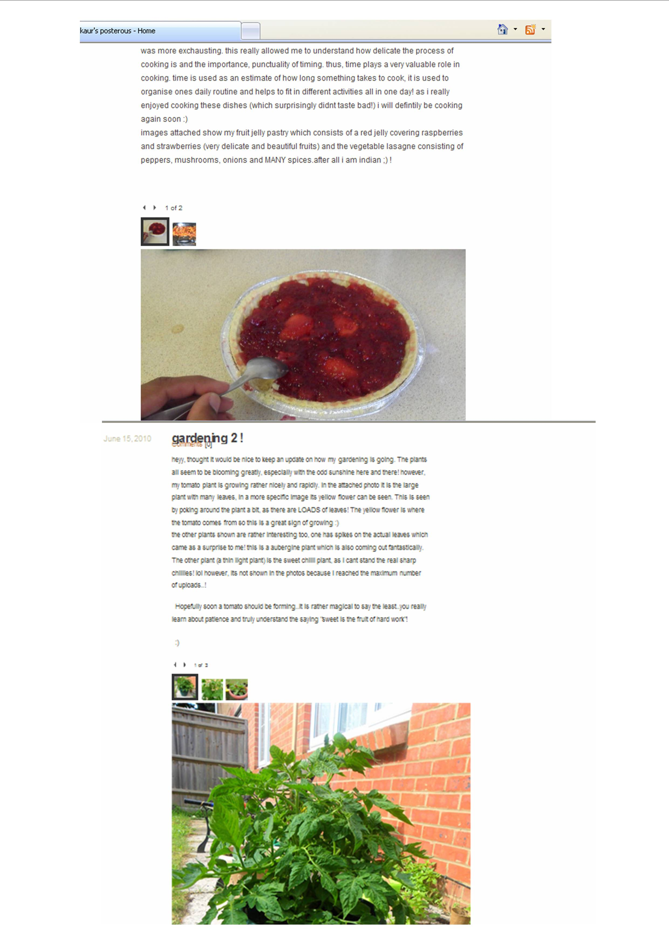
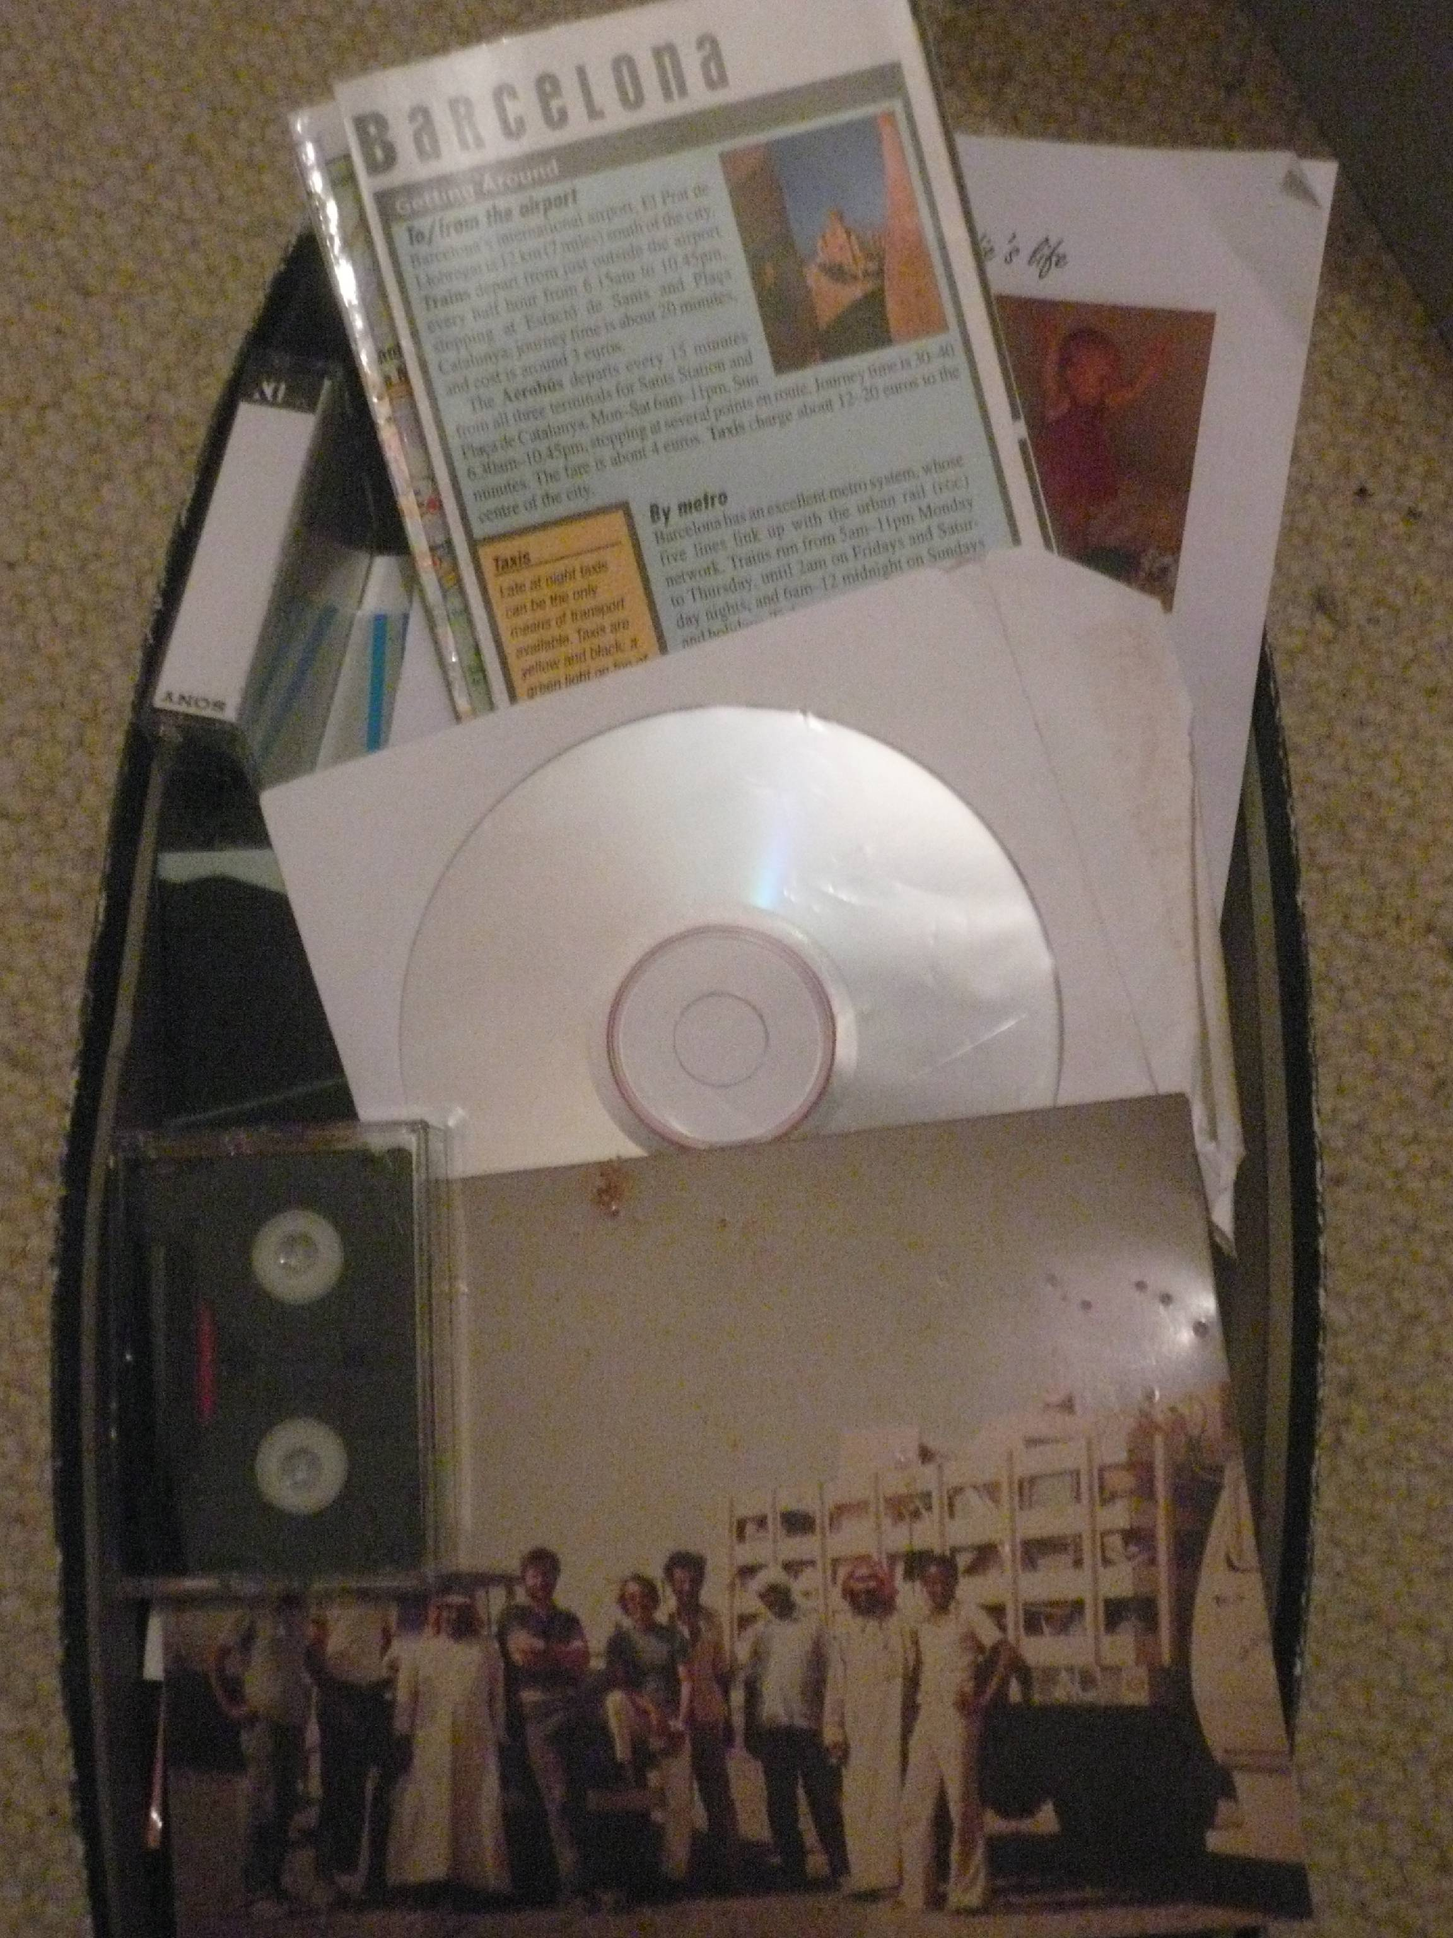
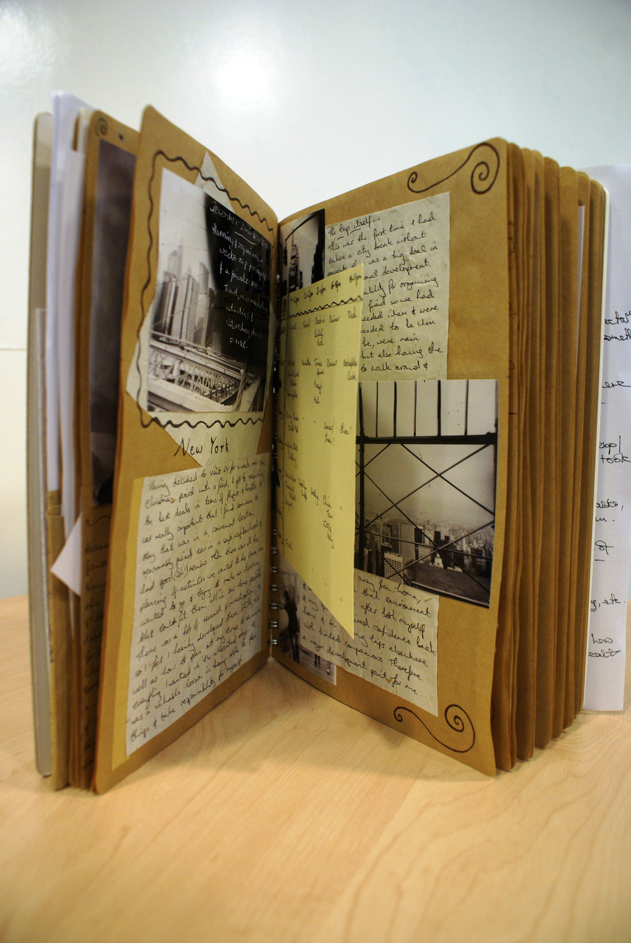
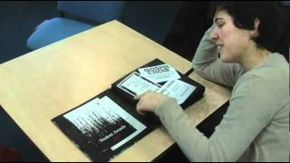
Ecologies for learning & development are revealed in the narratives of trying to achieve something
SHOE BOX!
BLOG
SCRAPBOOK
E-PORTFOLIO
VIDEO DIARY
DIGITAL STORY
VIDEO FILM
SLIDE SHOW
PERSONAL
DEVELOPMENT
PLANNING
Notes:
Lifewide Learning & Development Portfolios
The portfolio is the physical or virtual medium for students to record and represent their learning and development. Its role is intended to encourage learners to develop the habit of thinking about and recording their experiences, drawing out deeper meanings and understandings in the process. They are not intended to be showcases of best work but honest appraisals of life experiences and their own performance in the experience and learning from the experience. They are their accumulated narratives of learning.
Although the requirements for the award specify that a portfolio be produced containing various documentary artefacts (life space map, personal development plan, evidence of ongoing reflection, final written reflective account and updated CV), the presentation of this portfolio is entirely the choice of the individual. This freedom to choose reinforces the self-managed ethos that underpins the award and allows for creative self-expression.
Adopting this reasoning, participants in the Lifewide Learning Award were able to choose the format and style of portfolio but they were required to demonstrate an ongoing and regular engagement with it. The emphasis is on commitment to a process of critical reflection rather than purely listing or describing activities.
The portfolios submitted for the award pilot in 2010-11 were rich and diverse.Some students used blogs and e-portfolios, enabling them to blend or connect technologies and resources such as digital images, audio and video.
In contrast some students opted with enthusiasm to produce a physical portfolio in the form of a scrapbook rich in images and mementos of the events that they had experienced as well as the textual descriptions and reflective evaluations.
We discovered that having a conversation with students and inviting them to talk about their portfolios was an excellent way of bringing out the detail in the narrative learning. Simply because questions could be asked to gain deeper insights into why something was significant and
Narrative themes
A number of recurrent themes can be recognised in the experiences that students describe in their lifewide learning portfolios and integrating accounts, namely:
employability and career related experiences
personal, emotional or spiritual wellbeing / overcoming or coping with challenging situations
travel and being immersed in new cultures or countries
involvement in societies or clubs either as an organiser or participant
personal interests and hobbies
volunteering, caring for others and mentoring
being creative and enterprising including running their own business
When portfolios and integrating accounts are audited for their content, generalised patterns of responses can be identified namely 1) career, employability and development for being an effective professional 2) personal growth and self-actualisation 3) combination of these orientations.
Participants were expected to show, in their personal accounts, how their learning and development relates to the Capability and Values Statement. This was achieved by relating aspects of their account to specific items in the statement - an audit process.

Slide 22
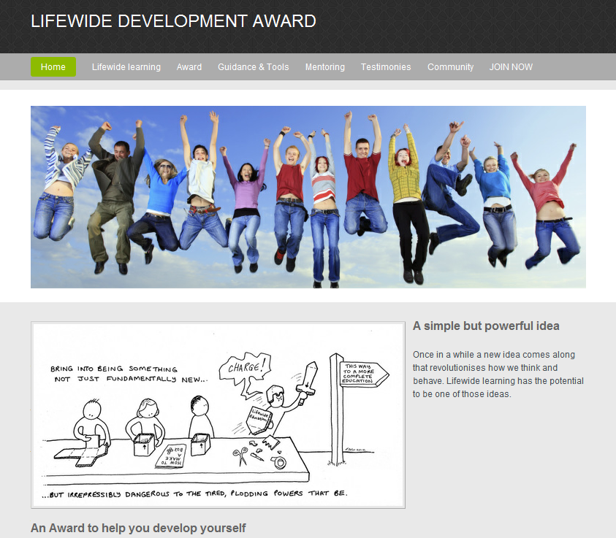
GUIDANCE CAN
BE DOWNLOADED
http://lifewideaward.com
Notes:
The Lifewide Education community is developing and implementing a Lifewide Development Award which can be adapted by any institution.
1 Encourage the holistic development of people through a self-directed, self-managed and self-evaluated process involving the whole of the individual’s life.
FUNDAMENTALLY THE LEARNER IS THE DESIGNER OF THEIR OWN MORE COMPLETE EDUCATIONAL EXPERIENCE
2 Provide encouragement, support and validation for the learners commitment and efforts to develop themselves
FUNDAMENTALLY ITS ABOUT BUILDING A CULTURE OF LEARNING & DEVELOPMENT AND A COMMUNITY THAT SUPPORTS THIS
3 Encourage and facilitate development of greater self-awareness and enhanced capability for managing and evaluating development
THIS IS ACHIEVED THROUGH THE PROCESS AND PRACTICE OF LIFEWIDE LEARNING AND THE USE OF THE TOOLS TO HELP PLAN, MANAGE AND REFLECT
Learners can register for the award through the website.

Slide 23
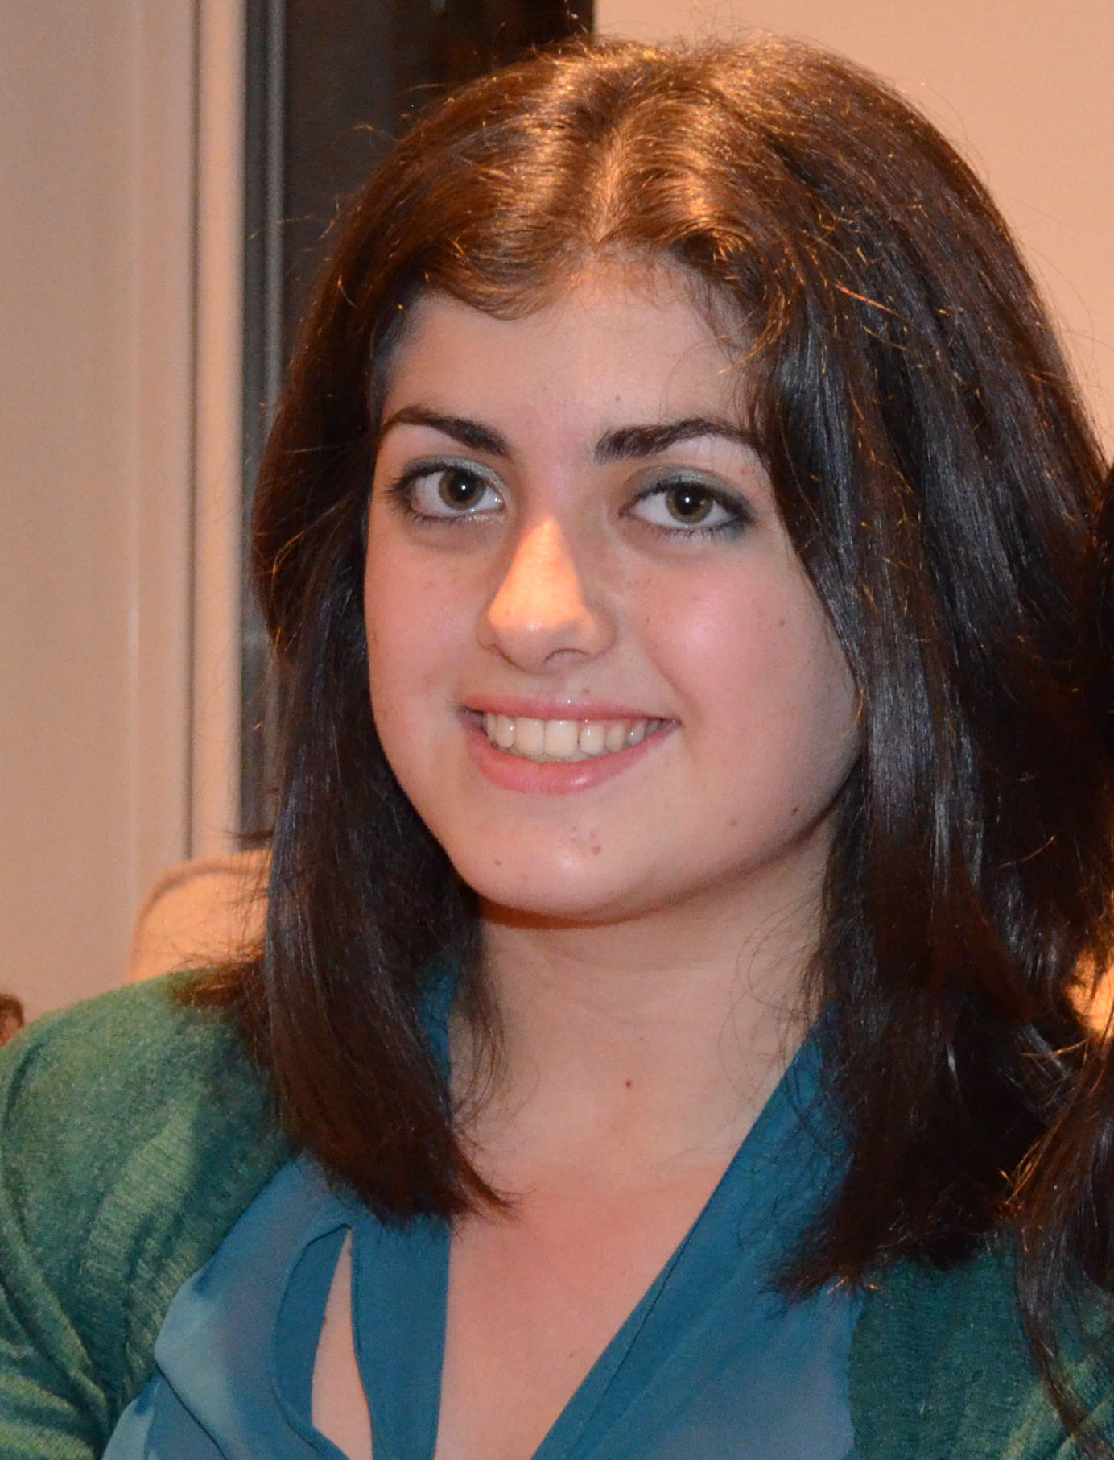
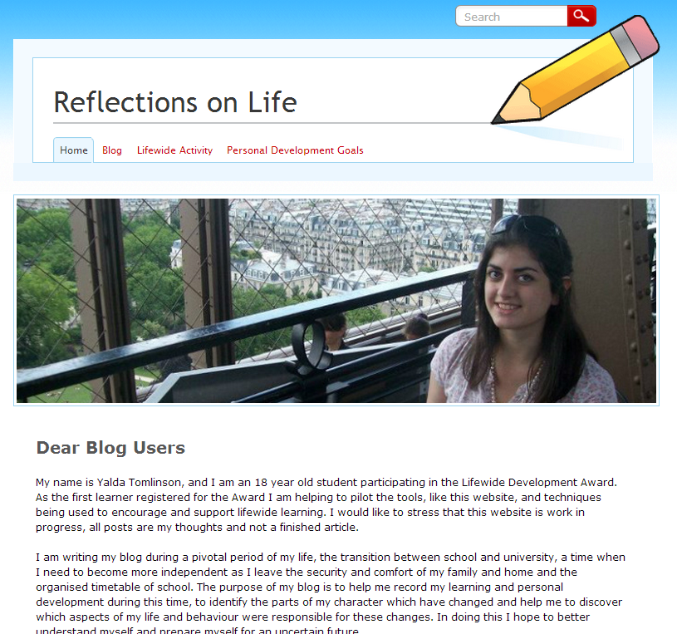
Framework for recognising a lifewide learning ecology
formal
education
work/ paid
voluntary
interests/
hobbies
family /
home
friends
o
t
h
e
r
4 ACTIVITY – personally significant learning projects
2 PLANNING
Personal
Development
Activities Plan
5 DIALOGUE
with mentor
who witnesses their journey & validates their learning
3 PORTFOLIO
to record & reflect
on experiences
1 AWARENESS
Lifewide Activity Map
& codified knowledge
about lifewide learning
6 SUMMARY NARRATIVE OF EXPERIENCE & CLAIMS FOR
LEARNING & ACHIEVEMENT
reveals her ecology for learning
Notes:
The important characteristic of lifewide learning is that it embraces a comprehensive understanding of learning, development , knowledge and knowing and achievement. Lifewide learning includes all types of learning – learning that is developed in formal educational environments which is directed or self managed.. Intentional or unintended. Interest or needs driven and learning which emerges during the course of activity. But all this only has meaning when you personalise it so here is an example of personalised learning, development and achievement
5min VIDEO + 10mins discussion
What does lifewide learning mean to this psychology student called Sarah who summarises six years of her life between leaving school and starting a doctoral programme?

Slide 24
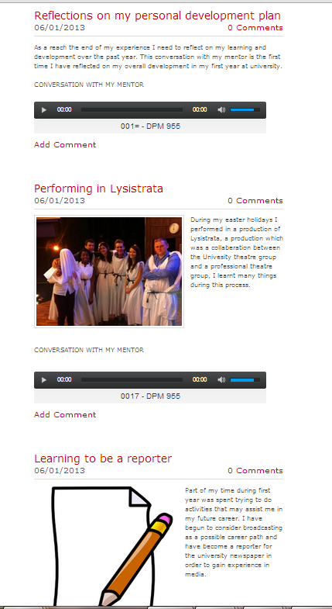
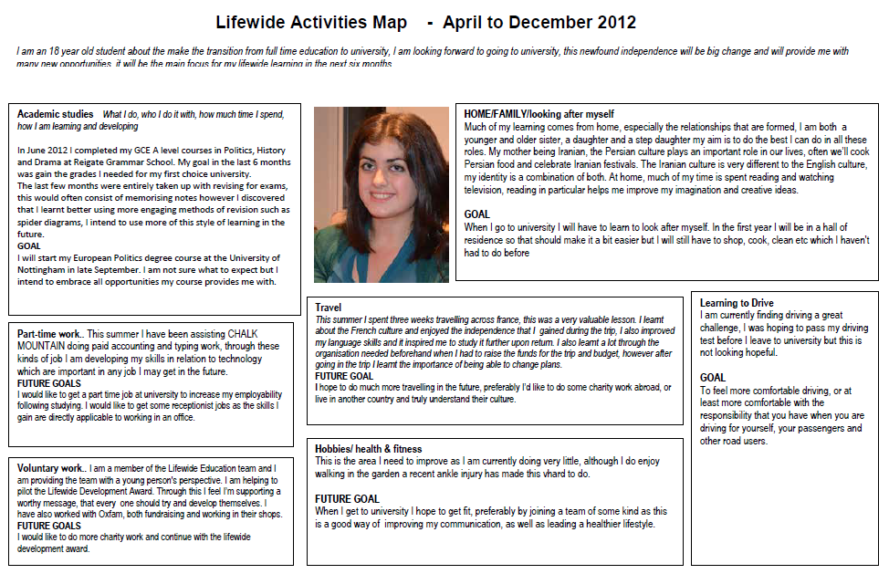
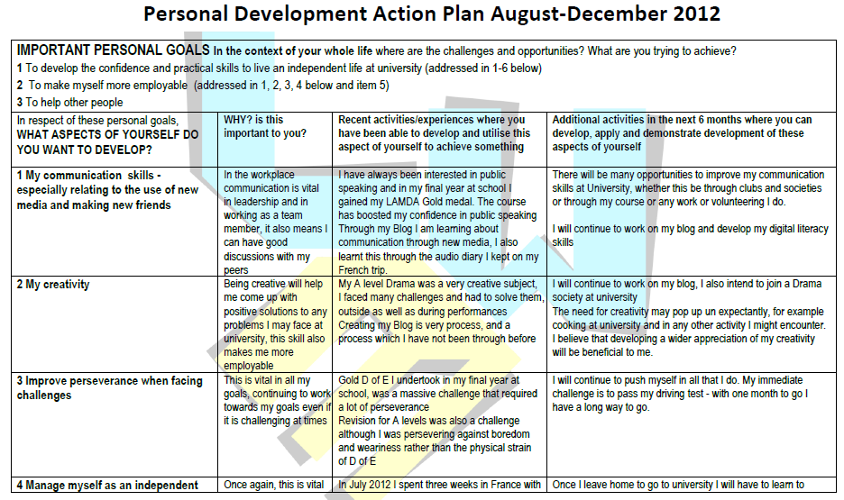
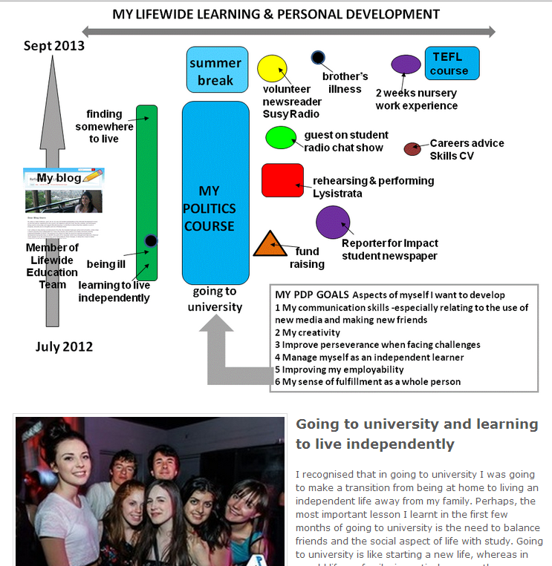
Ecological approach to lifewide learning and development
4
RECORD, DOCUMENT & REFLECT
AND SHARE WITH MENTOR
1
MAP & APPRECIATE LIFE – what are my contexts? where is the affordance for developing myself?
5
Mentor
witnesses
values,
encourages,
questions, validates
A
C
T
I
V
I
T
Y
2
DEVELOPECOLOGIES FOR LEARNING/ACHIEVING
ACTION PLAN – which aspects of myself do I want to develop & why? What is my purpose/my vision of a better self? How can I use the affordances I have?
6
REFLECT, SYNTHESISE &
MAKE CLAIMS
3
Notes:
An example of a learner engaged in the Lifewide Development Award.. in this case spanning the period June 2012 – June 2013 as she makes the transition from School to University and through her first year at university.
The learner creates a lifewide activity map and a personal development plan… engages in activities to develop herself and keeps a blog / much of it as audio recordings.. She engages in periodic conversations with her mentor to discuss her development (audio records) and at the end of the process she will submit a reflective account summarising her development over the 12 months.
Total time spent in mapping, planning, recording, evaluating and synthesising learning/development and having conversations with their mentor and building and maintaining their website is about 45/50 hours over the year. A relatively small investment considering the complex nature of achievements that will be recognised and validated.

Slide 25
MY LIFEWIDE LEARNING ECOLOGY (12 months)
Sept 2013
summer break
TEFL
course
brother’s
illness
volunteer newsreader
Susy Radio
2 weeks nursery
work experience
finding somewhere to live
MY
POLITICSCOURSE
guest on student radio chat show
Careers advice
Skills CV
My blog
Involvement in drama society rehearsing & performing Lysistrata
Reporter for Impact student newspaper
Member of Lifewide Education Team
coping with illness
Charity fund raising
learning to live independently
MY PDP GOALS Aspects of myself I want to use/ develop
1 My communication skills – interested in radio broadcasting
2 My creativity – find and use opportunities
3 Improve perseverance when facing challenges
4 Manage myself as an independent learner
5 Improving my employability
6 My sense of fulfillment as a whole person
Sept 2012
Notes:
This is the complete ecology for learning and personal development Natasha developed over the 12 months

Slide 26
Future of Lifewide Learning : Possible evolutionary pathways
of UK HE Ecosystem
Increasing complexity &
adaptation to radically different ecosystem
Open Education Vision
use e-portfolios
use of web 2.0 technologies
personal websites/blogs/Linked in
use HEAR / digital badges
involvement external agents
awareness of the ecology of learning in educational thinking
Teaching
Excellence
Framework
3
2
1
Increasing complexity, disturbance
& dissonance: adaptation to
new interventions that are not
sympathetic to lifewide learning
Increasing complexity, connectivity, integration & convergence : incremental adaptation within existing system

Slide 27
Approaches to recognising and valuing co- & extra- curricular learning
Betts and Jackson (2011)
1 Holistic Focus
Underpinned by conceptions of whole person development & self-actualisation
Possible effects of Teaching
Excellence Framework on what
is valued in students’ lifewide
learning & development
HYBRIDS
2 Employability Skills Focus
Underpinned by career development and preparation for future employment
3 Leadership Focus
Encouragement and opportunity to use & develop leadership qualities
Notes:
A UK wide phenomenon
In 2010/11 we undertook a survey across UK HE to find how many other institutions were involved in recognising extra curricular learning and personal development. We discovered over fifty universities either had a scheme or were developing a scheme this is now closer to 70 universities.
Although there is much variation in the way universities are recognising learning and development gained outside the programme there seem to me three main foci.
Holistic – whole person
Employability – major political driver
Leadership-
Our research has tried to identify the key conceptual features that underlie different schemes. While there is much variation and conceptual mixing, our sense is that schemes differentiate at the conceptual level according to whether:
the approach emphasises whole-person education and personal/career development or attention is focused primarily on transferable and employability skills
the environments for learning are predominantly controlled/taught or are predominantly experiential
assessment is primarily through reflective, self-evidencing and reporting or through a tutor-assessed/competency-based assessment
the experiences that make up the award are predominantly extra-curricular (not designed by the institution and not linked to a programme) or co-curricular (institution-designed, linked to or outside a student’s programme)
leadership skills are seen as either implicit or explicit within the scheme
forms of recognition - credit, certificates or badges are awarded
Most schemes contain a mix of these conceptual continua but some schemes tend to one or other sides of the conceptual diagram.

Slide 28
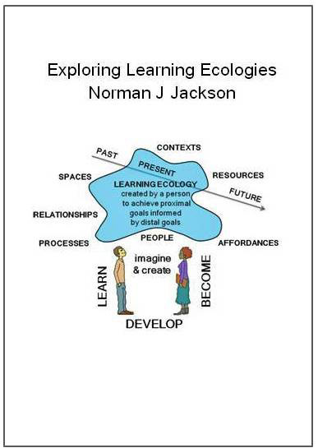
Thank You
Lifewide Education http://www.lifewideeducation.uk/
Creative Academic
http://www.creativeacademic.uk/
https://www.lulu.com/
Presentation & article can be downloaded from
http://www.normanjackson.co.uk/icolace4.html

