Slide 1
TILT Festival of Learning 2019
Lifewide & Ecological Perspectives
on Learning, Education & Practice
Norman Jackson
slides & narrative at http://www.normanjackson.co.uk/ntu.html

Slide 2
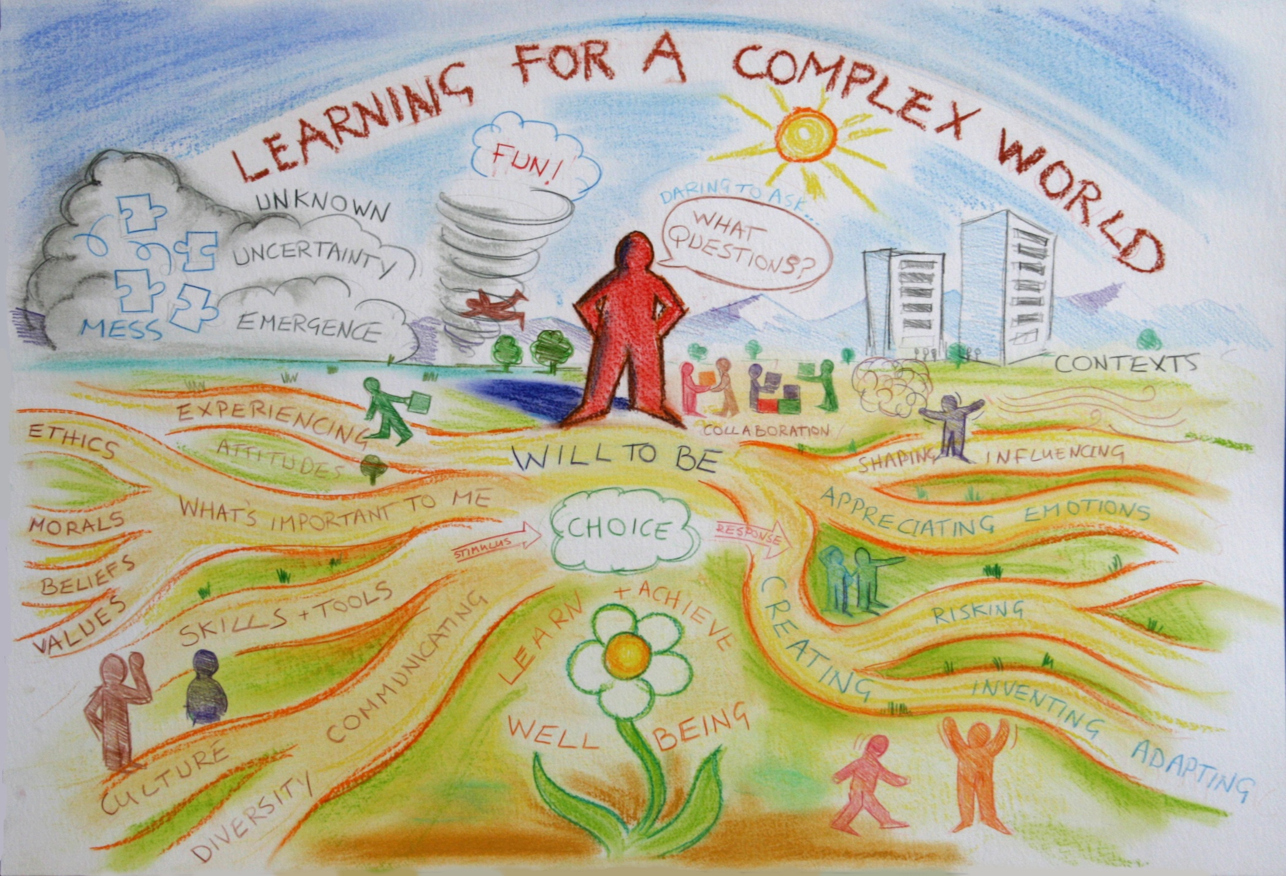
me 1978
Future readiness focuses on helping people develop uniquely human aptitudes and practice resilience rather than on training them for specific jobs or skills…. The core of the foundation for readiness lies in developing a strong inner self that is resilient, reflective, and able to see, develop and value positive connections and relationships [with the world].
The Future of Learning, Redefining Readiness from the Inside Out Knowledge Works Forecast 4.0

Slide 3
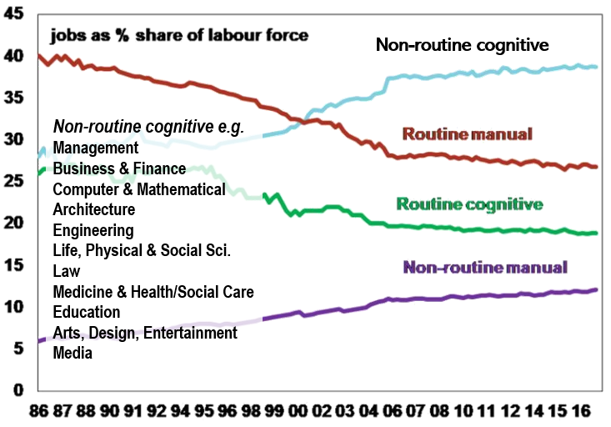
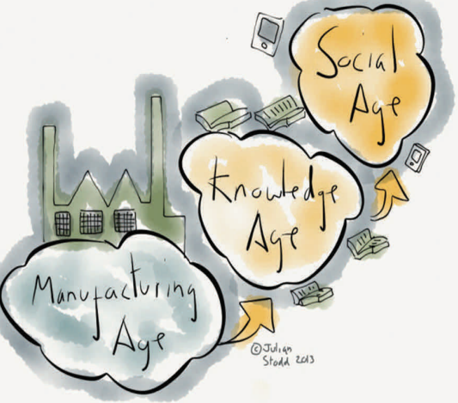

Slide 4
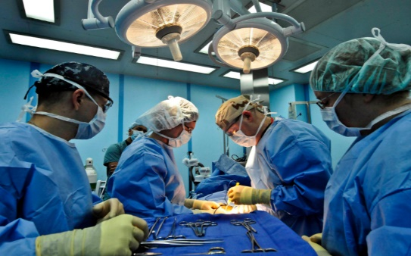
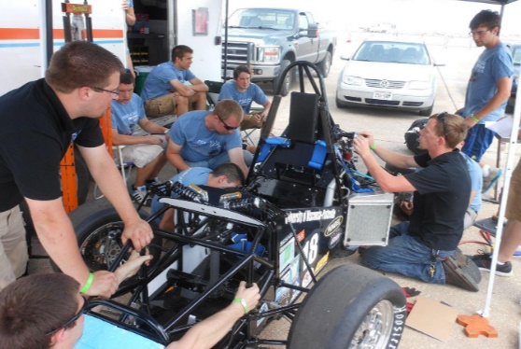
Example Human
Ecosocial Systems
Environment
Human-Environment
Interaction
Environment-Technology
Interaction
Humans
Technology
Human-Technology Interaction
An ecosystem is a community of living
things interacting with non-living things
in a particular space and time

Slide 5
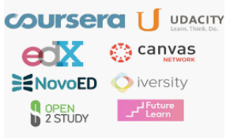
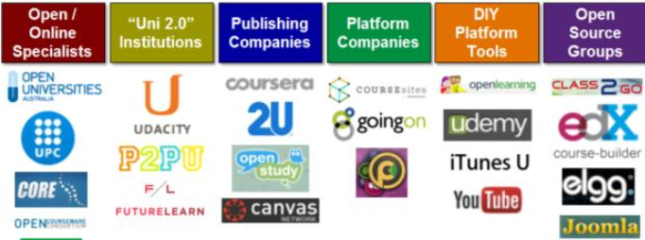
Global ecosystem of infinite possibilities
Other HEIs
Professional
Bodies
University Ecosystem
Content Creators
Creation Spaces
Mobilizers
people, leadership, management, governance & cultures, values accommodation and other physical and virtual infrastructure, services to support teachers and learners, and administrators regulatory frameworks, policies, tools, resources for learning - anything that impacts on teaching, learning & students’ experiences
On-line Courses
TRADITIONAL ECOLOGIES FOR
TEACHING AND LEARNING PRACTICES
On-line Service Tools
Meet Ups
Hacks
Personal Learning Networks

Slide 6
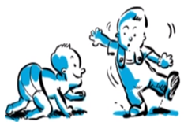
LLL is about acquiring skills that enable us to survive (Lewis-Fitzgerald 2005).
The process of gaining knowledge and skills throughout life, often to help you do your job properly (Cambridge Dictionary)
The ability continuously to develop over one’s life span
Nature of Learning OECD (2012)
LLL is a [lifelong] process in which people obtain meaning from interacting with their environment. (Wikipedia)

Slide 7
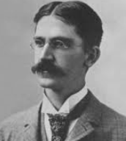
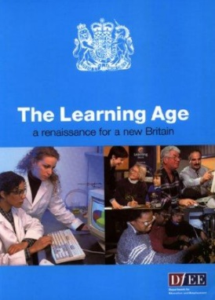
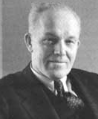
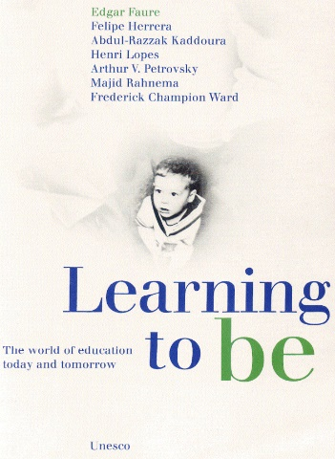
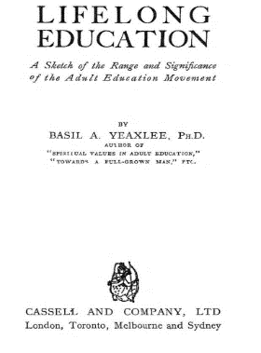
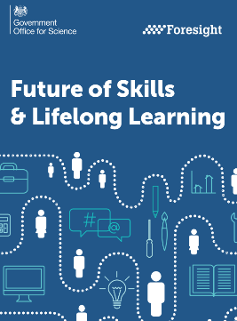
Lifelong Education
Lifelong Learning
lifewide learning
education is not
preparation for life:
education is life itself
John Dewey
1999
lifelong & lifewide learning
the central learning paradigm
EU 2030 Foresight study 2011
1996 EU Year of LLL
The whole of life is learning therefore
education can
have no endings
Eduard Lindeman
1926
lifelong learning - the
pathway for skills-driven economic growth 2017
lifelong education and
the learning society
Basil
Yeaxlee
1929
EU MEMORANDUN LLL
1920
1970
2000
2020
Lifelong Education
but education as life
Lifelong Education
provider provisions
Lifelong Learning – what people do
Lifelong Education – what institutions do

Slide 8
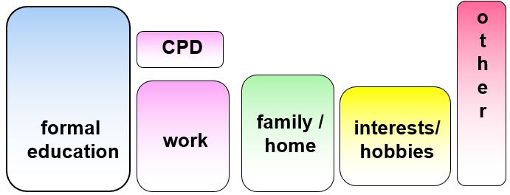
FUTURE
FUTURE
Lifelong learning:
All learning activity
undertaken throughout
life with the aim of
improving knowledge,
skills and competencies
within a personal, civic,
social and/or employment
-related perspective
(Commission of European
Communities 2001)
PRESENT
Lifewide learning: All learning and personal development that emerges through our interactions with the world in the multiple contexts and situations we inhabit contemporaneously at any point in our life, to develop knowledge, understanding skills, capabilities, dispositions, values and meaning within personal, civic, social and employment-related contexts.
PAST

Slide 9
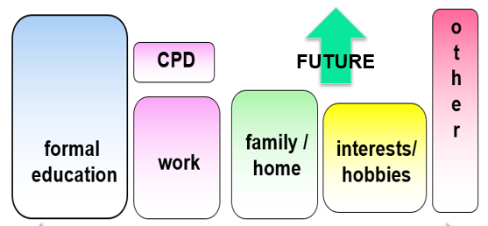
CREATING MEANING EVERY DAY ACROSS THE WHOLE OF OUR LIVES
Now, All, Personal & Significant –foundation for the future
Formal / non-formal
Intended
Need
Directed
Planned
Extrinsic Motivation
Cognitive
Informal
Unanticipated
Interest
Self-directed
Emergent
Intrinsic Motivation
Emotional

Slide 10
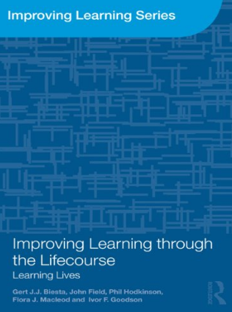
Learning Lives Project 2010-13
What learning means and does in the lives of adults
117 adults 25-84 years old
Biographical approach
528 interviews 4-5 x 2hr interviews per person 36 months
Learning of some sort ubiquitous in people’s lives
Much learning tacit and routinised; often goes unrecognised
Everyone has a unique learning trajectory
Major life changes / transitions trigger need for learning
Adults have wildly different dispositions towards learning.
For most people learning is a fact of life – continually striving to deal with problems rather than learning for itself – learning is a biproduct of doing stuff
For a minority sense of being a learner is part of their identity such people have a strong orientation towards learning in all aspects of life, expressing and constructing themselves and being aware of how and why they are learning
Surely one of the goals of a higher education is to enable learners to develop their identity as a learner and their sense of authoring their life
Notes:
Life is a complex process and we make up stories about ourselves to make sense of our experiences and ourselves often as part of a reflective process. These stories provide us with a type of knowledge from which we can learn.
I the context of preparing young adult learners for a lifetime of learning higher education could play an important role in enabling learners to create their own life narratives and learn from the process. PDP for example offers an important pedagogical context for development.

Slide 11
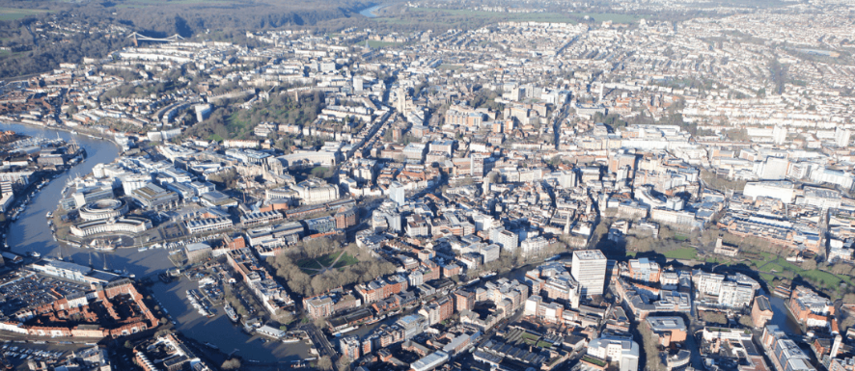
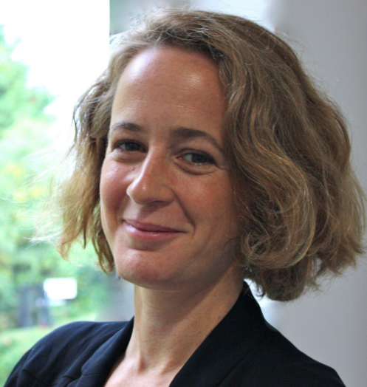
Keri Facer
How does a city learn? How does it encourage and support the learning of its inhabitants?
Two year ethnographic study in the city of Bristol with organisers of adult learning, conveners of protests, leaders of elite city institutions, refugees, longstanding inhabitants, artists, medics, city farmers, older people’s groups, parents, carers and social activists (amongst others)

Slide 12
What have I learnt? | Where did my learning happen? | What resources did I use? | What were the main methods I used?
About the UK English Language Skills Research and Learning Skills Work Related Skills Food and Cooking Driving Yoga Art | At home At work In the library In training/workshop rooms In the yoga Studio In museums In parks In shops On the Streets On the road Other places | Computer and Internet Ipad and Iphone TV Books Magazines Newspapers Training workshops, events Resources in parks, museums Others (advent calendar) | Online courses Website and online videos Talking to people Attending events Participating in Workshops Playing and making things Practising and taking part in activities (driving) Spending time with Tom Learning journey notes and photos
Notes:
What learning meant to Xiujuan in the first few weeks of arriving in a new city

Slide 13
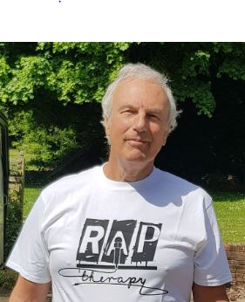
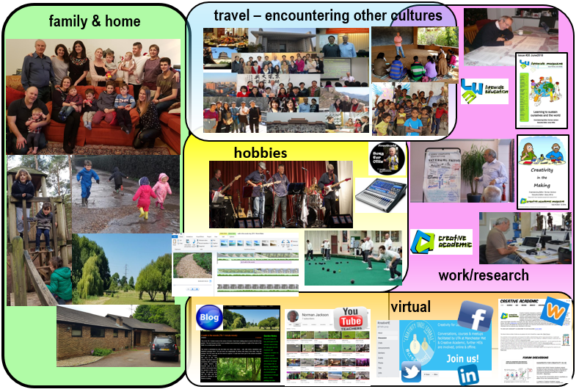
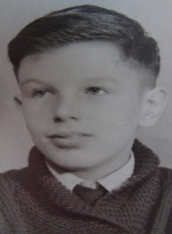
SCEPTrE
Uni Surrey
Lifewide Education
& Creative Academic
HE Academy
?
parent /grandparent
parenthood
2010
2ndmarriage
LTSN
2000
1990
QAA
HEQC
London
QA Uni Plymouth
Polytechnic
lecturer UK
HMI
bereavement
wife’s illness
& death
parenthood
living away from home
parenthood
Field Geologist
Saudi Arabia
Uni lecturer
Saudi Arabia
1970
geologist
in tin mine
1980
University
BSc geology
University
PhD geology
parenthood
School(s)
out of school activities
part time jobs
looking
after myself
marriage
living in Saudi
1960

Slide 14
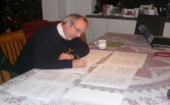
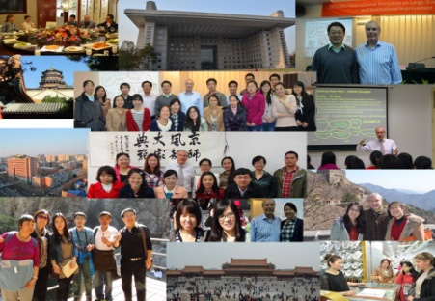
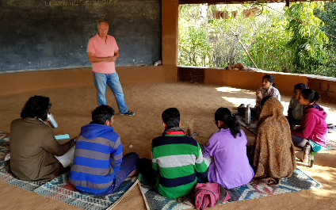
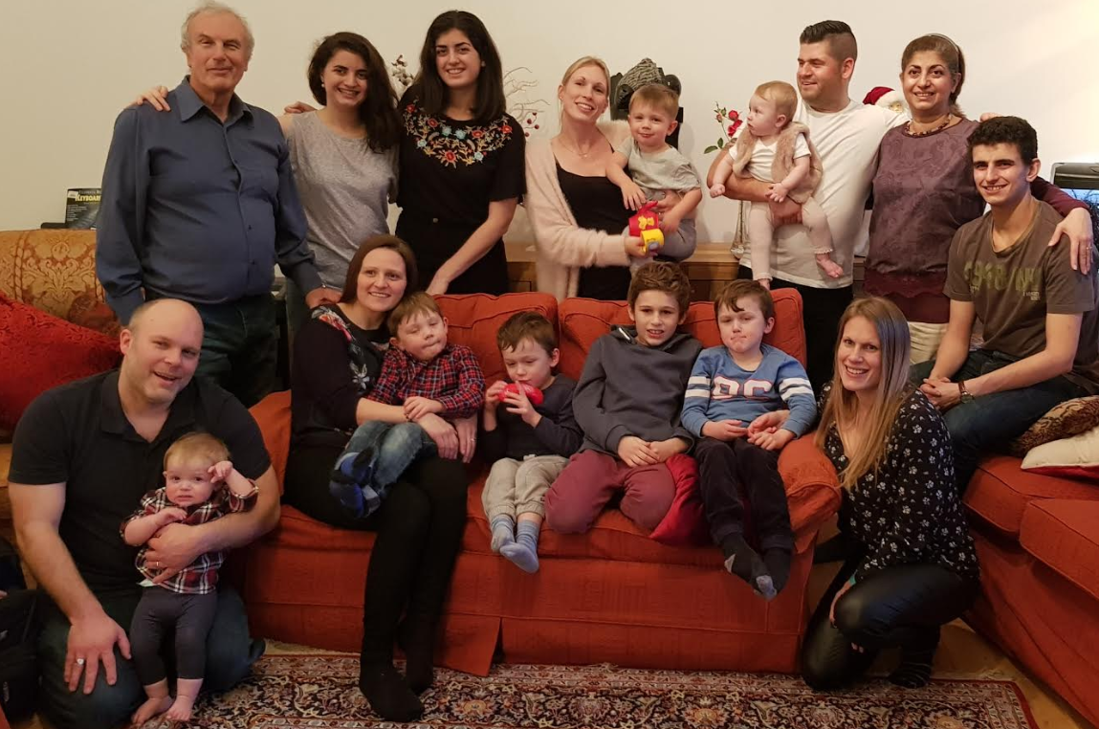
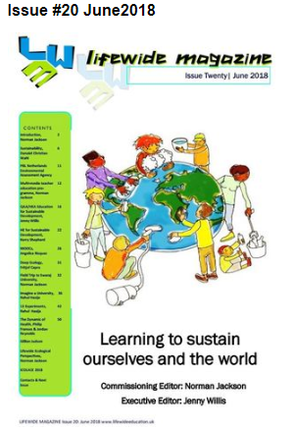
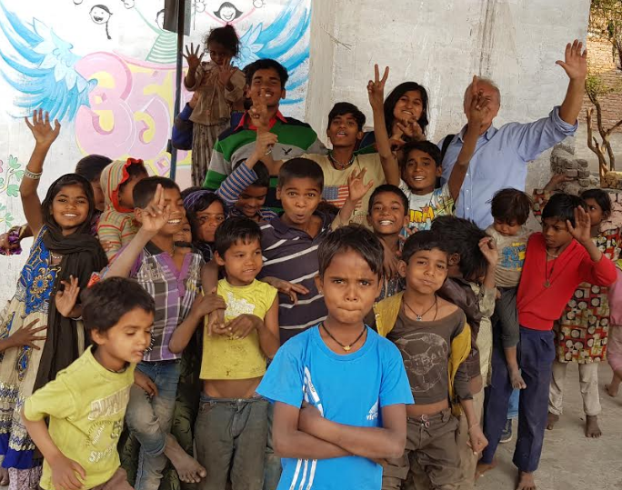
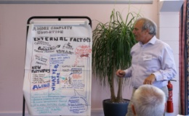
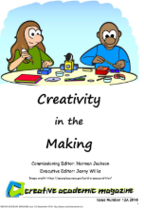
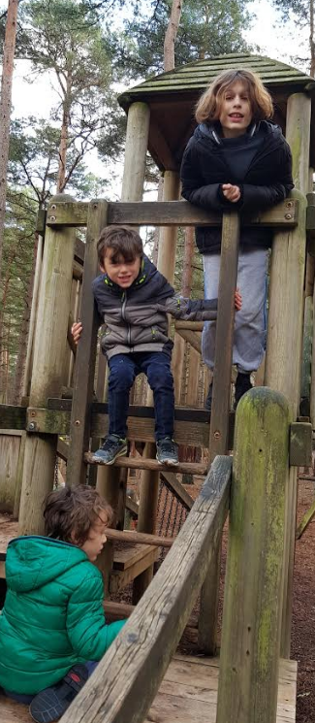
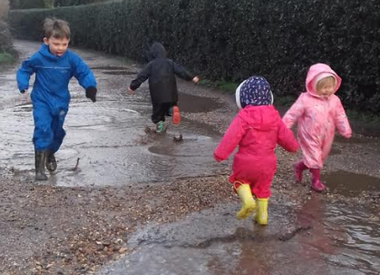
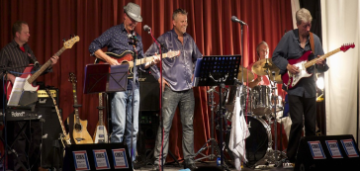
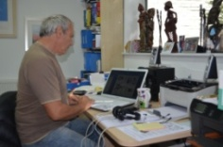
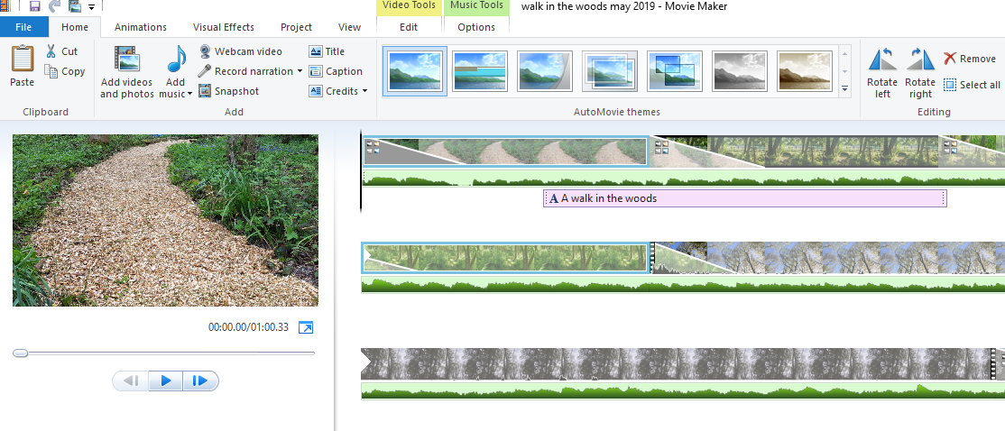
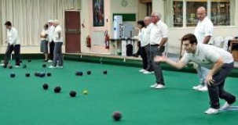
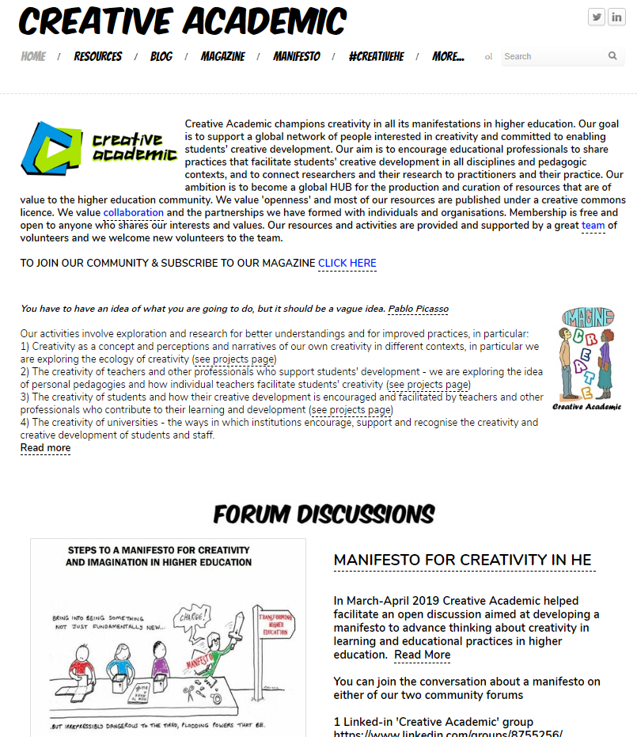
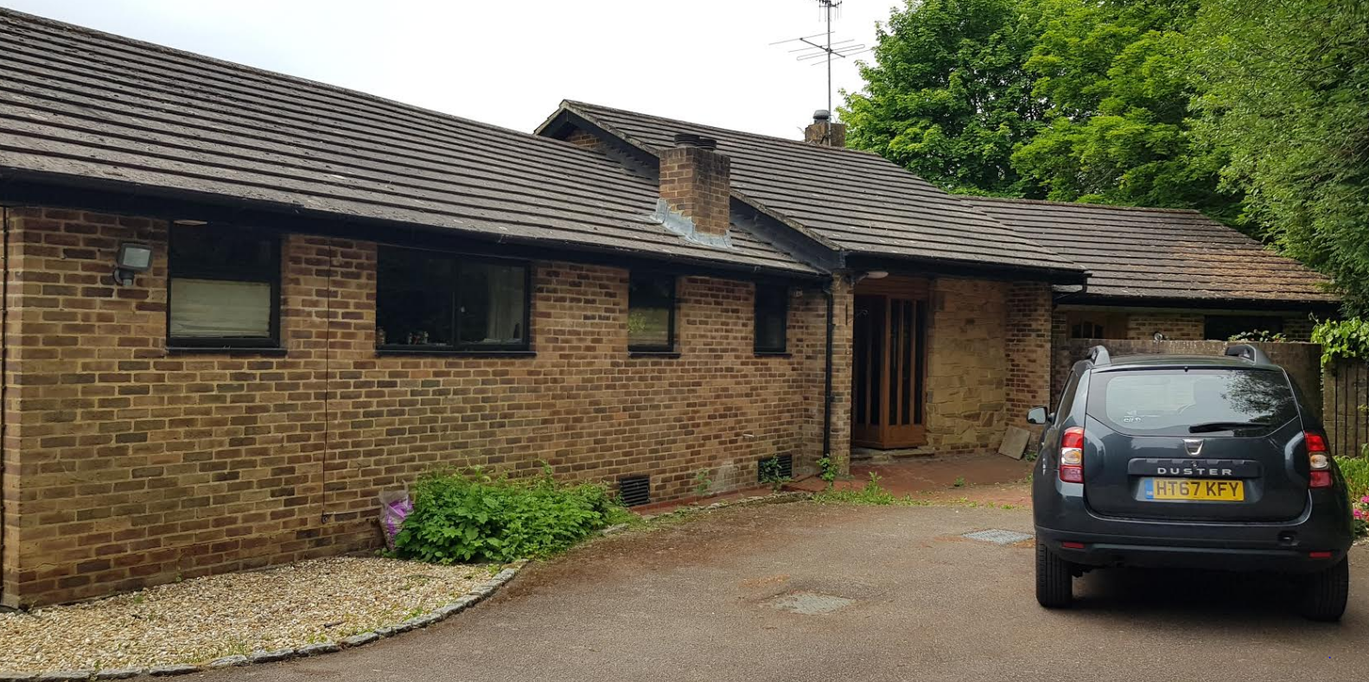
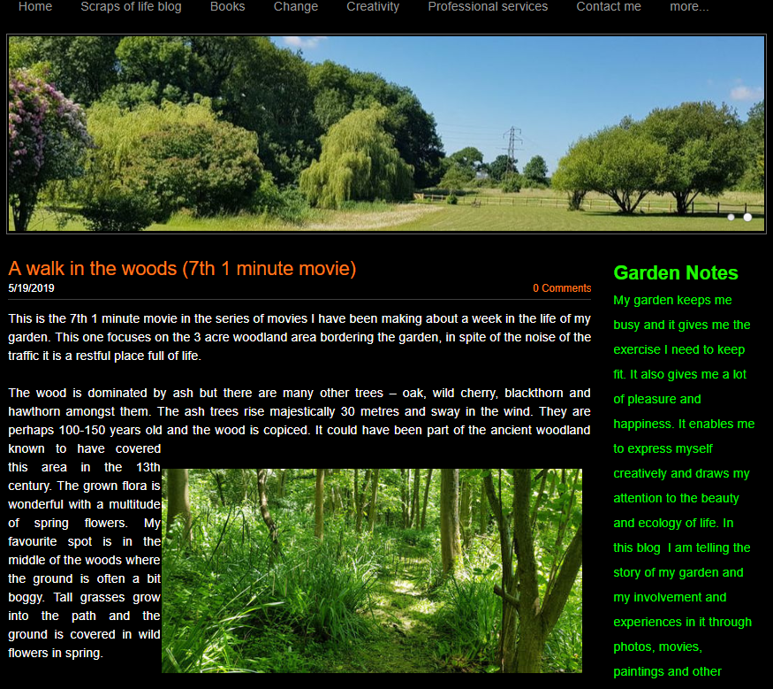
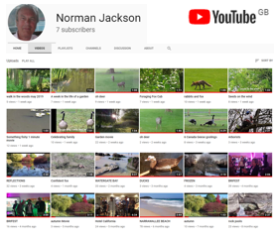
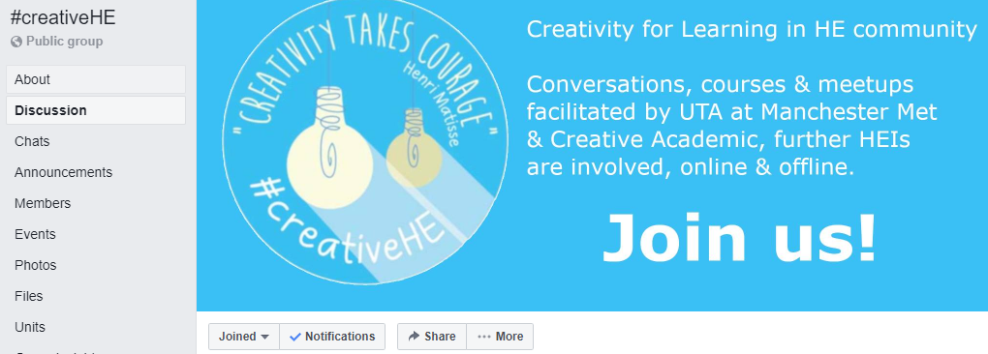
CREATING MEANING EVERY DAY: ACROSS THE WHOLE OF OUR LIVES
family & home
travel – encountering other cultures
hobbies
work/research
virtual
LIFEWIDE

Slide 15
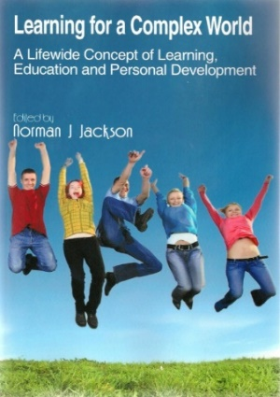
The whole of life is learning therefore education can have no endings
Eduard Lindeman
Academic
curriculum
UNIVERSITY
ECOSYSTEM
Extra-curriculum
Part-time work
and internships
Managing own life
Study
programme
/modules
Co-curriculum
Organised
learning
outside
formal
curriculum
Caring for others
Running own
business
Work-related curriculum
Placement Internship
Apprenticeship
Participating in Sport
Volunteering &
social enterprise
May include fieldwork,
projects in
real world,
study abroad, community projects
Travel
Mentoring
Creative activity
Student Representation
& Societies
Study abroad
AN MORE!!!
World of infinite possibilities for learning

Slide 16
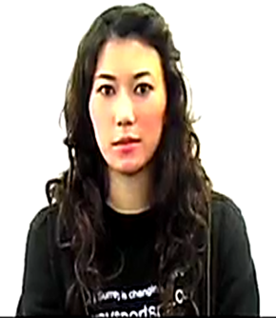
Level 1 international student University of Surrey (2009)
BSc Study Programme : I am studying biosciences. I have classes for about 20h per week and learn through lectures, lab practicals, books/papers and discussions with friends
Friends: As an international student it is difficult to be away from my home & family. Friends, become a kind of family
Looking after myself
Domestic chores
Shopping
Entertainment
music, cinema, meeting friends
University Tutoring
and Mentoring
I work at a Combined Learning Centre for students with learning disabilities and/or behavioural problems. I worked one-on-one with three different students, one of whom had Aspergers Syndrome
Sport – uni netball team
Playing as a part of a team allows me to develop my inter-personal and communication skills, and always gives me a feeling of satisfaction. It lends a sense of unity and strength- when we put on our match uniforms, we know that we are no longer individuals, but part of something that is bigger than ourselves.
Volunteer - St John’s Ambulance service
I joined St Johns’ Ambulance, to learn first aid and general safety measures. I think this is an essential part of not just University life but life in general. Taking part in that course allowed me to feel more secure in my ability to deal with emergencies. As I hope to study Medicine as a Postgraduate degree, I found the course interesting and engaging.
Organising & leading a group of student volunteers to work during the summer vacation in Uganda

Slide 17
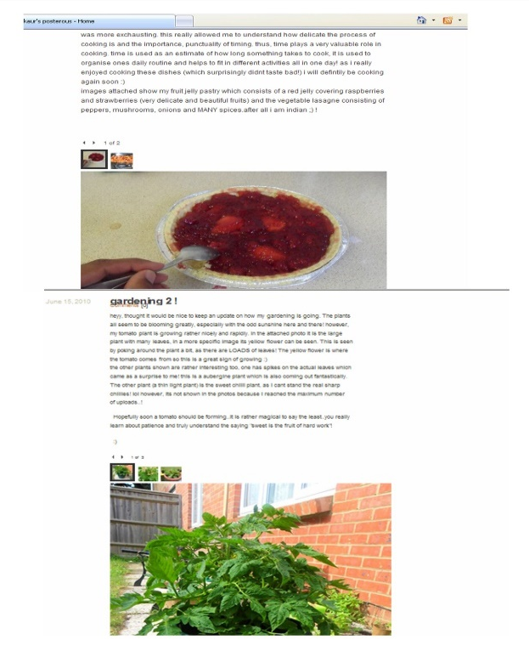
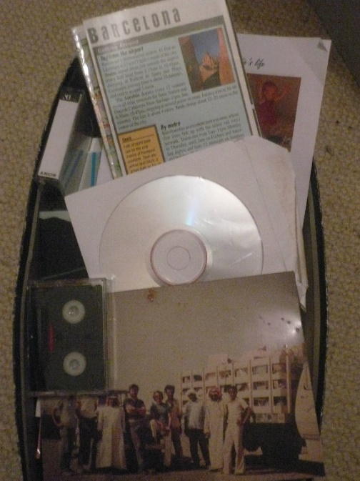
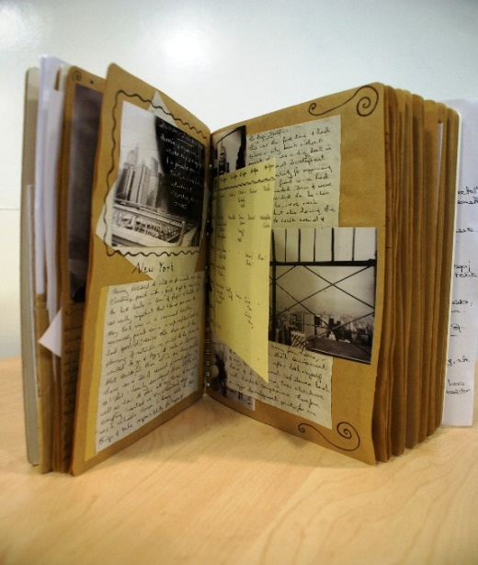
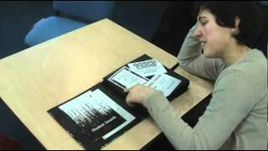
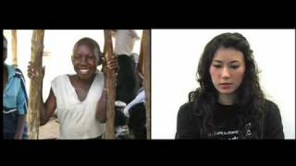
Using life as curriculum, students can reflect upon their own ontological journey to reach self-awareness – the sense of authoring their life and how they construct themselves. Pharr Sharrah
SHOE BOX!
BLOG
SCRAPBOOK
E-PORTFOLIO
VIDEO DIARY
DIGITAL STORY
VIDEO FILM
SLIDE SHOW
PERSONAL
DEVELOPMENT
PLANNING

Slide 18
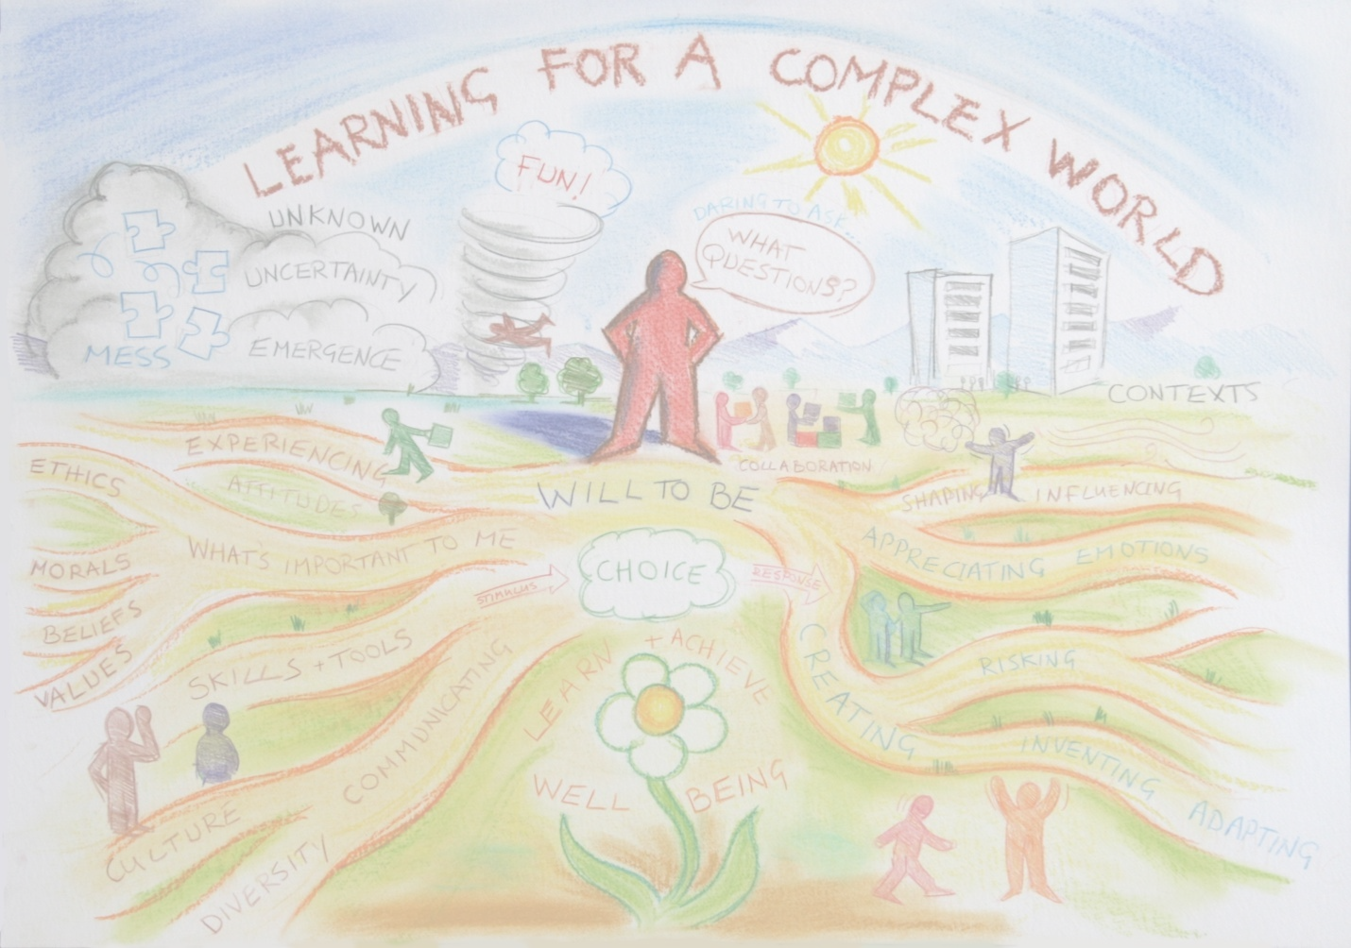
WORLD ECONOMIC FORUM
Top skills required for non-routine cognitive work
2015
1 Complex problem solving
2 Coordinating with others
3 People management
4 Critical thinking
5 Negotiation
6 Quality control
7 Service orientation
8 Judgement and decision making
9 Active listening
10 Creativity
2020
1 Complex problem solving
2 Critical thinking
3 Creativity
4 People management
5 Coordinating with others
6 Emotional intelligence
7 Judgement and decision making
8 Service orientation
9 Negotiation
10 Cognitive flexibility
2040??
1
2
3
4
5
6
7
8
9
10

Slide 19
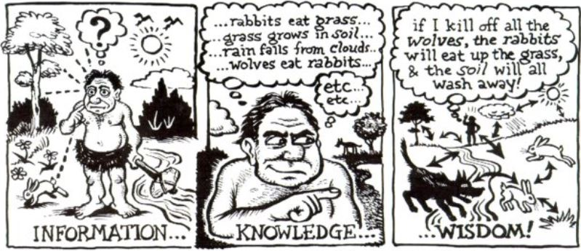
Learning through our experience
of interacting with our environment
Learning through experiences of
interacting with others
PERCEPTION REASONING IMAGINATION INSIGHT COMMUNICATION
with permission of the artist Tom Chalkley

Slide 21
Under these conditions of uncertainty, the educational task is in principle, not an epistemological task; it is not one of knowledge or even knowing per se. It is not even one of action, of right and effective interventions in the world… Amid supercomplexity, the educational task is primarily an ontological task. (Ron Barnett 2004)

Slide 24
information
KNOWLEDGE & PRODUCT
information
TOOLS
KNOWLEDGE & PRODUCT
KNOWLEDGE & PRODUCT
KNOWLEDGE & PRODUCT

Slide 25
3 RESOURCES
information, knowledge, people, tools, technologies
& other artefacts (anything that can be used)
4 SPACES
physical, social, virtual, intellectual, psychological, liminal
WHOLE PERSON
with their mind and body, purposes and motivations, sensing, perceiving, feeling, imagining, relating to, interacting with, interpreting & making sense of their environment & emerging situations
ENVIRONMENT
2 AFFORDANCES
possibilities that can be perceived or imagined for thinking and action
PAST
FUTURE?
5 PLACES
some things can
only be learned in a
particular place.
1 CONTEXTS
situations, circumstances, culture, ourselves, problems/opportunities - familiar or unfamiliar, simple –complicated - complex or chaotic
6 RELATIONSHIPS
with people, communities, places, ideas, objects, work, hobbies, problems, anything!
7 PROCESSES/ACTIVITIES/EXPERIENCES
sg study, work, making, research, inquiry,
problem solving and much more….
Jackson, N. J. (2016) Exploring Learning Ecologies.
Notes:
Summary of the components of a learning ecology
Learning ecologies (Jackson 2013a:14) 'the process(es) we create in a particular context for a particular purpose that provides us with opportunities, relationships and resources for learning, development and achievement'.
This definition represents the integration and interdependence of the elements of learning and achievement which include the contexts and spaces we inhabit, including our history, relationships and resources, (the most important being knowledge and tools to aid thinking), and our will and capability to create a learning process or learning ecology for a particular purpose.
Such actions may be directed explicitly to learning or mastering something but more likely they will be primarily concerned with performing a task, resolving an issue, solving a problem, or making the most of a new opportunity.
Learning ecologies have temporal dimensions as well as spatial and contextual dimensions: they have the capability to connect different spaces and contexts existing simultaneously across a person's life-course, as well as different spaces and contexts existing in different time periods throughout their life-course.
HYPOTHESIS : ECOLOGIES FOR ACHIEVING OUR PURPOSES
ARE OUR VEHICLES FOR DISCOVERING & CREATING MEANING
Our beliefs shape what we value and what we value shape our beliefs
Our beliefs & values shape our purposes – purposes emerge from the circumstances of our life and what we value they give our life meaning
Purposes create intentions (will/desire/ambition) to act on purpose (to reinforce the meaning that is our life) eg the desire to make a positive contribution/to make a difference to create a better version of oneself and to create new value in the world we are attending
Intentions cause us to search our life/world (contexts) for affordance (perceptions of possibility for action – eg to make a difference)
Affordance enables us to formulate goals to drive specific actions and behaviours in the particular contexts and situations of our life/world
These actions and behaviours result in an ‘ecology for achieving our goals’. Our ecology is the way we interpret, relate to, connect and interact with our world of which we are a part not a separate entity. Our ecology involves relationships, activities, experiences, use of resources (knowledge/tools and other artefacts) through which we learn and develop in order to accomplish something we value and create new and deeper meanings in the process.
New meaning grows from the experiences and reflections on experience grown through our ecology when it is integrated with our previous understandings, values and beliefs. Our unfolding experiences contain things which are currently meaningful and also things that do not make sense to us. It is in striving to make sense or better sense of such things that new meaning grows in relation to all of the above. Its an ecological process.

Slide 27
FROM THIS TO
A COLLABORATIVE CREATIVE LEARNING ECOLOGY
MANUFACTURE
DESIGN
MARKET
SELL
REFLECT ON AND LEARN
FROM THE STORY

Slide 28
Students’ higher
education experiences
can be visualised as
a constellation of
ecologies for learning
and practice.
Most are created
by teachers & institution
some by students, and
some by organisations
outside the university
University Ecosystem
Global Ecosystem
Co-curriculum
& student
organised
activities
‘Living’
project
Modules
PT work
Travel
sport
Programme
Volunteering

Slide 29
Determined by learner
Partly to significantly determined
by learner(s)
D Completely
determined
by learner
B
D
Academic
Programme
Other Contexts
eg. work, community
field, co-curriculum
extra-curriculum
LEARNING CONTEXT
LEARNING ECOLOGY
A
C
Partly to
significantly
determined
by learner
Completely determined
by teachers
Determined by institution or other body
eg a work placement or volunteering organisation
Learning ecology includes goals, affordances, processes, spaces,
relationships , resources (knowledge, tools, technologies, mediating artefacts)

Slide 30
Y3 project & dissertation
Y3 organize & facilitate seminar
Y3 Lead & Co-organised first Annual Student Archaeology conference (ASA)
organize
my own digs
Y3
participating
in numerous excavations
volunteer Young Archaeologists Club for schools
attending archaeology conferences
MY COURSE
Y2
Editorial team
for ‘Posthole’
Departmental
Archaeology
Magazine
Y2 ‘Homeless Heritage’ excavation & exhibition
working with homeless
people
Y1
GOAL
to learn archaeology
past knowledge, experience
interests and orientations

Slide 31
Y3 project & dissertation
Y3 organize & facilitate seminar
Y3 Lead & Co-organised first national Student Archaeology conference (ASA)
B
D
organize
my own digs
C
Y3
B
D
participating
in numerous excavations
volunteer Young Archaeologists Club for schools
attending archaeology conferences
A
C&D
Y2
D
A
Editorial team
for ‘Posthole’
Departmental
Archaeology
Magazine
Y2 ‘Homeless Heritage’ excavation & exhibition
working with homeless
people
A
Y1
GOAL
to learn archaeology
past knowledge, experience
interests and orientations

Slide 32
A thousand tiny universities – Barbara Grant
“How can we [be] alert to the daily possibilities for transformation towards our imagined future university. I propose the idea of a thousand tiny universities as one that offers a … basis for continually proposing and enacting in the present the kind of university we cherish.” Philosophy and Theory in HE (2019)
A good place to start is to create and embody your personal manifesto
‘the whole of life is learning and education can have no endings’ Eduard Lindeman
Slides, Narrative & Personal Manifesto at http://www.normanjackson.co.uk/ntu.html
Notes:
Inspired by Barbara Grant’s idea that we are all a university. The thought I will leave you with, is that we are all able to contribute to shaping the sort of education system we believe is right for the development of our students. Perhaps the place to start is for each of us to develop our own manifesto setting out the type of learning experiences we want to enable in order to make an enduring difference to the lives of our learners.

