Slide 1
Beijing Normal University International Workshop on Large-
Scale Assessment and Institutional Improvement April 2013
The Wicked Challenge of Changing a University:
Encouraging Bottom-up Innovation
through Strategic Change
Norman Jackson
Founder Lifewide Education Community
Paper & slides at:
http://www.normanjackson.co.uk/beijing.html
Notes:
This talk was prepared for the Beijing Normal University International Workshop on Large-Scale Assessment and Institutional Improvement April 2013
My powerpoint slides and a background paper entitled 'The Wicked Challenge of Changing a University' : Encouraging Bottom-up Innovation through Strategic Change, can be downloaded from my website

Slide 2
PART 1 ORGANISATIONAL CHANGE & INNOVATION
– concept of change and tools for examining change in organisations
and the nature of innovation
Questions, discussion & exercise in personal change
PART 2 EXAMPLE OF CHANGE IN A UNIVERSITY
– Case Study 1 - strategic change and innovation at Southampton Solent
University
Factors and conditions that support and encourage bottom-up innovation
within strategic change
- Questions & discussion
PART 3 EXAMPLE OF CHANGE IN A UNIVERSITY
Case Study 2 – my experience of trying to innovate at the
University of Surrey
- Questions & discussion
Notes:
2 The talk is in three parts

Slide 3
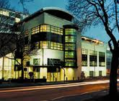
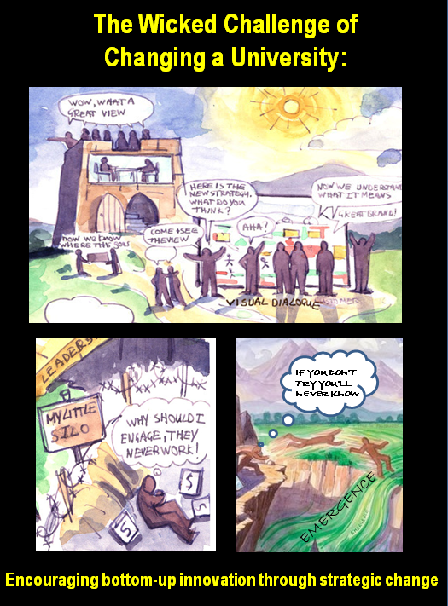
My personal story of organisational & system change
University of Surrey
HEQC
Southampton
Solent University
Research Policy/Regulation Enhancement Innovation/Research Research
HEQC
Self-
Evaluation
for Self-
Improvement
‘Experience of making change happen in a University
Research study ‘how
a university changed’
System change through policy
‘Self-Evaluation’ ‘Benchmarking’ ‘Regulation’ ‘Brokerage’
1995
2000-05
2006-11
2011-12
Notes:
3 In my earlier presentation I talked about personalising learning through your narratives of learning. This is my story of involvement in organisational and system change
I could go back further but in 1995 when I worked for the Higher Education Quality Council. I was involved as a researcher on a large scale team project called the Graduate Standards Programme which examined the impact of rapid expansion of the HE system on educational quality and standards. But I also initiated a network of people who were interested in how institutions evaluated themselves in order to improve. This took me into the field of benchmarking and a book to consolidate what had been learnt.
In 1997 I joined the Quality Assurance Agency where I was tasked with developing policy for better regulation. I developed two policies in consultation with the sector and wrote extensively on the new Quality Assurance Framework for HE I was helping to develop.
In 2000 I joined the Higher Education Academy a national agency for encouraging improvement and innovation.
I set up two new networks the first was for people who were interested in sharing their perspectives on creativity and students’ creative development. We called it the imaginative curriculum network and the work we did culminated in a book – Developing Creativity in Higher Education: an imaginative curriculum. I suppose the motive behind creating a network of professional interest was to influence thinking and try to ‘nudge’ higher education towards paying more attention to students’ creative development.
I was also given responsibility for leading the development and implementation of something we called ‘Change Academy’ which comprised a three day facilitated workshop for teams of people from different universities who were trying to bring about institutional change. Again we developed a network of professional interest around the theme of change – my personal ecology for learning if you like. I was performing the role of a knowledge broker – bringing people, ideas and resources together to help facilitate change and I published a book on the concept of brokerage in education.
I began to see myself as a broker in the HE system, occupying different roles over a 10 year period and I tried to make sense of the idea in a book Engaging and Changing Higher Education through Brokerage.
In 2006 I moved back into a university as Director of the Surrey Centre for Excellence in Professional Training and Education at the University of Surrey. SCEPTrE was funded externally for the explicit purpose of encouraging innovation and change. My role switched to one of trying to innovate and support innovation within a university.
While I was working at SCEPTrE in 2008 I became an advisor to a strategic change project at Southampton Solent University and eventually, after I had left SCEPTrE in 20011 was invited to undertake a retrospective study of the strategic change process. We are in the final stages of writing up this study and what I have discovered about changing a university will form the main part of my talk.

Slide 4
Change is brought about by people engaged in intentional activity (Human activity systems theory Engeström (1987:78)
Theorising this workshop session
TOOLS
OUTCOMES
learning
knowledge
& tools
change
SUBJECT
ACTIVITY
thinking/discussing
OBJECT
RULES
COMMUNITY
DIVISION
OF EFFORT
Notes:
4 The emphasis in this talk is on conceptual thinking and I am trying to open your eyes to different ways of seeing and appreciating change. I will use a lot of pictures and diagrams to try to stimulate your imaginations.
Change comes about through activity so we might visualise this session in terms of the activity system descriptive framework.

Slide 5
What is Change?

Slide 6
CHANGE = DIFFERENCE
NEWNESS - INVENTION
New structures, tools, frameworks, processes, procedures, products
New behaviour and practices
New knowledge, understanding, ways of thinking, beliefs and feeling.
MAKING SOMETHING DIFFERENT
Modifying, adapting, converting something that already exists.
STOPPING
Stopping doing something
REPLACING
Substituting or exchanging something
BECOMING
Becoming different – transitioning from one thing to another
Notes:
6 Change is one of the things that affects all of us and it doesn’t matter how much you know about change you still have to learn how to do it when you encounter it in an unfamiliar context or situation. But knowing something about it helps us to anticipate and interpret what is happening and to respond more wisely to things as they emerge. It also stops us from doing things that are unlikely to work. Big and profound change is endemic in many people’s working lives and we invest a huge amount of physical, intellectual and emotional effort in participating in change and changing ourselves in the process. Because there is a strong emotional dimension to change we feel it.
It's a natural instinct to resist change. Peter Senge once said People don't resist change. They resist being changed! Peter Senge It feels much better to create our own change than to have it forced on us.
Change is fundamentally about difference but it has some characteristics that make it an interesting phenomenon (refer to slide)
Change includes the concept of enhancement - which means improving something that already exists and innovation - creating new things or adapting in significant ways something that already exists. This talk is concerned with the latter. These types of change require our creativity to accomplish them.

Slide 7
Aspects of change seeking improvement
risks increase going up the scale of change
Doing the right things
Doing things right
Doing things better
Stopping doing things
incremental
change or
enhancement
Increasing risk of not improving
Doing new things that already exist
Appropriating what someone else is doing
Doing things no one else is doing
Trying to do things that can’t be done
more radical
change or
innovation
Notes:
7 Levels of change and difficulty in changing
Change is accomplished at many different scales: small scale, incremental changes can be accomplished more easily and more quickly than larger more complex changes that require many connected things to change.
Improvement seeking change embraces all scales from small, incremental change to large scale transformational change and invention. The figure below represents change in terms of seven levels of difficulty and complexity. A number of propositions can be derived from this framework.
Types of change and Increasing levels of difficulty (from 1 to 7) in changing. Source: School for Innovators (http://www.thinking-expedition.com/change7.html).
1 Effectiveness Doing the right things
2 Efficiency Doing things right
3 Improving Doing things better
4 Cutting Stopping doing things
5 Copying Doing things other people are doing
6 Different Doing things no one else is doing
7 Impossible Doing things that can’t be done
Innovation is primarily concerned with levels 6 and 7.
Much enhancement in higher education is concerned with levels 1-4. It is a continuous and natural process for many teachers and others who support students’ learning.
The notion of spreading good or best practice broadly equates with copying and adapting. Its position at level 5 tells us that it is a hard thing for someone to take an imaginative idea that someone has learned to turn into good educational practice in one context and transfer it by learning how to do it in another context. What is fundamentally underestimated in the idea of dissemination is the personal investment (time and intellectual effort) required to convert someone elses ideas and knowledge into your own. It is not therefore surprising that the transfer of ‘good practice’ is not a simple or easy matter as dissemination sometimes implies.
The reform agenda for higher education increasingly pushes teachers and institutions to the levels of change that are most difficult to accomplish. This is compounded by QA environments that discourage risk taking and work environments that are unable to provide the space and time for individuals and groups of individuals to think through and make these changes.
The higher we go through the innovation scale of change the greater the risk that the intervention will not result in improvement but the greater the potential gains if it does. Working with risk is an important feature of transformative change: one that is not associated with more incremental forms of change.

Slide 8
Three Types of Change Processes Ralph Stacey
Problem size, complexity, and uncertainty will push a problem
to the right side of the scale. Reliable information and
communication can pull a problem to the left side.
The location on the scale will determine the approach.
Notes:
8 Ralph Stacey defined three types of change processes in his book The Chaos Frontier:
Closed change Unambiguous problems and clear connections between cause and effect are the distinguishing characteristics of closed change. People are able to accurately forecast the effects that closed changes have on a system. It is possible to control such changes in a formal and analytical way. Examples of closed change might be: changing a logo. With closed change a task has a known purpose, including any alternative ways of achieving that purpose, with a corresponding effort that can be correctly estimated or calculated.
Contained change Management of contained change takes the form of probabilistic forecasts. In this case the effect of one particular change cannot be determined accurately, but similar historical tasks and events in the past provide valuable empirical data on the probability distribution. With contained change the purpose of the task is still known, though the estimate of effort is somewhat blurry due to many possible changes. However, the variability of those changes is restricted to a range we understand well. Example, designing and equipping a new teaching and learning space.
Open-ended change For open-ended situations control is impossible. The changes themselves and their consequences are unknown to us, so we cannot compare probabilities to similar historical tasks and events. There can be many reasons. We're unfamiliar with the problem. The purpose of the task may be vague. The people involved may not be not fully committed. Or the information available is insufficient or subjective. In short, the situation is unique and/or unclear, and it defies both analytical and empirical forecasts. An example of open-ended change would be an organisation engaging in strategic change.

Slide 10
Organisational change/innovation creates
new contexts and unfamiliar situations
unfamiliar problems & challenges
Situations that really challenge us
to learn and develop new capability
familiar
context
unfamiliar
context
everyday
work
familiar problem & challenges
Notes:
18 Importance of context
Situations can be categorised according to whether the context is familiar or unfamiliar and whether the problem (challenge or opportunity) is familiar or unfamiliar. John Stevenson (1998) developed a simple 2x2 matrix to explain how we utilise our capability (including our creativity) within this conceptual framework.
Much of our life is spent in familiar situations where we don’t have to pay too much attention to what we are doing and we can reproduce our responses without really thinking deeply about our actions. Stephenson considered this space to be one in which we practised dependent capability and he related this to traditional teaching approaches adopted in higher education. We can, if we choose, adopt and perform the routines we have learnt in these situations with little or no need to invent.
Moving to the other domains we can appreciate that if we are confronted with a problem, challenge or opportunity, or we enter a context that is unfamiliar we have to develop new contextual understandings and / or invent and try out new practices and ways of behaving. Through this process we are creating new understandings and new ways of performing or producing. These are the situations in which we develop (invent) new knowledge and capability.
We can use this as a tool to help learners reflect on their lifewide learning and the opportunities they have for learning in different contexts.
Stephenson, J. (1998) The Concept of Capability and Its Importance in Higher Education. In J. Stephenson and M. Yorke (eds) Capability and Quality in Higher Education, London: Kogan Page.

Slide 11
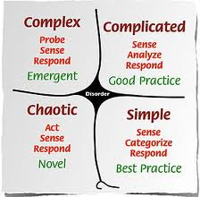
Understanding change ‘Cynefin’ Tool Dave Snowden
Notes:
9 The challenge of complexity
The human condition is to try to understand situations in order to make good decisions about how to act (or not to act). Some situations are easy to comprehend: they are familiar and we have dealt with them or something like them before and we are confident that we know what to do. Others are more difficult to understand and some are impossible to understand until we have engaged in them. The Cynefin framework developed by David Snowden (Snowden 2000; Snowden and Boone 2007) and described by Callaghan (2009) on YouTube helps us appreciate the nature and level of complexity in different types of situation. The framework was originally developed to aid understanding of situations and how to deal with them in organisations, but the concept can also be used to evaluate personal situations. There are four domains within the framework.
In the simple domain things have a simple cause and effect – you do X and you are very likely to get Y. The environment is familiar and understood. You will probably have had many similar experiences that can be directly related to the situation. You know that ‘what you do’ is likely to have a particular result. And if you do the same thing in a similar situation the same result will happen. At the other extreme is the chaotic domain where there is no perceivable relationship between cause and effect. If this situation happens in your life, you feel totally out of control and overwhelmed. In these situations your natural response is to act, sense what happens and then act again until you get yourself into a more understandable and comfortable situation. Between these two extremes there are two other types of situation.
The Cynefin tool helps us think about situations of differing complexity (Snowden 2000, Callaghan 2009)
SIMPLE SITUATIONS
Cause leads to a predictable effect. Relationships are repeatable. Situation is known
CHAOTIC
No cause and effect relationships. Situation is not perceivable.
COMPLICATED situations are not single events but involve a stream of interconnected situations (many of which may be simple) linked to achieving a goal (like solving a difficult problem or bringing about a significant innovation or corporate performance). They can be difficult to understand: there are cause-and-effect relationships but you have to put some effort into working out the relationships by gathering information about the situation and analysing it to see the patterns and look for possible explanations of what is happening. Engaging in these sorts of challenges is the way you become more expert in achieving difficult things and a lot of professional work is like this.
COMPLEX situations are the most difficult to understand. They are not single events but involve multiple streams of variably connected situations linked to achieving a significant change in the pattern of beliefs and behaviours (culture) in a society or organisation. In such situations the cause-and-effect relationships are so intertwined that things only make sense in hindsight and sometimes well after the events have taken place. In the complex space, it’s all about the inter-connectivity of people and their evolving behaviours and patterns of participation that are being encouraged or nurtured through the actions of key agents. The results of action will be unique to the particular situation and cannot be directly repeated. In these situations relationships are not straightforward and things are unpredictable in detail. People involved may not know the cause of the change that they have been involved in or ascribe the source of change to something that is quite removed from the trigger for change. The sort of factors being dealt with in the complex space are things like culture, trust and leadership, and the way you make progress in understanding what is happening is to sense the patterns of change and respond accordingly.

Slide 12
Organisations as complex adaptive systems (Stacey 2000)
diverse agents in
an organisation
A
B
agents respond
by self-organising
change
D
C
new patterns of thinking and behaviour emerge
new patterns of behaviour feedback
Notes:
10 Organisational change is complexity in action
Higher education institutions are large, complex, adaptive social systems. A ‘complex adaptive system consists of a large number of agents, each of which behaves according to its own principles of local interaction. No individual agent (eg teacher or administrator), or group of agents (eg teaching team or department) determines the patterns of behaviour that the system as a whole displays, or how these patterns evolve, and neither does anything outside the system’ (Stacey 2000).
Those responsible for creating improvement strategies and for supporting improvement have to be aware of and sympathetic to the complexity of change and changing. They must be conscious of the way in which social systems like teaching teams and departments self-organise in response to change in ways that are often unpredictable and which might appear illogical to those sitting outside the actual environment in which change is happening. They need to be aware of the inherent paradox and contradictions in the plethora of policies, strategies and support mechanisms that seek improvement and of the nature of learning that emerges through changing. It is necessary for individuals and teams to invent their own wheels in order to understand and take ownership of change to gain improvement. In short, those responsible for promoting and supporting improvement need to be aware that where people work is primarily at what Fullan (2003) calls the edge of order ie somewhere between the world where things make sense from a managerial perspective and the world where anarchy prevails. In the organisational change literature this world is known as the edge of chaos (Stacey, 2000): the place which most people occupy most of their working lives.

Slide 13
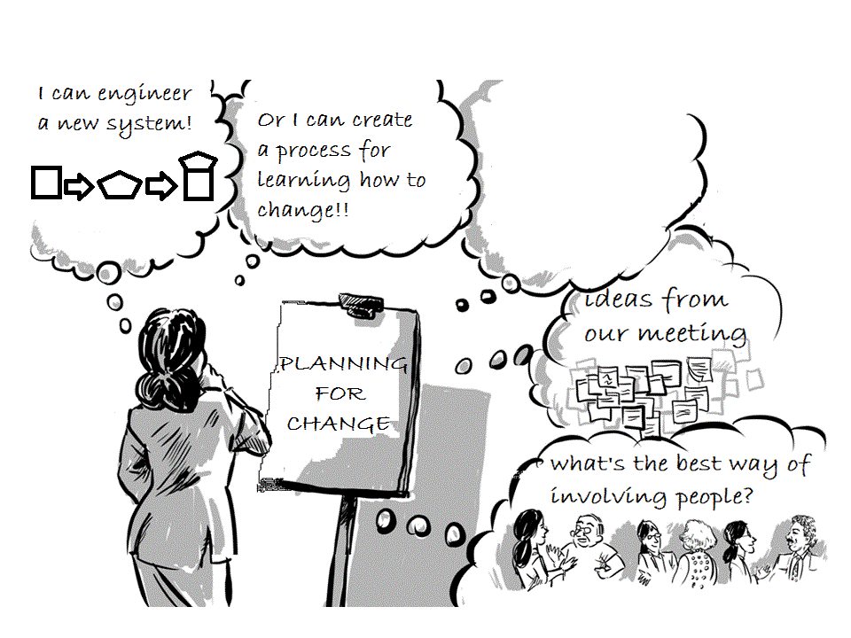
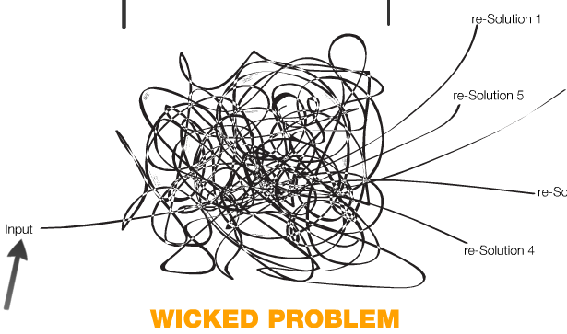
Planning for organisational change
Notes:
11 Creating significant organisational change is the toughest challenge for any organisational leader. It’s a systemic problem. By that I mean the organisation behaves as a system in which individuals and parts relate to each other often in a complex way and you change one part and it affects the other parts. Peter Checkland (199) describes organisational systems from two different perspectives. The first is through the lens of an engineering metaphor in which the parts of the system can be designed and function exactly as the designer intended – he called this a hard system. And in planning terms we might think that if we want to achieve this function we bring this and this together and it will happen.
But in socially constructed systems like a university the nature and complexity of human activity and interactions usually defies such a rational and logical approach. Checkland used the term soft systems to describe this type of situation. A soft systems view of the world accepts diversity, complexity and the non predictable behaviours of people and uses people as a resource to build a learning system. This is the way that we have to tackle wicked problems like organisational change – we have to involve people in creating the solutions for change rather than impose a design that assumes change will happen in a certain way.
Checkland (1999) Systems thinking, systems practice New York Wiley

Slide 14
Ten rules for emergence in organisational change
Seel (2004)
1 Improve connectivity
2 Increase diversity
3 Increase flow of relevant information
4 Contain anxiety
5 Ensure power is proportionate
6 Maintain identity while managing discomfort & conflict
7 Maintain good boundaries
8 Work with purpose and intention
9 Encourage positive emotional space
10 Watch with anticipation
See also the work of Michael Fullan

Slide 15
Strategic Change as a Wicked Problem
Wicked Problems Rittel & Webber (1973)
No proper definition or structure
No stopping rule.
Solutions are not true‐or‐false, but better or
worse
Every solution is a "one‐shot operation" and
counts significantly.
No pre‐determined solutions or well‐described
resolving actions.
Have multiple root causes and are nested in
other problems
Solutions are likely to generate unintended
consequences
Many social problems/challenges are wicked problems
TACKLING A WICKED PROBLEM
Notes:
13 Wicked problems and challenges
I want to frame the idea of accomplishing significant self-determined change in a university as a 'wicked problem' (Rittel and Webber 1973). By that I mean accomplishing significant change is an ill-defined, ambiguous, socially grounded and often contested problem associated with strong moral, political and professional issues and values (Richie 2011). As far as changing an organisation is concerned - changing is the last thing that most people in the organisation want to do and engaging in change - moving from the known, the tried and tested ways of doing things into unknown and unproven territory is a risk that creates a big problem for most people. In other words the act of trying to engage a university in significant change creates a new wicked problem (Camillus 2008). The term ‘wicked’ in the context being used here, is not about being evil, rather it describes an issue that is hard to understand and define, and highly resistant to resolution.
Some characteristics of wicked problems (Rittel & Webber 1973) Dilemmas in a General Theory of Planning. Policy Sciences, Vol. 4, 155-169
No proper definition or structure
No stopping rule.
Solutions are not true‐or‐false, but better or worse
Every solution is a "one‐shot operation" and counts significantly.
No pre‐determined solutions nor well‐described resolving actions.
Have multiple root causes and are nested in other problems
Solutions are likely to generate unintended consequences
Many social problems/challenges in a society are wicked problems
References
Camillus, J.C. (2008) Strategy as a Wicked Problem, Harvard Business Review. Available at: http://hbr.org/2008/05/strategy-as-a-wicked-problem/ar/1
Ritchie, T. (2011) Wicked Problems: Structuring Social Messes with Morphological Analysis Swedish Morphological Society. Available at: http://www.swemorph.com/pdf/wp.pdf
Rittel. H, & Webber, M.(1973) Dilemmas in a General Theory of Planning. Policy Sciences, Vol. 4, 155-169

Slide 16
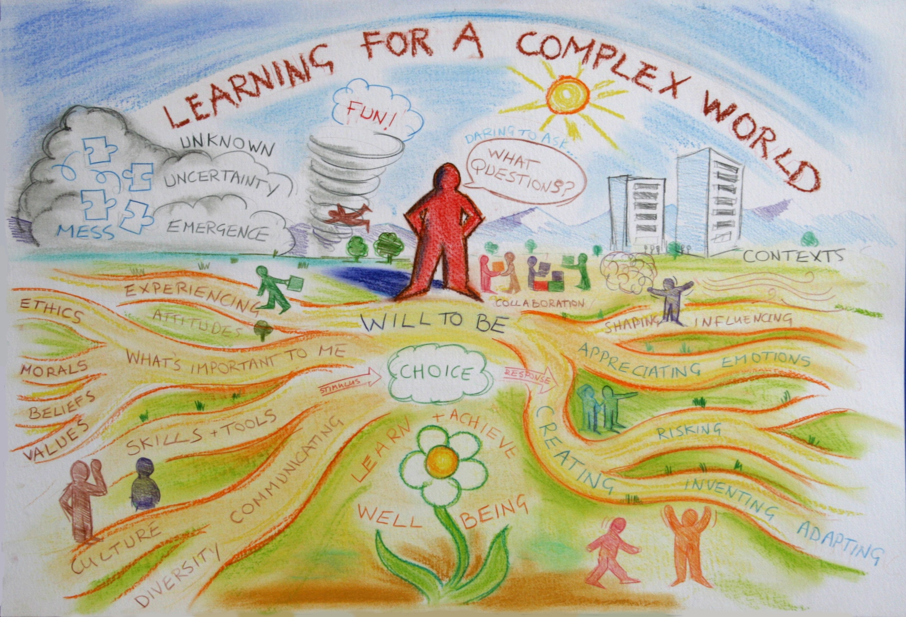
The learners’ & educators’ wicked challenge
me 1978
Notes:
14 People working and studying in higher education are confronted every day by essentially the same wicked challenge.
For teachers it is associated with a question like ‘ how do we prepare my students for an ever more complex world?’… I don’t just mean preparing students for their first job when they leave university I mean how do we prepare them so that they can face and adapt to the many challenges they will encounter over a lifetime of working, learning and living.
From the students’ perspective the same challenge is expressed in the question ‘ How do I prepare myself for the rest of my life?’… what sorts of things do I need to learn, what sorts of skills, qualities, dispositions and values do I need to develop, and what sorts of experiences do I need to have.. Personal and professional development needs to be so much more than simply studying and learning an academic curriculum.
This picture, which we drew on the wall of our Centre at the University of Surrey, symbolically represents some of the complexity embedded in this wicked problem – which is a problem that is very difficult to define, is nested in other problems and has many perspectives on it, has no right or wrong answers, and no clear resolving actions.

Slide 17
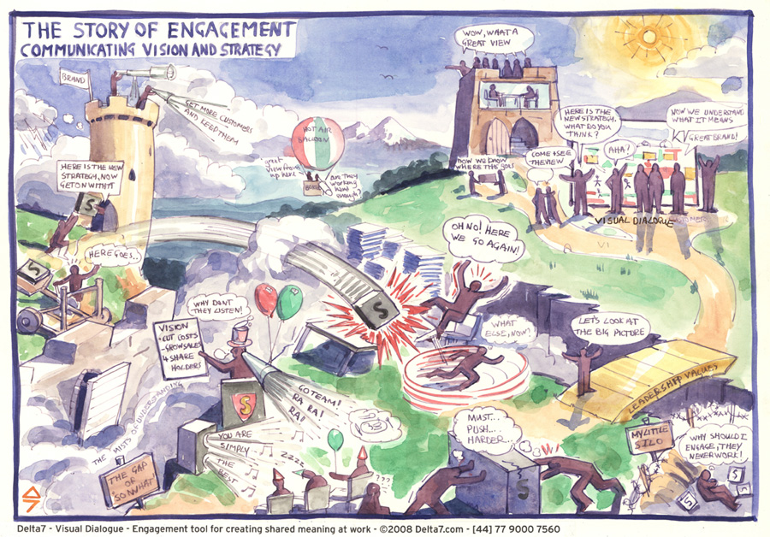
The organisational leaders’ wicked challenge
Notes:
15 The second challenge facing people who work in higher education, particularly the leaders of higher education institutions, can be described by the question ‘ How do we change our university so that it is better able to meet the challenge of preparing learners for a very complex, uncertain and ever changing world?’. How do we move from what is still a predominantly industrial provider-designed and directed model of higher education to a more ecological learner-designed and managed model of learning which is more appropriate for a modern world.
Many faculty would say that there is no problem.. and therein lies the problem….the challenge is to persuade people that believe there is no need to change something that has worked perfectly well for them in the past. Multiply that by the number of faculty and administrators working in a university and you can see how difficult it is to bring about change across a university.
University structures are hard to work cross, procedures are often non negotiable and require compliance, traditions and habits are deeply embedded in practices, and individual academics (at least in the UK) have significant levels of autonomy that means they have to be persuaded rather than be made to change. Bringing about significant change in a university is a complex and often messy process.

Slide 18
Why universities are wicked places for change
Universities are pluralistic institutions with multiple, ambiguous and conflicting goals. They are professional institutions that are primarily run by the profession (the faculty) often in its own interests rather than those of the clients and they are collegial institutions in which the Vice-Chancellor is less a CEO and more a managing partner in a professional firm who has to manage by negotiation and persuasion.
Change is extremely difficult to bring about in an institution
with these characteristics. (Bain 2007:13).
Institutions of higher education are characterized by extremely
decentralized structures of authority, remarkably dispersed incentive
systems, and relatively few restrictions on the way people choose to
use their time. These prominent organizational features that render
colleges and universities distinctive among social institutions certainly
help the academy protect its freedom from unwanted political and
external influences. But they simultaneously act to subvert change of
any kind (Ewell 2004:2).
Notes:
16 Two views of universities which provide insights into why they are difficult sites for change.
The first from a former Vice Chancellor Sir George Bain
Universities are pluralistic institutions with multiple, ambiguous and conflicting goals. They are professional institutions that are primarily run by the profession (the faculty) often in its own interests rather than those of the clients and they are collegial institutions in which the Vice-Chancellor is less a CEO and more a managing partner in a professional firm who has to manage by negotiation and persuasion. Change is extremely difficult to bring about in an institution with these characteristics. (Bain 2007:13).
The second from a highly respected commentator on higher education in the USA Peter Ewell
Institutions of higher education are characterized by extremely decentralized structures of authority, remarkably dispersed incentive systems, and relatively few restrictions on the way people choose to use their time. These prominent organizational features that render colleges and universities distinctive among social institutions certainly help the academy protect its freedom from unwanted political and external influences. But they simultaneously act to subvert change of any kind (Ewell 2004:2).
Now it might be that these cultural characteristics are not found in China’s universities, in which case my talk will be of little value. But they are then I’m confident that what I have to say will be relevant. It is the organisational respect for autonomy in the academy, combined with the ability of the academy to subvert change, that are the source of much of the 'wickedness' in the challenge of accomplishing signiifcant strategic change in universities.

Slide 19
What are the factors and conditions that enable universities to change which encourage teachers to innovate in ways that engage with this wicked problem?
Notes:
17 The two challenges I have alluded to are linked. They are not the only problems facing faculty and their leaders but it is the unifying educational challenge.
I became interested in questions about how universities harness the power of their innovators to bring about the sorts of changes that they can assimilate and make their own when I took responsibility for an innovation project that was trying to address this wicked challenge. So my professional learning needs and interests have been driven by an underlying question like -
What are the factors and conditions that enable universities to change which encourage teachers to innovate in ways that engage with this wicked problem?

Slide 20
FORCES FOR CHANGE
university
spontaneous innovation from the bottom
Notes:
18 Forces for change in UK universities are numerous and continuous. In the UK we are still in the midst of a 30 year transformation from a low participation system of higher education where only 10% of the18-19 group leaving school went to university to a mass system of HE where we have 40-45% of this group going to university and also a greater than 50% of studying university in your life. This transformation is also about reshaping higher education so that it is fit for purpose in a modern world. This means there is a strong emphasis on preparing students for working in the knowledge economy.
Innovation from the bottom of the organisation occurs spontaneously as faculty and administrators respond to the various forces for change that are all around them. Generally, results in local often temporary change and rarely affects the organisation strategically.

Slide 21
FORCES FOR STRATEGIC CHANGE
Pervasive organisational change
and innovation from the bottom
Notes:
19 Strategic change introduces a new force from within the organisation when the organisational leadership try to orchestrate and support a direction for change and provide a new context for bottom- up innovation.
I am going to present two case studies. In the first one a decision was made by a university to engage in self-determined change. It saw an opportunity to acquire additional resources to change and then engaged in a deliberate three year programme of change orchestrated from the top.

Slide 22
FORCES FOR STRATEGIC CHANGE
innovation from bottom tries to
influence top to create strategic change
Notes:
20 In my second case study I will also talk about a different scenario in which a department in a university tried to influence university in order to bring about strategic change

Slide 23
Strategic change is brought about by people engaged in intentional activities driven by their interpretation of the organisation’s vision & supported by the organisation
TOOLS
OUTCOMES
learning
strategy
change
SUBJECT
ACTIVITY
OBJECT
RULES
COMMUNITY
DIVISION
OF EFFORT
Human activity systems theory (Engeström 1987:78)
Notes:
21 Fundamental change of the type we are talking about does not happen without two essential factors. The first is institutional will which is embodied in the practices and communications of an institutions leaders and transmitted through its workforce. Organisations use their strategy as a tool to convey the organisational will.
The second is activity. Without new activity that is different to what has been done before nothing will change. Because change is activity-based we can use Engstrom's activity system model to describe and map the dynamics of the system

Slide 24
Strategic change involves creating lots of new activity
systems aligned with new vision, mission, objectives
involving individuals, teams and departments
Notes:
22 Strategic change orchestrated by the institutional leaders and conveyed through its strategy and policies for engaging faculty and resourcing new activity stimulates lots of new activity. Every part of the system that is involved in change is creating its own activity systems out of which change emerges. If all these activity systems are more or less aligned to the strategy then strategic change will be accomplished.

Slide 25
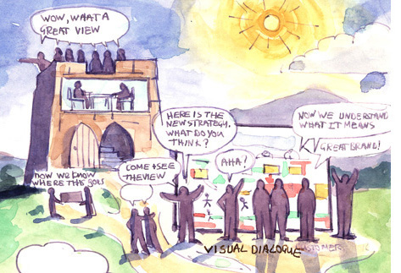
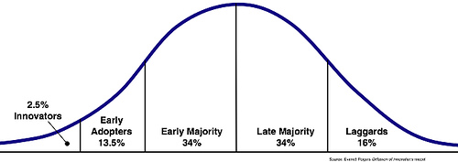
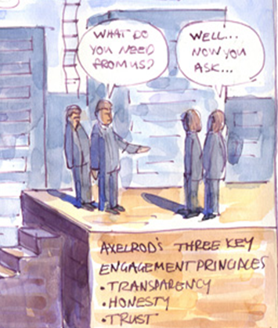
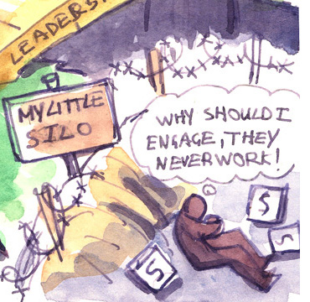
Rogers (1995) Innovation/diffusion curve
IF YOU DON’T
TRY YOU’LL
NEVER KNOW
EMERGENCE
Notes:
23 When a university decides it wants to significantly change institutional leaders have to create a vision of what the future will look like and sell that vision to the people working in the university. We know from the work of Rogers on the way innovations are diffused that the attitudes of the members of the university are likely to follow a pattern like the one shown by this distribution curve.
A small percentage of the population will embrace change and step forward to lead change.. They are the enthusiasts, innovators and early adopters.
At the other end of the spectrum a small proportion of staff will resist change….. These are the laggards, the people who hang back, who have no intention of changing if they can help it..
The bulk of the population, the early and late majority, will change if they can see why it is important to do so and if they can see the benefits in a very concrete way. They can also be encouraged to change if new systems or procedures are introduced that require them to change their behaviour. The people in the early and middle majority need to draw on examples of what change will look like produced by the innovators and early adopters. These people are crucial to change in any organisation so lets start by looking at these people and the nature of innovation.
Rogers, E.M. (1995). Diffusion of innovations. 4th Edition. The Free Press, Simon & Schuster, New York.

Slide 26
An innovation is an idea, practice or object that is
perceived as new by an individual or other unit of
adoption…. If the idea seems new to the individual,
it is an innovation (Rogers 1995:11).
An innovation in one situation may be something already established elsewhere, but .... initiative takers and participants see it as innovation in their circumstances.. Such changes may be new to a person, course, department, institution or higher education as a whole. (Hannan and Silver, 2000:10).
An educational definition
'a novel solution to an educational problem, opportunity or challenge, that is more effective, efficient, sustainable, or just than existing solutions and for which the value created accrues to both the individual learner and society as a whole.' (adapted from Phills et al 2008 definition of social innovation)
Notes:
24 What do we mean by innovation –
We usually think of innovations as new global products such as what apple bring out from time to time but innovation also applies to services and practices at a more local scale. Here are a couple of definitions that I have found useful.

Slide 27
Scope, significance and level of influence.
Personal
Organisation/
system/market
Global
innovative actions of experts/experienced
people & teams within an organised process
3 impact on society, 'global phenomenon‘
new ideas and their implementation
2 impact on an organisation, field or system of practice,
or market
Individuals’
innovative acts
1 impact an individuals’
zone of influence
eg new way of teaching
significance and impact of an innovation (1-3)
Notes:
25 Innovation is related to creativity in that it is an act of creation that is applied to practice, products or services. Like the concept of creativity, innovation can be visualised in terms of its scope, significance and influence (Figure 3) mirroring the 4-C model of creativity proposed by Kaufman and Beghetto (2009).
At the global level there are innovations - like the world wide web - which have the potential to affect everyone on the planet. Individual organisations may develop a set of products and applications (like Apple for example) that are also global in their reach and effects. Such innovations are normally created by teams of people working collaboratively with a shared vision of the product or service they are trying to create.
At the individual level we all innovate to varying degrees in our daily lives. It's all part and parcel of adapting and seeking better, quicker, more effective and more interesting ways of doing things. For example communications technology like computers and smart phones have profoundly affected the way we shop on line.
As individuals we also innovate in our professional lives. For example, in universities, the fact that Faculty have a high degree of autonomy and control over what they teach and how they teach it, means that teachers are continually inventing and re-inventing the curriculum, learning resources, teaching and learning strategies and assessment practices. Changing in a deliberate and incremental way, is a way of life for the conscientious higher education teacher.
But, the norming process in the professional environment means that most teachers tend to adopt similar practices to their peers so even though there is lots of invention it tends to follow the patterns of behaviour already established in the local cultural setting - the department or school. Established practices like acceptable forms of assessment, rigid timetable structures and the rooms in which classes take place can all constrain innovation. But it is not uncommon for teachers to engage in more radical change or innovation for example when a new module or programme is being created, or an entirely new pedagogy (like problem based learning) or technology is being introduced for the first time.
But some teachers create practices that are very different to local norms and these practitioners are perceived locally as the innovators or early adopters of new ideas or technology.
Without this personal level of activity in an organisation, through which individuals learn to innovate, to experiment and turn their ideas into new practices, it is unlikely that innovation in a strategic organisational sense, will flourish.

Slide 28
Incremental, adaptive and innovative change
adaptive
original
innovation
DEGREE OF CHANGE
adaptive
innovation
incremental
ORIGINALITY
Existing Practice
New Practice
Doing the right things
Doing things right
Doing things better
Doing new things that already exist
Appropriating what someone else is doing
Doing things no one else is doing
Notes:
26 Categories of innovation

Slide 29
Types of innovation Wai (2011)
3 Disruptive innovations - disrupt current market behaviour rendering existing solutions obsolete, transforming value propositions, and opening new markets
Breakout innovations - significantly up the level of play within an existing category.
Sustaining innovations –
sustain products and services - variations on an existing theme.
Notes:
28 Categories of innovation

Slide 30
Innovation Radar - 12 dimensions of business innovation (Sawhney et al 2011: 30).
OFFERINGS
(WHAT?)
Brand
Platform
Networking/
Partnerships
Solutions
PRESENCE
(WHERE)
CUSTOMERS
(WHO)
Supply Chain
Customer Experience
Organisation
Value Capture
PROCESSES
(HOW?)
Notes:
29 Types of Organisational Innovation
Organisational or business innovation used to be focused on products and services but the need to innovate means that businesses now approach innovation more systematically and holistically.
We define business innovation as the creation of substantial new value for customers and the firm by creatively changing one or more dimensions of the business system.(Sawhney et al 2011: 28)
These authors took a 360 degree view and identified 12 key dimensions of business (Figure 5) comprising four main 'anchors' 1) the offerings the company creates 2) the customers it serves 3) the processes it employs 4) the points of presence it uses to take its offerings to market. Between these anchors are embedded eight other dimensions of business systems.
Systematic innovation that is stimulated through a deliberate organisational change strategy requires well managed and repeatable processes to move an organisation beyond a dependence on sporadic innovations to create a more constant and dependable and flow of new ideas (Speirn et al 2008:4). Equally important are the cultural conditions that encourage people to feel empowered and to know that support will be available should they invest their time, intellect and creativity in developing a new idea which has good potential for adding value to what already exists.

Slide 31
PART 1 NATURE OF ORGANISATIONAL CHANGE & INNOVATION
Questions, comments & discussion
PERSONAL CHANGE & INNOVATION ENQUIRY

Slide 32
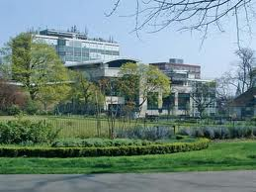
Southampton Solent University
New university (2005)
17,500 students
Teaching-led
Strong vocational tradition
Good graduate employability
Recognised excellence in education for
Creative Industries & Maritime education
HEFCE
approval
SDP
team
SDP Options
Appraisal
Bid
SDP YEAR 1
SDP YEAR 2
SDP YEAR 3
Strategic Development Programme (SDP)
£7.8m over 3Y educational innovation, organisational devt & infrastructure
New
LEADER
New
Strategic Plan
July 2007
July 2008
July 2009
July 2010
July 2011
July 2012
Notes:
30 In 2011 I was fortunate to be invited to undertake a research study into how one university tried to accomplish strategic change over a three year period between 2009-2012 and I want to share the results of that study which will soon be published in a book.
Southampton Solent University is located on the south coast of England in Southampton, a major sea port and busy city of about 240,000 people. The university has about 19,000 students is located on three sites. It is teaching-led rather than research intensive, with a strong tradition in vocational education, good student employability statistics, and recognised excellence in maritime education and education for the creative industries.
In 2007 a new Vice Chancellor was appointed and this coincided with the development of a new 5 year strategic plan. The new university recognised that it had to adapt to what was a fast changing HE system in the UK. It bid for additional funding to help it change and in 2009 was awarded just over £7million over three years. Half as a direct grant and half as the full economic cost – which funded the development of new business systems.
This process of change became known as the Strategic Development Programme or SDP…

Slide 33
Southampton Solent University Strategic Plan 2008-13
Vision
• A vibrant, inclusive and successful University that is well known for the excellence of its
work with students and employers and the effective integration of theory and practice
• A stimulating student experience characterised by intellectual rigour, personal fulfilment and
excellent career prospects
• Imaginative external partnerships which develop the University and make a significant
contribution to social justice and economic competitiveness
Mission
The pursuit of inclusive and flexible forms of Higher Education that meet the needs
of employers and prepare students to succeed in a fast-changing competitive world.
Objectives
1. Inclusive and flexible forms of Higher Education that meet market needs;
2. Imaginative working partnerships with Further Education and employers;
3. A significant contribution to social justice and economic competitiveness for Southampton
and its region;
4. Knowledge creation and exchange that fuse academic rigour and professional practice;
5. Excellent student employability;
6. Entrepreneurship and diversified income streams;
7. Changed employment arrangements that support high performance;
8. Sustainable growth and investment in the estate.
Notes:
31 Southampton Solent’s strategic plan was unusual because the essence was condensed to one sheet of paper with the details of how to implement the plan contained in a series of strategies covering different functions.

Slide 34
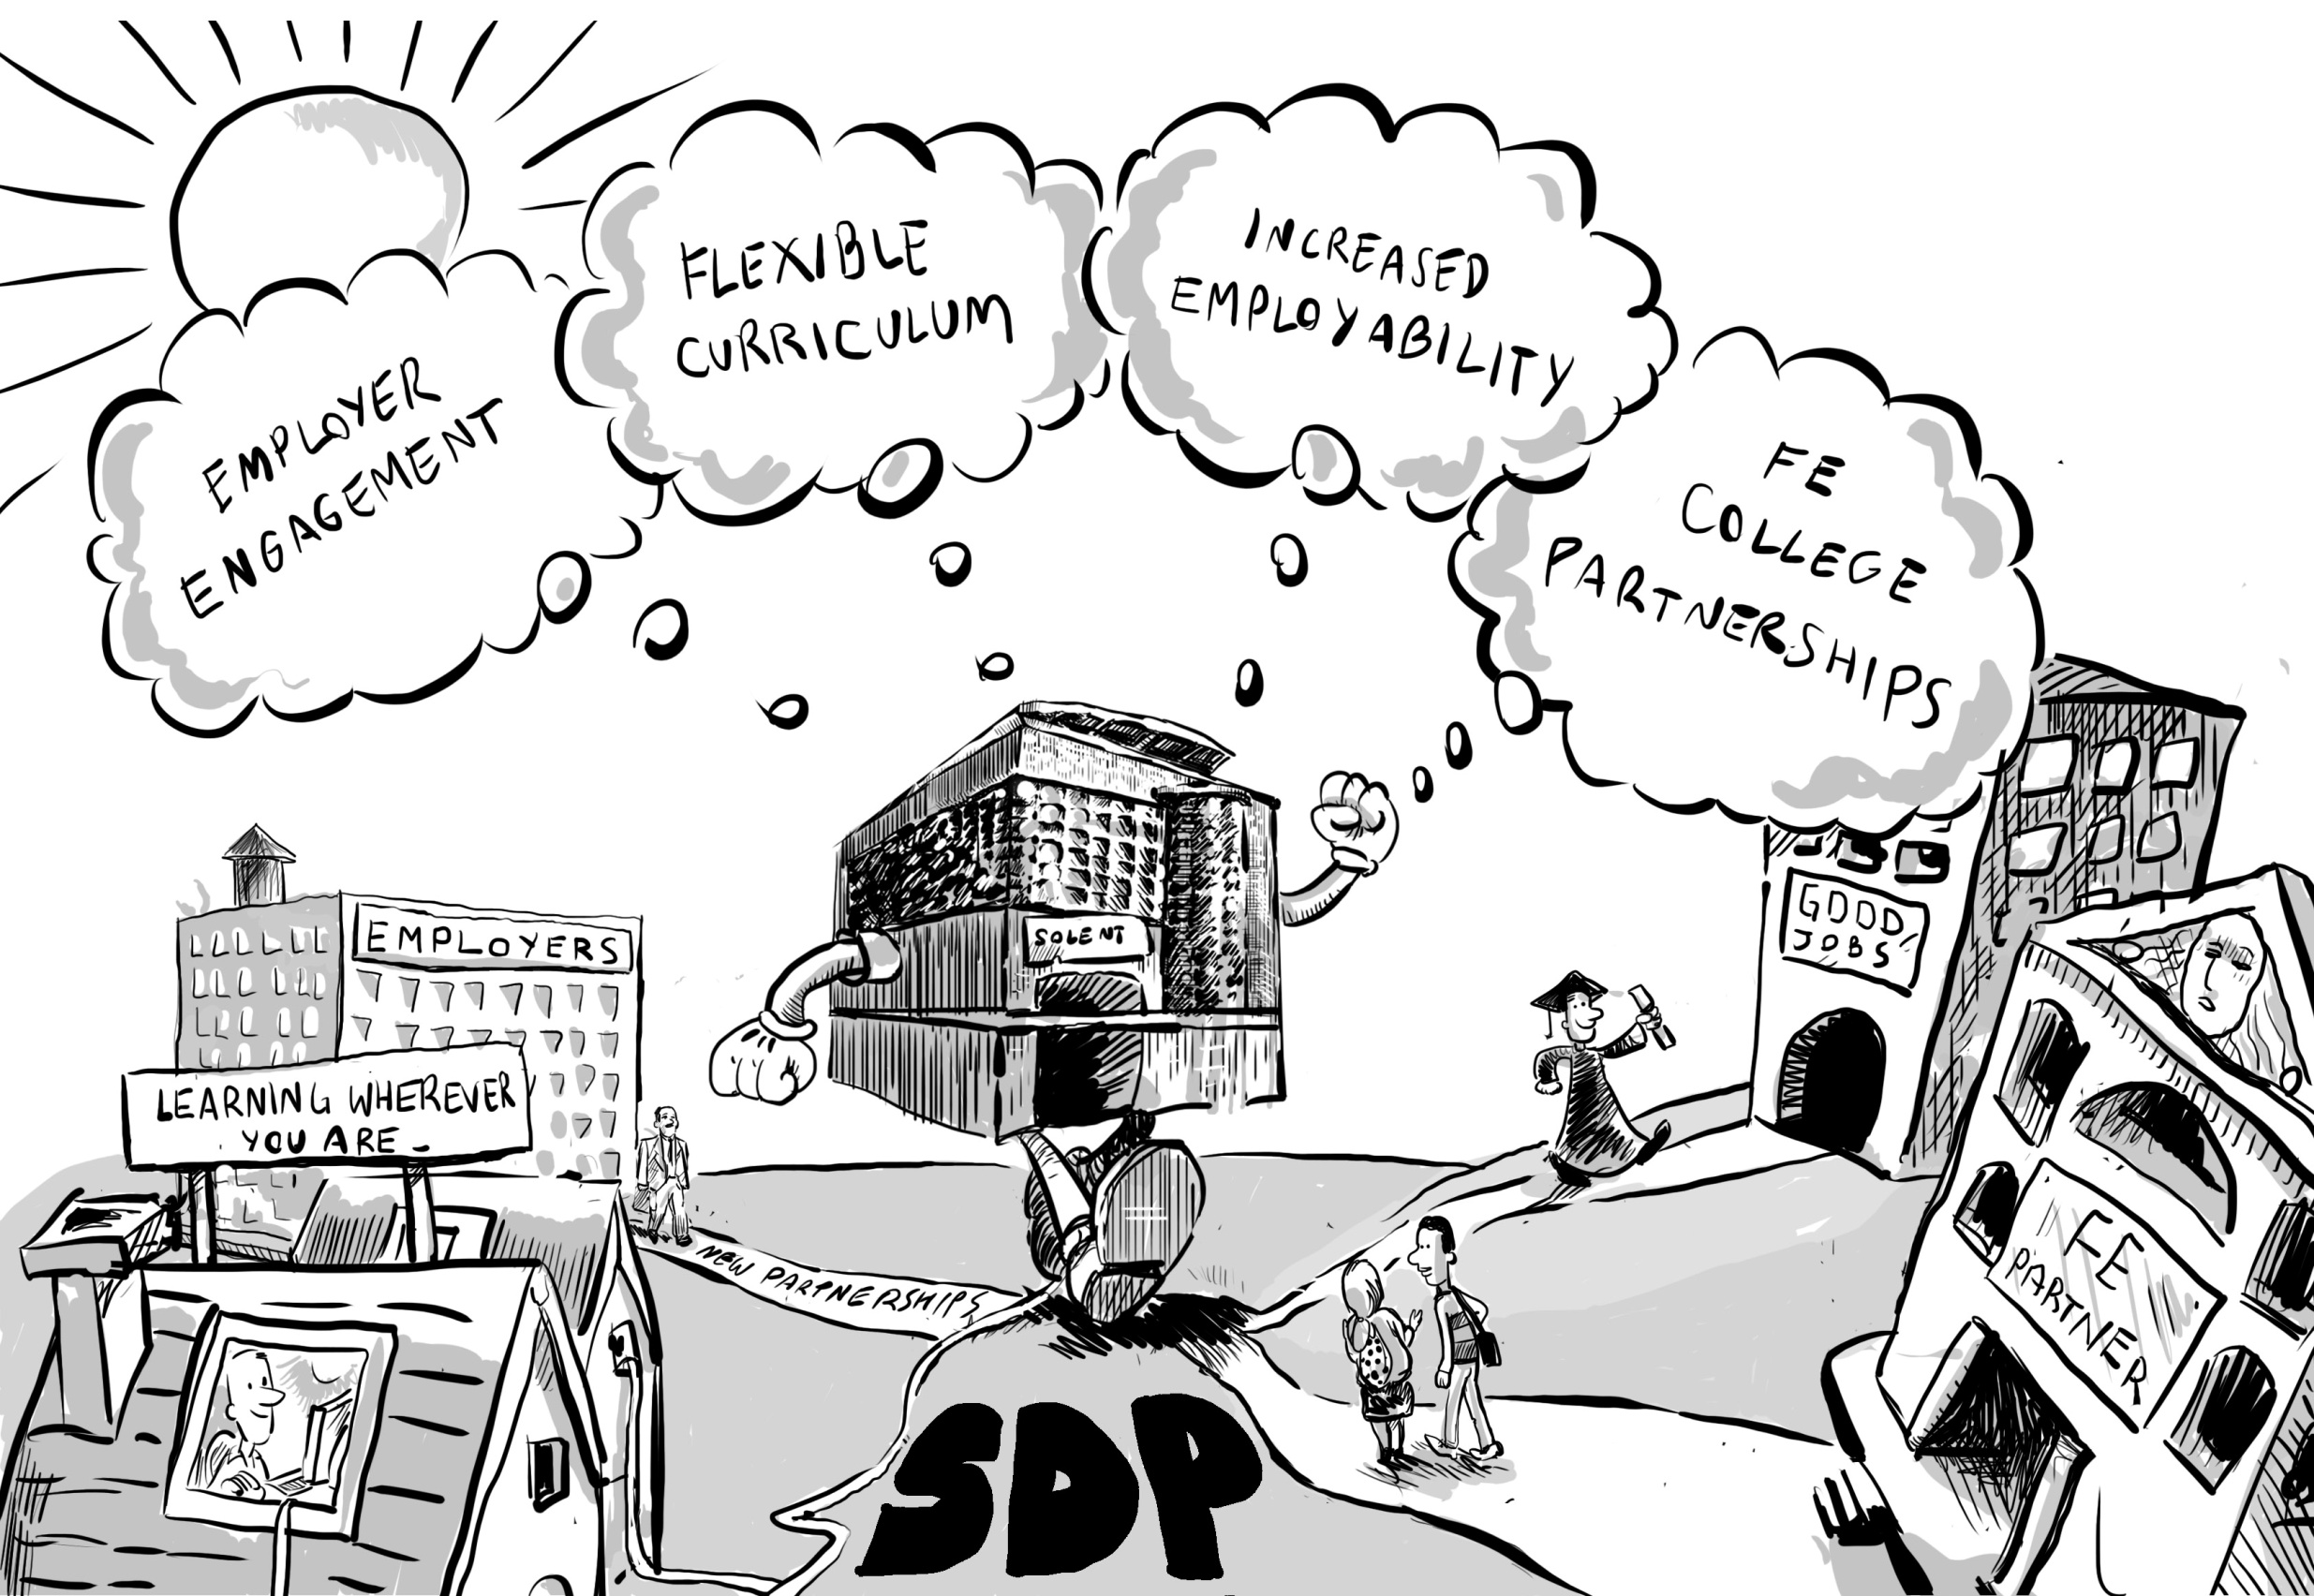
Mission The pursuit of inclusive & flexible forms of Higher Education that meet the needs
of employers and prepare students to succeed in a fast-changing competitive world.
Notes:
32 The rhetoric of change within the university was about becoming more agile, capable of responding and adapting quickly to changes in the external environment.
The University saw its future in meeting the needs of employers – local, regional and national by providing curricula that were more in tune with the education and training nees of employers and of providing education that was relevant to students gaining employment.
Its strategy focused on four objectives..
1) Improved relationships with a wider range of employers such that they were more involved in the design and delivery of the curriculum and were more involved in funding their workforce to participate in such programmes.
2) A more flexible curriculum in which learners could study anywhere and at any time… e-learning and new support systems
3) Learning experiences that improved the employability prospects of students – making higher education more relevant to the career choices of learners
4) New forms of partnership with the schools and colleges that were close to the university

Slide 35
What factors and conditions encourage and facilitate
bottom-up innovation within a strategic change
process in a university?
60 semi-structured interviews
Senior and middle managers
Strategic project managers
Innovators
Significant others
Plus working documents
Notes:
33 My study began in October 2011 with a small scale interview-based study in the School of Design involving 9 members of staff 12 staff. The study was expanded between March-July 2012 when another 50 people were interviewed. About 60 people were interviewed altogether including managers, innovators, systems managers, administrators and other people involved in the change process.
The core of the study was a series of case studies which were the stories of how innovators accomplished the changes they were trying to make.
These stories were used to identify factors and conditions that seemed to encourage and facilitate bottom-up innovation within a process of strategic change..

Slide 36
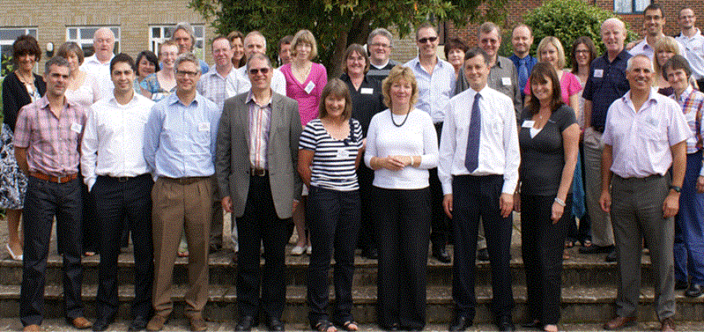
Who are the innovators?
Any Faculty member has the potential to be an innovator but
innovators have certain characteristics that make them different
Characteristics
Motivations
Notes:
34 Who are the innovators?
Any Faculty member has the potential to be an innovator but innovators have certain characteristics that make them different.
Individuals do not self-identify as being particularly unique or innovative, instead they present themselves modestly and with humility.
Most innovators don't need incentives to innovate but if there are incentives they will see them as opportunities. What a strategic plan does is encourage innovators to align their innovations to the directions and accords these inventions and the innovators a status.
Qualities, dispositions and capabilities shared by innovators include: passion and enthusiasm, commitment, ambition, creativity, drive, energy, integrity, honesty, openness to new experiences, self-confidence, self-belief, a positive and optimistic attitude.
Innovators are willing to put themselves into unfamiliar territory and involve themselves in significant change. They are willing to try something and then adapt in response to what happens. They have to be flexible in their thinking and approach.
They are good at imagining seeing things differently and visualising the steps need to change.
And they are good communicators - able to sell their ideas, and negotiate with and persuade others that their ideas have value.
Finally they are persistent, once they start they aim to finish. They want to actualise their ideas.

Slide 37
Innovation Radar - 12 dimensions of business innovation (Sawhney et al 2011: 30).
New programmes, professional
development units & opportunities for
students to develop employability
skills and work with employers
OFFERINGS
(WHAT?)
New e-learning delivery platform
and niche market portal
Platform
Networking/
Partnerships
Solutions
PRESENCE
(WHERE)
CUSTOMERS
(WHO)
New relationships
with colleges, schools
andemployers
New types of student –
professional learners
Supply Chain
Customer Experience
New types of learner experiences
Organisation
Value Capture
PROCESSES
(HOW?)
New business systems and processes
Notes:
35 The types of innovation are shown using (Sawhney et al 2011: 30) innovations mapping tool.
What? new offerings
New types of educational programme like the:
Foundation Degree Health and Social Care designed, delivered and resourced in partnership with a local Hospital Trust.
MSc Shipping Operations
new designs for professional development units in areas where there are known to be markets
New types of experiences for developing employability skills
within existing programmes eg real world design, manufacture and marketing of garments in fashion courses
new opportunities for freelance work with employers in the creative arts through Solent Creatives
Who? new customers
New types of learner like :
distance learners who are working at sea served by the MSc Shipping Operations or SuperYacht Academy
learners served by new professional development units in areas where there
is a market for this type of provision.
How? new processes
New business systems and processes
New delivery and marketing platforms - Solent Virtual Campus, SuperYacht Academy
New networks through the assimilation of existing networks from outside the university into the university structures Solent College School Partnerships
New problem solving and opportunity creating practices -
Where? - new points of presence to take offerings to market
New relationships with FE colleges to improve student progression.
New relationships/strategic alliances with employers to create new co-designed programmes like the Foundation Degree Health and Social Care
New relationships with schools and colleges through the sports partnership

Slide 38
Incremental, adaptive and innovative change
adaptive
original
innovation
DEGREE OF CHANGE
adaptive
innovation
incremental
ORIGINALITY
Existing Practice
New Practice
Notes:
36 Types of innovation

Slide 39
Types of innovation Wai (2011)
3 Disruptive innovations - disrupt current market behaviour rendering existing solutions obsolete, transforming value propositions, and opening new markets
Breakout innovations - significantly up the level of play within an existing category.
Sustaining innovations –
sustain products and services - variations on an existing theme.
Notes:
37 Innovations could be classified into each of the three categories defined by Conrad Wai

Slide 40
What’s important to innovators ? 21 ratings Max 5.0
1 Having a clear vision of how the university saw its future and how SDP contributed to that vision | 3.7
2 My readiness and willingness to get involved in the SDP opportunity | 4.7
3 My vision of what I wanted to achieve | 4.5
4 My will/motivation to succeed | 4.7
5 Having explicit goals and realistic work plans | 4.4
6 Having the autonomy to implement the project as I wanted to | 4.3
7 Having the opportunity to use my personal creativity | 4.1
8 Believing I could take risks without feeling I would be criticised if I wasn't completely successful | 4.3
9 Having the financial resources I needed when I needed them | 4.3
10 Having the time I needed to complete the job | 4.4
11 Being able to find the help I needed when I needed it | 4.3
12 Having good communication with the people I needed to talk to | 4.5
13 The active involvement of others - teamwork | 4.7
14 Learning through the experience (learning from problems as well as successes) | 4.3
15 Feeling trusted and being allowed to get on with it without interference | 4.7
16 Feeling that I made good progress within the time available | 4.5
17 Feeling that what I was doing was valued by my colleagues | 4.5
18 Feeling that what I was doing was valued by Head of School/Service/ Dean | 4.4
19 Forming new productive relationships with colleagues in my school or university | 4.2
20 Forming new productive relationships with people outside the university | 4.3
21 Feeling that the environment encouraged and supported me throughout the process especially when things did not go as planned | 4.3
22 Feeling my contribution has been recognised and appreciated | 4.3
Notes:
38 A questionnaire was developed from a pilot study within the larger SDP study which identified factors that seemed to be important in enabling change to happen. Innovators were invited to rate the importance of each factor when trying to accomplish significant change on a five point scale.
The most striking conclusion is that all these factors are important to people when they are undertaking significant change. 21 of the 22 factors scored an average of 4 or more, and 19 factors scored 4.3 or more (max 5.0). The only factor to score less than 4 was (1) 'Having a clear vision of how the university saw its future and how SDP contributed to that vision.' However, most innovators had a clear vision of what they wanted to accomplish. Their vision is clearly more important to them than the strategic vision of the institution.
Personal characteristics (my will, my vision, my readiness) feature prominently in what is important, together with the way people wanted to be trusted and feel that their contributions would be valued. High value is also placed on communication, the social dimension of work and the need to make progress. The large number of factors innovators believe are involved in enabling innovation to be accomplished is striking and accounts for much of the complexity involved in innovating.

Slide 41
Eight factors had significantly lower average scores for realisation within SDP
1 Having a clear vision of how the university saw its future and how SDP contributed to that vision
2 My readiness and willingness to get involved in the SDP opportunity
3 My vision of what I wanted to achieve
4 My will/motivation to succeed
5 Having explicit goals and realistic work plans
6 Having the autonomy to implement the project as I wanted to
7 Having the opportunity to use my personal creativity
8 Believing I could take risks without feeling I would be criticised if I wasn't completely successful
9 Having the financial resources I needed when I needed them
10 Having the time I needed to complete the job
11 Being able to find the help I needed when I needed it
12 Having good communication with the people I needed to talk to
13 The active involvement of others - teamwork
14 Learning through the experience (learning from problems as well as successes)
15 Feeling trusted and being allowed to get on with it without interference
16 Feeling that I made good progress within the time available
17 Feeling that what I was doing was valued by my colleagues
18 Feeling that what I was doing was valued by Head of School/Service/ Dean
19 Forming new productive relationships with colleagues in my school or university
20 Forming new productive relationships with people outside the university
21 Feeling that the environment encouraged and supported me throughout the process especially when things did not go as planned
22 Feeling my contribution has been recognised and appreciated
Notes:
39 Eight factors had significantly lower average scores for realisation compared to the average scores for what was believed to be important, namely -
5 Having explicit goals and realistic work plans to achieve my objective (3.1 versus 4.4)
9 Having the financial resources I needed when I needed them (3.6 versus 4.3)
10 Having the time I needed to complete the job (3.3 compared to 4.5)
11 Being able to find the help I needed when I needed it (3.0 versus 4.4)
12 Having good communication with the people I needed to talk to (3.6 versus 4.5)
13 The active involvement of others - good teamwork (4.0 versus 4.7)
18 Feeling that what I was doing was valued by the Head of School/Service or Dean (3.7 versus 4.4)
21 Feeling that the environment encouraged and supported me throughout the process especially when things did not go as planned (3.2 versus 4.3)
These factors boil down to a combination of having the resources to complete the task of innovating, and innovating in an environment that supports and values the efforts of the innovator. In other words there was a consistent pattern of responses that suggests that there is a gap between the type of environment innovators believe is important to bring about innovation successfully and the environment that they experienced while they were innovating. Closing this gap would go a long way to creating an organisational culture that was as supportive of innovation as the innovators would like it to be.

Slide 42
What organisational factors & conditions encourage
strategic change and innovators to innovate?
Notes:
40 The study of strategic change demonstrated the value and importance of bottom-up innovation within a comprehensive and sustained strategic change project. While top down initiatives, like the introduction of new business systems and processes are essential to enabling a university to be more effective, responsive and adaptive in its educational work, it is the innovators who provide the key resource to enact and embody the significant educational changes a university is trying to make. The study reveals that innovators thrive in an organisational culture where leaders and managers are encouraging, supporting and enabling. Where they have the resources - especially time to make change happen. Where the institution's systems and procedures enable rather than hinder progress. Where they have the respect, emotional support and encouragement of managers and colleagues and where they can find help when they need it and where they feel their efforts have been valued and have made a positive difference.
It stands to reason that for organisational change to be successful the conditions and situations embodied in the factors that innovators consider to be important in accomplishing significant change have to be supported and realised. Twelve factors grouped under 1) leadership, management & facilitation or 2) environment/culture provide an overarching framework within which bottom-up innovation is more likely to be encouraged, supported and facilitated within a process of strategic change.

Slide 43
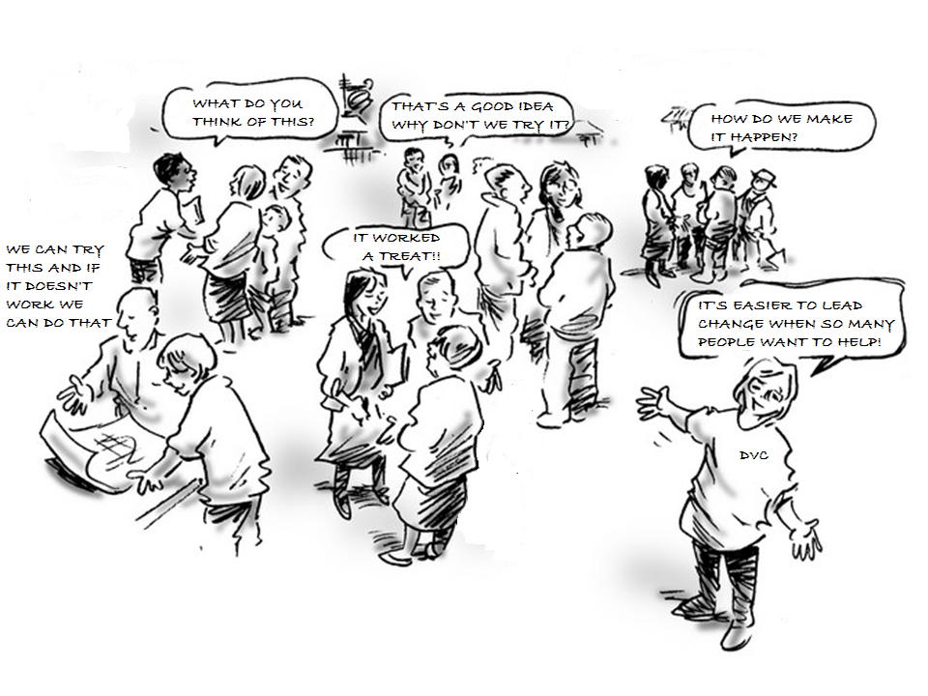
1 Leadership is shared and distributed throughout the organisation
Notes:
41 Whole organisation change is led from the top, middle and bottom. Leadership is shared and distributed throughout the organisation and innovators must be viewed as leaders of strategic change.
Leading from the top involves visualising the future and creating the conditions that motivates people to move the organisation in the direction of that future. It requires an integrating style able to hold the vision and deliver on commitments, but which is also open, flexible and trusting to allow ideas to emerge from the middle and bottom, and enable people to take ownership and exercise their autonomy to create and implement change. It involves trusting people to create the change once the direction has been set and encouraging and supporting the right sort of changes as they emerge.
Leading from the middle requires managers to accept responsibility for involving their Department, School, Faculty or Service in the strategic change and creating the conditions that encourage and enable their staff to participate in change. Leading from the middle involves translating organisational objectives into objectives that are meaningful in the local socio-cultural practice environment. Leading from the middle does not mean 'go and do it' it means 'we will do it together.'
Leading from the bottom involves individuals accepting responsibility to make change happen by adapting existing or inventing new practice that is consistent with the change the institution is seeking to make. The innovators are people who lead change by involving themselves in it and showing others how to accomplish it.
There is one secret to leading organisational change. The leaders at the top and in the middle have to create the conditions in which people at the bottom feel empowered and are enabled to change themselves and their own practices in order to make strategic change happen. This is a shared concept of leadership in which leadership is broadly distributed, such that people within a team and organization lead each other. It is a social, non-hierarchical concept and contrasts with more traditional notions where leadership roles are vested in individuals appointed by management.

Slide 44
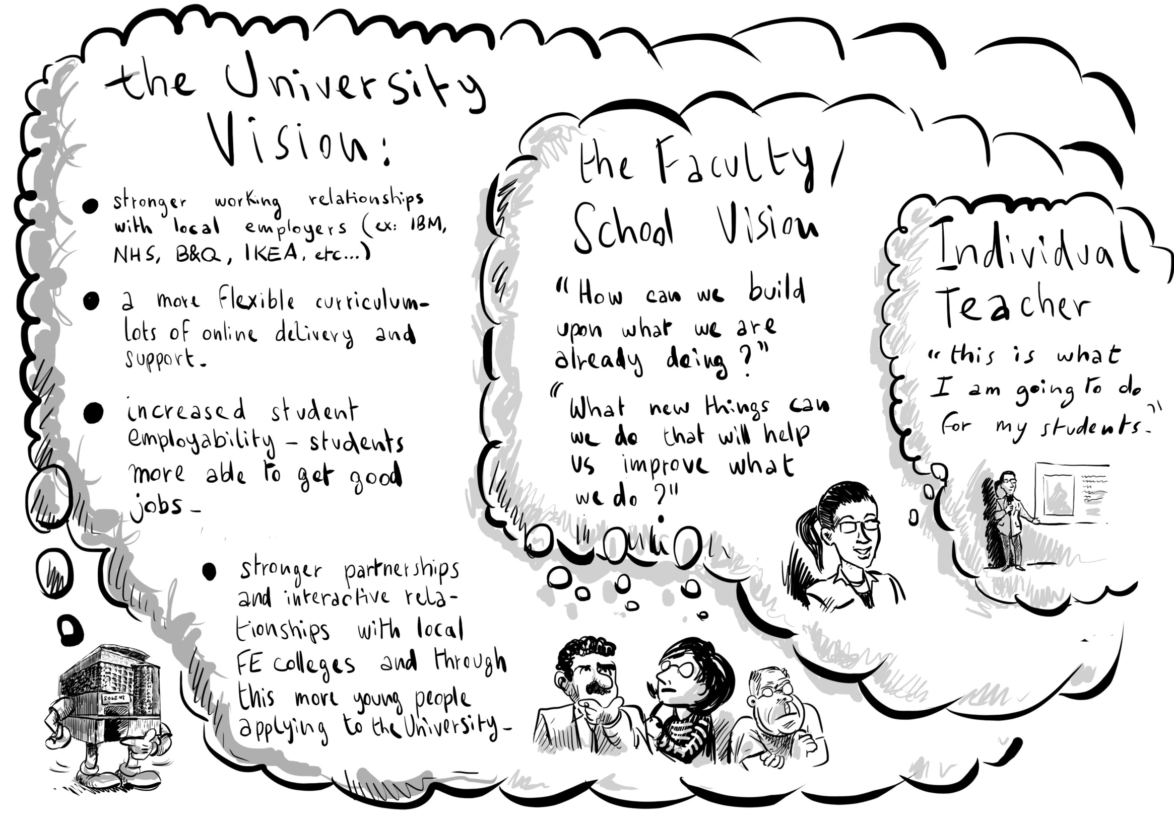
2 A vision that inspires people to create their own visions
Notes:
42 Organisational change involves someone with the power and authority to see the direction in which the organisation needs to travel and communicate that through a vision for a different and better world. An organisational vision for strategic change, must encourage and enable people to see things in a different way and inspire them to create their own visions through which they can enact and embody change that they own. A vision at the top is of little value if people at the bottom cannot understand and relate it to their world of everyday practice. Middle managers have an important role in translating high level ideas and engaging staff in new conversations about the implications of such ideas.
From an institutional leaders perspective the most important vision is the one they hold about the future of their university. From an innovators perspective this is far less important than the vision they hold of the new practices and experiences they want to create. As long as the two visions are aligned strategic change will progress.

Slide 45
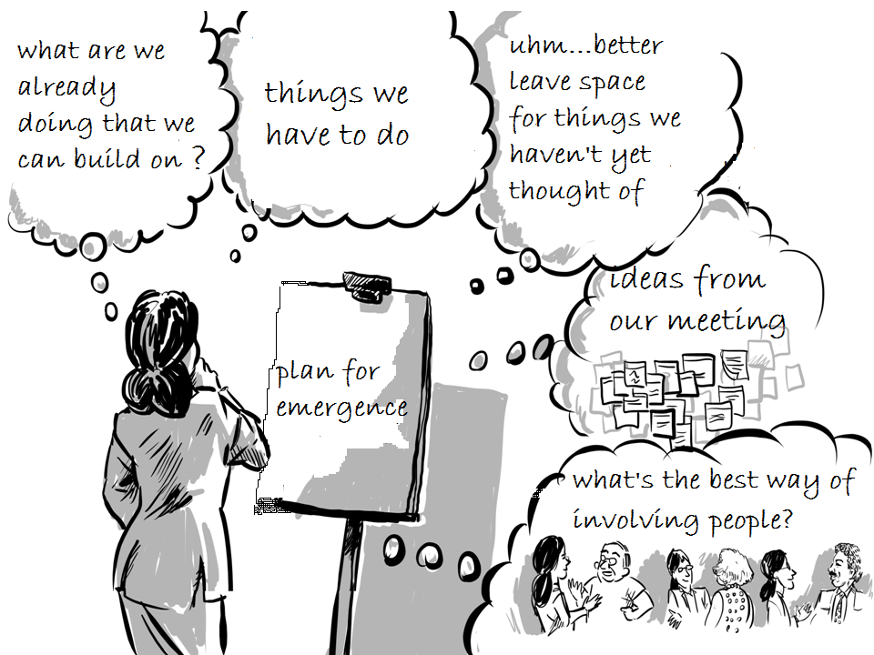
3 A strategy for both planned and emergent change
Notes:
43 For a strategy to be successful it needs to involve deliberate planned actions to achieve tangible objectives and goals but also contain the space and intention to improvise as new and better ideas emerge. It needs to encourage, stimulate and support activity that will lead to change and provide sufficient resources to enable change to happen and ensure that people involved in change have the necessary resources when they need them. This process of connecting top, middle and bottom in this way is more likely to create ownership and responsibility for ideas and actions so that the change that emerges is owned at all levels of the organisation. It is this connectivity that creates the sense of affiliation that is so important in change – we are all in it together.
Emergence cannot be controlled, predicted or managed but the leaders, managers and facilitators of organisational change can create conditions that are more likely to lead to changes of a certain type (Richard Seel's ten conditions for emergence are highly relevant here - Seel 2006).The successful management of change combines and integrates managed, purposeful and focused change through planned activities that enable and encourage people to improvise and discover the best ways forward for themselves.

Slide 46
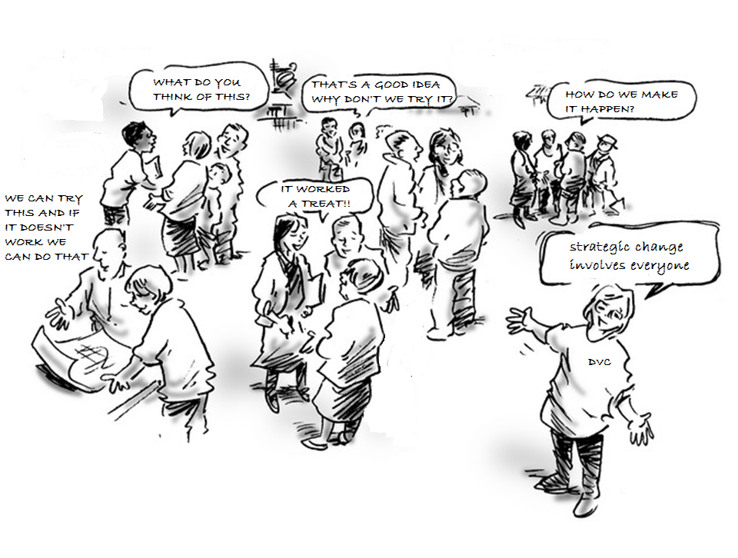
4 A strategy that involves the whole organisation
Notes:
44 Change will only happen if people actually do new things ie they get involved in change by actively doing things rather than only thinking and talking about it. The strategy must involve most of the people in the organisation doing new things only then will change at the level of the whole organisation occur. This is why engagement is so important in creating a sense of whole organisation participation in the enterprise of strategic change.
The SDP sought to involve the academic (faculty) teaching community in all the Faculties and Schools through the funding of innovation through Faculties, Schools and individuals. It engaged Faculty and Service Administrative teams through the Service Plus project that sought to involve administrators in creating solutions to problems and challenges relating to the strategic agenda. Furthermore, by changing a number of business systems that were central to many of the university's operations it involved all staff in fundamentally new practices that were more in tune with the strategic changes the university was seeking. The feeling that everyone was involved, and change was not just targeted at a specific group of people was an important factor in accomplishing change at the organisational scale. By offering incentives to stimulate change and innovation within academic Faculties and Schools the university was seeking to work within the disciplinary cultural grain.
People are more likely to commit themselves to significant change if their will to be involved is driven by their own intrinsic motivations rather than extrinsic forces. Giving people the choice or freedom to chose to be involved seemed to be crucial for involving self-motivated innovators -

Slide 47
5 Involvement of brokers to facilitate organisational change
Notes:
45 Complex organisational systems with many internal divisions and boundaries need brokers or boundary spanners to facilitate organisational change. They facilitate communication, networking and working between and across the constituent parts of the organisation and help overcome impediments to progress
Organisational brokers work in collaborative and creative ways with people, ideas, knowledge and resources to enable things to happen that otherwise would not happen. They are a kind of multi-skilled anthropologist who can get inside and comprehend not just needs and desires, but the language, politics, positioning and outlook of the different parties.
The small (3 member) SDP Project Team acted as organisational brokers. They likened their role to the metaphor of gardeners cultivating the conditions for SDP projects and innovators to flourish and enable people with new ideas and practices to grow through the process of enacting change. They provided encouragement and resources to enable people to take on an innovation project, practical help in getting started, and emotional support when things got tough. They also monitored what was happening on the ground and provided feedback to senior managers on progress. Where appropriate they brought in new people to support and facilitate the process of change.

Slide 48
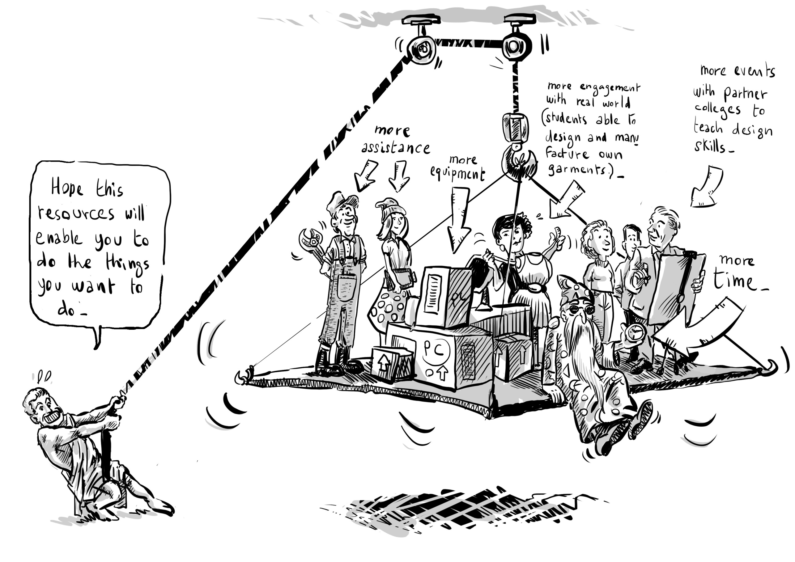
6 Adequate resources and an effective but flexible approach to
managing and accounting for their use
Notes:
46 Large scale organisational change requires the distribution of significant new resources. Regardless of whether the funding is externally or internally sourced there need to be effective mechanisms for assigning and distributing resources, monitoring and accounting for their use. The Solent strategic change programme used a combination of SDP Team procedures and decision making, and the University's Management Board to approve the distribution of resources and account for their use.
People who were directly involved in change discussed resources in terms of their time and workload, and their ability to manage their time for development work alongside existing teaching and administrative commitments. Being able to manage and juggle time for development and existing commitments is an essential capability for all those involved in change. For academics the additional complication involves managing time within a fairly rigid academic calendar and weekly timetabling of teaching activities.
SDP resources provided additional capacity to employ knowledgeable consultants, or administrative or technical assistance from people within and outside the School. People also talked about resources in terms of funding and physical resources like equipment, the manufacturing of products created through an educational process, and social activity like hosting events and exhibitions for students from local 6th Form Colleges. The Strategic Development Fund was able to help with all these things.

Slide 49
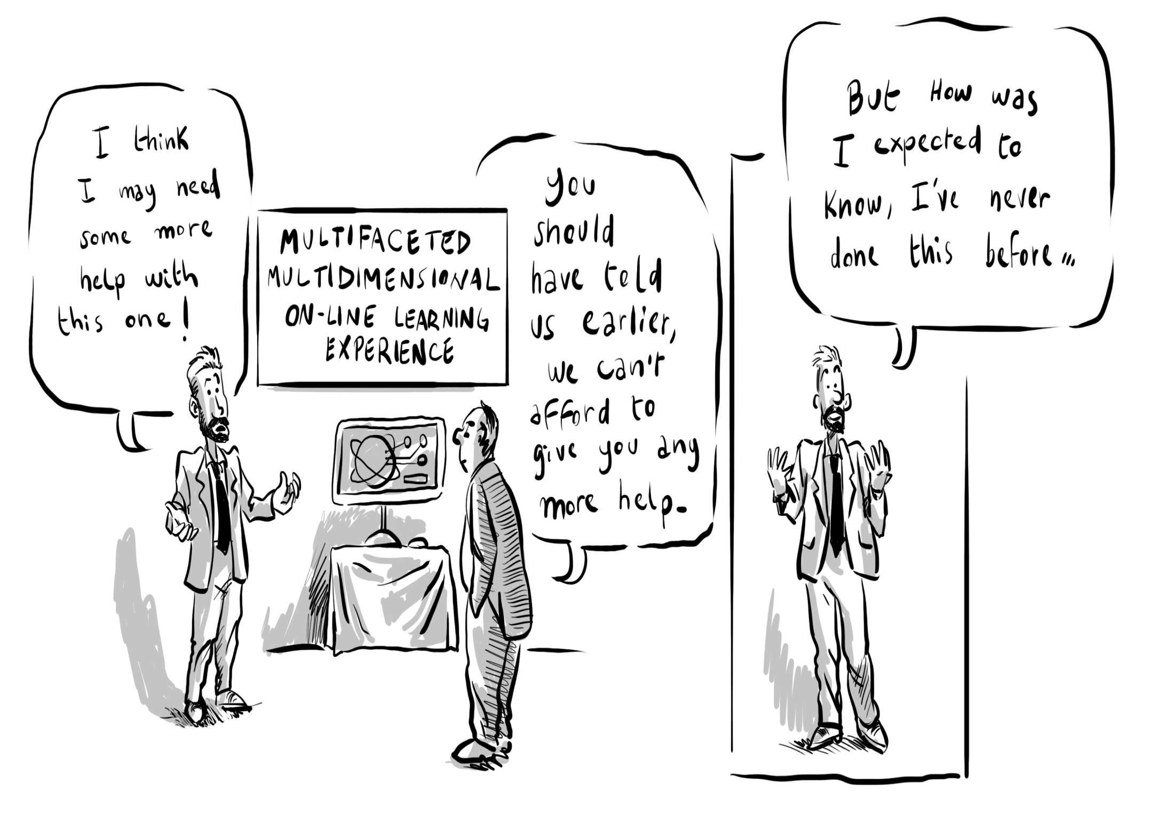
Having resources when you need them
Notes:
47 While it is a straightforward matter to distribute and account for resources in a system that is operating in a business as usual mode, it is not so easy when the business is change and much of that change appears in an emergent form. The case studies reveal that from the innovators' perspective resourcing mechanisms were not always responsive to the emergent nature of the change process. Designers of strategic change and innovation projects need to design in a significant contingency to deal with the unexpected or develop mechanisms for gaining additional funds as a change process unfolds.

Slide 50
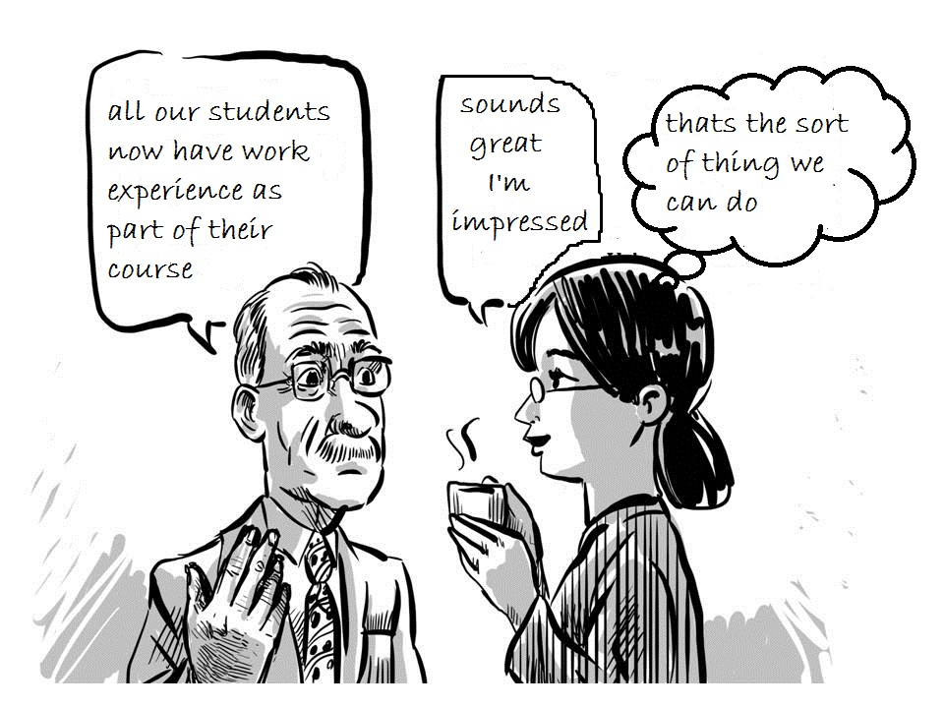
7 A culture that promotes effective, honest and meaningful communication
Notes:
48 Change involves creating new meanings and communication that is meaningful to those receiving it, pervades innovators' stories of change. If visions, ideas and invitations to contribute are not communicated in a way that has meaning to those who receive it - nothing will happen. The lesson is clear that just sending information to people who are busy and who have many urgent priorities, will often not cause them to act. What causes them to act is when information causes them to create their own interpretations and meanings for themselves.

Slide 51
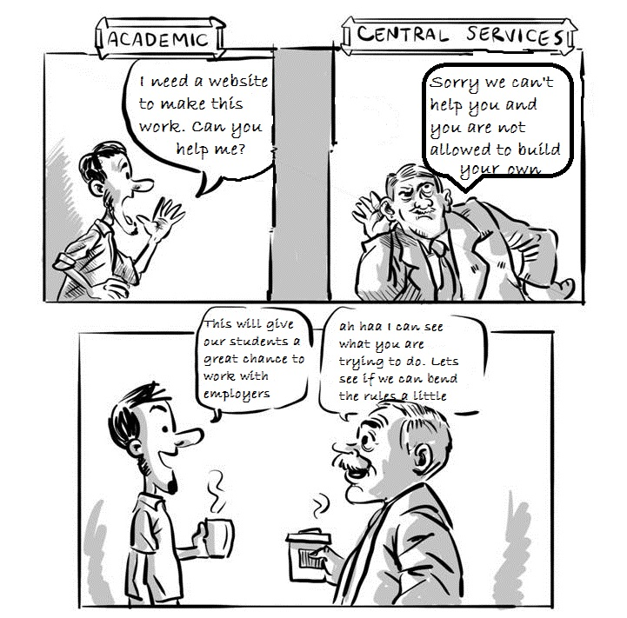
8 A culture that recognises and supports
resolution of local contentious practice
Notes:
49 Tensions and conflicts often arise when bottom-up innovation meets existing procedures and systems. An organisation involved in strategic change needs the awareness, will and capability to facilitate the resolution of local contentious practice.
People working in an organisation (persons in practice) historically constitute their everyday world as they help to make it through their participation in it while being shaped by the world in which they are a part (Holland and Lave 2009). Local contentious practice, and its resolution, lies at the heart of bringing about innovation in an organisation that is full of systems, procedures and traditions. Local practice comes about in the encounters between people as they address and respond to each other while enacting cultural activities under conditions of political-economic and cultural historical conjuncture. Elements of the SDP narrative reveal that when working within their cultural domain (eg their school) innovators have control over what they do. But once they have to relate their innovations to existing business systems there is often conflict between the new practices they were trying to create and practices that already existed within the institutions established systems and processes.
Relationships and communication between innovators and system owners are crucial to resolving these troublesome areas.
One of the really crucial factors in enabling local contentious practice to be resolved, is for the people who are trying to make change happen to be able to find people who will help them overcome the procedural and decision making barriers between different parts of the organisation. These are the brokers and boundary spanners, that hierarchical and silo'd organisations need in order to unblock things that seem to be frozen.

Slide 52
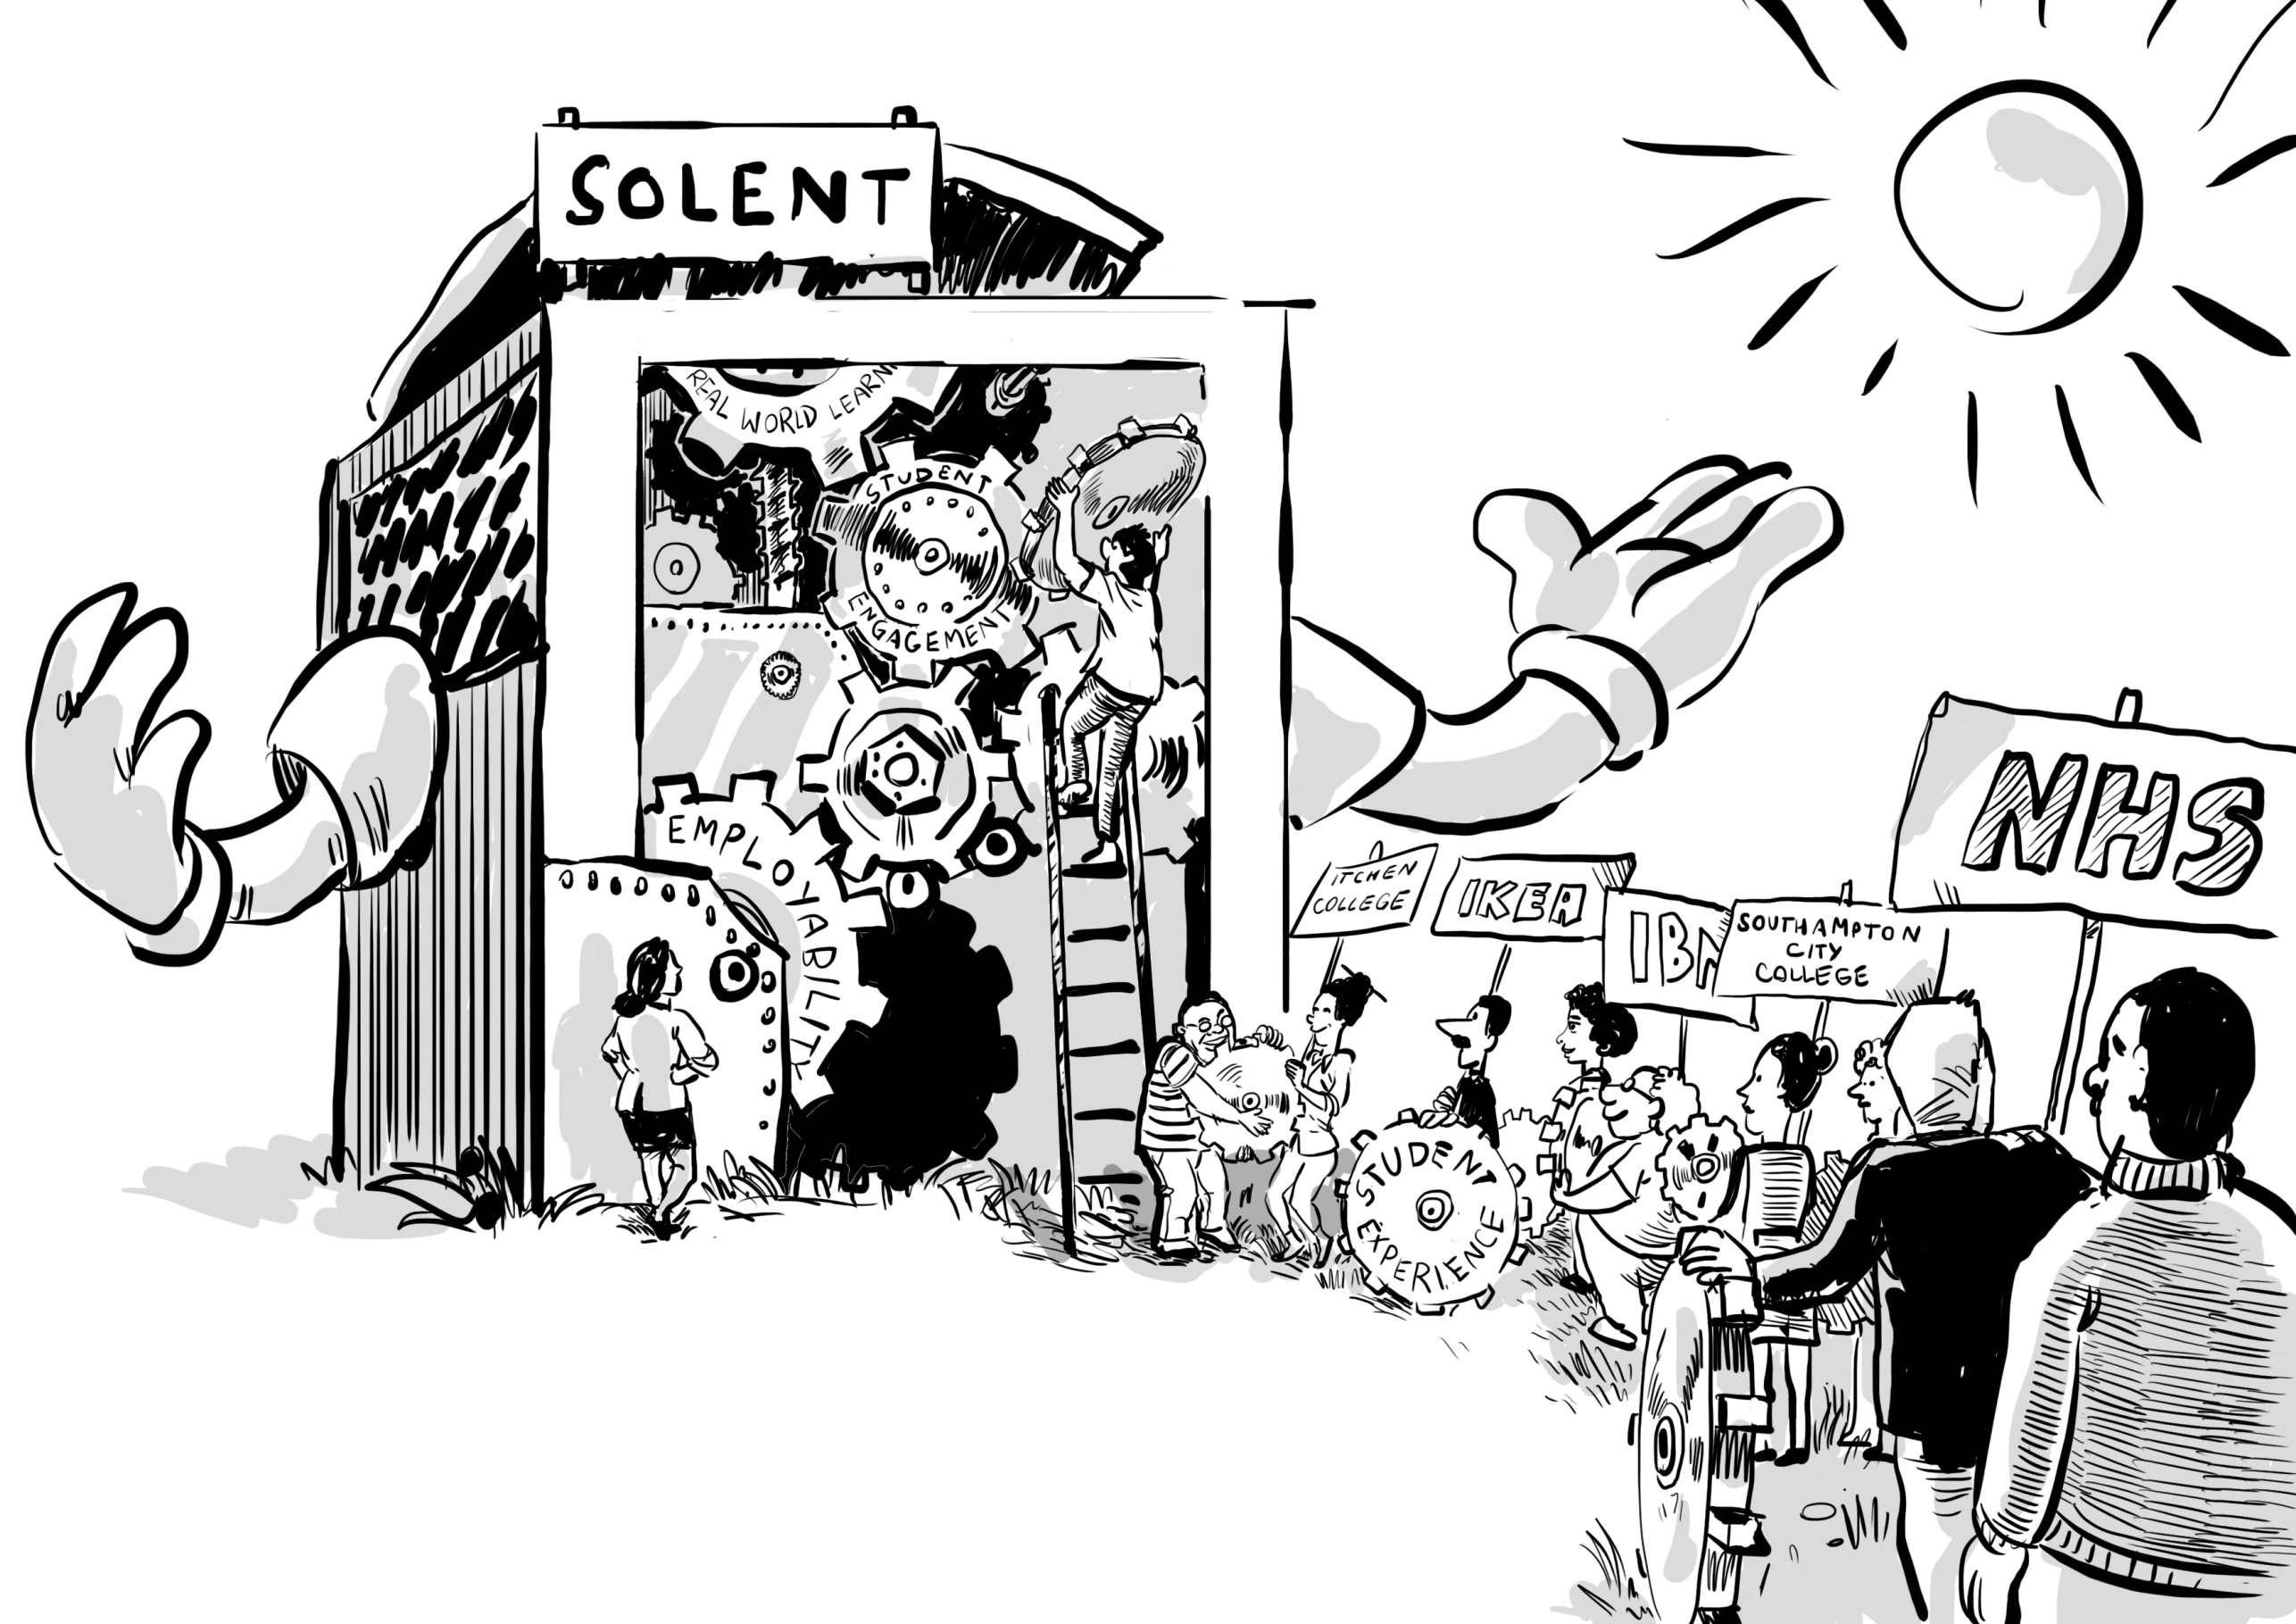
9 A culture that encourages new relationships and collaborations
Notes:
50 Organisational change is accomplished through the deepening of existing relationships and the forging of new collaborative partnerships that generate ideas and new opportunities, and which provide encouragement, practical help and support.
Forming productive, co-creative and emotionally supportive collaborative working relationships with members of their School or colleagues in central university departments - particularly the Flexible Delivery Team (e-Development and Educational Technology Unit) and Partnerships Office was an important strategy for innovators. Extending existing relationships or building new relationships in the external environment was also a priority in the strategic change process. Relationship building with employers was crucial to the success of several of the innovations. In the case of the Foundation Degree in Health and Social Care the relationship was underpinned by a formal strategic alliance but ultimately it is the interpersonal relationships between the people who are directly involved in change that really matter.
Such relationships helped innovators to appreciate the value of their own work and efforts, encouraged them to 'go the extra mile' and enabled them to persist especially at the most frustrating and challenging moments.

Slide 53
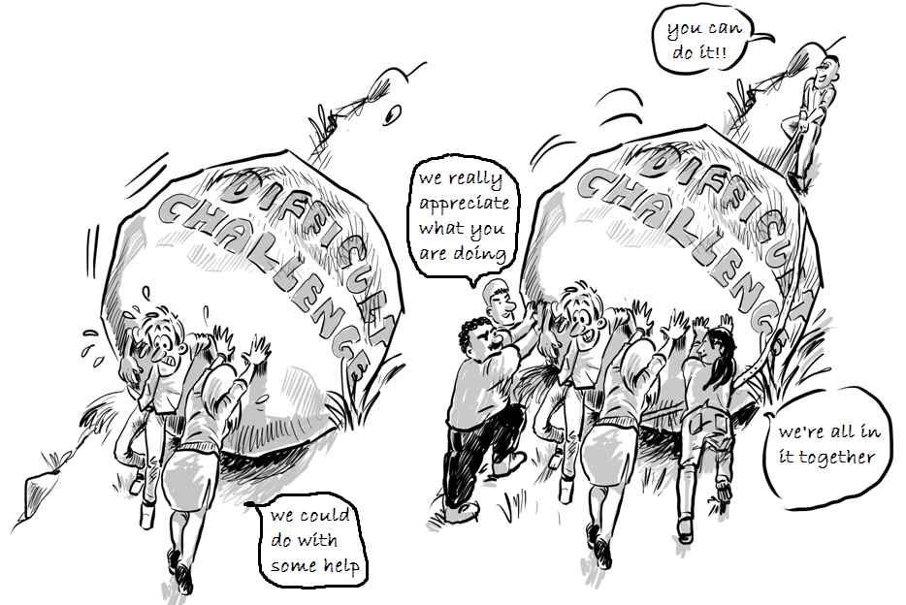
10 A culture that provides emotional support
Nourishers in the work environment
(Amabile and Kramer 2011)
1 Respect, 2 Encouragement,
3 Emotional Support
and 4 Affiliation
Notes:
51 An emotionally nourishing environment helps people deal with the challenges, stresses, anxieties and frustrations of trying to bring about significant change and helps them to remain positive in the face of setbacks. Such an environment recognises the efforts and celebrates the achievements of those who are involved in change.
Stress, anxiety and frustration are often associated with significant organisational change as people encounter problems and setbacks, things do not work out as intended or other situations. Sources of stress, anxiety and frustration encountered in this study included: 1) the competing demands of developing new practices while continuing to teach 2) inadequacy of resources for some projects where the amount of resource was underestimated or could not be estimated in advance, or when there was a lack of transparency as to how resources were being allocated 3) insufficient support when dealing with difficult problems 4) seeming inability of some institutional systems, procedures and infrastructures to adapt to the changes that they were creating. Such adverse psychological impacts could have been reduced if participants had more time particularly at critical moments in the change process, had more resources - not only money but practical help at certain stages of their project and had more support and empathy in resolving difficult problems that blocked progress.
Amabile and Kramer's study of the socio-cultural work environment identified four categories of nourishers (Amabile and Kramer 2011: 131- 33) and all seemed to be important to the innovators. They have a significant impact on the way they feel and on their creativity and productivity. These are:
1 Respect - managerial actions determine whether people feel respected or disrespected and recognition is the most important of these actions.
2 Encouragement - for example when managers or colleagues are enthusiastic about an individual's work and when managers express confidence in the capabilities of people doing the work increases their sense of self-efficacy. Simply by sharing a belief that someone can do something challenging and trusting them to get on with greatly increases the self-belief of the people who are engaging with the challenge.
3 Emotional support - People feel more connected to others at work when their emotions are validated. This goes for events at work, like frustrations when things are not going smoothly and little progress is being made, and for significant events in someone's personal life. Recognition of emotion and empathy can do much to alleviate negative and amplify positive feelings with beneficial results for all concerned.
4 Affiliation - people want to feel connected to their colleagues so actions that develop bonds of mutual trust, appreciation and affection are essential in nourishing the spirit of participation. One of the challenges for innovators is that they often feel alone because they are moving into new territory by themselves - where there is no-one they can affiliate with! The role of the SDP team was important here in giving people an affiliation that was purpose- as well as culturally-based.
It is clear from the case studies that innovators thrive and innovation is more likely to happen when the environment is emotionally nourishing in the manner described above. An environment that is respectful, positive, encouraging and emotionally as well as practically supportive. SDP was an important additional element in the institutional climate that contributed to a climate of positivity.

Slide 54
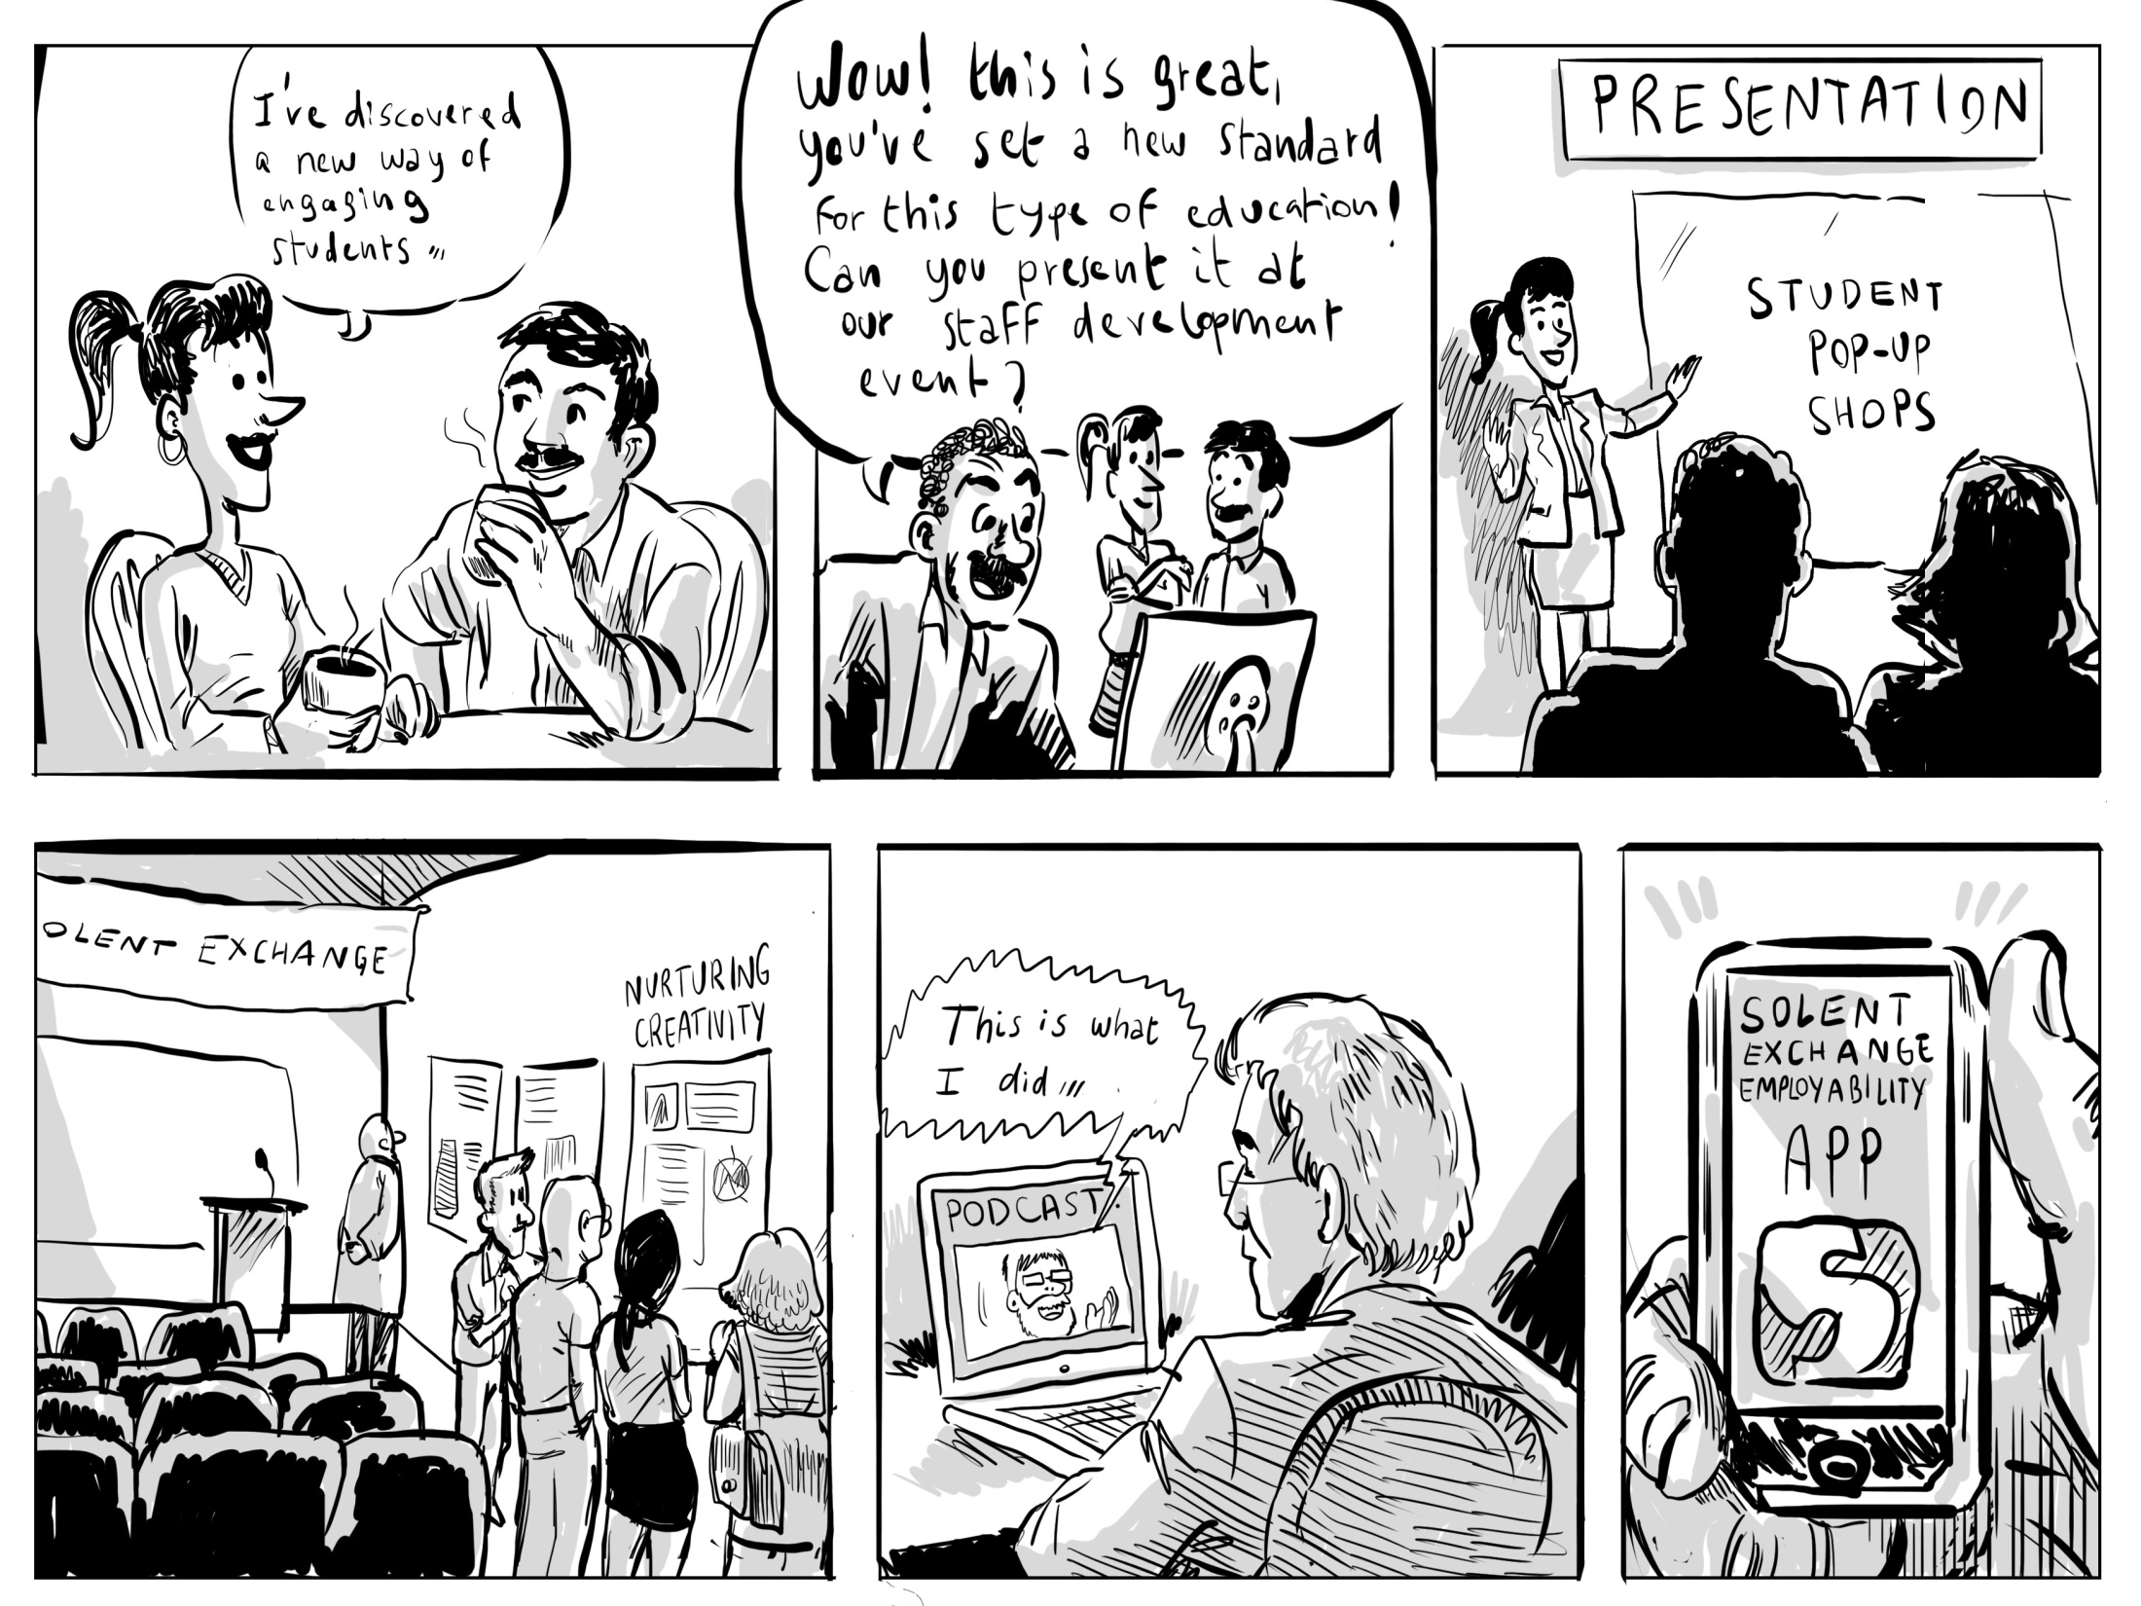
11 a culture that values learning and encourages and enables people to share what
has been learnt so that it can be used and adapted to other contexts
Notes:
52 If learning to do new and better things is the core enterprise in strategic change it is vital that new knowledge and understanding grown through the change process, is consolidated, made visible and distributed to other members of the organisation in ways that are appropriate and meaningful to them. Only then can what has been learnt be applied in other situations and contexts.
Creating opportunity for meaningful communication is as important after change has been accomplished as it is before and during the change process, remembering that to change an organisation you need to change a majority of conversations in the organisation (Seel 2004).

Slide 55
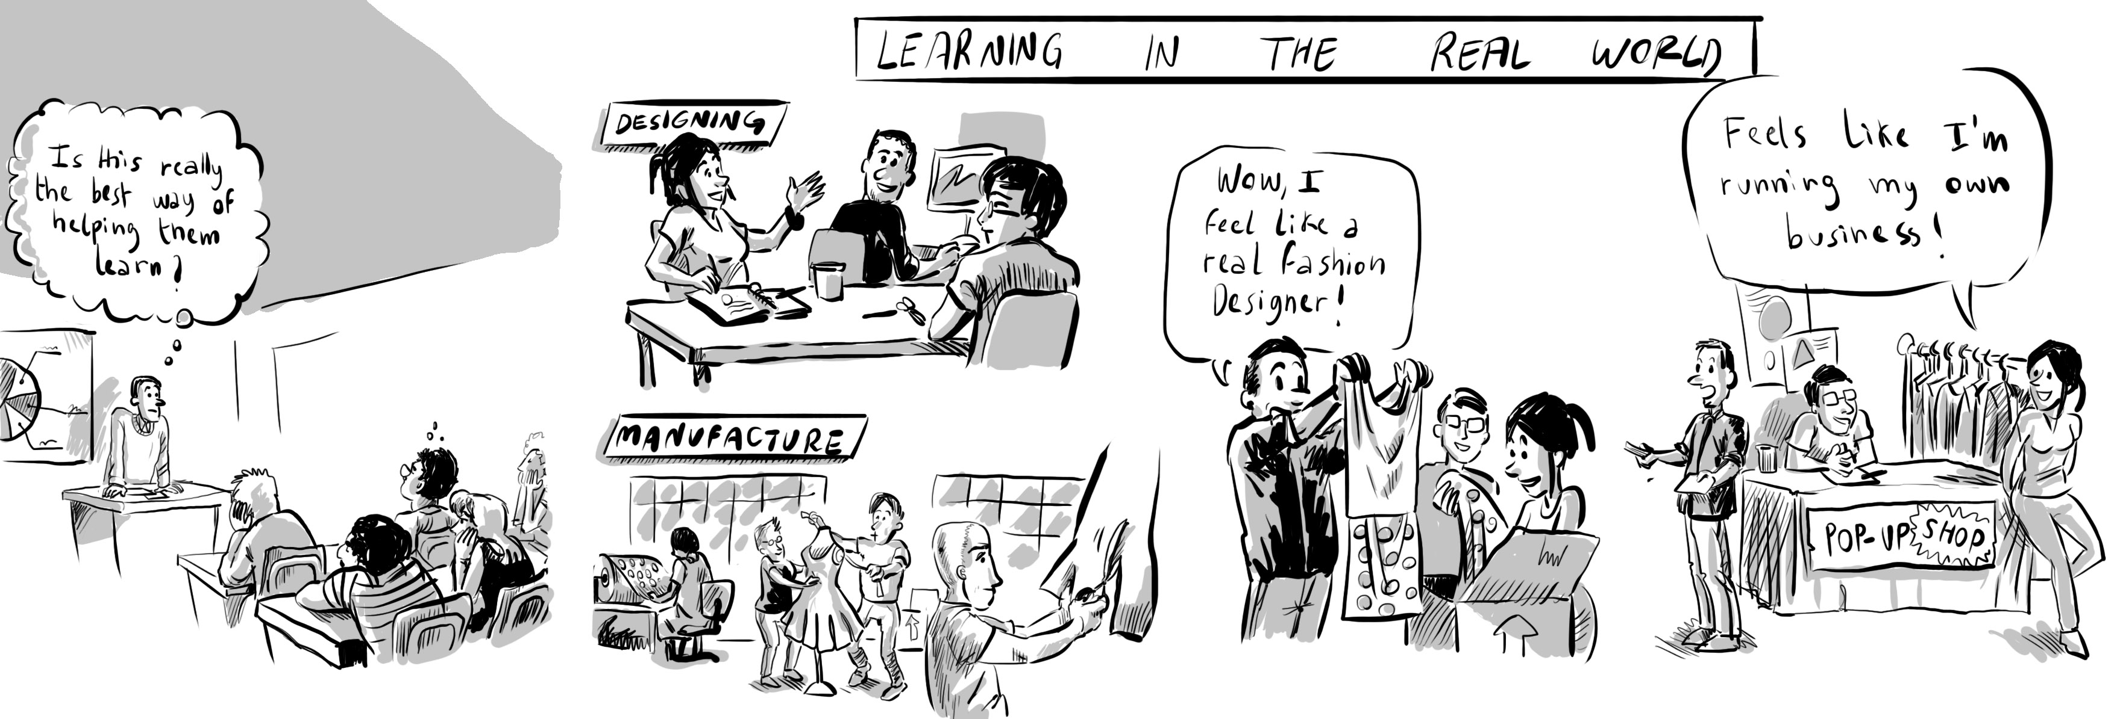
12 a culture that encourages people to take risks to put themselves into unfamiliar
situations where they need to harness their creativity to realise their ideas and
achieve their ambitions
Notes:
53 Accomplishing change - involves new ideas, new ways of thinking, new practices and new ways of being - it's an inherently creative process and ultimately it involves people becoming different and taking risks to challenge themselves and put themselves into new situations in order to achieve their goals.
Innovators viewed creation in terms of the invention of practice that was entirely new to them or existing practice that was significantly modified. They also recognised creation in new relationships and infrastructures to support new practice, and new policies and procedures to guide future practice. The real value of strategic change initiatives is in enabling people to realise their creative potential to actualise themselves to become who they want to become. Innovators and early adopters thrive in such a culture.
Higher education teachers are motivated to innovate by the ideas of helping their students learn more and better, and through this to improve their chances in life. By creating a more imaginative and more effective curriculum they are helping their learners to actualise themselves. In the process of designing and implementing and new curriculum they are actualising themselves. In actualising themselves they are helping to enable the university to realise its strategic ambition.

Slide 56
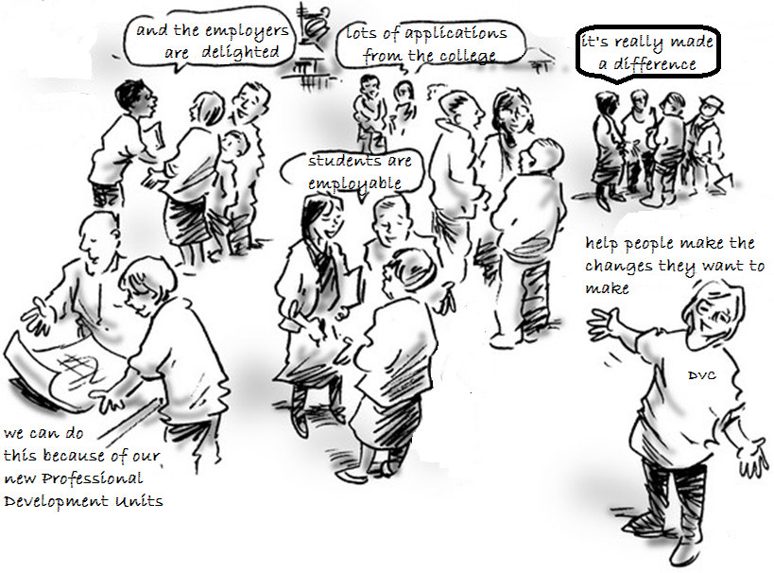
A self-actualising university!
A self-actualising university:
Notes:
54 The secret of accomplishing significant organisational change is to connect the people who want to actualise themselves through their innovations with the strategic changes the organisation wants to make
In trying to answer the question how does a university accomplish strategic change in which a large part of the change is brought about through the educational innovations of teachers (faculty) we discover that an organisation's strategic ambition and the will and creativity of the individuals who bring about change are intertwined.
In its mission and vision statements a university sets out where it believes its destiny and future identity lie but it is only through the concerted and deliberate actions of individuals and groups of individuals in its community, each of whom is striving to actualise their own vision and destiny, that the university achieves its ambition.
People leading and enacting change appear to be a particular type of person with the will to get involved in something and stay involved until the job is done. Not only do they generate ideas, they also like to actualise these ideas and they do not want to fail so they persist until they are satisfied. The will to complete something is a strong as the will to begin it.
It is the will to be and become a certain sort of person (like a better teacher) or to help others (like enabling students to learn better), or to develop a better system (to improve the support given to students, teachers or perhaps external employers and businesses), that provides the deep motivational force for many of the people who contributed to the Southampton Solent change project. The combination of challenge, personal autonomy, the desire for doing something new and the invention and mastery of new practice, and the belief that people are making a valuable contribution to the educational enterprise of students, were the most important factors that caused deep and sustained engagement in SDP projects.
What comes out of this process is not something that can easily be codified or quantified on a piece of paper. What comes out of it are new relationships and new sorts of conversation within and outside the university, new forms of practice and models or approaches that can be re-used and adapted to other contexts, and new ways of seeing and understanding things - in other words culture that is different to what existed before.

Slide 57
PART 2
– Case Study 1 - strategic change and innovation at Southampton Solent University
Factors and conditions that support and encourage bottom-up innovation within strategic change
- Questions & discussion

Slide 58
Case Study 2: SCEPTrE innovation and strategic change
A research intensive university with a commitment to
professional as well as academic education.
13,500 students - 9000 ugrad, 4500 pgrad
27% international – multicultural campus
Undergraduate programmes
3Y academic (30%)
3Y integrated theory/ practice (Health Care) (20%
3Y academic + 1Y professional training (50%)
Notes:
56 My second case study is based on my involvement in an innovation project at the University of Surrey between 2006-11. In 2005 the University was awarded a grant (£2.5m over 5 years) to establish a Centre for Excellence in Teaching and Learning - one of 74 established in England. The funding was used to set up the Surrey Centre for Excellence in Professional Training and Education (SCEPTrE) and through the centre to fund innovation in teaching and learning in line with its educational mission.
The university is a research intensive university (top 20 ranking) with a commitment to professional as well as academic excellence in the education it provides.
13,500 students - 9000 ugrad, 4500 pgrad and 27% are international. It’s a multicultural campus.
For nearly 60 years the University of Surrey has been at the forefront of the work integrated learning (WIL) or co-op education movement in the UK through a curriculum model that requires programmes in all disciplines to provide opportunities for learners to develop their professional capabilities through either year long work placements or a curriculum that integrates theory and practice throughout the period of study. The University’s claim for excellent education was based on its excellent graduate employability record – top or very near the top of graduate employability statistics over the last 15 years.
SCEPTrE’s was established to support and enhance the Professional Training (PT) enterprise (year long work placement) and to promote enquiry-rich approaches to learning.

Slide 59
Ways in which SCEPTrE supported educational change and innovation
Sponsorship & support for innovation for faculty in other universities:1) 13 SCEPTrE Fellowships 2) 12 Professional Development Academies and 7 conferences 3) over 60 seminars shared through streamed / filmed events that were later archived 4) consultancy to institutions 5) Learning to be Professional e-book
Sponsorship & support for innovation for University of Surrey faculty
1) 31 SCEPTrE Fellowships 2) Curriculum Development Awards 3) Teaching with New Technologies awards 5) 60 seminars and 7 conferences 6) Learning to be Professional e-book.
SCEPTrE's own innovations
Lifewide Learning Award
CoLab - student team of technologists
Design Thinking Academies
Immersive Experience Symposium
Extensive use of technology - to film, stream, document and record activity
Awards for students and staff
Support for a community of innovators
Notes:
57 During the five years of its existence, SCEPTrE sponsored and managed nearly one hundred and thirty curriculum development or educational research projects including fifteen projects involving external partners. It worked collaboratively with the university's e-Development Unit to offer Learning with New Technologies Awards which encouraged 40 teachers to incorporate new technology into their teaching and learning strategies. It pioneered new and imaginative ways of working with students - for example creating a student organisation called CoLab to provide the Centre and the University with new capability for using emerging technologies. Most of these sponsored projects involved practitioners doing things that were entirely new to them they were innovative at both the personal and organisational level.
SCEPTrE made 31 teaching Fellowship Awards to support educational development much of it innovative in Faculties and Departments in the University, and another 13 Fellowship Awards to academic teachers in other universities and colleges. It sponsored and organised seven conferences including four national conferences on the educational themes of the Centre, twelve Training Academies for professional development, over 60 seminars many of which were streamed, recorded and archived, and six events specifically for business representatives.
All in all we probably sponsored as much local innovation across the university but very little of it had strategic impact. Only one Faculty tried to use SCEPTrE resources in a strategic way and the university made no attempt to do so.
The CoLab initiative became a national case study (https://wiki.brookes.ac.uk/display/slidacases/Surrey).
SCEPTrE's work is documented on its website http://www.sceptre.org.uk and wikis which can be accessed through te website. An end of project evaluation report, together with other key documents can be found at: http://sceptreevaluation.pbworks.com

Slide 60
Notes:
58 SCEPTrE’s most significant innovation was its Lifewide Learning Award – this was described in my previous presentation. I’m not going to describe this again rather I will look at it from the perspective of how the innovation was accomplished and its effect.

Slide 61
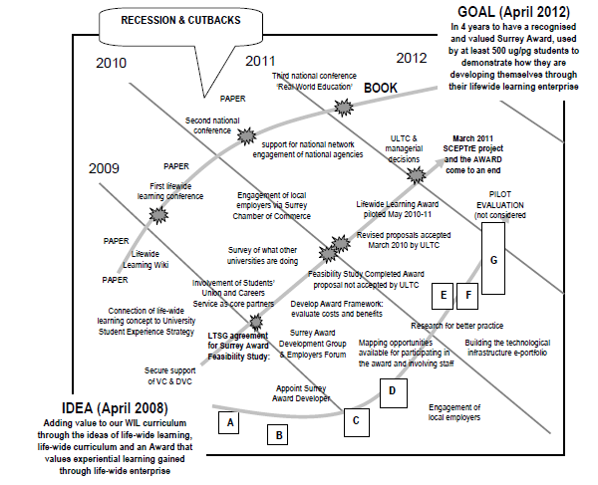
Notes:
59 SCEPTrE was never part of a university strategy for organisational change. Rather, SCEPTrE attempted to influence the university to create a strategy that built on and extended its existing educational model which valued students' experiential learning in the workplace and create movement towards a more holistic model of learning which valued students' development in all parts of their life.
In planning and orchestrating a significant change process in a university there is so much that cannot be predicted – a plan can at best only provide a sense of what the planner imagines has to be done at any stage in the project. It must also contain the space for emergent opportunity or responding to the unanticipated consequences of actions. In a dynamic change environment it is much easier to fill in the details of a plan after it has been completed! It is also sometimes wiser to wait until something happens in order to know how to respond and capitalize on a situation as it develops.
SCEPTrE's plan for developing, piloting and implementing the idea of an Award, to recognize and value learning achieved outside the academic curriculum, contained three main strands of activity represented by the grey lines : top-line represents conceptual development, scholarship, research and public engagement, middle - line political engagement with senior managers and committees, bottom -line practical development and implementation
Much of this strategy was created as the innovation progressed ie the details of the plan were not conceived at the start of the process. The summary you see in this figure has been compiled after the event rather than before. Much of what happened in detail emerged through the process of pursuing action in these different strands of activity often in response to an opportunity or need.
The whole process was one of trying to make progress, trying to overcome obstacles, creating new opportunities and learning our way into the future.
Also bear in mind that we were also supporting the broader programme of work indicated in the earlier slide.
Sadly for SCEPTrE the university took the decision in December 2011 not to adopt the award, and to close down the SCEPTrE project when funding ceased in March 2011.

Slide 62
Factors & Conditions that Encourage Strategic Change and Bottom-up Innovation
Factors not resolved through SCEPTrE’s attempt to innovate
Leadership, management & facilitation of strategic change & bottom up innovation
Leadership is shared and distributed throughout the organisation
A strategic vision that inspires people to create their own visions for change that they will embody
A strategy for both planned and emergent change
A strategy that involves the whole environment
5 Involvement of brokers to facilitate change across and between organisational
structures, hierarchies and boundaries
6 Adequate resources and an effective but flexible approach to managing and accounting for their use
Environmental /cultural factors that support, encourage and enable strategic change and bottom-up innovation
An environment/culture that :
promotes effective, honest and meaningful communication
recognises and supports resolution of local contentious practice and facilitates rather than inhibits progress
encourages/facilitates new relationships and collaborations to foster change
provides emotional support and celebrates what has been achieved
values learning and encourages and enables people to share what has been learnt so that it can be used and adapted to other contexts
encourages people to take risks to put themselves into unfamiliar situations where they need to
harness their creativity to realise their ideas and actualise themselves
Notes:
60 When we look at the critical factors for success identified in the first case study we can see more clearly the reasons why the SCEPTrE innovation was not adopted
1 Although SCEPTrE was able to provide leadership to the institution the Lifewide Learning Award was never part of a strategy that was led from the top of the organisation. Rather, SCEPTrE's strategy was to try to demonstrate the value of the award in order to convince the leaders that it was worthy of adoption. The failure was to persuade the third senior manager to be responsible for the SCEPTrE project, to incorporate these ideas into her own leadership strategy.
2 One of the big ongoing issues for SCEPTrE was the absence of an institutional vision for teaching and learning that SCEPTrE could be part of. SCEPTrE created its vision 'learning for a complex world' 6 months after it started. This vision was articulated in a wall sized picture - everything SCEPTrE did was related to this vision which the university accepted implicitly but did not explicitly embrace.
6 When the additional resources ceased, and at a time of severe cutbacks in the university due to the economic recession, SCEPTrE as an organisational entity was vulnerable. At a time of cost-cutting with most staff on fixed term contracts, SCEPTrE was easy to eliminate together with the work it was doing.
8 The introduction of the Lifewide Learning Award juxtaposing an unfamiliar and contested concept of learning and personal development against a traditional view of what higher education learning and education meant at Surrey university. It proved impossible to resolve in the short time available to demonstrate the value of the award to students and given the organisational contexts described above.
9 The failure was in not establishing a partnership with the third senior manager responsible for the SCEPTrE project: a manager who was pursuing a very different agenda
11 The failure was in the university not capitalising on the innovation. This failure is however offset by SCEPTrE making its resources available to the whole community through its websites.

Slide 63
The wicked challenge of preparing people for an uncertain future
me 1978
Notes:
61 So we return again to the wicked challenge for everyone involved in higher education and in this talk I have looked at the ways in which people in two different universities have tried to address it. In one case the approach was orchestrated from the top and it stimulated innovation and much of it is now embedded. In the other innovation was stimulated from the middle but, in the face of economic recession and conflicting interests at the top of the organisation it was not successful, at least in this university. But the ideas and work that was done are being carried forward in a different context so that is the value of open innovation…. Ideas and practices that are publicly shared can be used by others.

Slide 64
我 非常 感谢 大家
Thank you all very much
slides & speech - http://www.normanjackson.co.uk/beijing.html

