Slide 1
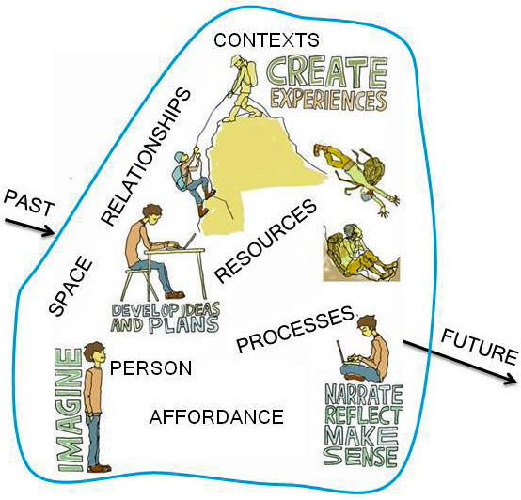
An ecology for learning, developing and achieving
Exploring Learning Ecologies http://www.normanjackson.co.uk/learning-ecology.html
An individual's self-created learning ecology grows from and within the circumstances (contexts) of their life.
It is established for a purpose that is directed to accomplishing proximal goals connected to more distal goals.
Their learning ecology comprises themselves, their environment, their interactions with their environment and the learning, development and achievement that emerges from these interactions.
Resources : http://www.normanjackson.co.uk/ouc.html
Notes:
Ideas drawn from Jackson N J (2015 in prep) Exploring Learning Ecologies
The ecologies we create for learning is itself an act of creation which can be defined using Rogers (1961) concept of creativity where the products we bring into existence are our ecology for learning and the learning, personal development and achievements we accomplish through our learning ecology.
Our learning ecology is our self-determined and self-expressed process for achieving tangible proximal goals, within which we create our novel relational products [including our own development] grown out of our individual uniqueness which has been shaped by our past histories and imaginings of a different and better future, and the materials, events, people and circumstances of our life.

Slide 2
PAST
My past learning ecologies provided me with experiences through which I have learnt, developed and become aware of the affordances of my life world. I can draw upon this in my new ecology for learning.
CONTEXTS
The spaces, places , situations we inhabit with their distinctive social-cultural and settings physical characteristics and affordances
SPACE
A space to explore uncertainty for inquiry & learning. A liminal space – betwixt & between states of understanding. A smooth rather than striated space. A dialogic spaces for conversation and discussion. An ecological space grown within the circumstances of the person’s life.
TIME
SPACE
RESOURCES
That we find or create and are able to use to help us learn and achieve our goals, including information, knowledge, expertise,
mediating artefacts –signs, tools and technologies
RELATIONSHIPS
With people - both existing and newly developed, and with things, objects and
tools that provide affordances in my physical, social or virtual environment
LEARNING ECOLOGY
created for a PURPOSE
shaped by my proximal
goal and informed by
more distal goals
AFFORDANCE
Any situation provides me with an environment containing ‘objects’ – things, people, circumstances which provide affordances – possibilities for action formed by my interactive relationship with the object in my environment
PROCESSES
Enable me to explore the possibilities for action in my environment in order to learn and achieve. They may be learning or task oriented and include the dimensions of time, space and purposeful action. My processes enable me to discover and create the affordances I need to learn, develop and achieve. They enable me to gain the feedback I need to develop my understanding and capability.
PERSON
My learning ecology is self-motivated, self-directed and self-regulated. My will, agency and creativity enable me to pursue my goals recognising the affordances in my life. My agency involves everything I can bring to a situation to deal with it and my self-belief enables me to try to work with whatever emerges. My self-awareness enables me to monitor the effects I am having and change my performance to achieve better results. Ultimately reflection helps me make better sense of my experience.
FUTURE
My learning and development will be drawn upon in future ecologies which may also be inspired and influenced by my distal goals
Notes:
Summary of the components of a learning ecology chapter 3 Exploring Learning Ecologies

Slide 3
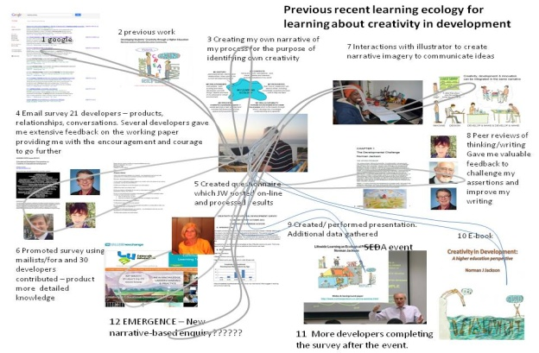
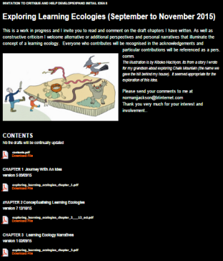
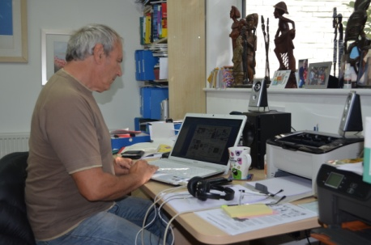
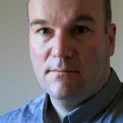
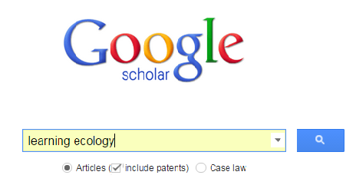
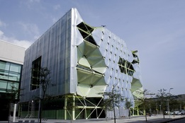
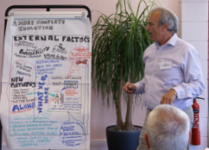
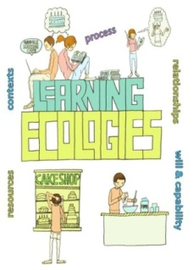
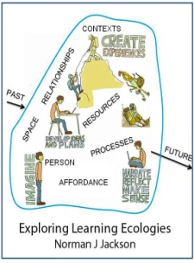
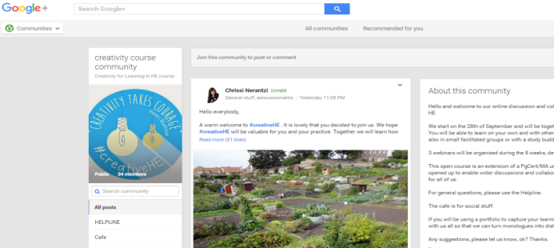
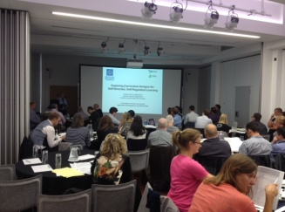
PAST LEARNING ECOLOGIES
through which ideas developed
My LE for the UOC seminar
SOCIAL MEDIA
OPEN PLN Twitter
& Academia.edu
Linkedin
BOOK PROJECT ENGAGING PEERS :
TO COMMENT
ON DRAFT CHAPTERS
ADAPTING
EXISTING
RESOURCES
CORE PLN
personal
relationships
FINDING & UTILISING NEW
KNOWLEDGE RESOURCES
PRESENT/
DISCUSS GAIN
FEEDBACK
UOC SEMINAR
WORKSHOPS AT TWO UNIVERSITIES
ON LEARNING ECOLOGIES
CREATIVITY FOR LEARNING IN
HE mini MOOC
CURATE &
SHARE
KNOWLEDGE
VIA LIFEWIDE
MAGAZINE
& BOOK
Notes:
LEARNING ECOLOGY FOR UoC Serminar Barcelona
Outside formal education we continually build learning ecologies to accomplish tasks in everyday life that require us to learn. For example, here is a representation of the ecologies for learning I have created in order to prepare for your seminar. The time span is about 10 weeks.
I drew on past learning ecologies and the resources I had developed through them including the ecologies I had created in order to develop my ideas on learning ecologies
2) I decided that I would use the seminar as MY REASON for consolidating and developing further my ideas in a book. The idea of the book became my purpose for creating a new learning ecology to help me prepare for your seminar and to achieve something new in the process.
3) During this period there were two other events that have been incorporated into my ecology 1) a workshop I facilitated at Manchester Metropolitan University and 2) a 6 week mini-mooc I participated in
4) The ecology for my book comprised
Drawing together the writings I had done previously (my starting point)
Identifying gaps and writing to fill these gaps
Extensive searches for relevant knowledge resources
Reflections on my own life/learning processes
Publishing chapters in draft form and inviting peers to review and give me feedback
Using social media (Twitter, Academia.edu and Linkedin) to invite anyone who was interested in my thinking to provide feedback on the drafts
Using the feedback I gained to develop my thinking
5) What I learned through these processes I was involved in has informed my thinking and my talk
Its influenced the presentation, handouts and book chapter resources (my mediating artefacts) that I am bringing to this event
And I am hoping that relationships I will form through this event will enable me to involve you in my future learning enterprises

Slide 4
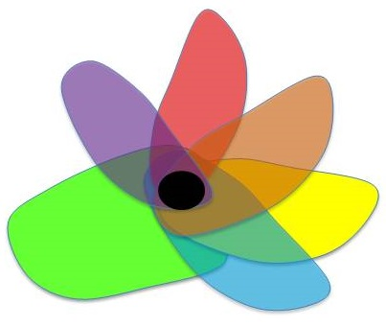
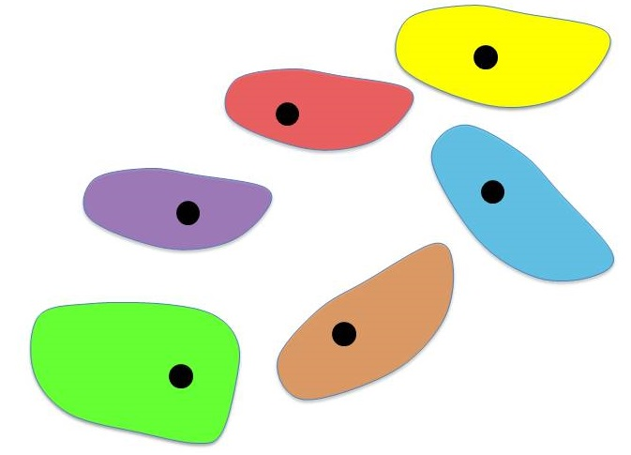
Connecting Learning Ecologies – lifelong & collaborative
Lifelong Learning Ecologies: an individual’s learning ecologies in their working life
Time
First job – organisation 1
Second job – organisation 2
Connections & convergence between the learning ecologies of different people
People doing
different things
People doing
similar things
People working together
to achieve same goals

