Slide 1
Teaching for Students’ Creativity
Personal Pedagogies for Creative Learning Ecologies
Norman Jackson
@lifewider1
Presentation & resources can be downloaded from
http://www.normanjackson.co.uk/portsmouth/
Notes:
My talk is underpinned by the belief that
Our life involves the whole of us in a complex, ever unfolding interactive relationship with the diverse physical, social, virtual, intellectual and psychological spaces, contexts and cultures in which we learn, develop and achieve. This perpetual interactive relationship between the whole of us, our whole life and all the environments, contexts and situations we inhabit is an ecological relationship.

Slide 2
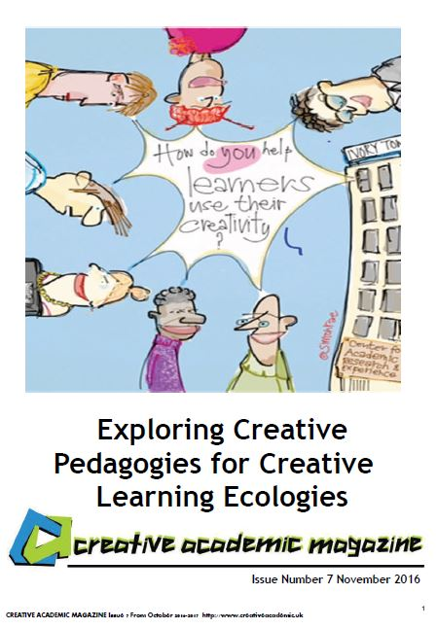
Creative Pedagogies for Creative Learning Ecologies Project July 2016 - October 2017
http://www.creativeacademic.uk/creative-pedagogies.html
Articles published monthly
In Creative Academic Magazine
http://www.creativeacademic.uk/magazine.html

Slide 3
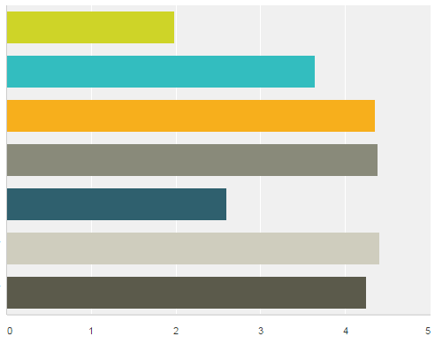
HE teacher beliefs about creativity #lthechat n=40
Creativity is a rare gift that
only a few people have
Some people are naturally
more creative than others
Most people can develop their
creativity if they are given the
opportunity to do so
Developing students' creativity
should be integral to their
development while at university
Students' programmes are
designed to encourage students'
to use and develop their creativity
HE could do more to encourage &
support students' creative development
HE should do more to encourage &
support students' creative development
STRONGLY DISAGREE
STRONGLY AGREE

Slide 4
HE teacher beliefs about creativity #lthechat n=40
In the context of your work what does being creative mean?
Having ideas that are new to the context
Being able to look at new concepts and put them
together in different but personally meaningful ways
INCREASING LEVEL OF AGREEMENT
Seeing situations from different perspectives
Solving problems and overcoming barriers
Going beyond what has been done before
Having ideas that are new to me
Generating something new in response
to an educational need
Adapting ideas to the context
Changing my understanding
Making new things happen
Doing things differently
Improvising when necessary
Using my imagination
Making new things

Slide 5
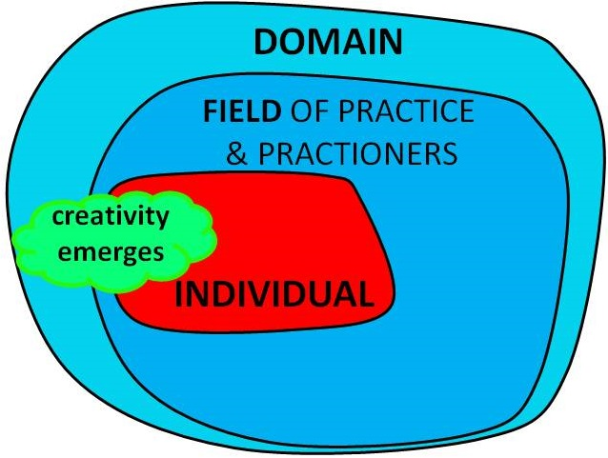
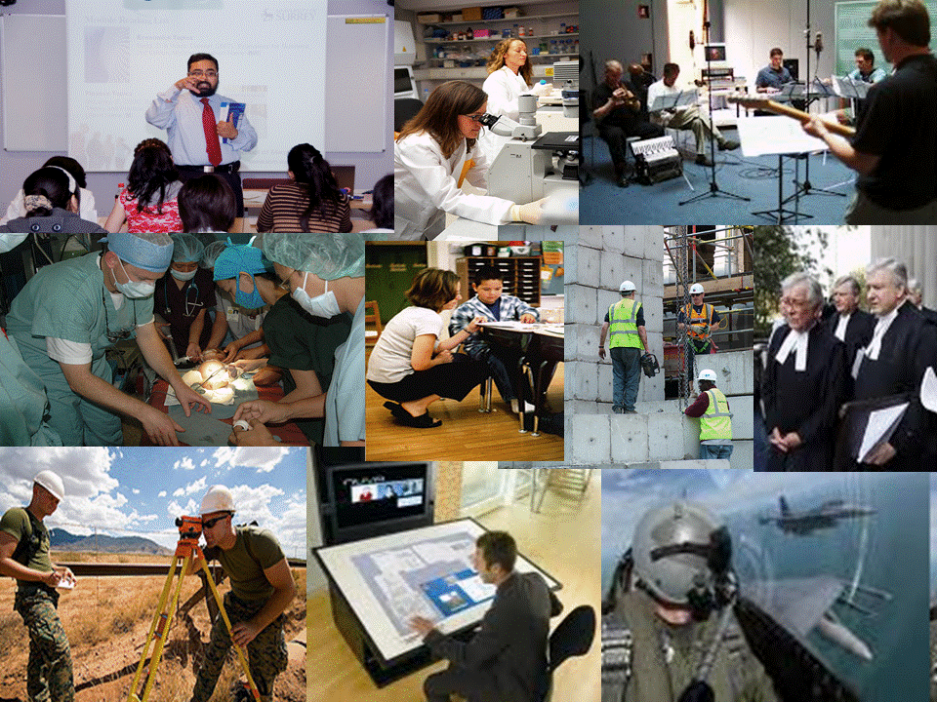
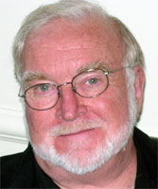
Disciplinary /academic context
Creativity is a process that can be observed only at the intersection where individuals, domains and fields interact
This environment has two salient aspects: a cultural or symbolic aspect called the domain, and a social aspect called the field. Csikszentmihayli (1999)
Notes:
Drawing Inspiration From the Discipline
Creativity is a social and cultural phenomenon and we need to understand how it is understood in the different cultural domains (disciplines) and the field (teachers and others who practice in the discipline). creativity results from the interaction of a system composed of three elements: a culture that contains symbolic rules, a person who brings novelty into the symbolic domain, and a field of experts who recognise and validate innovation. All three are necessary for a creative idea, product or discovery to take place^{p6}
One way in which universities could encourage students to develop their understandings of what being creative means is to help them appreciate what creativity means in disciplinary practices and in the achievements of disciplinary practitioners. What does it mean to be a creative engineer, doctor, historian, teacher or any other practitioner in a discipline? Surveys show that faculty share similar perceptions of what being creative means in their discipline and sites for creative thinking that relate to these characteristics appear to be available in most aspects of disciplinary practice. Growing understanding and making explicit what creativity means in the academy is the first step in engaging the academy with this challenge.
Csikszentmihalyi M (1997) Creativity: Flow and the Psychology of Discovery and Invention. New York Harper Adams

Slide 6
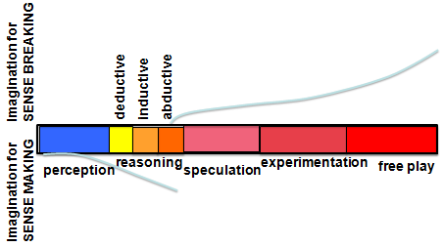
What being creative means in eight disciplines
Based on surveys within each community (Jackson & Shaw 2006)
Being imaginative – ability to think generatively & associatively
Being original / inventive - new ideas which add value
Being able to adapt/improvise (re-creation)
Being curious having an enquiring disposition –
having the desire to find out
Being able to think synthetically and
relationally – connect in novel ways,
work with incomplete data, recognise patterns
Being able to think critically to evaluate ideas
Being resourceful – finding and making use of what is available
Being able to communicate in ways that help people
comprehend and if necessary, see things differently
Notes:
Where Does Creativity Reside in the Discipline?
Surveys of academic teachers in different disciplines²⁴ reveal that sites for creative thinking and action appear to be available in most aspects of disciplinary practice. Sites for creativity can be connected through the idea of disciplinary enquiry and problem solving.
Being original – is understood as creating something new and useful to the discipline. For most academics this is embodied in the processes and products of research many of whom are active contributors. The idea is also connected to invention and innovation. For example in history this could mean: new approaches to solving historical problems; new techniques to gather and analyse data; new approaches to validate evidence; new interpretations of evidence; new forms of history and new forms of communicating historical information.
Making use of imagination – is focused on the use of mental models in disciplinary thinking. It is a source of inspiration, stimulates curiosity and sustains motivation. It generates ideas for creative solutions and facilitates interpretation in situations which cannot be understood by facts or observations alone. Disciplinary problems and concerns provide an essential context for the use of imagination.
Finding and thinking about complex problems – the engine of academic creativity is intellectual curiosity – the desire to find out, understand, explain, prove or disprove something. Curiosity leads academics to find questions that are worth answering and problems that are worth solving.
Making sense of complexity, synthesising, connecting and seeing relationships – Because working with complex problems often involves working with multiple and incomplete data sets, the capacity to synthesise, make connections and see new patterns and relationships is important in sense-making (interpreting and creating new mental models) and working towards better understandings and possible solutions to difficult problems.
Communication - the communication of ideas, knowledge and deeper understandings are important dimensions of creativity in the discipline. The symbolic language and tools and vehicles for communicating are all part of the disciplinary heritage. Story telling is an important dimension of communication. Disciplinary cultures are largely based on writing using the conceptual and symbolic language and images that have been developed to communicate complex information. Story-telling and story-writing are important sites for academics’ creativity.
Resourcefulness – in the professional disciplines many roles involve solving difficult problems requiring ingenuity and resourcefulness. For example, a social worker or medic might need all their resourcefulness to access and acquire the resources to solve a client or patient’s problem.
Amabile⁶ reveals how these characteristics of disciplinary creativity might be integrated into her model of creativity (Figure 3) through the example of a bio-engineer utilising his expertise, creative thinking and motivations to find and solve problems (contexts) that motivate him. In this scenario we are dealing with the Pro-c versions of creativity recognised by Kaufman and Beghetto¹⁶
A bio-engineer's expertise includes his innate talent for imagining and thinking about complex scientific problems as well as sensing out the important problems in that domain, his factual knowledge of biochemistry and the techniques of genetic engineering, his familiarity with past and current work in the area, and the technical laboratory skill he has acquired. This component can be viewed as the set of cognitive pathways that may be followed for solving a given problem or doing a given task ^{6 p5}
Our bio-engineer's arsenal of creativity skills might include his ability to break out of a preconceived perception or expectation when observing experimental results, his tolerance for ambiguity in the process of deciding on the appropriate interpretation for puzzling data, his ability to suspend judgment as he considers different approaches, and his ability to break out of strict algorithms for attacking a problem^{6 p5}
Task motivation makes the difference between what our bio-engineer can do and what he will do. The former depends on his levels of domain-relevant skills and creativity-relevant skills. But it is his task motivation that determines the extent to which he will fully engage his domain-relevant skills and creativity-relevant skills in the service of creative performance.^{6p7}
For many people, simply having the intellectual challenge of a problem they care about is all they need to motivate themselves and increase their potential for creativity.

Slide 7
Four-C model of creativity Kaufman and Berghetto (2009)
mini-c
little-c
pro-c
Big-C
eminent creativity
of exceptional
people
creative acts
of experts
& experienced
people
creativity is often the
result of making a third
‘thing’ from two existing
things or ideas, rather
than making something
from nothing 1+1=3!
McWilliam (2016)
new ideas & their implementation
everyday
creative
thoughts
and actions
of you and me
changes in
understanding
Students
Academics
location, scale of influence and impact
Notes:
Creativity has a scale and level dimension. Kaufman and Berghetto (2009) developed a 4C model refering to 'Big-C' creativity that brings about significant change in a domain; 'Pro-c' creativity associated with the creative acts of experts or people who have mastered a field, including but not only people involved in professional activity; 'little-c' creativity - the everyday creative acts of individuals who are not particularly expert in a situation and 'mini-c' the novel and personally meaningful interpretation of experiences, actions and events made by individuals. Central to the definition of mini-c creativity is the dynamic, interpretative process of constructing personal knowledge and understanding within a particular socio-cultural context.
Both mini-c and little-c forms of creativity are relevant to higher education learning and curriculum designs, teaching and learning strategies could usefully encourage and facilitate these. One might speculate that participation in these forms of creativity are pre-requisite for Pro-c and Big-C creativity in later life: if we want creative professionals then we should be encouraging students to be creative. It is however important to note that 'everyday creativity can extend from mini-c to little-c through Pro-c. It is only Big-C that remains eminent creativity (ibid:6) beyond the reach of most of us. From an educational perspective it might be reasoned that by encouraging and empowering students to use, develop and make claims for mini-c and little-c forms of creativity, we are better preparing them not only for using these forms in later life but for engaging in more expert-based forms of creativity that emerges through sustained engagement with a particular domain or field of activity.

Slide 8
Identify possible techniques
that you could use to
encourage students to use
their creativity in your own
teaching / learning contexts
https://www.youtube.com/watch?v=IC_ZT00fasY
Notes:
In this video clip Tina Seelig describes some of the techniques she uses to facilitate a MOOC on the theme of creativity.
Which of her techniques might be applied to more conventional classroom-based courses?
Can you teach creativity to 44,000 people?
Tina Seelig, Stamford University - ideas for teaching for creativity
http://www.ksucreatives.com/teaching-for-creativity.html
Stretch imaginations and show students that everything is ripe for creativity and innovation
Start with short 5min lecture - each lecture takes 5 days to produce could be on topics like - challenging assumptions, reframing problems, creativity in teams
Readings to support the lecture theme to enable students to develop their knowledge
Every week set a challenge (assignment) - sometimes individuals, sometimes teams. Break assignments down to small parts to avoid confusion - eg design a cover for your own biography to stretch imaginations.
Everyone uploads their assignment so everyone can see everyone else’s work
Everyone evaluates/comments on everyone else - Crowd Source Grading
Teacher provides rubric to guide evaluation and examples to show how rubric is used
Huge amount of feedback
Self-organising / self-regulating community - people take on supportive roles
Amazing on-line community. High level of commitment from people hungry for learning. But not everyone motivated to same degree.
Teacher's role is CHIEF INSTIGATOR - I get things going then let them happen. Teacher reacts to problems and reflects to learn from experience. Assumes that others know more than she does.
Driven by problems and problem solving - you can problematize anything. Every problem is an opportunity
Problem solving pattern example
1) Take anything common eg PETS and imagine a problem associated with Pets
2) Brainstorm lots of ideas at least 100 possible solutions then pick one
4) Pick favourite and develop idea
5) Prototype the solution - show how it will work
6) Tell a story to explain solution
Lots of space for experimentation

Slide 9
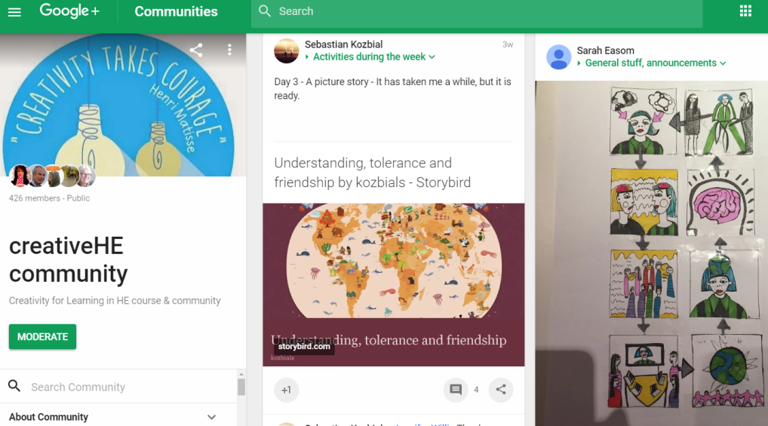
#creativeHE courses
SHARE/ LEARN
create/learn
create & learn
CHALLENGE
make & tell a story
instigator
create
& learn
instigate, encourage, ‘get out of the way’, observe,
recognise & value, share meanings of creation

Slide 10
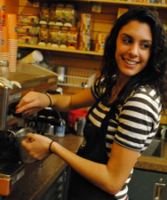
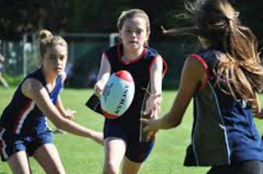
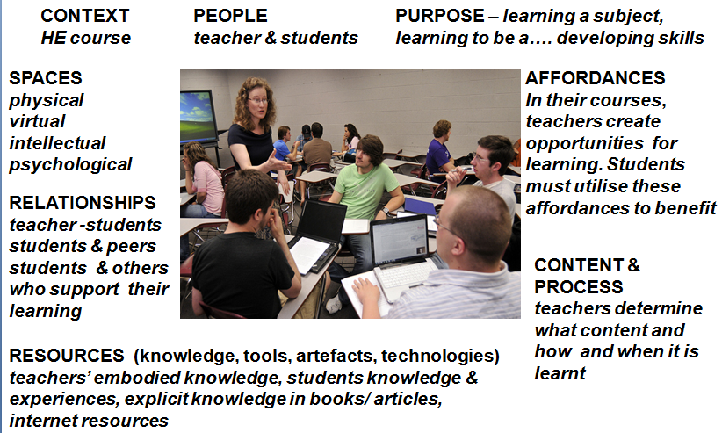
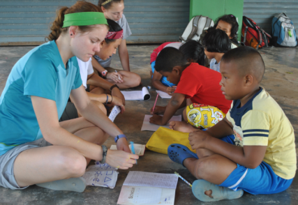
1 From a students’ perspective – ecologies for learning
and creativity can occur in every part of their life
Students’ higher
education experiences
can be visualised as
a constellation of
ecologies for learning.
Most are shaped/created
by teachers & institution
some by students, and
some by organisations
outside the university
University Ecosystem
Macro system
Co-curriculum
& student
organised
activities
‘Living’
Modules
PT work
Travel
sport
Programme
Volunteering
Notes:
Students are subjected to many different pedagogic practices within their course. These are generally consistent with the signature pedagogies of the discipline, but they will also include teachers’ own pedagogic orientations that might be influenced by their interests and beliefs.
But students also learn in environments outside the course and implicitly or explicitly they are developing skills, beliefs and values and having experiences that they can assimilate into their overall development.
By getting involved in many different experiences they are in fact creating their own unique ‘signature’ learning experience.. They are in fact being the person they want to be and striving to become the person they want to become.

Slide 11
1 To accommodate all the affordances for learning and creativity in a
students’ life HE needs to embrace the idea of a Lifewide Curriculum
HONOURS
DEGREE
LIFEWIDE LEARNING AWARD
commitment to own personal and professional development
Academic
curriculum
Extra-curriculum eg
Mentoring
Caring for others
Work-related
curriculum
Work placement
related to area of study or integration
theory & practice
eg health and social care programmes
Work including PT jobs and internships
Sport
Co-curriculum
learning spaces
outside formal
curriculum
Travel
Study abroad
Running own
business
Volunteering
& social enterprise
Creative
enterprise
Student Representation & Societies
AND MORE!!!
Notes:
There are opportunities and affordances for self-directed, self-regulated learning across the whole of a learners life while they are studying at university but to support and recognise learners’ self-regulated learning, development and achievement across their whole life requires the adoption of a lifewide curriculum and the means of recognising student development outside the formal academic curriculum (Jackson 2011)
The concrete expression of a lifewide curriculum as depicted in this diagram it contains four different curricular domains:
Academic curriculum,
Work-related curriculum
3. Co-curriculum: experiences provided by the university that may or may not be credit-bearing and for which learners may or may not receive formal recognition
4 Extra-curriculum: experiences that are determined by the learners themselves and constitute all the spaces that they inhabit outside of 1 and 2 above.
The distinction between co- and extra-curricular has been deliberately blurred in some universities as experiences that would be considered to be extra-curricular have been incorporated into the co-curriculum. But regardless of the way institutions define their curricular domains this book is primarily concerned with the co-curricular and extra-curricular domains of student experience and achievement and the ways in which student learning and development is being supported and recognised in these domains.

Slide 12
2 Conceptual tool for making sense of a students
ecologies for learning, creating & achieving
Determined by learner
B Partly to significantly determined
by learner(s)
B Partly to significantly determined
by learner(s)
D Completely determined
by learner
Academic
Programme
Other Contexts
eg. work, community
field, co-curriculum
extra-curriculum
LEARNING CONTEXT
LEARNING ECOLOGY
A Completely determined
by teachers
C Partly to
significantly
determined
by learner
Determined by institution or other body
eg a work placement or volunteering organisation
Learning ecology includes goals, affordances, processes, spaces,
relationships , resources (knowledge, tools, technologies, mediating artefacts)

Slide 13
Encouraging students to use their creativity
PEDAGOGICAL DESIGN TOOL
PEDAGOGIC APPROACHES THAT
foster intrinsic motivation
immerse the learner in challenging, solution-finding situations and tasks
involve inquiry-rich approaches to learning and problem working
are rich in peer2peer interaction and collaboration
involve teacher as co-creator, activist, facilitator not just a transmitter
involve teachers in getting out of the way
involve space for reflection and conversation to enable learners’ to understand their own creativity
involve the use of strategies for recording, curating and communicating learning, creativity and achievement
AND CREATE OPPORTUNITY FOR LEARNERS TO
create their own ecologies for learning & achieving
experience contexts that are unfamiliar
experience novel tasks and challenges
experience real word situations
use their imaginations to design, invent, adapt and/or develop something
use their skills to make something or make something happen
take risks without being penalised for not fully succeeding
reflect on their processes and grow personal understandings about their own creativity
gain recognition for their creativity

Slide 14
Pedagogical practices that encourage students’ creativity
Many of these approaches have potential to enable students to develop
their own ecologies for learning
IMPORTANT FEATURES OF CREATIVITY IN DISCIPLINES
* Using imagination
Being original - new ideas /
perspectives / things /solutions * Being curious / inquiring /
find solutions * Being resourceful * Being able to combine,
connect, synthesise etc * Being able to think critically,
analyse, evaluate * Being able to think reflectively /
empathically
*Being able to represent ideas
and communicate meaning to
others & form / tell stories
GAMES
SIMULATIONS
CASE STUDIES
ROLE PLAY
INQUIRY- BASED
PROBLEM-BASED
LEARNING
MAKING
SOMETHING
PROJECT- BASED
LEARNING
MAKING
SOMETHING HAPPEN
‘ENTERPRISE’
DESIGN
THINKING
STORY &
REFLECTIVE NARRATIVE
VISUALISATION
TECHNIQUES

Slide 15
Examples of ecologies that encourage students
to use their creativity in the learning process

Slide 16
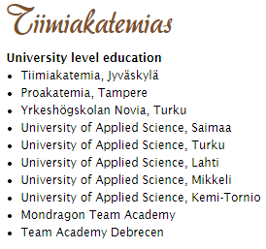
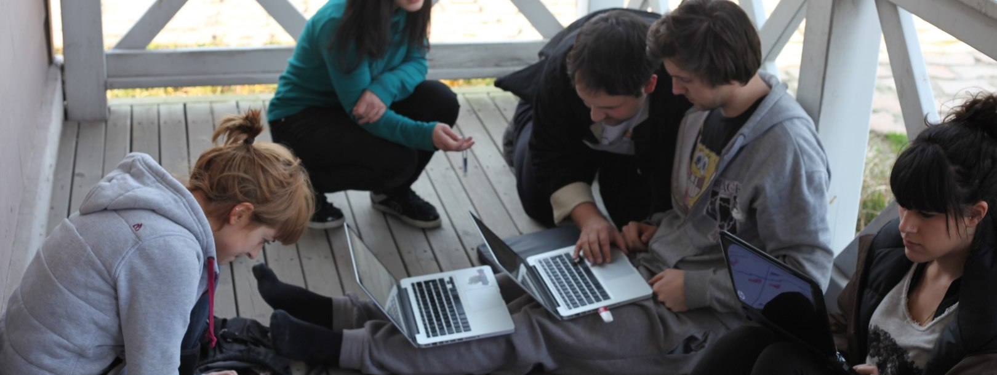
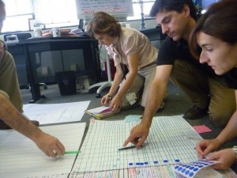
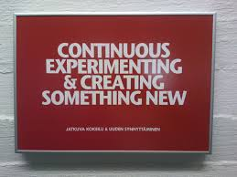
Tiimiakatemia jyväskylä Finland
students work in teams and invent then run their own cooperative businesses
No curriculum – students discover what they need to know as they try to run their business
Notes:
See slide share presentation
http://www.slideshare.net/Tiimiakatemia/tiimiakatemia-presentation-shortbasicsaugust2014-37793652

Slide 17
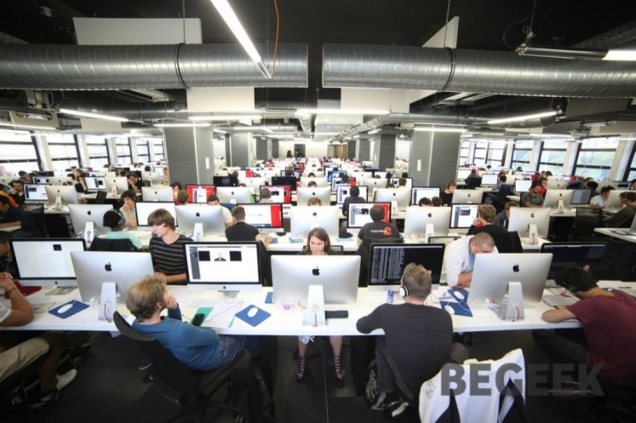
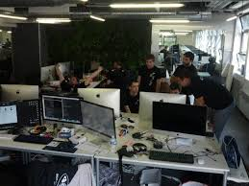
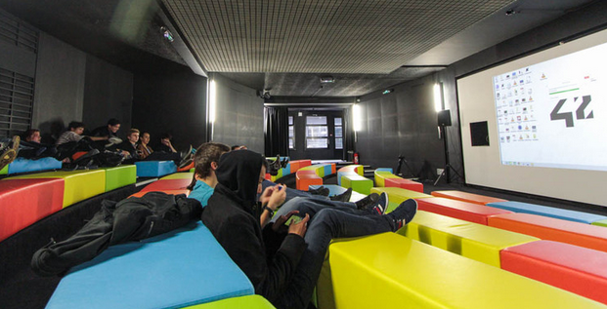
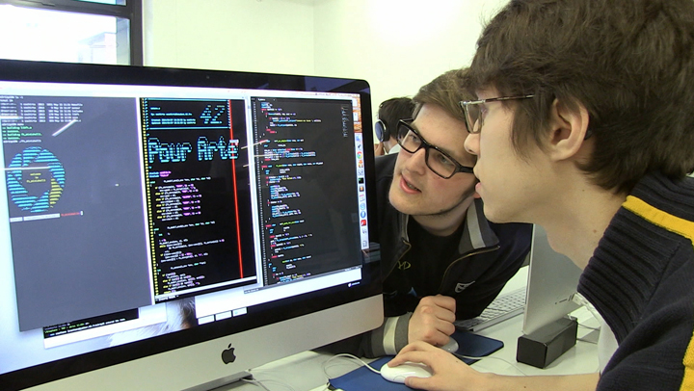
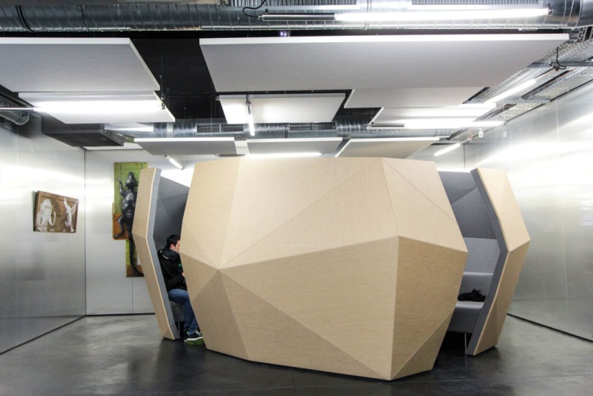
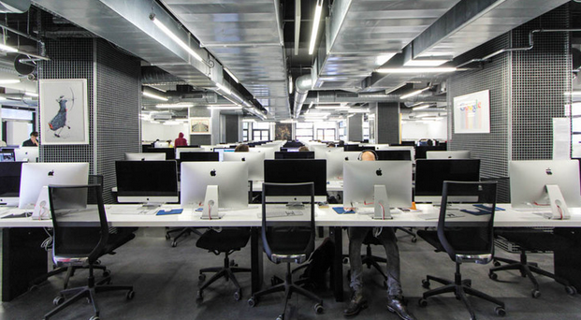
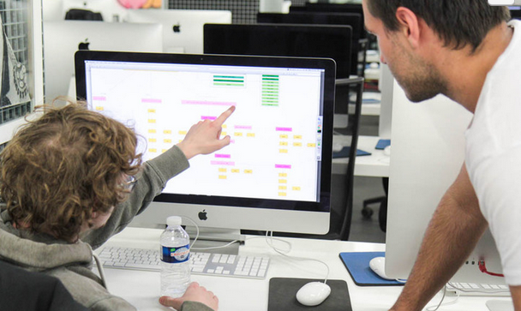
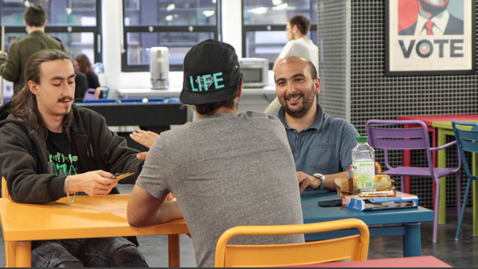
École 42 Innovative approach to Inquiry/Problem-Based Learning
Notes:
The basic idea of École 42 is to throw all the students — 800 to 1,000 per year — into a single building in the heart of Paris, give them Apple computers with large screens and throw increasingly difficult programming challenges at them. The students are given little direction about how to solve the problems, so they have to turn to each other — and to the Internet — to figure out the solutions. All of École 42′s projects are meant to be collaborative, so the students work in teams of two to five people. At first glance, the École’s classrooms look a little bit like a factory floor or a coding sweatshop, with row after row of Aeron-style chairs facing row after row of big monitors. But a closer look reveals that the layout is designed to facilitate small-group collaboration, with the monitors staggered so that students can easily talk to one another, on the diagonals between the monitors or side by side with the people next to them. Students can come and go as they please; the school is open 24 hours a day and has a well-appointed cafeteria in the basement. Students share all of their code on Github (the world's largest open source platform and community). They communicate and collaborate with one another, and receive challenges and tests, via the school’s intranet. Everything else they figure out on their own, whether it means learning trigonometry, figuring out the syntax for C code, or picking up techniques to index a database.
Tests are essentially pass-fail. A team either completes the project or it doesn’t. The no-teachers approach makes sense, as nearly anything you need to know about programming can now be found, for free, on the Internet. Motivated people can easily teach themselves any language they need to know in a few months of intensive work. But motivation is what’s hard to come by, and to sustain — ask anyone who has tried out Codecademy but not stuck with it. That has prompted the creation of “learn to code” bootcamps and schools around the world. École 42 takes a similar inspiration but allows the students to generate their own enthusiasm via collaborative (and somewhat competitive) teamwork.
Tweney D (2014) Ecole 42 Available at:
http://venturebeat.com/2014/06/13/this-french-tech-school-has-no-teachers-no-books-no- tuition-and-it-could-change-everything/
Interview with Florian Bucher et Kwame Yamgnane, Co-Founders of Ecole 42
https://www.youtube.com/watch?v=yW22H1VZnyw
Premier Hackathon
https://www.youtube.com/watch?v=oV7h8mu4-lw
Learning through work environment
https://www.youtube.com/watch?v=AM1w_YWPzJ0

Slide 18
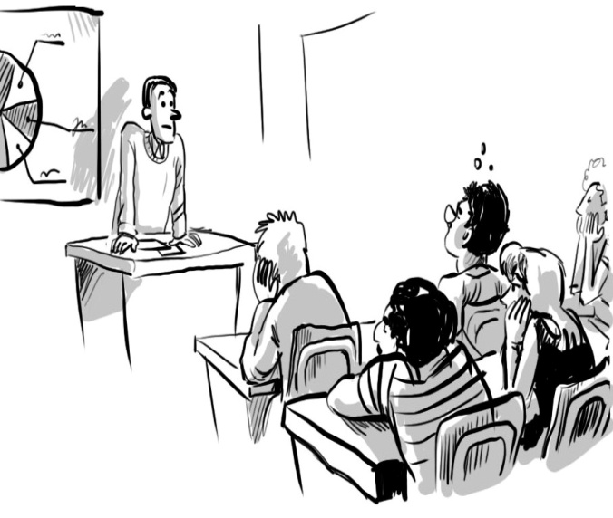
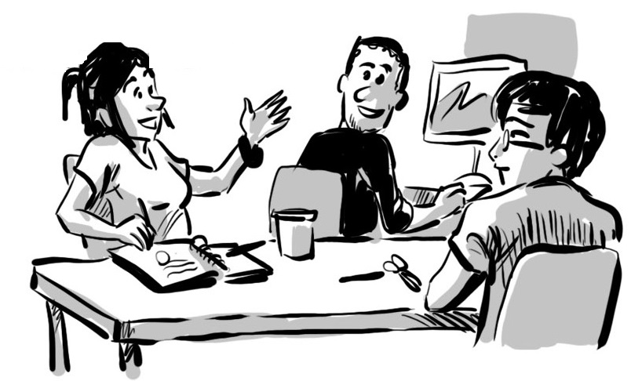
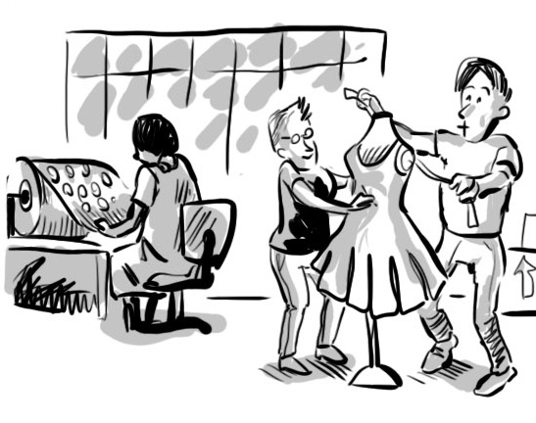
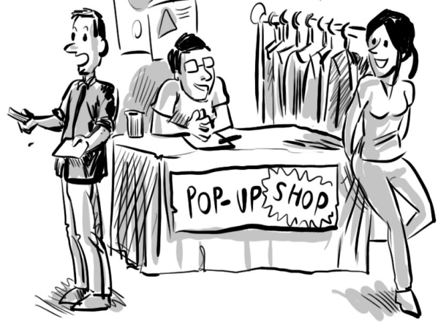
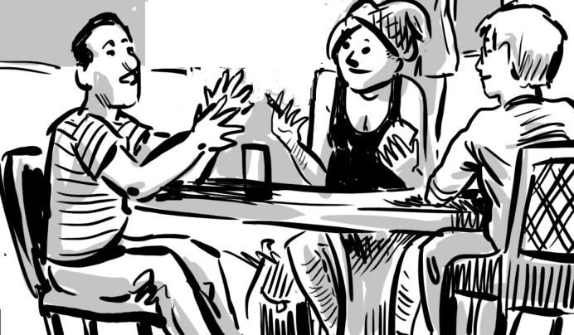
Southampton Solent University School of Fashion
Combining inquiry-rich learning, design, making & selling
FROM THIS TO
A CREATIVE LEARNING ECOLOGY
DESIGN
MANUFACTURE
MARKET
REFLECT ON – what would
we do differently next time?
SELL

Slide 19
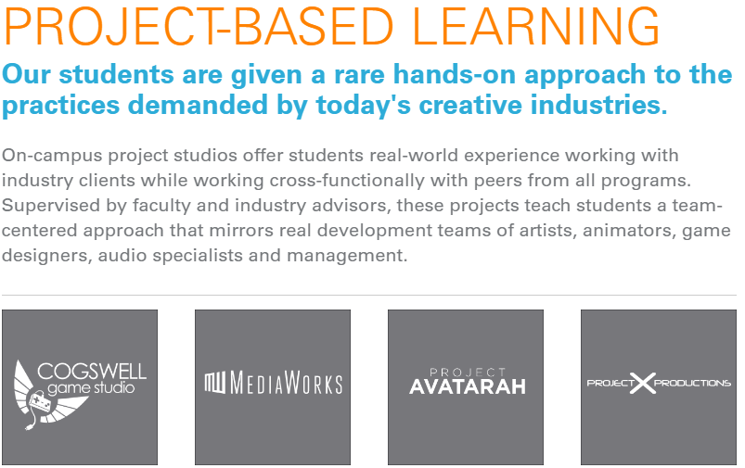
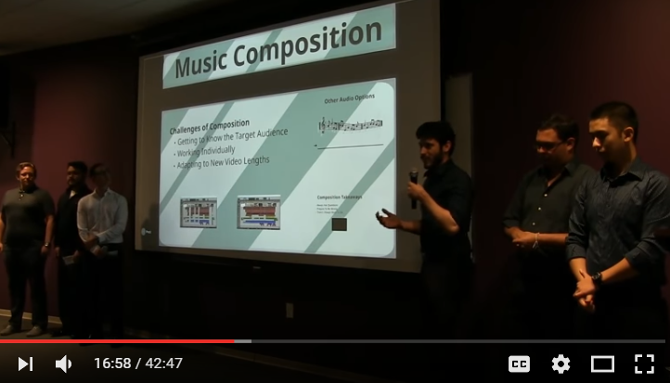
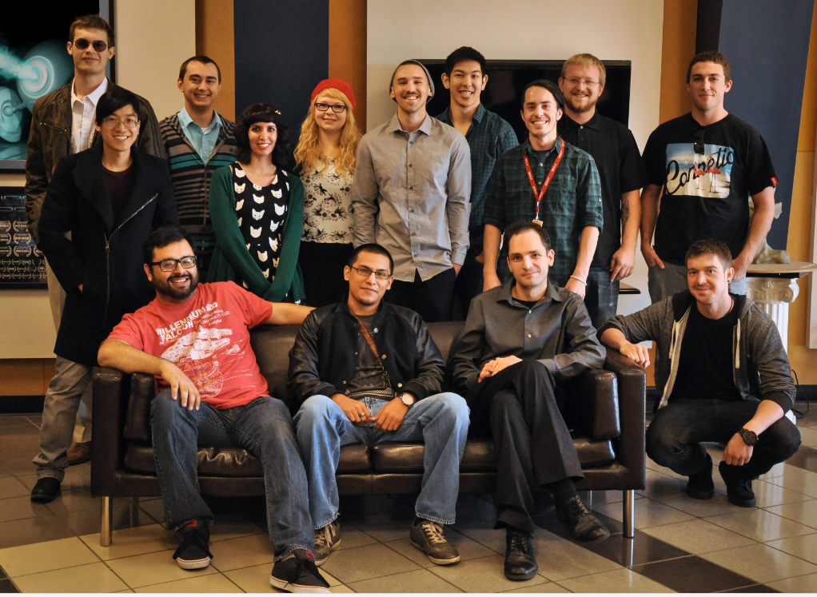
Media Works Cosgrove Polytechnic College
MediaWorks is a project-based learning Digital Audio Technology initiative, in which Audio and Digital Art & Animation students collaborate on the production of short audiovisual pieces made for various Silicon Valley businesses – and beyond.
Article in April Creative Academic Magazine
Notes:
Cogswell Polytechnical College is located in the heart of the legendary Silicon Valley in San Jose, California. Its educational mission is to be a leader in providing practical education in the combined disciplines of technology and entrepreneurship with an emphasis on leadership, and a strong focus on new technologies and business models to prepare graduates for careers in the global economy¹. It offers a specialized curriculum that fuses digital arts, audio technology, game design, engineering and entrepreneurship.
The college has adopted project-based learning involving students working with industry.
These original audiovisual pieces are created by Cogswell students under the guidance of the Audio and Visual Directors.
The results are industry-quality "media works." The produced pieces include sound design, original music, animation and live action footage. The projects involve real-life client meetings, creative brief and concept generation, participation in the approval process, project and time management, deadlines and full-scale production by students working individually, in teams and cross-team. The production follows the current industry pipeline and delivery standards.

Slide 20
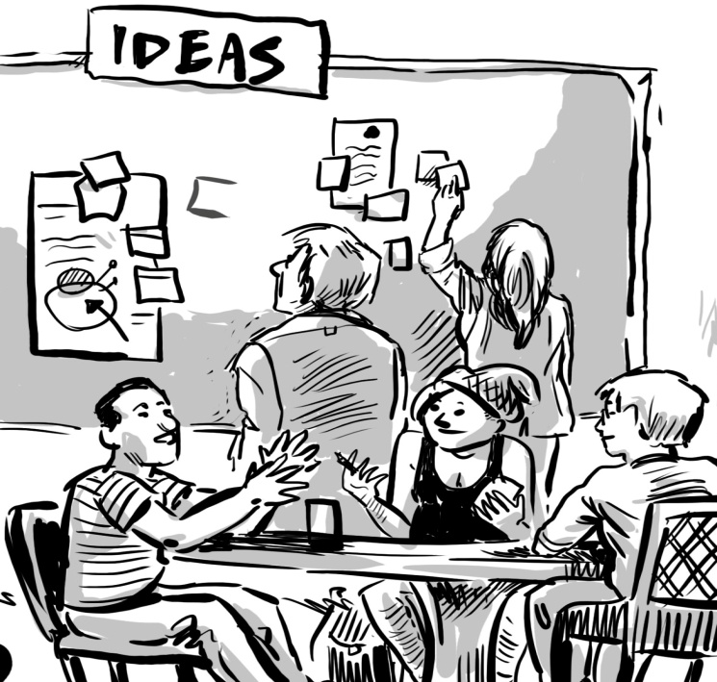
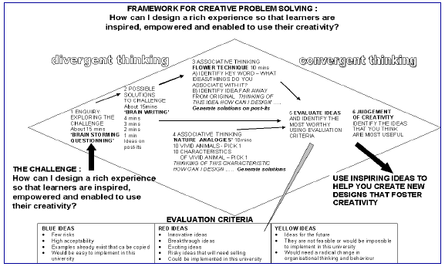
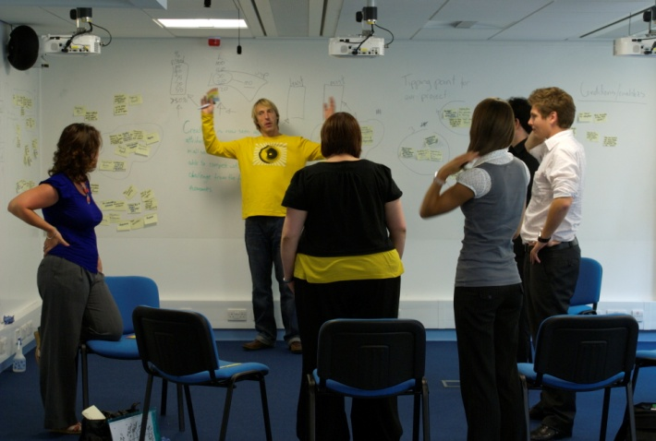
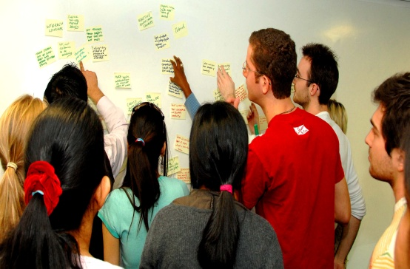
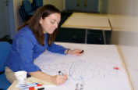
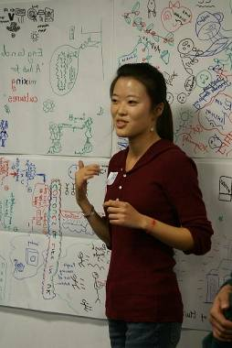
FRAMEWORK FOR INTEGRATING IMAGINATION & CRITICAL THINKING
Notes:
Design Thinking and IBL
We need to learn to look at problems from many different perspectives. Designers have developed routines and techniques that can really help us to do this.When confronted with the problem of innovation, designers have developed ways of thinking about the problem that enhance their ability to imagine lots of possibilities from which they can chose the best solutions. Because of the way they think about problems they are particularly good at creating novel solutions to their problems. Jackson and Buining (2010) describe the use of 'design thinking' skills in group work with students.
Design thinking involves a series of divergent and convergent steps (Brown 2008a and 2008b) and Figure 12. During divergence we are creating choices and during convergence we are making choices. Divergent thinking can feel frustrating. It demands a high level of tolerance for ambiguity, uncertainty. Divergence needs to feel optimistic, exploratory and experimental but it often feels confusing to people who are more comfortable with a scientific approach to solving a problem. Design thinking relies on an interplay between analysis (breaking problems apart) and synthesis (putting ideas together). The uncertainty of divergence and the integrative, head-hurting complexity of synthesis are the unique characteristics of design thinking. They are the very experiences that make this type of creative thinking both challenging and liberating at the same time.
The idea generation and evaluation process takes about 90 mins to complete. You will need a large wall or expanse of windows for this process and the wall or windows need to be systematically covered with sheets of flip chart paper. Alternatively, white wall paper can be used. Participants sit in a semi-circle facing the papered wall. The optimum size for a group is 10-12 but this process can be undertaken with smaller or larger groups. If the group is larger than 15 it should be split into two groups each with its own facilitator. Participants will need half a pad of posit-its and a felt tip pen or biro to write on the post-its.
Figure 12a A process map showing the techniques used to stimulate Design
Thinking for creative enquiry and problem solving (Jackson and Buining 2012)
Framework for evaluating ideas and possible solutions to the problem
GREEN IDEAS
Ideas for the future
They are not feasible or would be impossible to implement in this university
Would need a radical change in organisational thinking and behaviour
RED IDEAS
Innovative ideas
Breakthrough ideas
Exciting ideas
Risky ideas that will need selling
Could be implemented in this university
BLUE IDEAS
Few risks
High acceptability
Examples already exist that can
be copied
Would be easy to implement in
this university
The process involves seven stages
Collaborative (90mins)
1) Framing the Challenge: creating a problem statement
2) Generating possible solutions (braindumping)
3) Generating more solutions using associative techniques
4) Evaluating ideas using the framework in
Individual or pairs (30-45mins)
5) Creating designs/solutions drawing on one or more ideas that have emerged
Collaborative (60mins - depends on number of participants)
6) Individuals present their designs/solutions to the group who
7) Provide feedback and additional ideas to enrich the individual's designs
A Comprehensive Guide to the process can be found at:
http://www.ksucreatives.com/creativity-guides.html
A short video clip illustrating the process
https://www.youtube.com/watch?v=rRzKmebah-I

Slide 21
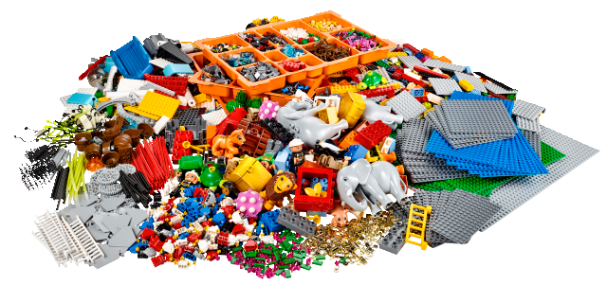
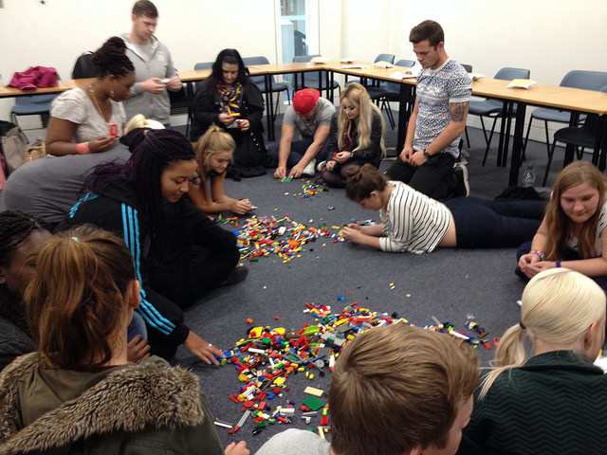
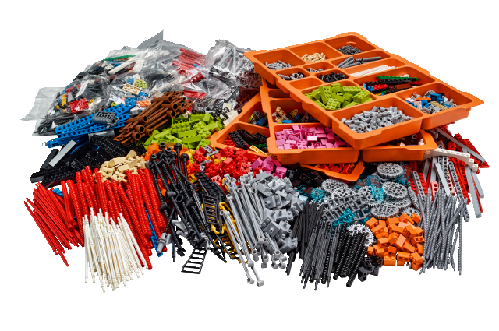
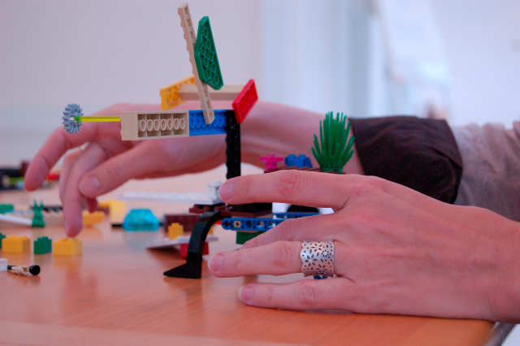
Lego Serious Play
1 Introduction: facilitator establishes ground
rules and outlines process
2. Focusing Question an idea or situation.
3. Building the model: Each participant makes
a model in response to the question.
Models are a concrete/symbolic
representation of thoughts and feelings
with specific metaphorical meaning.
4. Sharing the model: The model acts as a
'mediating artifact' to enable individuals to
share their stories/meanings with others
and connect with stories shared by others.
5. Reflecting: reflection is involved at
every stage
Identity and Landscape Kit
Connection and Networking Kit
Notes:
Lego Serious Play provides relatively low cost, reusable materials that can be incorporated into learning strategies that utilise the idea of making something physical in order to create meaning..
Nerantzi and McCusker (2014) provide a useful introduction to this relatively new approach to imagining, reflecting and the making and sharing of meaning which combines, play with making a symbolic artifact. LSP was developed by the LEGO company for the corporate world to provide a novel and engaging way engaging in professional conversations. Specialist LSP kits are sold by LEGO but experienced facilitators often put their own kits together
A characteristic of LSP is learning through play and the construction of mental models for a role, situation, context, experience, purpose, ambition, challenge or anything else that needs to be thought about coupled to the creation of physical artifacts to symbolically represent these mental models (James, 2013). The process of making a model then sharing its meaning helps individuals to use their creativity to represent and explain quite complex things. The process is consistent with the “learning through making” or “constructionism” theory of learning that views knowledge as being constructed through mental or physical models (Papert & Harel, 1991) while Frick et al. (2013, 8) note that constructionism is “about making formal and abstract ideas more concrete and tangible, therefore easier to understand.”
The 3D models enable participants to reflect through the use of metaphors that are personally meaningful. Metaphors play a vital role in constructing meaning in a more creative way (Schön, 1983). They also enable us to gain a deeper insight into our own thinking and as such they are a valuable tool for reflection. This happens in an LSP workshop too, individuals quickly move from describing their models in a mechanistic way and turn to storytelling as this is the way we communicate and engage with our audience. Moon (2010) notes that stories are powerful for the storyteller and the listeners and are important vehicles for reflection, sharing of messages, creating opportunities for conversation and learning as well as enabling us to connect emotionally with the stories and their creators.
The LSP method is premised on the idea that the solution is in the system, it encourages everybody to participate actively and become part of that solution. Everybody has a voice and the opportunity to shares their thoughts, reflections, ideas and feelings, to move the collective forward and become the solution to a specific problem or intervention through building LEGO® models. The models and their metaphorical meanings are owned by their creators and the creativity in expression has nothing to do with the representation of an idea from an artistic standpoint. There is no right or wrong way of building a model. Each participant is unique and expresses themselves in unique ways.
The LEGO® SERIOUS PLAY® Method is a technique which improves group problem solving. By utilizing visual, auditory and kinesthetic skills, the Method requires participants to learn and listen, and it provides all participants with a voice. The Method serves as a shared language regardless of culture or position
http://www.lego.com/en-gb/seriousplay/the-method
The LSP facilitator plays an important role by creating a safe environment for participants to share their thoughts and feelings, guiding them through the process and helping them makse sense of the experience. They do not participate in the building process; their role is to monitor what happens during the workshop, sense challenges or tensions and respond quickly to maximise engagement and learning. The workshop process is based on a series of challenges set as questions, a visual response to these through the building of a symbolic model and the sharing of the meaning of the model through conversations and stories.
1 Introduction: the facilitator establishes the ground rules and working practices, outlines the process and anticipated outcomes so that everybody is clear. There is usually a warm up exercise designed to show participants how easy it is to create a metaphorical model and to share their thinking.
The main LSP building process involves:
2. Posing the question: the facilitator asks a question which is addressed to the whole group. This acts as a trigger and helps participants to focus in on a thought, an idea or a situation. The question needs to be clear and open-ended so that participants understand what they are asked to do.
2. Building the model: Each participant makes a model individually as a response to the facilitator’s question. Building starts while everything is still messy in their minds. The models will emerge and become a visualisation of thoughts that have a specific metaphorical meaning for the makers. The model and their meanings belong to the makers.
3. Sharing the model: This is a very important part of the LSP process. The model acts as a 'mediating artifact' to enable individuals to share their stories with others and connect with the stories shared by others. This can be done in pairs, small groups or whole group. It is important to give enough time to listen to all stories and to allow them to be heard.
4. Reflecting: the process of reflection kicks in as soon as building begins, continues through the building process and when the stories are shared. The facilitator and participants might ask open-ended questions to seek clarification linked to specific models or features to aid deeper reflection.
The end: The facilitator summarises what has been captured during the LSP workshop and invites participants to reflect individually and capture these on the model itself but also in a notebook or learning journal.
Resources
The LEGO Group (2010). Open-source/<Introduction to LEGO(R) Serious Play(R), available at http://seriousplaypro.com/docs/LSP_Open_Source_Brochure.pdf
Videos explaining the process
https://www.youtube.com/watch?v=k4VZ8xnJn2I

Slide 22
Activity 4 Creative Pedagogies : imaginative approaches
to encouraging students’ creativity
5mins : Individuals
Using a module you are already teaching & deliberately trying to be
imaginative, identify at least three new ways to encourage students
to use their creativity. List these on the coloured sheet of paper with
the name of the module on the top.
8mins Table
Quickly share the ways of encouraging students’ creativity and
identify on a flip chart poster the three most imaginative /innovative
approaches
Whole Group
Most imaginative and innovative ways of encouraging students
to use their creativity

Slide 23
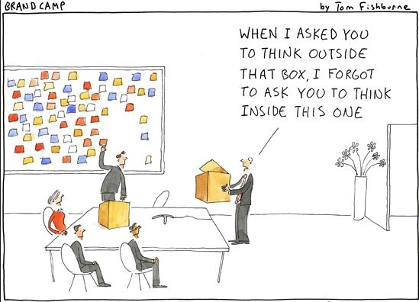

Slide 24
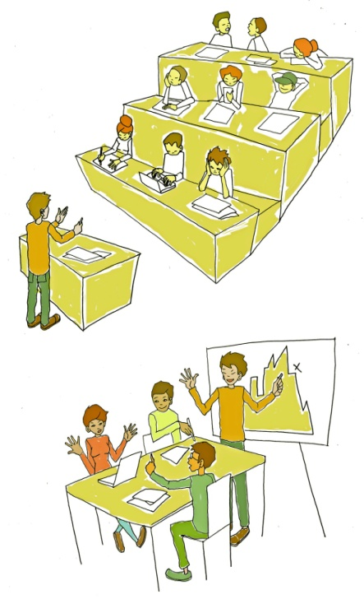
Possible influences on a teacher’s pedagogical thinking & practice
INSTITUTIONAL INFLUENCES
OTHER
STRATEGIC
PRIORITIES
eg employabiIty
social inclusion
internationalisation
sustainability
technology
PROGRAMME/
MODULE
PHILOSOPHY/
ORIENTATION
GRADUATE
ATTRIBUTES
EMPLOYERS
INDUSTRY/
BUSINESS
PRACTICES &
EXPECTATIONS
PEERS
PROFESSIONAL/
BODIES
POLICIES &
INCENTIVES
LEARNERS ANDTHEIR
NEEDS & INTERESTS
PROFESSIONAL
NETWORKING,
social media &
conferences
QA POLICIES
module feedback
NSS
TEACHER
TECHNOLOGY
Formal
training/
professional
development
GENERIC
PEDAGOGY
READING
NATIONAL FRAMEWORKS
Prof. Development
DISCIPLINARY PEDAGOGY
PAST HISTORY
Notes:
PROPOSITION: We must locate the idea of a teacher’s pedagogical thinking and practice within a university ecosystem for teaching and learning.
All higher education teachers develop unique pedagogical thinking based on their personal history of experience & learning and pedagogical practices based on their interactions with their ecosystem.
Their personal pedagogy involves their self- awareness, disciplinary & pedagogical knowledge and skill, interests, beliefs, values, emotions and history – in fact everything they can bring to the situation to fulfil their role as a teacher and help their learners learn

Slide 25
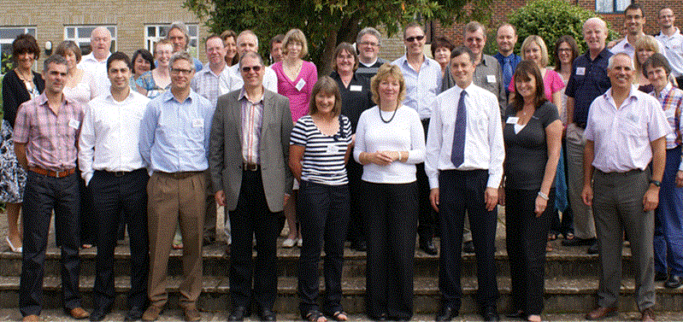
Study of strategic change & innovation
Southampton Solent University
What factors & conditions encourage YOU to
innovate YOUR teaching and learning practices?
Notes:
40 The study of strategic change demonstrated the value and importance of bottom-up innovation within a comprehensive and sustained strategic change project. While top down initiatives, like the introduction of new business systems and processes are essential to enabling a university to be more effective, responsive and adaptive in its educational work, it is the innovators who provide the key resource to enact and embody the significant educational changes a university is trying to make. The study reveals that innovators thrive in an organisational culture where leaders and managers are encouraging, supporting and enabling. Where they have the resources - especially time to make change happen. Where the institution's systems and procedures enable rather than hinder progress. Where they have the respect, emotional support and encouragement of managers and colleagues and where they can find help when they need it and where they feel their efforts have been valued and have made a positive difference.
It stands to reason that for organisational change to be successful the conditions and situations embodied in the factors that innovators consider to be important in accomplishing significant change have to be supported and realised. Twelve factors grouped under 1) leadership, management & facilitation or 2) environment/culture provide an overarching framework within which bottom-up innovation is more likely to be encouraged, supported and facilitated within a process of strategic change.

Slide 26
What’s important to innovators ? 21 ratings Max 5.0
1 Having a clear vision of how the university saw its future | 3.7
2 My readiness and willingness to get involved in the opportunity to innovate | 4.7
3 My vision of what I wanted to achieve | 4.5
4 My will/motivation to succeed | 4.7
5 Having explicit goals and realistic work plans | 4.4
6 Having the autonomy to implement the project as I wanted to | 4.3
7 Having the opportunity to use my personal creativity | 4.1
8 Believing I could take risks without feeling I would be criticised if I wasn't completely successful | 4.3
9 Having the financial resources I needed when I needed them | 4.3
10 Having the time I needed to complete the job | 4.4
11 Being able to find the help I needed when I needed it | 4.3
12 Having good communication with the people I needed to talk to | 4.5
13 The active involvement of others - teamwork | 4.7
14 Learning through the experience (learning from problems as well as successes) | 4.3
15 Feeling trusted and being allowed to get on with it without interference | 4.7
16 Feeling that I made good progress within the time available | 4.5
17 Feeling that what I was doing was valued by my colleagues | 4.5
18 Feeling that what I was doing was valued by Head of School/Service/ Dean | 4.4
19 Forming new productive relationships with colleagues in my school or university | 4.2
20 Forming new productive relationships with people outside the university | 4.3
21 Feeling that the environment encouraged and supported me throughout the process especially when things did not go as planned | 4.3
22 Feeling my contribution has been recognised and appreciated | 4.3
Notes:
38 A questionnaire was developed from a pilot study within the larger SDP study which identified factors that seemed to be important in enabling change to happen. Innovators were invited to rate the importance of each factor when trying to accomplish significant change on a five point scale.
The most striking conclusion is that all these factors are important to people when they are undertaking significant change. 21 of the 22 factors scored an average of 4 or more, and 19 factors scored 4.3 or more (max 5.0). The only factor to score less than 4 was (1) 'Having a clear vision of how the university saw its future and how SDP contributed to that vision.' However, most innovators had a clear vision of what they wanted to accomplish. Their vision is clearly more important to them than the strategic vision of the institution.
Personal characteristics (my will, my vision, my readiness) feature prominently in what is important, together with the way people wanted to be trusted and feel that their contributions would be valued. High value is also placed on communication, the social dimension of work and the need to make progress. The large number of factors innovators believe are involved in enabling innovation to be accomplished is striking and accounts for much of the complexity involved in innovating.

Slide 27
Factors & conditions that encourage creativity in a university ecosystem
Relational
COLLEAGUES
MANAGER
STUDENTS
SUBJECT
ENVIRONMENT
IDEAS
THINKING
INTRINSIC
MOTIVATION
AUTONOMY
CAPABILITY
TRUST
OPPORTUNITY
ENCOURAGEMENT
SUPPORT
VALUE
RESOURCES
PROBLEM
CHALLENGE
OPPORTUNITY
Environment
/Culture
Personal
FINDING NEW WAYS
MAKING PROGRESS
Process
Notes:
Factors highlighted in institutional surveys
Personal
Ability to think and act creatively
Having the capability to undertake the work or the belief that the necessary knowledge and capability can be developed
Having particular attitudes or orientations – like being open to new ideas, willing to take risks and to persevere when faced with obstacles
Having the ability to persuade others
Being motivated from within intrinsic motivations might be triggered by:
a problem or issue needing resolution
exposure to an exiting idea or practice
feelings of boredom and staleness
Process factors relate to
the dynamics of engagement and interaction – belief that good things will emerge from good work processes
the opportunities for communication in order to persuade or involve people
meaningful and productive working relationships with colleagues/clients
having the freedom, time and space to develop something in a particular way
Organisational / cultural / environmental factors that encourage include
managerial regimes that trusts and empowers developers and appreciates and values their efforts
being part of a supportive and productive team
a culture/community which values and cares about people
having sufficient resources. Limited resources do not necessarily stifle creativity as it is can be an incentive for resourcefulness.
Employment conditions or situations that provide the developer with the freedom/ autonomy/ flexibility/independence they need to fulfil their role.

Slide 28
Factors & Conditions Encouraging Strategic
Change & Innovation in a University Ecosystem
Leadership, management & facilitation of strategic change & bottom up innovation
Leadership is shared and distributed throughout the organisation
A strategic vision that inspires people to create their own visions that they can embody
A strategy for both planned and emergent change
A strategy that involves the whole environment and everyone in it
5 Involvement of brokers to facilitate change across and between organisational
structures, hierarchies and boundaries
6 Adequate resources and an effective but flexible approach to managing their use
An environment/culture that :
promotes effective, honest and meaningful communication
recognises and supports resolution of local contentious practice and facilitates rather than inhibits progress
encourages/facilitates new relationships and collaborations to foster change
provides emotional support and celebrates what has been achieved
values learning and encourages and enables people to share what has been learnt
encourages people to take risks to put themselves into unfamiliar situations where they need to harness their creativity to realise their ideas and actualise themselves
Notes:
Synthesis of factors and conditions from Solent study

Slide 29
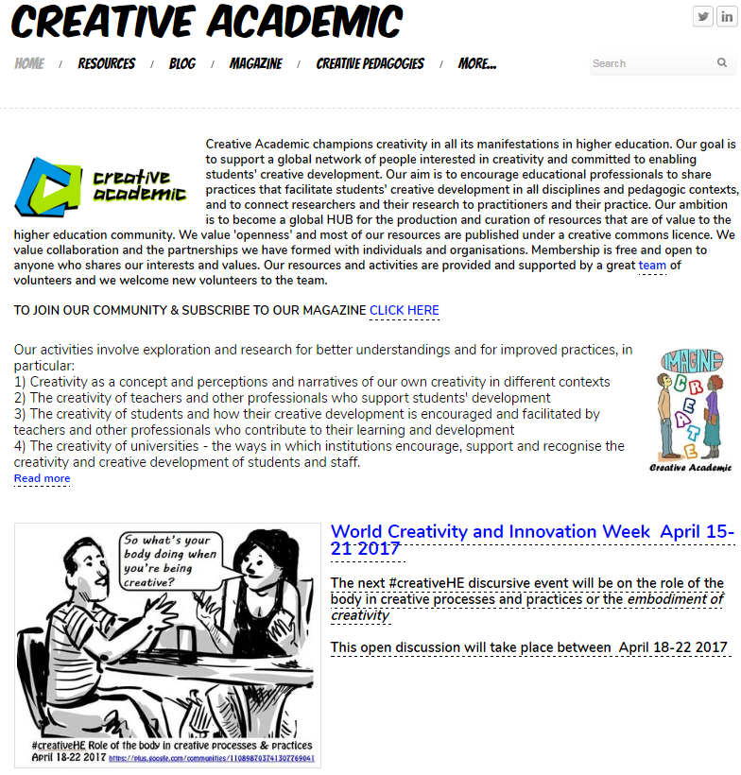
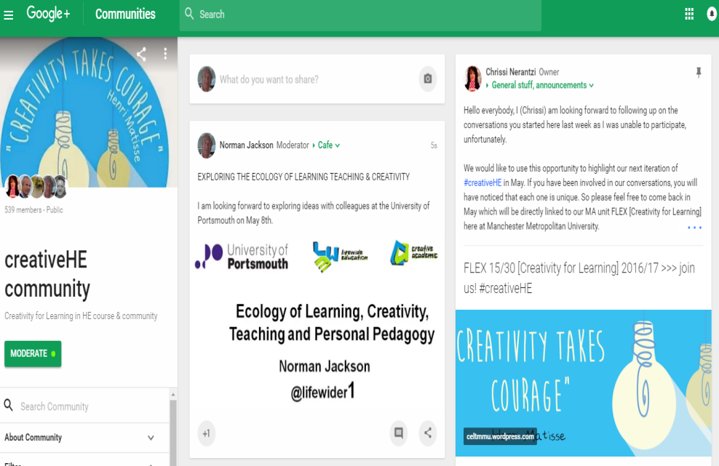
Thank you
#creativeHE Google+ Forum

