Slide 1
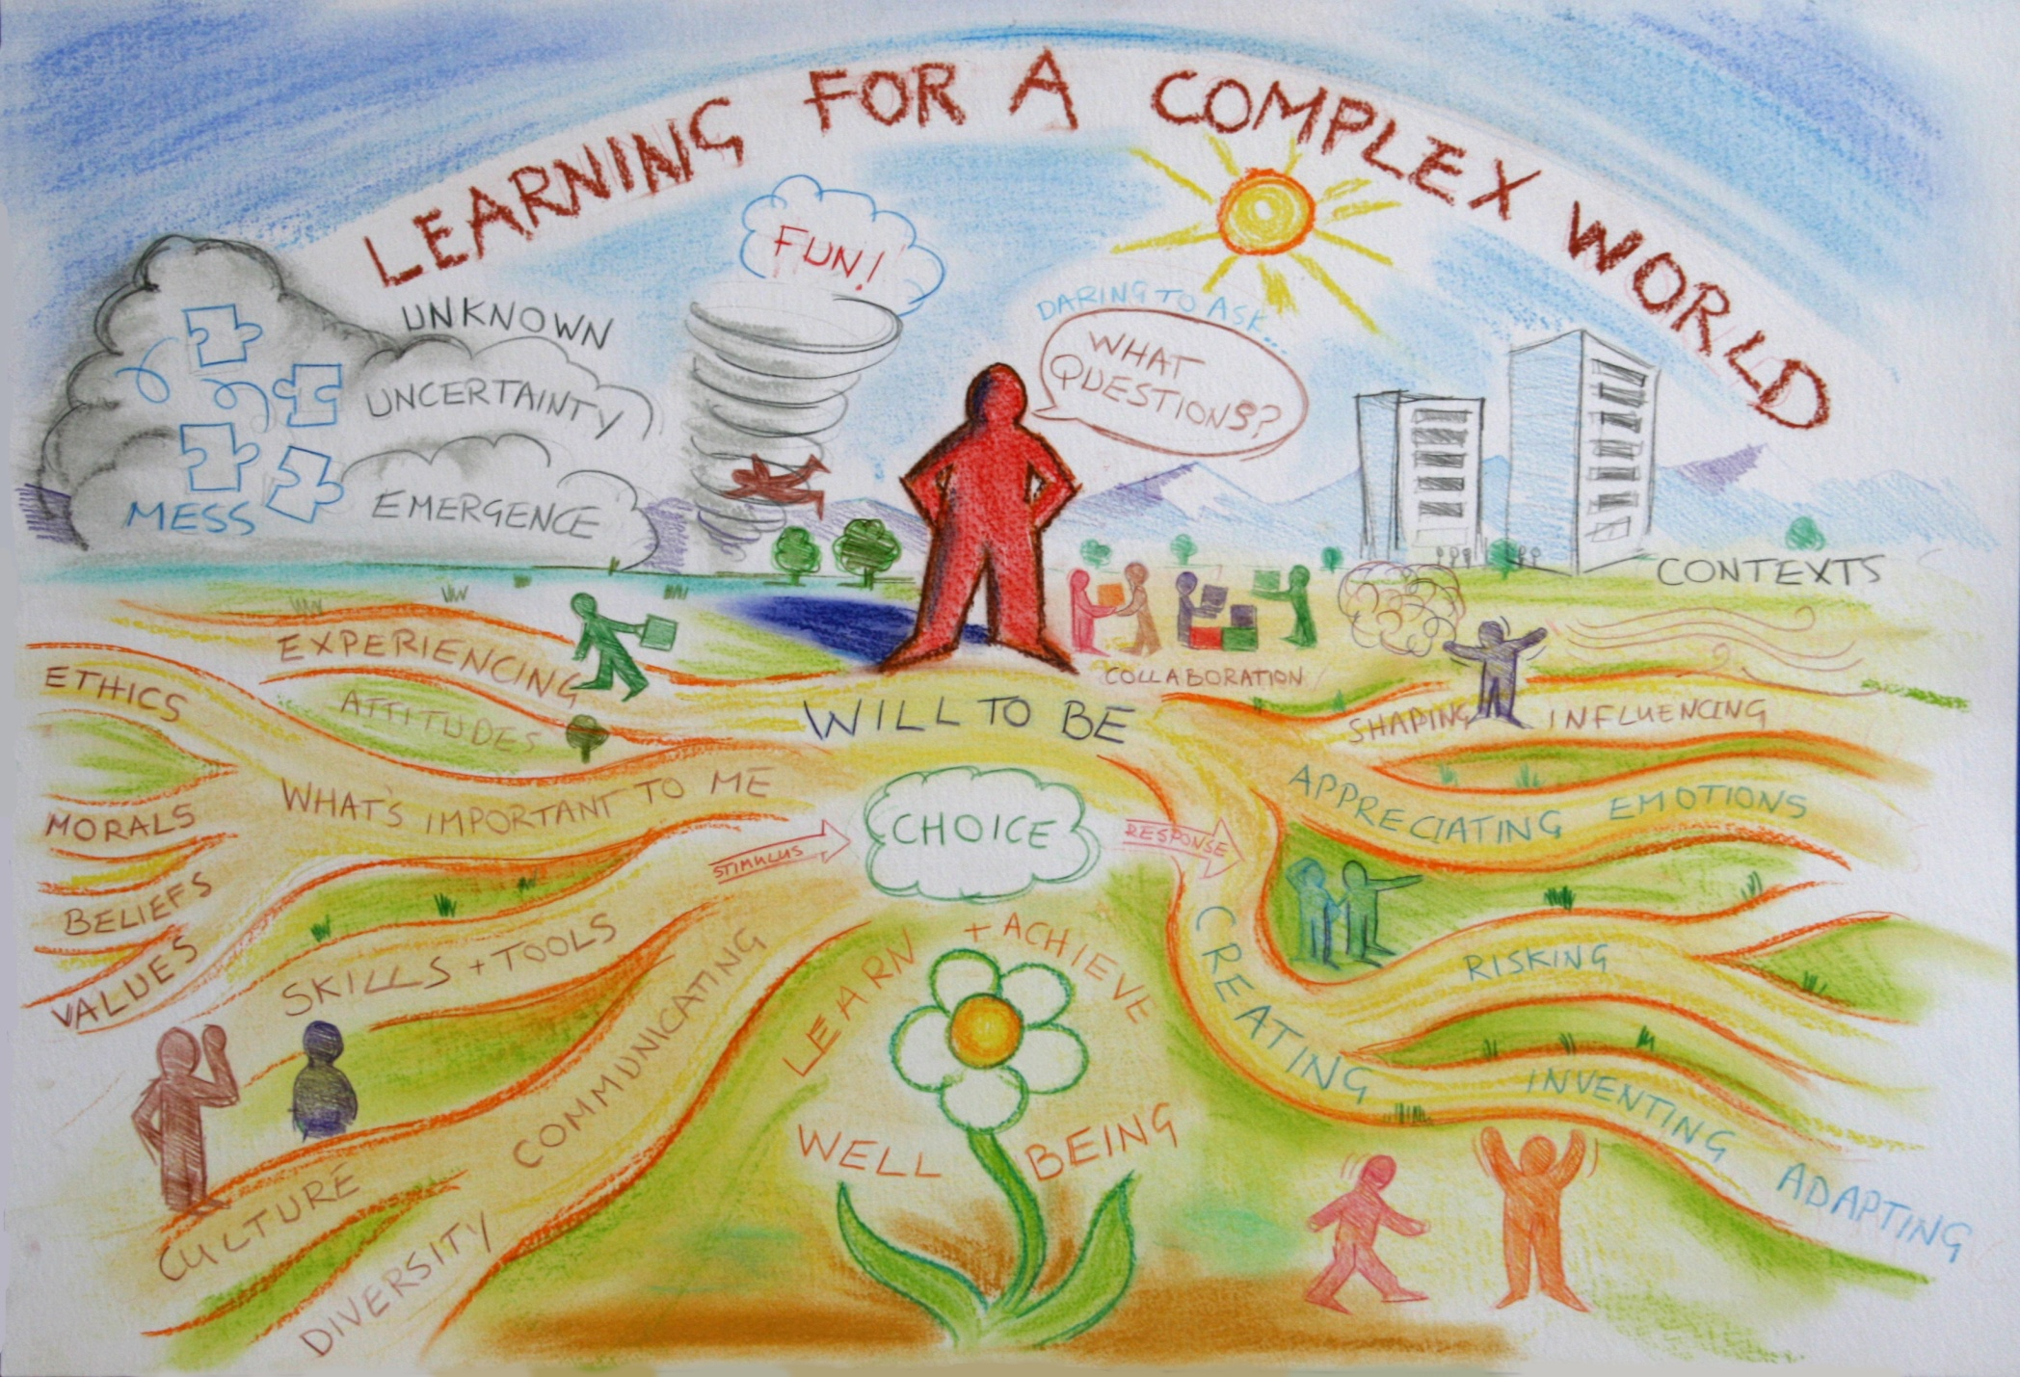

Slide 2
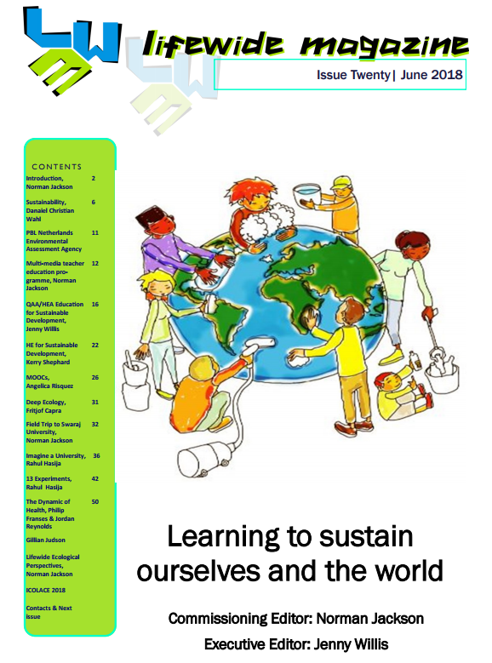
Sustaining mankind and our planet cannot be achieved by technological solutions, political regulation or financial instruments alone.
We need to change the way people think and act but changing the way a global society thinks and acts in order to sustain the Earth is a huge challenge and a key moral purpose for the world's education systems.

Slide 3
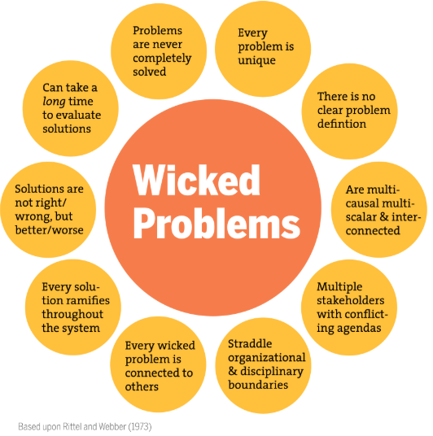
‘we are living in a unique time in the history of our civilization, facing several simultaneous challenges and converging crises: a deteriorating environment, a very unequal distribution of dwindling resources, widespread poverty, wars, climate change, oppression of many peoples, and dissatisfaction with life even in those countries with a surplus of material wealth. How did we get into this mess?.....What can we do about it?’
Daniel Christian Wahl
‘Design for sustainability PhD’

Slide 4
UN Decade of Education for Sustainable Development (2005-2014) initiated the process of educating the planet for a different future.
The 2030 Agenda for Sustainable Development provides new impetus for Education for Sustainable Development (ESD).

Slide 5
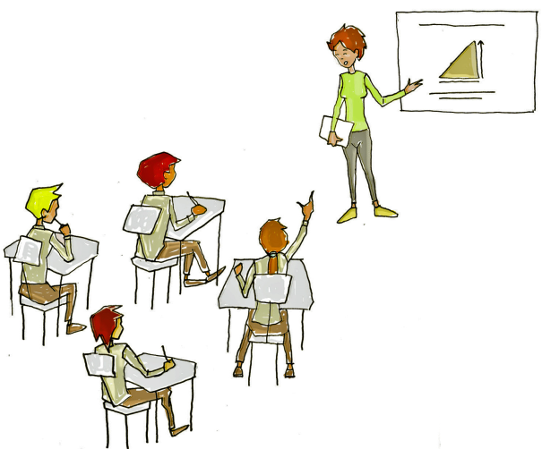
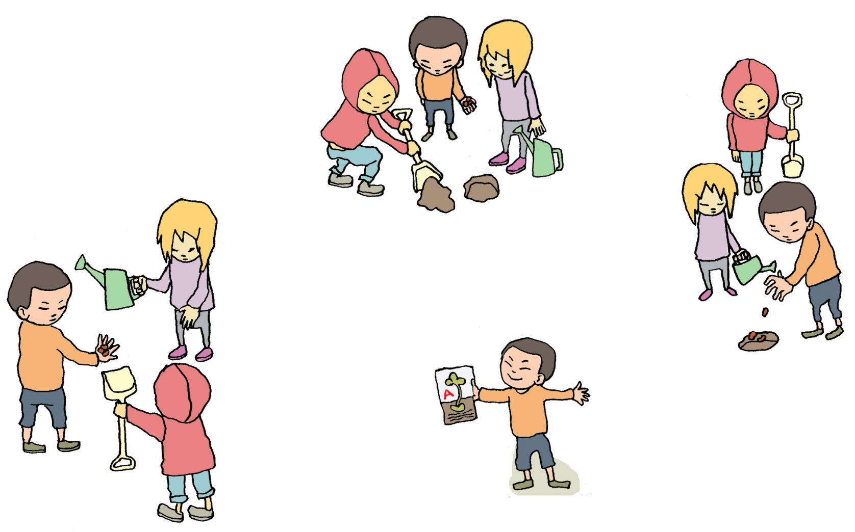
“By 2030, ensure that all learners acquire the knowledge and skills needed to promote sustainable development, including, among others, through Education for Sustainable Development and sustainable lifestyles, human rights, gender equality, promotion of a culture of peace and nonviolence, global citizenship and appreciation of cultural diversity and of culture’s contribution to sustainable development”
LEARNING TO THINK
& ACT ECOLOGICALLY

Slide 6
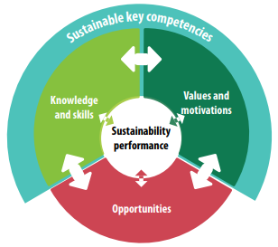
Competencies (Wiek et al. 2016)
systems thinking competence,
anticipatory competence,
normative competence,
strategic competence,
interpersonal competence
self-awareness competence
integrated problem-solving competence.
Learner-centred approach
active development of knowledge rather than transfer & passive learning experiences.
Action-oriented learning
learners engage in action and reflect on their experiences and outcomes (e.g. in-service learning), implementation of a campaign

Slide 7
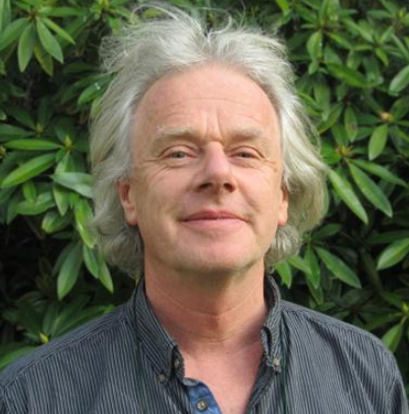
the essence of education for sustainability is a quest for affective outcomes
Higher education traditionally focuses on the cognitive domain of learning - what we know and understand, and how we describe, comprehend, apply, analyze, synthesize and evaluate this knowledge and understanding.. But engaging with the world and learning through our actions and activities also involves the affective domain which includes the manner in which we deal with things emotionally, such as feelings, values, appreciation, enthusiasms, motivations, and attitudes.
Kerry Shephard

Slide 8
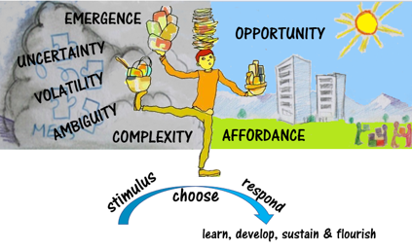
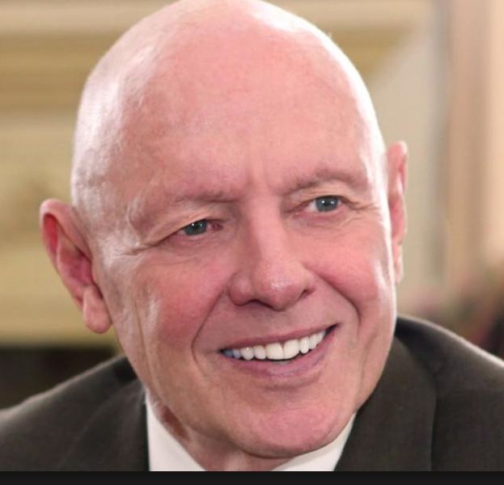
THE HABIT OF ACTING SUSTAINABLY
‘Between stimulus and response there is a space and in that space lies our freedom to choose our response. In those choices lie our growth and happiness.’ – in those choices lie the means of sustaining ourselves and the world.
Stephen Covey

Slide 9
Contains more affordance for developing & applying
habits for sustaining ourselves and the world
HONOURS
DEGREE
LIFEWIDE LEARNING AWARD
commitment to own personal and professional development
Academic
curriculum
Extra-curriculum eg
Mentoring
Caring for others
Work-related
curriculum
Work placement
related to area of study or integration
theory & practice
eg health and social care programmes
Work including PT jobs and internships
Sport
Co-curriculum
learning spaces
outside formal
curriculum
Travel
Study abroad
Running own
business
Volunteering
& social enterprise
Creative
enterprise
Student Representation & Societies
Notes:
There are opportunities and affordances for self-directed, self-regulated learning across the whole of a learners life while they are studying at university but to support and recognise learners’ self-regulated learning, development and achievement across their whole life requires the adoption of a lifewide curriculum and the means of recognising student development outside the formal academic curriculum (Jackson 2011)
The concrete expression of a lifewide curriculum as depicted in this diagram it contains four different curricular domains:
Academic curriculum,
Work-related curriculum
3. Co-curriculum: experiences provided by the university that may or may not be credit-bearing and for which learners may or may not receive formal recognition
4 Extra-curriculum: experiences that are determined by the learners themselves and constitute all the spaces that they inhabit outside of 1 and 2 above.
The distinction between co- and extra-curricular has been deliberately blurred in some universities as experiences that would be considered to be extra-curricular have been incorporated into the co-curriculum. But regardless of the way institutions define their curricular domains this book is primarily concerned with the co-curricular and extra-curricular domains of student experience and achievement and the ways in which student learning and development is being supported and recognised in these domains.

Slide 10
Determined by learner
ACTING
SUSTAINABLY
ACTING
SUSTAINABLY
Other Contexts
eg. work, community
field, co-curriculum
extra-curriculum
Academic
Programme
LEARNING CONTEXT
LEARNING ECOLOGY
LEARNING
ABOUT
ACTING
SUSTAINABLY
Determined by institution or other body
eg a work placement or volunteering organisation
Learning ecology includes goals, affordances, processes, spaces,
relationships , resources (knowledge, tools, technologies, mediating artefacts)

Slide 11
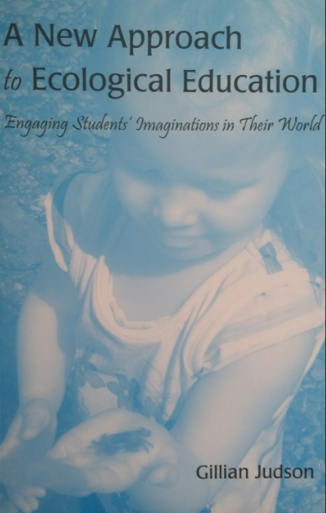
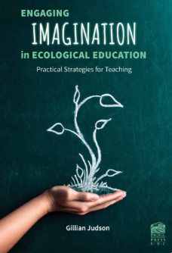
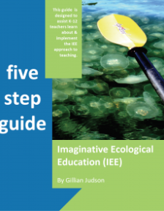
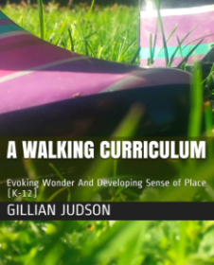
Dr Gillian Judson
Director at the Imaginative Education Research Group
Teacher Educator Faculty of Education at Simon Fraser University
http://ierg.ca/IEE/

Slide 12
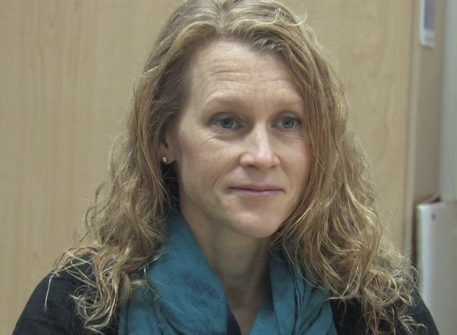
What is Imaginative Ecological Education? Gillian Judson
https://www.youtube.com/watch?v=1bnkjofMUjo&t=147s

Slide 13
Imaginative Ecological Education is a place-based and context specific approach. It aims to develop students’ somatic, emotional, and imaginative bonds with the natural world generally, and with specific places in particular.
A teacher who practices IEE must begin with engagement. What engages me and my students emotionally and imaginatively?
The second question is, How can the body the experience this topic? I'm not just talking about sensory engagement. I’m talking about the powerful emotional responses of our bodies participating in the world that support learning, meaning-making, and memory.
Thirdly, we need to ask, What does the topic mean in this particular Place? Places, contexts and situations matter.
Answering only one of these questions isn’t enough: we need our emotional engagement, we need our somatic engagement, and we need engagement with place and context.

Slide 14
the imaginative means we use to make sense of the world around us
1 Feeling - Engaging Emotion and Imagination
How can the topic be shaped to bring out its emotional force? In other words, what’s the story on the topic? (story-form/narrative) Teachers in primary and elementary school will use story, abstract binary oppositions, metaphor, vivid mental imagery, rhyme, rhythm and pattern, games, drama and play, and the recognition of mystery, among other tools, in their teaching.
2 Activeness: Engaging the Body
Activeness involves affording students’ opportunities to feel their connectedness with the world around them. To engage students teachers ask questions like
How does the body participate in this story?
What activities can engage the learner somatically in learning about the topic?
How can students’ sense of relation to the world around them be engaged?
3 Place/Sense of Place: Engaging with Context
IEE, is centrally concerned with developing students’ sense of place—a personal
relationship with one’s context as well as a certain depth of knowledge about it.

Slide 15
1 sense of relation: the innate human desire to form relationships and, in this way, to engage with our surroundings. Teachers must ask questions like:
How can students learn about this topic by forming relationships with the material and non-material world?
2 emotional attachments with features or objects in the world we encounter or make Teachers must ask questions like:
How can students learn about the topic in a way that engages them emotionally and imaginatively with some aspect of the natural world around them?
How does the topic connect to the local environment?
What does it mean here?
How can they be involved in making something that requires an emotional investment?

Slide 16
3 Creating or claiming special places/spaces By exploring the natural world and creating special places in it and in our imaginations we not only develop knowledge of the natural context but we develop emotional connections with it.
Teachers must ask questions like :
What aspect of the topic might be learned in a way that affords students the opportunity to explore the natural world around them and to create places that are special to them in it?
How might learning about the topic support a sense of belonging in the natural environment?
4 Creating cultural artefacts By making an artefact with cultural meaning that
has been grown in the natural world when we connect our imaginations, emotions
physical bodies and creativity to a place.
Teachers must ask questions like :
What aspect of the topic might be learned in a way that affords students the opportunity to make culturally meaningful artefacts?

Slide 17
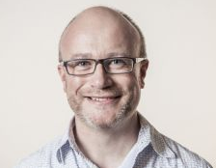
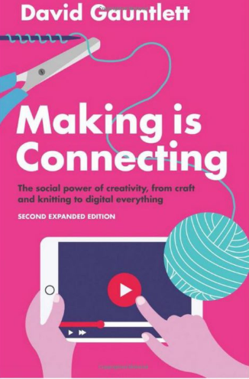
Making is connecting because you have to connect things together (materials, ideas, or both) to make something new;
Making is connecting because acts of creativity usually involve, at some point, a social dimension and connect us with other people;
And making is connecting because through making things and sharing them in the world, we increase our engagement and connection with our social and physical environments.
David Gauntlet

Slide 18
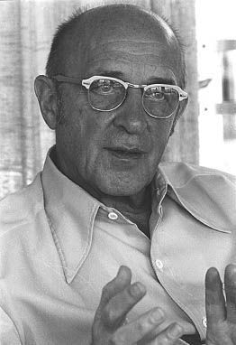
Personal creativity is
'the emergence in action of a novel relational product growing out of the uniqueness of the individual on the one hand, and the materials, events, people, or circumstances of his life'
Carl Rogers (1960)
product = ideas, material or virtual objects, practices, performances, relationships, processes, learning and more……
Notes:
There are many definitions of creativity and most seem to have the ideas of bringing something new and original into existence as their core conception without providing any sort of context. It’s as if creativity and invention happen in isolation from the world of their creator. Because of this I have come increasingly to appreciate and respect the way Carl Rogers framed the idea of personal creativity as, 'the emergence in action of a novel relational product growing out of the uniqueness of the individual on the one hand, and the materials, events, people, or circumstances of his life' ^{27:350}
The bottom line is that creativity is an ecological phenomenon. It’s about human beings having thoughts that are stimulated by their relationship and interactions with the world around them. A creative thought is the result of a person interacting cognitively, physically, emotionally, virtually with something in their world ideas, people, things, problems, situations and experiences, and a multitude of other things and this interaction triggering a novel thought. These thoughts are often the result of connecting/combining two or more things to create something that is different to the things that were connected. McWilliam and Taylor⁶ catch this beautifully in their idea that creativity is often the result of making a third ‘thing’ from two existing things or ideas, rather than making something from nothing. Perhaps we might capture the idea in 1+1=3!
Rogers' view of personal creativity and how it emerges from the circumstances of our life, is an ecological concept. The ecological metaphor affords us the most freedom and flexibility to explore and appreciate the ways in which we and our purposes are connected to our experiences and the physical, social and psychological world we inhabit. I believe that our creativity lies in seeing affordance in an idea, thing or situation and then acting on this
affordance by doing something useful and novel (at least to ourselves) with what is afforded²⁹. If we translate this way of thinking to the formal teaching and learning environment then the most important things a teacher does through their pedagogic practice is to create affordance for learning, enable learners to appreciate that affordance, and equip them with the means and motivation to make use of it. If the object of affordance has a creative dimension then their pedagogic task is to encourage and enable learners to make use of it.
A learning ecology contains not only the physical, virtual and social spaces that form the circumstances of our lives, but also the mental / psychological spaces that enable us to think about ideas and situations in a variety of ways. If we translate this way of thinking to the formal teaching and learning environment then the most important things a teacher does through their pedagogic practice is to create affordance for learning, enable

Slide 19
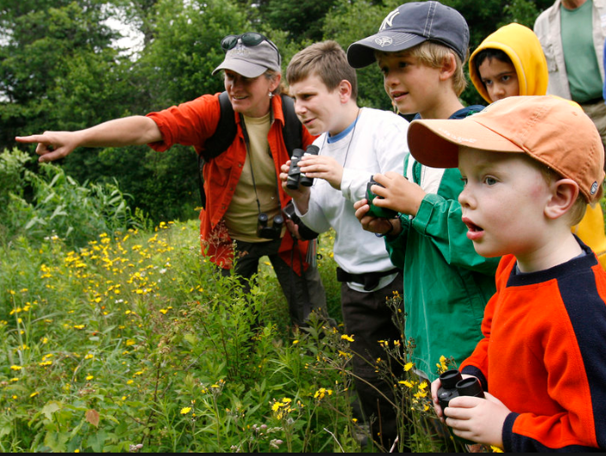
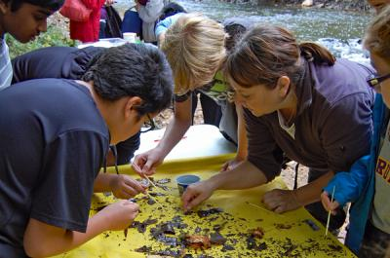
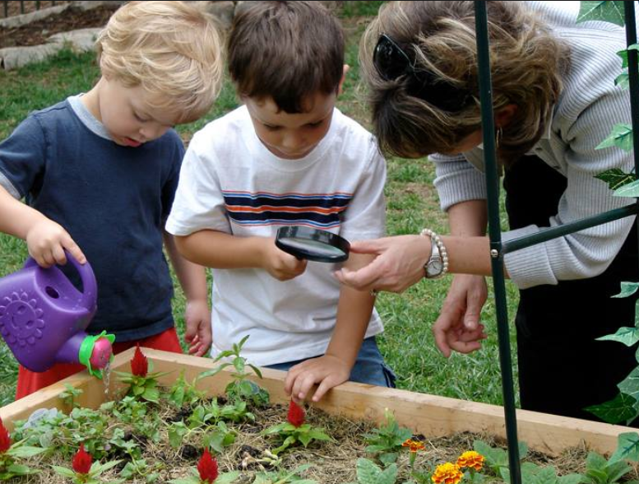
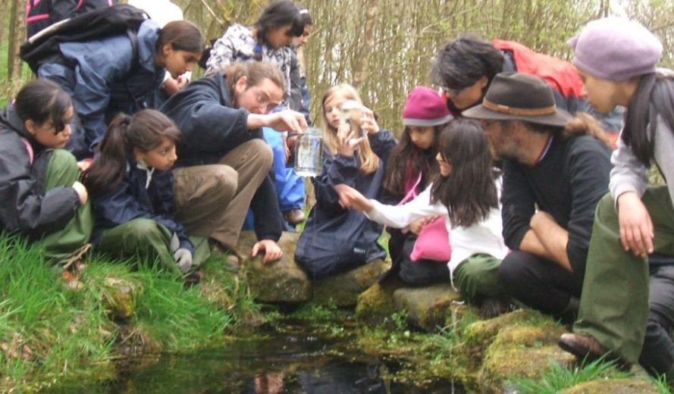
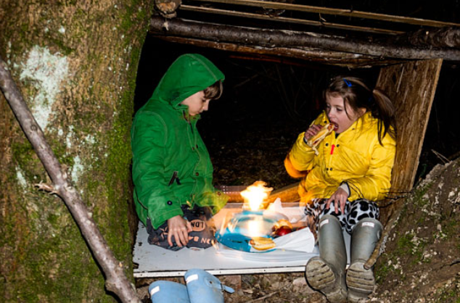
A Strategy For Engaging Learners With The World Outside The Classroom And Developing Ecological Understanding & Emotional/Physical Connectivity
Involves using IEE cognitive tools to encourage learners to develop a sense of relationship with the world, sense of attachments to particular features in the world and may enable them to create a physical or imagined place/space or artefact that is special (meaningful) to them.

Slide 20
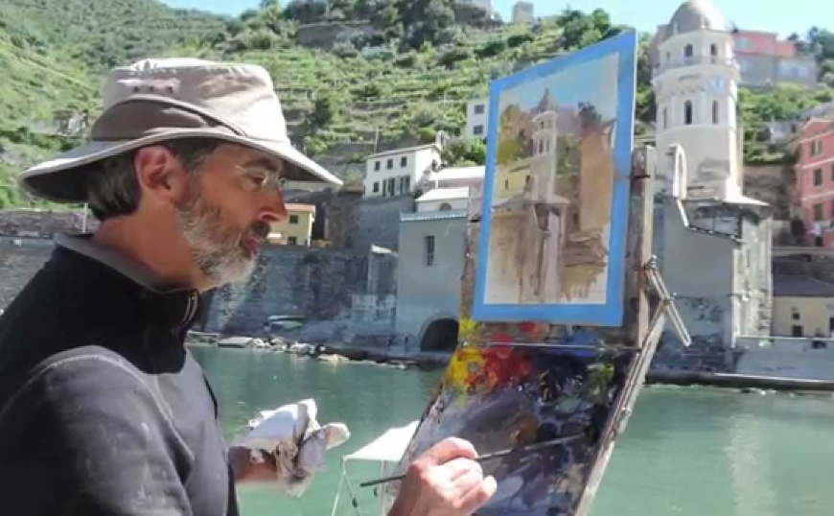
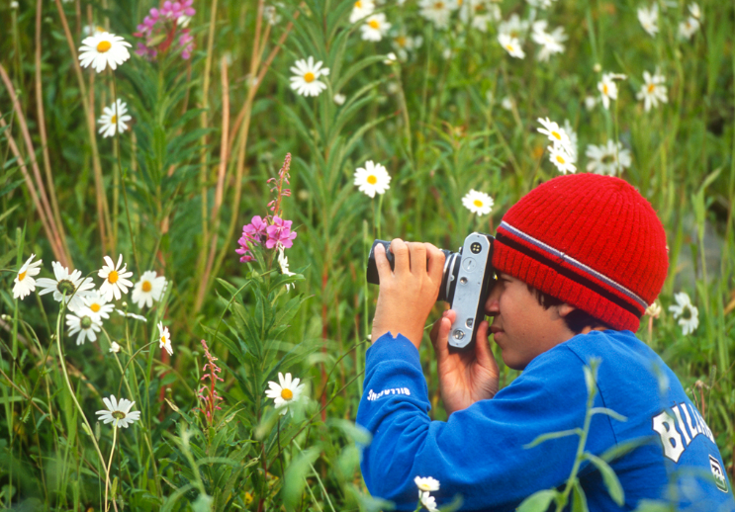
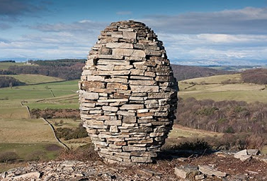
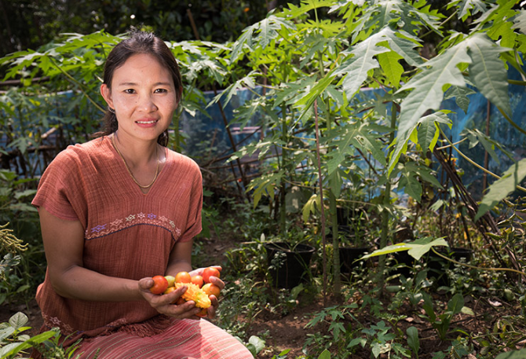
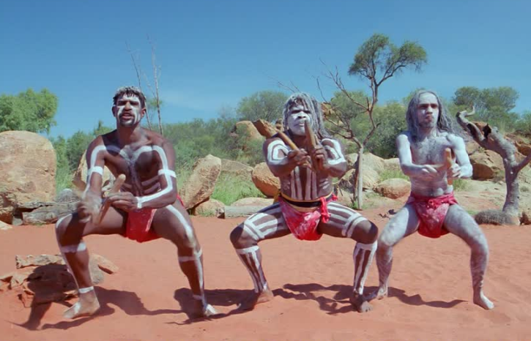

Slide 21
The creative process is
'the emergence in action of a novel relational product growing out of the uniqueness of the individual on the one hand, and the materials, events, people, or circumstances of his life'
Carl Rogers (1960)
product = ideas, material or virtual objects, practices, performances, relationships, processes, learning and more……
Notes:
There are many definitions of creativity and most seem to have the ideas of bringing something new and original into existence as their core conception without providing any sort of context. It’s as if creativity and invention happen in isolation from the world of their creator. Because of this I have come increasingly to appreciate and respect the way Carl Rogers framed the idea of personal creativity as, 'the emergence in action of a novel relational product growing out of the uniqueness of the individual on the one hand, and the materials, events, people, or circumstances of his life' ^{27:350}
The bottom line is that creativity is an ecological phenomenon. It’s about human beings having thoughts that are stimulated by their relationship and interactions with the world around them. A creative thought is the result of a person interacting cognitively, physically, emotionally, virtually with something in their world ideas, people, things, problems, situations and experiences, and a multitude of other things and this interaction triggering a novel thought. These thoughts are often the result of connecting/combining two or more things to create something that is different to the things that were connected. McWilliam and Taylor⁶ catch this beautifully in their idea that creativity is often the result of making a third ‘thing’ from two existing things or ideas, rather than making something from nothing. Perhaps we might capture the idea in 1+1=3!
Rogers' view of personal creativity and how it emerges from the circumstances of our life, is an ecological concept. The ecological metaphor affords us the most freedom and flexibility to explore and appreciate the ways in which we and our purposes are connected to our experiences and the physical, social and psychological world we inhabit. I believe that our creativity lies in seeing affordance in an idea, thing or situation and then acting on this
affordance by doing something useful and novel (at least to ourselves) with what is afforded²⁹. If we translate this way of thinking to the formal teaching and learning environment then the most important things a teacher does through their pedagogic practice is to create affordance for learning, enable learners to appreciate that affordance, and equip them with the means and motivation to make use of it. If the object of affordance has a creative dimension then their pedagogic task is to encourage and enable learners to make use of it.
A learning ecology contains not only the physical, virtual and social spaces that form the circumstances of our lives, but also the mental / psychological spaces that enable us to think about ideas and situations in a variety of ways. If we translate this way of thinking to the formal teaching and learning environment then the most important things a teacher does through their pedagogic practice is to create affordance for learning, enable

